Slide 1
Scaling policy

Slide 2
Terms
A/I/O/T : num of allocated/idle/other/total nodes
R: num of reserved nodes
J: job in the queue
P:job is running
Min: the minimum number of nodes reserved
Assumption
All jobs will take a reasonable LONG time
Jobs won’t come and go very frequently(slow change)

Slide 3
Case 1 simple increase
I>0
No J in the queue
R increases until I=0 by submitting job

Slide 4
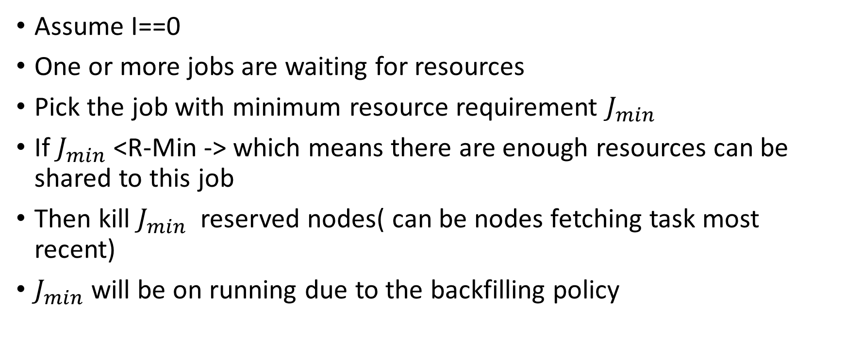
Case 2 make a way
Assume I==0
One or more jobs are waiting for resources
Pick the job with minimum resource requirement $J_{min}$
If $J_{min}$<R-Min -> which means there are enough resources can be shared to this job
Then kill $J_{min}$ reserved nodes( can be nodes fetching task most recent)
$J_{min}$ will be on running due to the backfilling policy

Slide 5
Case 3 (Other job) finished
Let’s say T=15, R=8,P1=3,P2=4,Min=7,J1=5
Assume P2 finished, then I==4
At this time J1 require 1 more nodes to become running while R-Min=1 then kill one node
Assume P1 finished, then I==3
At this time J1 require2 more nodes to become running while R-Min=1<2 then R increase to absorb the 3 idle nodes, and decrease next time when P2 finished
Over all assumption, no jobs will require too much resources which will led to: J>(T-Min), then these jobs will never be executed

