Slide 1
Self adjusted auto provision system at resource level
Weekly report 15th July
You Hu

Slide 2
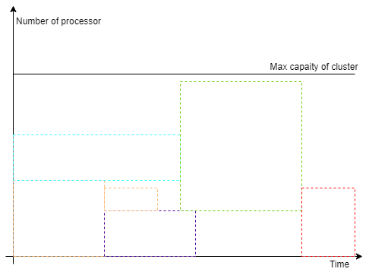
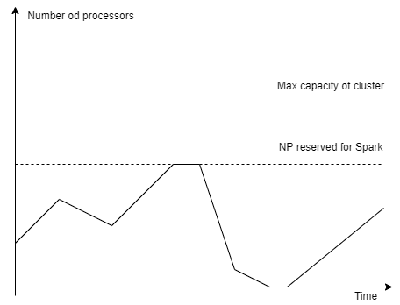
Recap – issue and research question
Existing solutions result in resource waste

Slide 3
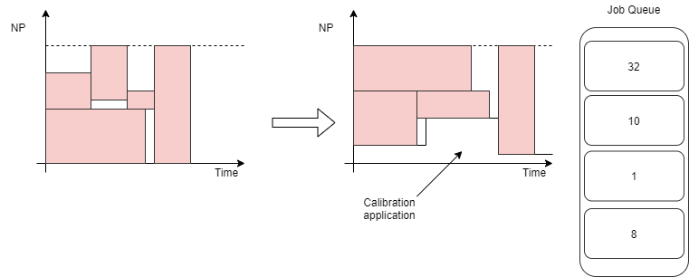
Recap – issue and research question
How to increase the resource utilization level in a batch cluster?
Use calibration applications to fill in the blank.
It requires: auto scaling/provisioning;

Slide 4
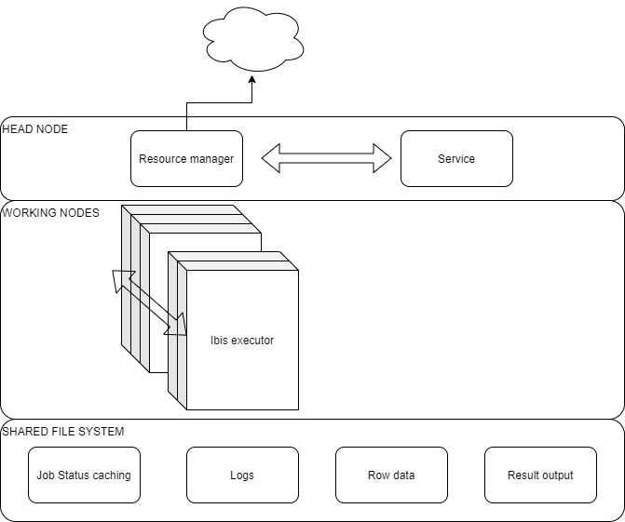
Design-current layout
Auto scaling algo
Elastic distributed computing
(Master/Worker)

Slide 5
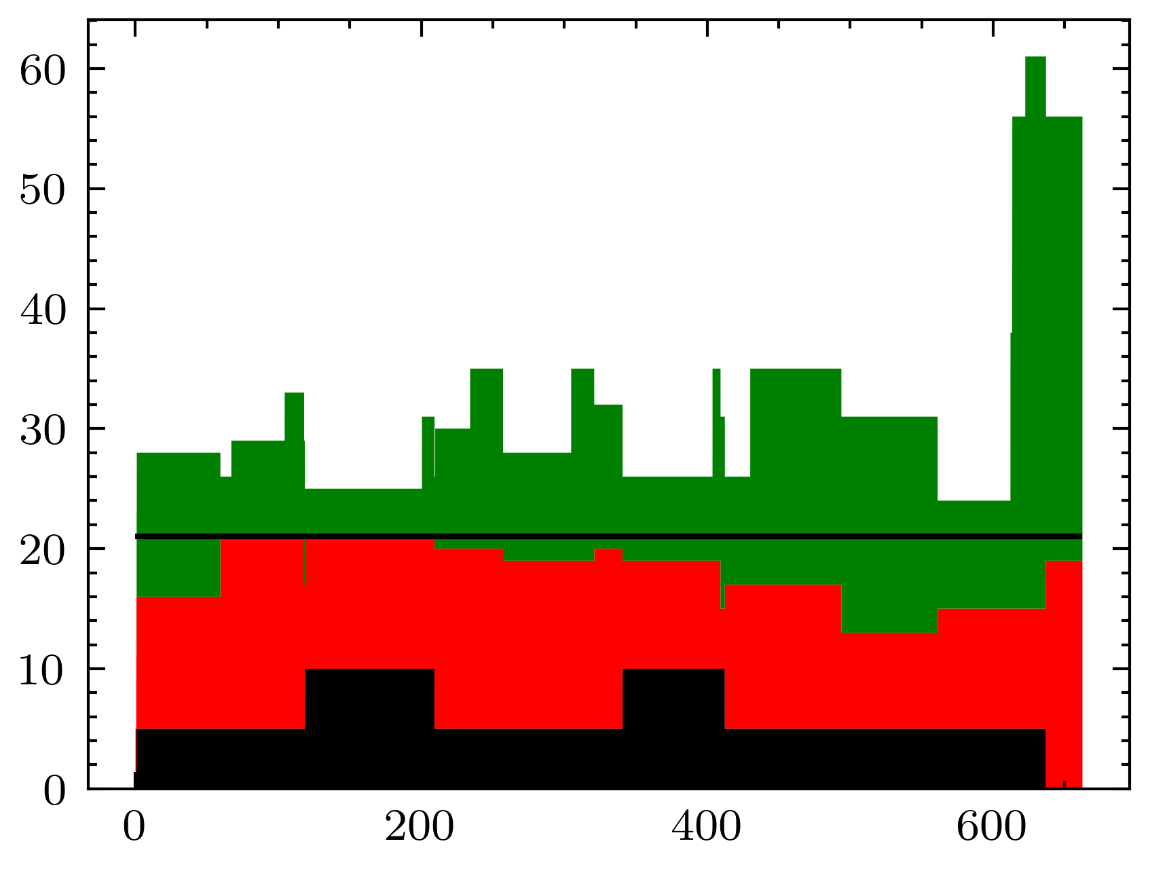
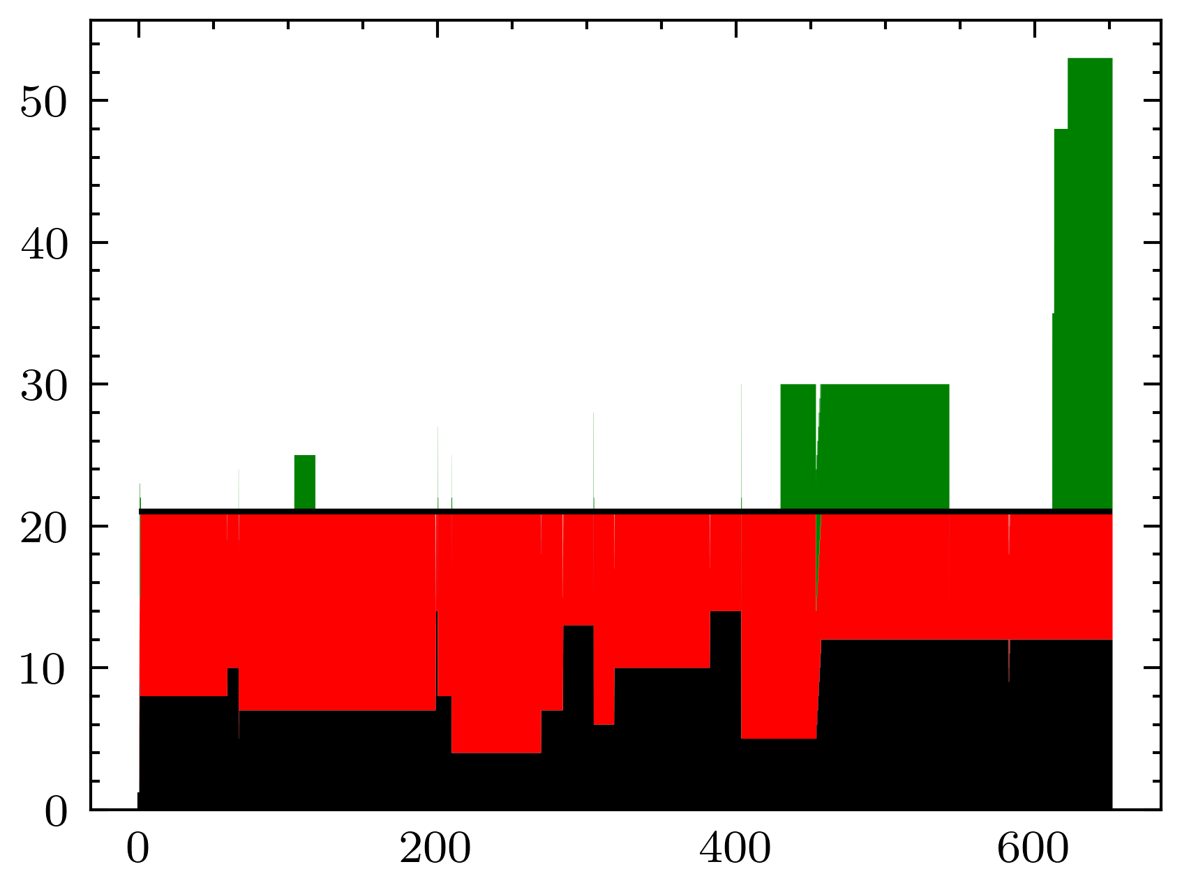
Auto scaling simulation
Calibration resource: 47.8% increase
Other resource: 1% increase
Total resource: 16.8% increase
In total check point:39012
In total Calibration use:235280.0 AVG:6.030964831333948
In total Normal use:464868 AVG:11.91602583820363
In total use:700148.0 AVG:17.946990669537577
In total check point:38506
In total Calibration use:343185.0 AVG:8.912507141744143
In total Normal use:463826.0 AVG:12.045551342647899
In total use:807011.0 AVG:20.958058484392044
85.5% → 99.8%
Utilization rate
Pending jobs
Other Jobs
Calibration
Fixed mini node = 4
MPI
AUTO SCALING

Slide 6
DynPrvDriver – compute layer
Executor
Master
DATA DIR PATH
WebService
LOAD AND SPLIT TASKS
TASK
RESULT
Storage
Executor
DATA DIR
EXECUTE(Sagecal inside singurarity)

Slide 7
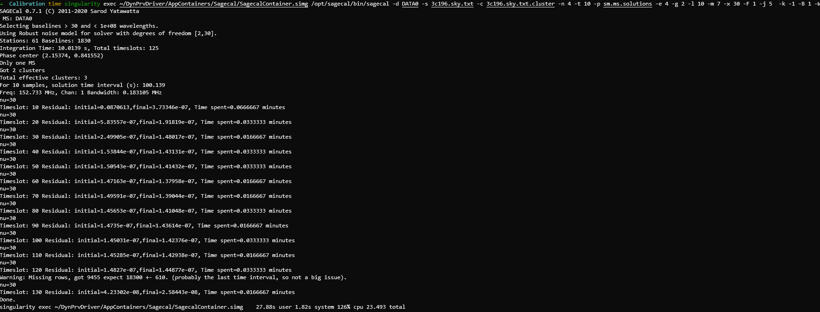
How data processed

Slide 8
Current data & speed
Dataset sm.ms https://github.com/nlesc-dirac/data
Size 69M
Speed:
-n 2: 31s
-n 4: 26s
-n 6: 20.7s
Work around:
Big/mid/small data set = duplicate sm.ms x 500/150/50 30G+/10G/3G+
estm. 150/45/15Min*Node
The assumption behind: an observation can be divided into sub data sets
Limit:
40 GB disk quotum on DAS5
No Sky Map for sagecal

Slide 9
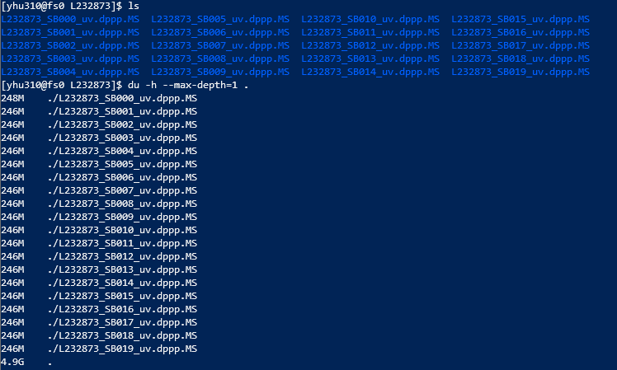
Current data
The data Souley is using
L232873_SB[0-19].dppp.ms, 4.9 GB
L232875_SB[0-19] ].dppp.ms, 228GB
The data Onno is using
L246909_SAP006_SB486_uv_001.MS_02134b61.tar, 22GB
L250048_SB311_uv.dppp.MS_b8783fe7.tar, 3.2GB
L250048_SB342_uv.dppp.MS_32c7efc3.tar, 3.2GB
What do these fields mean? SBXXX, dppp
How can I get the sky maps of them?

Slide 10
How .MS data relates to sky map
L232873_SBXXX
One sky map vs multiple sub dataset
One sky map vs one sub dataset
Sky map
Sky map
Sky map
Sky Model Construction Using Shapelets
restore -f example.fits -i sky.txt -c sagecal_cluster.txt -l sagecal_sky.txt

Slide 11
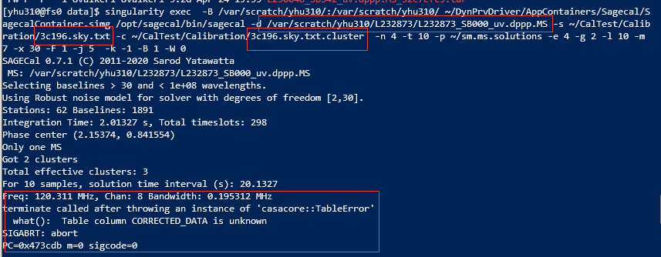
What is wrong?
How can we apply Sagecal on .MS data with skymap ?

Slide 12
Next phase: performance test
Implementation: finished
Performance testing: finished
Implementation: finished
Performance testing: Not on real data
AUTO SCALING
DISTRIBUTED COMPUTING
Integrate test:
Dynamic mini node
Log the time from submission to the end
INTEGRATE TEST

