Slide 1
Self adjusted auto provision system at resource level
Weekly report 8st July
You Hu

Slide 2
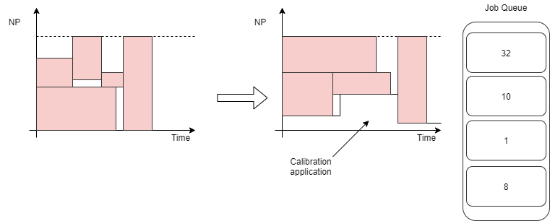
Recap – issue and research question
How to increase the resource utilization level in a batch cluster?
Use calibration applications to fill in the blank.
It requires: auto scaling/provisioning;

Slide 3
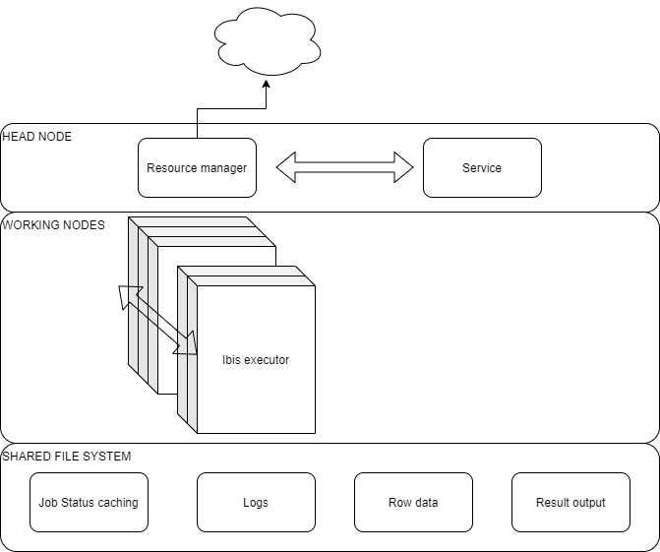
Design-current layout
Auto scaling algo
Elastic distributed computing
(Master/Worker)

Slide 4
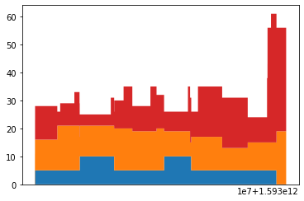
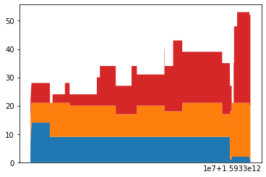
Auto scaling simulation
Calibration resource: 45.2% increase
Other resource: 7.0% decrease
Total resource: 10.6% increase
In total check point:39012
In total Calibration use:235280.0 AVG:6.030964831333948
In total Normal use:464868 AVG:11.91602583820363
In total use:700148.0 AVG:17.946990669537577
In total check point:39062
In total Calibration use:342067.0 AVG:8.757027289949312
In total Normal use:433084 AVG:11.087092314781628
In total use:775151.0 AVG:19.844119604730942
Pending jobs
Other Jobs
Calibration
Fixed mini node = 8
MPI
AUTO SCALING

Slide 5
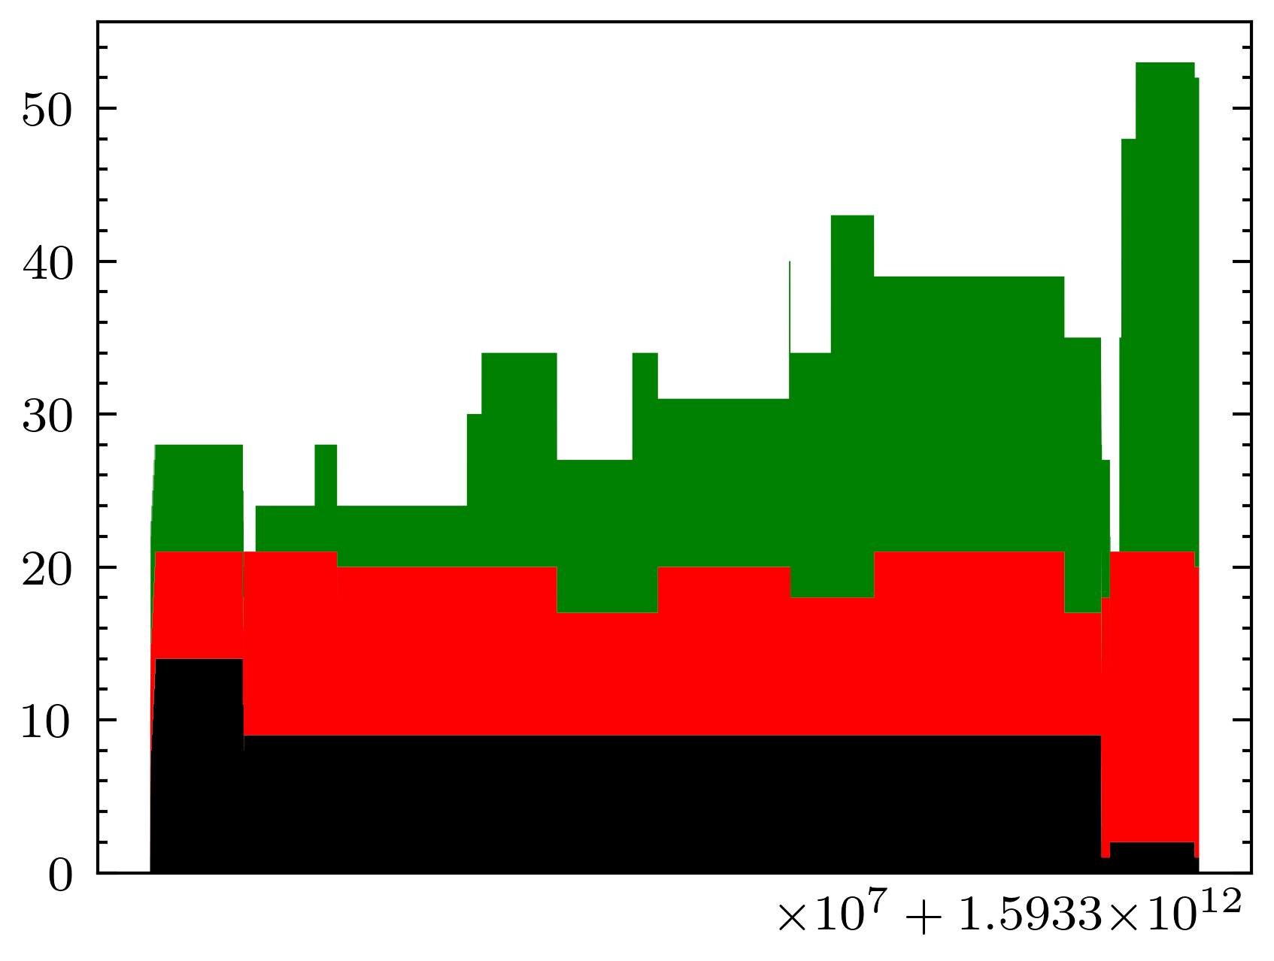
Auto scaling simulation
Issues:
The one last node is not taken by the calibration application
Reduce the limit of (Xenon) job running time, does not help to increase the performance( node/sec)
Reduce the mini number does not help as well
Possible reasons
Auto-scaling algorithm still hidden problem
The given test case can not give a chance to show the mechanism
AUTO SCALING

Slide 6
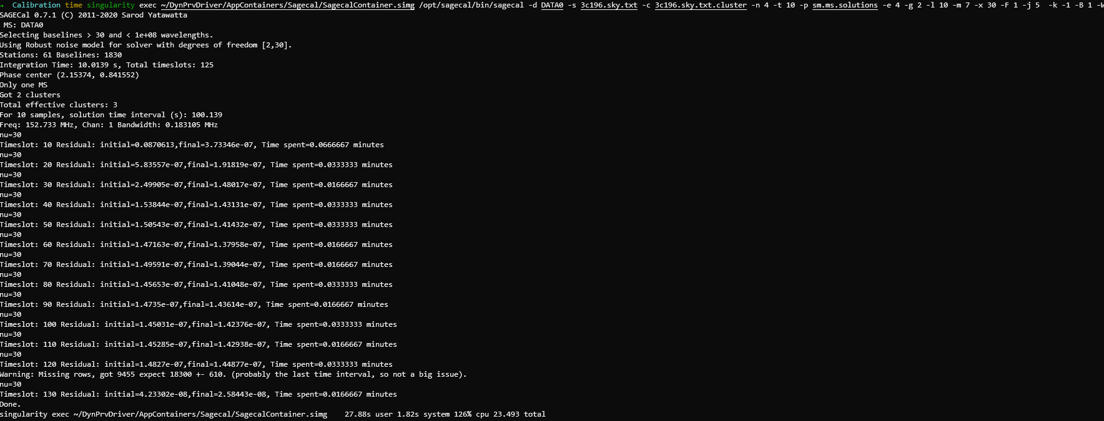
How data processed

Slide 7
Current data & speed
Dataset sm.ms https://github.com/nlesc-dirac/data
Size 69M
Speed:
-n 2: 31s
-n 4: 26s
-n 6: 20.7s
Work around:
Big/mid/small data set = duplicate sm.ms x 500/150/50
The assumption behind: an observation can be divided into sub data sets
Limit:
40 GB disk quotum on DAS5
No Sky Map for sagecal

Slide 8
DynPrvDriver – compute layer
Executor
Master
DATA DIR PATH
WebService
LOAD AND SPLIT TASKS
TASK
ACK
Storage
Executor
DATA DIR
EXECUTE
(Sagecal inside Singurarity container)

Slide 9
DynPrvDriver – compute layer
Issues:
Waste of compute resource: one node as master
Possible solution: if it is a master, create a new thread or process as Ibis executor(be careful about limiting the CPU usage)
How AssumeDied works?
Currently, AssumeDied+signalhandler is used for fast recover, but the function is not clear

Slide 10
Next phase: performance test
AUTO SCALING
DISTRIBUTED COMPUTING
Integrate test:
Dynamic mini node
Log the time from submission to the end
INTEGRATE TEST

Slide 11
Overall problems
Data set( from Souley or fetch it from LOAFR website by myself)
Including: observation and sky map
L246909_SAP006_SB486_uv_001.MS_02134b61.tar + 3c196.sky.txt?
L250048_SB342_uv.dppp.MS_32c7efc3.tar
Capability of singularity:
LU site: 3.4 headnode,2.6 work node
VU site: 3.4 head and work node (8888 port occupied)
DDL: 31st August for grading or submission?
I can extend for 2 months, new rules, Non-EU student 2K a year now
Second reader?
Contract with eScience Center
At least a record from eScience Center, showing I used to be there ☺

