Slide 1
SupplyGuard
AI-Powered Late-Delivery Risk Prediction & Logistics Mitigation System
19 Domain Features
12 Numerical + 7 Categorical
Random Forest Model
200 Trees • Bagging Ensemble
Operational Threshold
0.41 Optimized (88.31% Recall)
Overall Performance
83.89% Accuracy • 91.18% AUC
Presenter: Adon Renji • Academic Project Presentation & Defense

Slide 2
SUPPLYGUARD | AI-POWERED LOGISTICS
The Real-World Problem: Costly Delivery Delays
❌ The Industry Crisis
• In e-commerce, 15% to 25% of shipments miss their promised delivery date.
• Delivery delays cause furious customers, bad reviews, and lost sales.
• In the global DataCo dataset (180,000+ orders), over 54% faced delivery friction.
⚠️ The Traditional Warehouse Flaw
• Warehouses are completely REACTIVE.
• Staff pack boxes blindly on a first-come, first-served basis.
• The company only finds out an order is late AFTER the customer calls to complain!
✅ The SupplyGuard Solution
• SupplyGuard makes warehouse fulfillment PROACTIVE.
• The AI predicts delay risk the second the customer places the order.
• Warehouse managers rush high-risk orders BEFORE the delay ever happens!

Slide 3
SUPPLYGUARD | AI-POWERED LOGISTICS
How SupplyGuard Works: 4-Step Fulfillment Loop
🛒
1. Customer Orders
Shopper selects products & shipping speed (e.g. First Class Priority).
⏱️
2. SLA Assigned
Company policy automatically sets scheduled delivery days (e.g. 1 day).
🧠
3. AI Evaluation
19-feature Random Forest evaluates order risk in under 100 milliseconds.
🚚
4. Proactive Action
If risk ≥ 41%, warehouse rushes packing and assigns a direct courier.

Slide 4
SUPPLYGUARD | AI-POWERED LOGISTICS
Feature Selection: Reducing 53 Raw Columns to 19
Stage 1: Remove Data Leakage
Dropped columns known only AFTER delivery: 'Days for shipping (real)', 'Delivery Status', 'Shipping date'. Using them would be cheating!
Stage 2: Remove IDs and PII
Dropped unique IDs, customer names, zipcodes, and image URLs. These cause severe tree overfitting and carry zero generalizable knowledge.
Stage 3: Remove Redundancy
Dropped duplicate financial totals (like 'Order Item Total', 'Profit per order') to prevent multicollinearity. Kept clean distinct accounting terms.
Stage 4: Domain Feature Engineering
Engineered 8 new domain features from the order timestamp: night shifts, weekend depot closures, week of year, and shipping-hour interactions.

Slide 5
SUPPLYGUARD | AI-POWERED LOGISTICS
The Final 19 Features: 12 Numerical & 7 Categorical
📊 12 Numerical Features
1. Days for shipment (scheduled) [0, 1, 2, 4 days]
2. Order Item Quantity [Units ordered]
3. Order Item Product Price [Unit price in $]
4. Order Item Discount Rate [0% to 25%]
5. Sales [Total order transaction value in $]
6. Order Month [1 to 12]
7. Order Day [1 to 31]
8. Order Day of Week [0=Mon, 6=Sun]
9. Order Hour [0 to 23]
10. Order Week of Year [1 to 52]
11. Is Weekend [1=Sat/Sun depot closure, 0=Weekday]
12. Is Night [1=10 PM to 6 AM off-shift, 0=Day]
🏷️ 7 Categorical Features (One-Hot Encoded)
1. Shipping Mode (Standard, First Class, Second Class, Same Day)
2. Market (Europe, LATAM, Pacific Asia, USCA, Africa)
3. Order Region (Western Europe, Central America, etc.)
4. Order Country (Destination Country)
5. Order State (Destination State / Province)
6. Type (Payment Type: DEBIT, TRANSFER, PAYMENT, CASH)
7. Interaction_ShippingMode_OrderHour (e.g. 'First Class_23')
⚡ Note: Encoded using scikit-learn OneHotEncoder(handle_unknown='ignore') inside ColumnTransformer pipeline.

Slide 6
SUPPLYGUARD | AI-POWERED LOGISTICS
Machine Learning Model: Why Random Forest & 200 Trees?
🌳 Why Random Forest?
• Native Mixed Data: Handles both numeric and categorical data seamlessly.
• No Scaling Required: Tree splits are invariant to monotonic scaling.
• Robust to Outliers: Bagging averages out extreme prices or unusual quantities.
• Handles Complex Interactions: Captures non-linear dependencies (e.g. night express orders).
🌲 Why 200 Trees (Estimators)?
• Bagging Stability: 200 trees vote independently, reducing prediction variance to near zero.
• Peak ROC-AUC: Testing showed AUC reaches an optimal 91.18% at 200 trees.
• Diminishing Returns: 500+ trees give <0.05% gain but double model size and web latency.
• Optimal Engineering: Perfect balance between statistical stability and fast inference.

Slide 7
SUPPLYGUARD | AI-POWERED LOGISTICS
Why Decision Threshold = 0.41 (Instead of Default 0.50)?
💡 The Asymmetric Business Cost of Errors in Supply Chain
A False Negative (missed delay) destroys customer trust, causes refunds, and damages brand reputation. A False Positive (false alarm) only expedites a package that was on time. Therefore, we lowered threshold from 0.50 to 0.41.
Exact Test Set Evaluation (36,105 Orders Tested):
• Recall (Late Catch Rate): 0.50 = 72.16% ──► 0.41 = 88.31% ⭐ (+16.15% more late deliveries detected!)
• Missed Delays (False Negatives): 0.50 = 5,512 orders missed ──► 0.41 = 2,315 orders missed ⭐ (SAVES 3,197 shipments from unflagged delays!)
• Overall Accuracy: 0.50 = 79.36% ──► 0.41 = 83.89% ⭐ (+4.53% overall accuracy gain!)
• F1-Score: 0.50 = 79.31% ──► 0.41 = 85.73% ⭐ (+6.42% optimal balance between precision & recall)
• ROC-AUC Score: 0.50 = 91.18% ──► 0.41 = 91.18% ⭐ (Outstanding class separation across all thresholds)

Slide 8
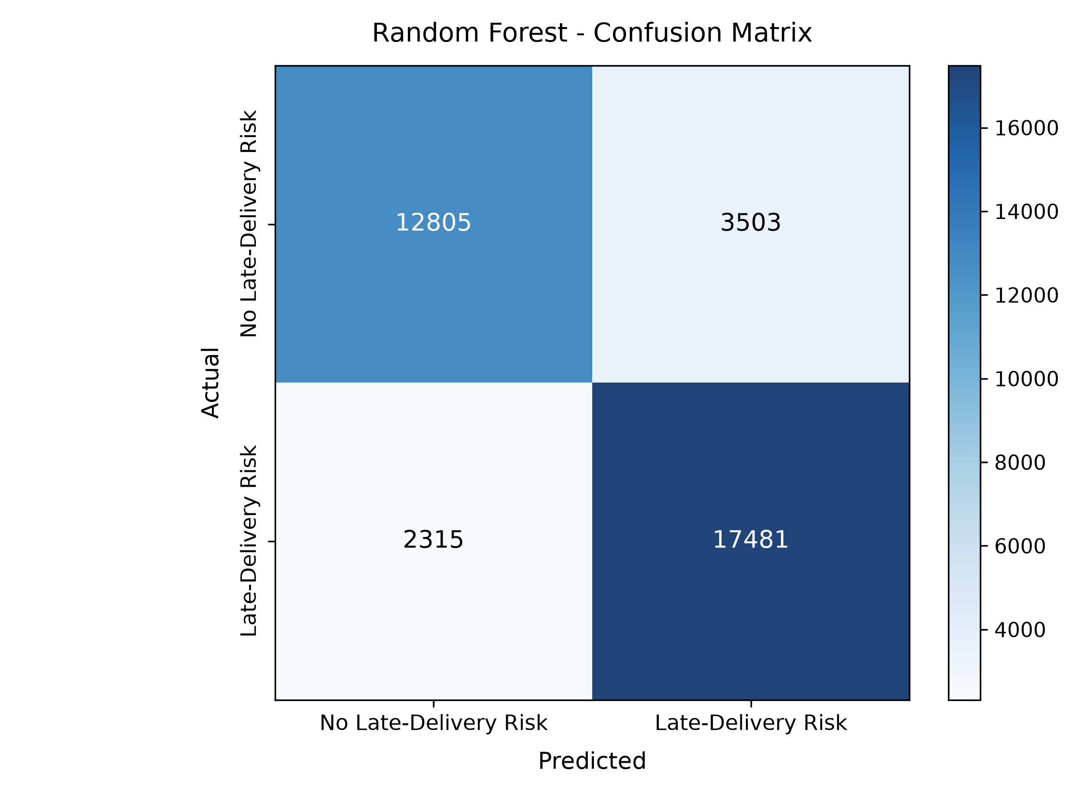
SUPPLYGUARD | AI-POWERED LOGISTICS
Model Performance & Test Confusion Matrix
🎯 Key Performance Indicators (Test Set)
ROC-AUC Score: 91.18%
Recall (Catch Rate): 88.31%
Overall Accuracy: 83.89%
F1-Score: 85.73%
Precision: 83.31%
Actual Late Orders Caught: 17,481 of 19,796

Slide 9
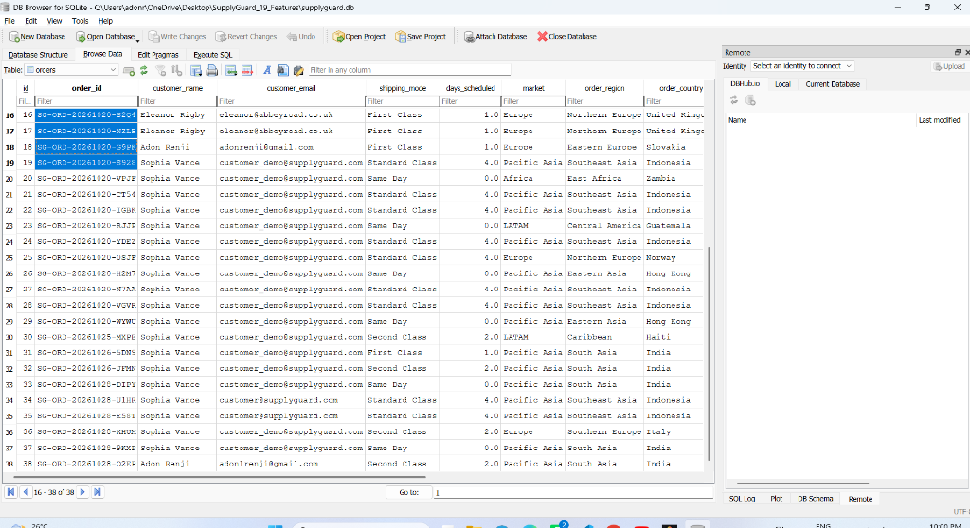
SUPPLYGUARD | AI-POWERED LOGISTICS
UI Screen 1: Real-Time Order Search & Inspection
🔍 Operational Capabilities
• Order ID Lookup: Search any customer order stored in SQLite database.
• Customer & Route Meta: Displays destination country, state, region, and market.
• Itemized Products: Shows individual items, unit price, quantity, and discount rate.
• One-Click Assessment: Instant button to run 19-feature late delivery risk assessment.

Slide 10
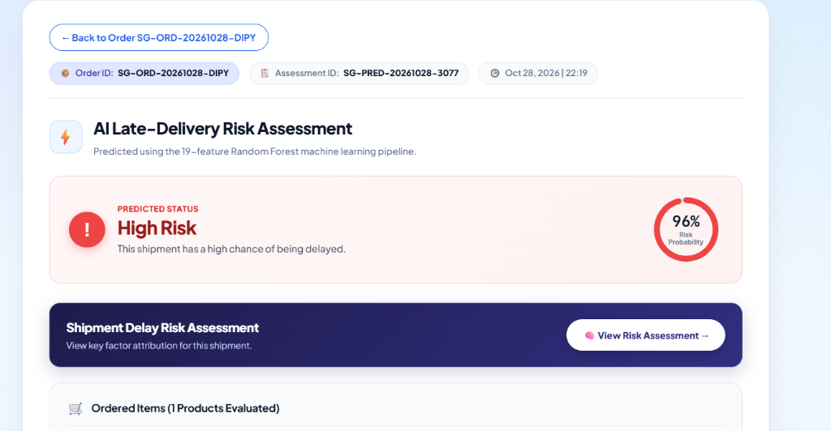
SUPPLYGUARD | AI-POWERED LOGISTICS
UI Screen 2: Risk Assessment Gauge & 19 Features
⚡ Real-Time ML Assessment
• Circular Risk Gauge: Displays exact late probability (e.g. 85.0% Late Risk).
• Threshold Evaluation: Compares against 0.41 cutoff to classify Late Risk vs On-Time.
• Full 19 Features: 4 operational grid cards account for 100% of model inputs.
• Actionable Recommendations: Provides 3 immediate warehouse instructions.

Slide 11
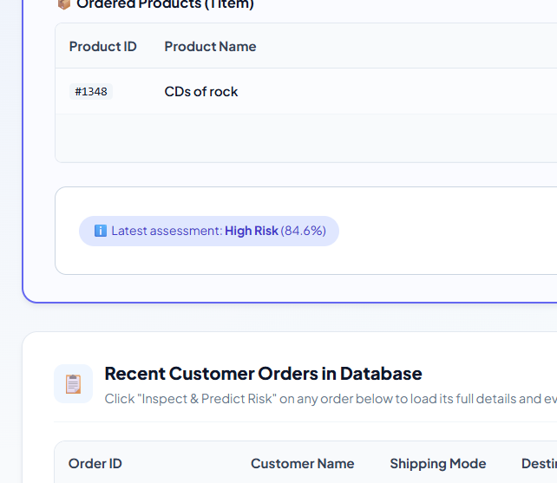
SUPPLYGUARD | AI-POWERED LOGISTICS
UI Screen 3: Key Contributing Factors (Explainable AI)
🔬 Explainable AI Insights
• Transparent Decision Making: Shows managers WHY the order is predicted late.
• Top Contributing Factors: Identifies critical friction points (e.g. Shipping Mode, Scheduled Days, Destination, Interaction Hour).
• Operational Value: Helps warehouse managers fix systemic route bottlenecks rather than guessing.
• Trust & Compliance: High-stakes logistics decisions backed by clear statistical evidence.

Slide 12
SUPPLYGUARD | AI-POWERED LOGISTICS
Future Scope: Evolving to Dynamic In-Transit Intelligence
📡 IoT & Live Telematics
Integrate GPS tracking from delivery trucks and RFID checkpoint scans to recalculate delay probability dynamically while in transit.
🌦️ Weather & Traffic APIs
Ingest real-time OpenWeather and Google Maps traffic feeds to anticipate highway blizzards, floods, and port congestion.
🤖 Automated Carrier Rebooking
Interface directly with FedEx/DHL APIs to automatically re-route and upgrade >70% risk shipments without requiring manual clicks.
🏬 Multi-Warehouse Routing
Automatically shift order fulfillment to alternate regional warehouses that have free picking capacity during local depot surges.

Slide 13
SUPPLYGUARD | AI-POWERED LOGISTICS
Conclusion & Key Achievements
✅ Proactive Fulfillment
SupplyGuard transforms logistics from reactive customer complaint handling to proactive pre-dispatch mitigation.
✅ 19 Engineered Features
Curated 12 numerical and 7 categorical features, capturing calendar seasonality, night shifts, and mode-by-hour interactions.
✅ Superior Model Accuracy
Random Forest of 200 trees delivers 83.89% Accuracy, 91.18% ROC-AUC, and an outstanding 88.31% Recall at 0.41 threshold.
✅ End-to-End Enterprise App
Fully functional Flask + SQLite web application with search, order creation, instant prediction, and explainable AI insights.

Slide 14
Thank You!
Questions & Discussion
Ready for Live System Demonstration & Viva Defense

