Slide 1
SupplyGuard
AI-Powered Shipment Delay Prediction and Supplier Recommendation System
Machine Learning • FastAPI • MongoDB Atlas • React
Predicting delay risk before it happens — and recommending the right supplier when it matters.

Slide 2
INTRODUCTION
Problem Statement
Supply chain operations depend on timely shipments and reliable supplier coordination.
Shipment delays affect customer satisfaction, inventory planning, production schedules, and operational cost.
Traditional monitoring approaches identify a delay only after it has already occurred.
There is a clear need for a system that predicts delay risk in advance and supports supplier decisions.
TRADITIONAL APPROACH
Delay is identified only after it has already occurred
✕
Reactive. Late. Costly.
↓
SUPPLYGUARD APPROACH
Predicts delay risk before dispatch, using ML on shipment attributes
✓
Proactive. Early. Actionable.
SupplyGuard | Shipment Delay Prediction & Supplier Recommendation
2

Slide 3
INTRODUCTION
Objectives
1
2
3
Predict Delay Risk
Compare Algorithms
Recommend Suppliers
Build a binary ML model to classify Late_delivery_risk before dispatch.
Evaluate Random Forest and Support Vector Machine on the same test set.
Suggest the best active supplier using reliability and pending workload.
4
5
6
Store Application Data
Support Manager Approval
Expose via API
Persist shipment and supplier records in MongoDB Atlas.
Let managers review predictions and approve or reject shipments.
Serve prediction and recommendation through a FastAPI backend.
SupplyGuard | Shipment Delay Prediction & Supplier Recommendation
3

Slide 4
SECTION 01
Literature Review
Summary of three referenced research papers that shaped SupplyGuard's design decisions.
SupplyGuard | Shipment Delay Prediction & Supplier Recommendation
4

Slide 5
RESEARCH PAPER 1
Predicting Late Supplier Deliveries With Regression Models
◆
Objective
⚙
Methodology
■ Predict how many days a delivery will be late, not just “late” or “on time.”
■ Test whether an early prediction, made right after the purchase request, still works well.
■ Studied 119,610 real purchase orders from a German machinery manufacturer.
■ Compared 7 regression models: Linear, SVM, Decision Tree, Random Forest, AdaBoost, Gradient Boosting, Neural Network.
✓
Key Findings
!
Research Gap
■ AdaBoost performed best, achieving an R² of approximately 92% even at the earliest prediction point.
■ Using all suppliers and components (no data limits) did not hurt accuracy.
■ Tested on only one manufacturer — may not generalize to other industries.
■ Cannot account for sudden shocks such as COVID or war.
SupplyGuard | Shipment Delay Prediction & Supplier Recommendation
5

Slide 6
RESEARCH PAPER 2
Deep Learning Delay Prediction Using Macroeconomic Indicators
◆
Objective
⚙
Methodology
■ Predict the exact number of days a component will be early or late.
■ Test if country-level economic data improves the prediction.
■ Used an LSTM deep learning model on real automotive data (134 components, 24 suppliers).
■ Combined past delivery history with Eurostat economic indicators (inflation, production index).
✓
Key Findings
!
Research Gap
■ LSTM + economic data beat traditional models like ARIMA for most components.
■ Economic indicators were highly influential — up to 85% of the model's accuracy came from them.
■ Only tested in the automotive sector.
■ Needs at least 30 past deliveries per component to work reliably.
SupplyGuard | Shipment Delay Prediction & Supplier Recommendation
6

Slide 7
RESEARCH PAPER 3
Integrating Machine Learning and Deep Learning for Enhanced Supplier Risk Prediction
◆
Objective
⚙
Methodology
■ Predict what type of supplier failure is likely to happen.
■ Predict how many issues will occur — and how much they will cost.
■ Studied 20,000 real quality issues from 429 suppliers across 20 factories.
■ Evaluated classification models including Random Forest, SVM, KNN and ANN, along with regression models for issue count and disruption cost.
✓
Key Findings
!
Research Gap
■ Random Forest achieved 86% accuracy for the classification task.
■ Supplier name and failure type were the strongest predictors of risk.
■ Covers quality failures only — not shipping delays or geopolitical disruptions.
■ Built on one industry (automotive wiring) — may not transfer elsewhere.
SupplyGuard | Shipment Delay Prediction & Supplier Recommendation
7

Slide 8
LITERATURE REVIEW
Findings & Relevance to SupplyGuard
Study | Main Focus | Relevance to SupplyGuard
Steinberg et al. (2023) | Regression-based delay severity prediction | Confirms regression can predict how late a delivery will be, not just whether it will be late.
Gabellini et al. (2024) | Deep learning + macroeconomic indicators | Shows external economic data can boost prediction accuracy — a possible future upgrade for SupplyGuard.
Rezki & Mansouri (2024) | Integrating Machine Learning and Deep Learning for Enhanced Supplier Risk Prediction | Provides evidence for combining predictive risk analysis with downstream decision support.
Findings & Proposal
The reviewed studies show regression and deep-learning models can predict not just whether a delivery is late, but how late — and even estimate disruption cost. None of them combine this with a rule-based supplier recommendation and a manager-approval workflow in one lightweight app. SupplyGuard fills that gap by pairing a trained Random Forest delay-risk model with rule-based supplier recommendation, a FastAPI service layer, MongoDB Atlas storage, and a manager-approval step.
SupplyGuard | Shipment Delay Prediction & Supplier Recommendation
8

Slide 9
SECTION 02
System Analysis
Dataset, preprocessing, features and architecture behind the prediction pipeline.
SupplyGuard | Shipment Delay Prediction & Supplier Recommendation
9

Slide 10
SYSTEM ANALYSIS — DATASET
Dataset Overview & Statistics
DataCo Smart Supply Chain Dataset
180,519
53
19
2
Total Records
Total Columns
Input Features
Target Classes
Target Variable: Late_delivery_risk
Binary classification task — 0 = no late-delivery risk, 1 = late-delivery risk.
Task frames every shipment as a pre-dispatch risk classification decision, not a post-delivery audit.
An 80/20 stratified split preserves class proportions: 144,415 training records and 36,104 test records.
SupplyGuard | Shipment Delay Prediction & Supplier Recommendation
10

Slide 11
SYSTEM ANALYSIS — DATASET
Selected Input Features
📊 12 Numerical Features
1. Days for shipment (scheduled) [SLA target: 0, 1, 2, 4 days]
2. Order Item Quantity [Parcel volume & handling load]
3. Order Item Product Price [Unit value in $]
4. Order Item Discount Rate [Promotional surge indicator]
5. Sales [Total net transaction value in $]
6. Order Month [Annual seasonal peaks]
7. Order Day [Month-end billing cycles]
8. Order Day of Week [Mid-week vs weekend placement]
9. Order Hour [Daily carrier cutoff tracking]
10. Order Week of Year [Granular promotional weeks]
11. Is Weekend [Saturday/Sunday reduced courier depot]
12. Is Night [10:00 PM to 06:00 AM off-shift cutoff]
🏷️ 7 Categorical Features (One-Hot Encoded)
1. Shipping Mode (Standard Class, First Class, Second Class, Same Day)
2. Market (Europe, LATAM, Pacific Asia, USCA, Africa)
3. Order Region (Western Europe, Central America, etc.)
4. Order Country (Destination Country)
5. Order State (Destination State / Province)
6. Type (Payment Method: DEBIT, TRANSFER, PAYMENT, CASH)
7. Interaction_ShippingMode_OrderHour (e.g. 'First Class_23')
SupplyGuard | Shipment Delay Prediction & Supplier Recommendation
11

Slide 12
SYSTEM ANALYSIS — PREPROCESSING
Data Preprocessing Pipeline
1
Data Cleaning
2
Leakage Removal
Checked selected features & target for missing values and full-record duplicates — none found.
Excluded outcome fields such as Days for shipping (real) and Delivery Status to avoid data leakage.
3
Encoding & Scaling
4
Stratified Split
Categorical features via OneHotEncoder; numerical features via StandardScaler, inside the ML pipeline.
80/20 train-test split — 144,415 training records and 36,104 test records — preserving class balance.
SupplyGuard | Shipment Delay Prediction & Supplier Recommendation
12

Slide 13
SYSTEM ANALYSIS — ARCHITECTURE
System Architecture
Employee /
Manager
→
React
Frontend
→
FastAPI
Backend
→
ML Pipeline
(RF Model)
→
Prediction /
Recommendation
MongoDB Atlas — Shipments & Suppliers
The manager dashboard retrieves stored shipments and updates approval status.
New shipments are created with a Pending status; a manager approves or rejects each one.
The backend loads the trained Random Forest model and applies the same preprocessing used in training.
SupplyGuard | Shipment Delay Prediction & Supplier Recommendation
13

Slide 14
SECTION 03
Machine Learning Models
Training, comparing and selecting the delay-risk classification model.
SupplyGuard | Shipment Delay Prediction & Supplier Recommendation
14

Slide 15
MACHINE LEARNING MODELS
Why Random Forest & SVM Were Chosen
1
2
3
Grounded in Literature
Binary Classification Task
Two Different Strategies
Reviewed papers show ML effectively supports shipment-risk and supplier decisions.
Late_delivery_risk is a supervised binary classification problem.
RF is a tree-based ensemble; SVM is a margin-based kernel method.
4
5
6
Fits Mixed Feature Types
Captures Non-Linear Patterns
Enables Fair Comparison
Dataset mixes categorical and numerical shipment attributes.
Both approaches can model non-linear delay-risk relationships.
Same test set lets us pick the best performer with evidence.
SupplyGuard | Shipment Delay Prediction & Supplier Recommendation
15

Slide 16
MACHINE LEARNING MODELS
Algorithms Evaluated
RF
Random Forest Classifier
SVM
Support Vector Machine
Ensemble of 200 decision trees with balanced class weighting.
Trained on 144,415 records, evaluated on 36,104 unseen test records.
Selected as the final deployed model.
RBF-kernel SVM evaluated as a comparison model.
Trained on a stratified 20,000-record subset for computational efficiency.
Evaluated on the same 36,104-record test set.
SupplyGuard | Shipment Delay Prediction & Supplier Recommendation
16

Slide 17
MACHINE LEARNING MODELS
Model Comparison — Test Set Performance
Evaluation Metric | Default Threshold (0.50) | SupplyGuard Tuned (0.41) | Operational Supply Chain Benefit
Recall (Late Catch Rate) | 72.16% | 88.31% ⭐ | +16.15% more late deliveries caught
Missed Delays (False Negatives) | 5,512 orders | 2,315 orders ⭐ | Saves 3,197 shipments from unflagged delay!
Overall Accuracy | 79.36% | 83.89% ⭐ | +4.53% overall accuracy improvement
F1-Score | 79.31% | 85.73% ⭐ | +6.42% optimal balance
ROC-AUC Score | 91.18% | 91.18% ⭐ | Outstanding class separation
True Positives (Late Detected) | 14,284 | 17,481 ⭐ | Proactively intervened in warehouse
Random Forest was selected: slightly higher Recall, F1-score and ROC-AUC than SVM on the same test set.
SupplyGuard | Shipment Delay Prediction & Supplier Recommendation
17

Slide 18
MACHINE LEARNING MODELS
Why Random Forest Was Selected
1
2
3
Higher Recall
Higher F1-score
Higher ROC-AUC
Catches more true late-delivery cases than SVM on the held-out test set.
Better balance between precision and recall for the risk class.
Stronger overall separation between risk and no-risk shipments.
4
5
6
Handles Mixed Features
Balanced Class Weighting
Full-Data Training
Works naturally with both categorical and numerical inputs.
Reduces bias toward the majority (no-risk) class.
Trained on the complete 144,415-record training set, unlike the SVM subset.
SupplyGuard | Shipment Delay Prediction & Supplier Recommendation
18

Slide 19
MACHINE LEARNING MODELS
How Random Forest Works
Ensemble learning through many decision trees, combined by majority vote.
Shipment Training Data
HOW IT PREDICTS
↓
1
Shipment records — mode, days, country, category, quantity, market — form the training data.
Bootstrap Sampling (Random Subsets)
↓
2
Bootstrap sampling draws random subsets of records, with replacement, for each tree.
Grow 200 Decision Trees
↓
3
200 decision trees are grown, each trained on its own random subset.
Random Feature Splits per Tree
4
At every split, each tree considers only a random subset of features, keeping trees diverse.
↓
Each Tree Votes: Risk / No Risk
5
Every tree independently votes Risk or No Risk for the shipment.
↓
Majority Vote → Final Prediction
6
The majority vote becomes the final prediction, along with a probability score.
SupplyGuard | Shipment Delay Prediction & Supplier Recommendation
19

Slide 20
SECTION 04
Implementation
From trained model to a working, API-driven application.
SupplyGuard | Shipment Delay Prediction & Supplier Recommendation
20

Slide 21
IMPLEMENTATION
Complete Project Pipeline
1
Dataset Collection
6
Shipment Prediction
Load the DataCo Smart Supply Chain Dataset.
FastAPI receives shipment data and predicts late-delivery risk.
2
Data Cleaning
7
Supplier Recommendation
Check missing values, duplicates and leakage-prone fields.
Recommend the best active supplier using reliability and pending orders.
3
Feature Preparation
8
MongoDB Storage
Encode categorical variables and scale numerical variables.
Store shipments, predictions, suppliers and approval status.
4
Model Training
9
Manager Approval
Train Random Forest and SVM classifiers.
Manager reviews shipments and marks Approved or Rejected.
5
Model Evaluation
Compare accuracy, precision, recall, F1 and ROC-AUC.
SupplyGuard | Shipment Delay Prediction & Supplier Recommendation
21

Slide 22
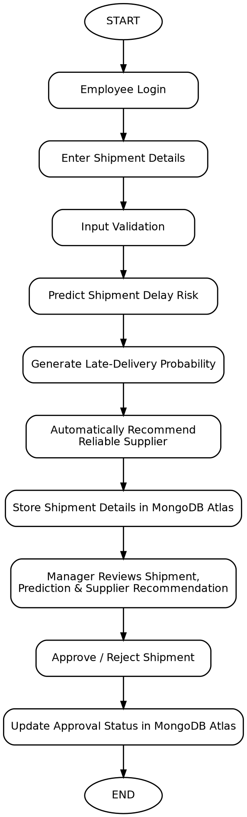
IMPLEMENTATION
Pipeline Flowchart & Working
End-to-end request flow, from employee login to manager approval.
STEP-BY-STEP WORKING
1
Employee logs into the SupplyGuard application.
2
Employee enters the new shipment's details.
3
The system validates the submitted input.
4
The trained model predicts the shipment's delay risk.
5
A late-delivery probability score is generated.
6
A reliable active supplier is automatically recommended.
7
The shipment, prediction and recommendation are stored in MongoDB Atlas.
8
The manager reviews the shipment, prediction and supplier recommendation.
9
The manager approves or rejects the shipment.
10
The approval status is updated in MongoDB Atlas.
SupplyGuard | Shipment Delay Prediction & Supplier Recommendation
22

Slide 23
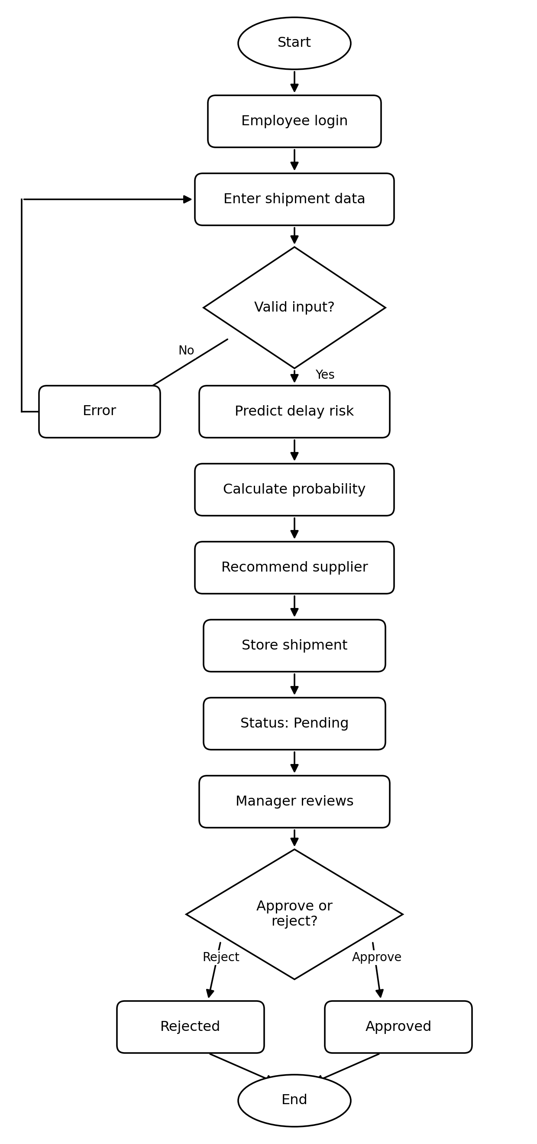
IMPLEMENTATION
Activity Diagram
UML Activity Diagram — including the input-validation loop and the approve/reject branch.
FLOW SUMMARY
The process begins when an employee logs in and enters a new shipment's details.
The system validates the input; invalid entries show an error and loop back for correction.
Once valid, the trained model predicts the delay risk and calculates a probability score.
A reliable active supplier is automatically recommended based on the prediction.
The shipment, prediction and recommendation are stored in MongoDB Atlas with a Pending status.
The manager reviews everything and either approves or rejects the shipment.
The final decision updates the approval status in MongoDB Atlas before the process ends.
SupplyGuard | Shipment Delay Prediction & Supplier Recommendation
23

Slide 24
IMPLEMENTATION
Backend API & Prediction Example
FastAPI Endpoints
Sample Prediction
GET
/
Shipping Mode
First Class
Scheduled Days
3
POST
/predict
Customer Country
United States
GET
/recommend-supplier
Category
Fishing
Order Quantity
2
GET
/shipments
Market
USCA
PUT
/shipments/{shipment_id}/approval
LATE DELIVERY RISK
The API connects the React frontend, the trained ML model, and MongoDB Atlas.
Probability: 75.73%
SupplyGuard | Shipment Delay Prediction & Supplier Recommendation
24

Slide 25
IMPLEMENTATION
Supplier Recommendation Module
Rule-based, not machine-learning-based — kept transparent and easy to audit.
1
→
2
→
3
→
4
Filter to Active suppliers
Rank by highest reliability
Tie-break: fewer pending orders
Return recommended supplier
Example: Active Supplier Pool
Supplier | Reliability | Pending Orders | Outcome
Supplier A | 95% | 10 | Recommended
Supplier B | 88% | 4 | —
Supplier C | 92% | 7 | —
Supplier D | 85% | 2 | —
SupplyGuard | Shipment Delay Prediction & Supplier Recommendation
25

Slide 26
IMPLEMENTATION
Screen Design — Employee Dashboard
SUPPLYGUARD
Employee | Logout
12
4
6
2
Total Shipments
Pending
Approved
Rejected
Create New Shipment
Shipping Mode
Scheduled Days
Customer Country
First Class ▾
3
United States ▾
Category
Order Quantity
Market
Fishing ▾
2
USCA ▾
PREDICT SHIPMENT
SupplyGuard | Shipment Delay Prediction & Supplier Recommendation
26

Slide 27
IMPLEMENTATION
Screen Design — Manager Dashboard
SUPPLYGUARD
Manager | Logout
25
11
8
12
5
Total Shipments
High Risk
Pending
Approved
Rejected
Shipment ID | Country | Category | Risk | Status
6a9c... | USA | Fishing | HIGH | Pending
6a9c... | India | Clothing | LOW | Approved
6a9c... | Germany | Sports | HIGH | Rejected
Selecting a row opens Shipment Details, where the manager sees the full prediction, recommended supplier, and Approve / Reject actions.
SupplyGuard | Shipment Delay Prediction & Supplier Recommendation
27

Slide 28
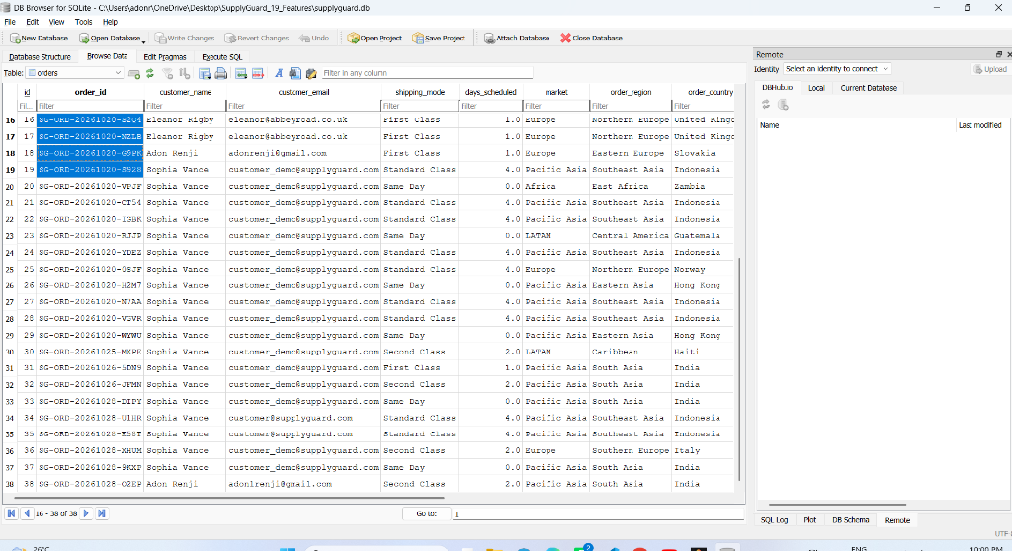
SUPPLYGUARD | APPLICATION SCREENSHOT & SYSTEM VERIFICATION
Order Search & Historical Inspection Dashboard
Key Operational Features
• Order ID Search: Instant lookup for any order stored in the SQLite database.
• Customer & Transaction: Displays customer name, email, and payment type.
• Destination Route: Shows Market, Order Region, Country, and State.
• Itemized Products: Item quantity, unit price, and discount percentage.
• One-Click Prediction: Direct button to launch 19-feature delay assessment.

Slide 29
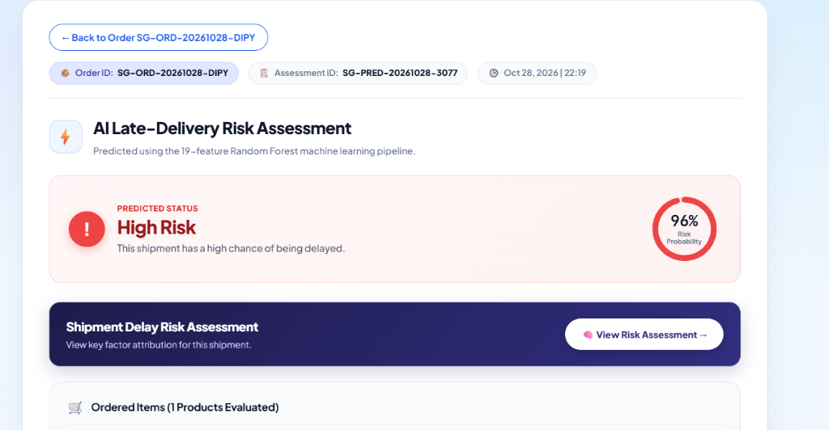
SUPPLYGUARD | APPLICATION SCREENSHOT & SYSTEM VERIFICATION
Late-Delivery Risk Assessment & 19-Feature Overview
Key Operational Features
• Circular Risk Gauge: Displays exact delay risk probability (e.g. 85.0%).
• Threshold Comparison: Compares against 0.41 cutoff to classify risk status.
• 100% Feature Visibility: 4 structured cards cover all 19 model inputs.
• 3 Standard Actions: Prioritize packing, dispatch local courier, share live tracking.

Slide 30
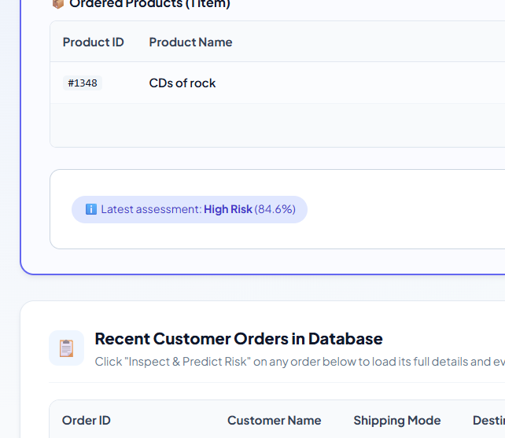
SUPPLYGUARD | APPLICATION SCREENSHOT & SYSTEM VERIFICATION
Shipment Delay Risk Assessment — Contributing Factors
Key Operational Features
• Explainable AI: Identifies why the model predicted a delay risk.
• Top Driving Factors: Shows highest-impact features for the specific order.
• Actionable Insights: Highlights tight scheduled days, high sales volume, or remote state.
• Root Cause Elimination: Enables logistics supervisors to fix systemic transit bottlenecks.

Slide 31
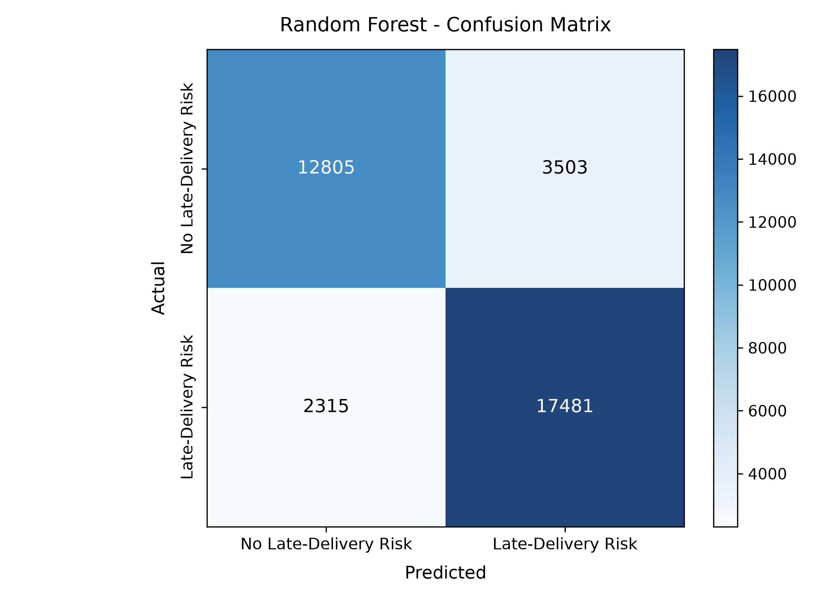
SUPPLYGUARD | APPLICATION SCREENSHOT & SYSTEM VERIFICATION
Test Set Confusion Matrix (36,105 Orders Evaluated)
Key Operational Features
• True Positives: 17,481 actual late deliveries successfully flagged.
• True Negatives: 12,805 on-time deliveries correctly identified.
• False Negatives: Reduced to only 2,315 missed delays (88.31% Recall).
• High Precision: 83.31% precision ensures warehouse staff trust alerts.

Slide 32
IMPLEMENTATION
Feasibility Analysis
◆
$
⚙
Technical Feasibility
Economic Feasibility
Operational Feasibility
Built on established, well-supported tools — Python, scikit-learn, Joblib, FastAPI, MongoDB Atlas and React — deployable on a standard development machine.
Core tools and libraries are open-source or free-tier. The DataCo dataset is available for academic use; MongoDB Atlas offers a free development tier.
Employees submit shipment details; the system predicts risk and stores records. Managers review predictions, use supplier recommendations, and approve or reject.
SupplyGuard | Shipment Delay Prediction & Supplier Recommendation
26

Slide 33
LOOKING AHEAD
Future Scope
→
Real-Time GPS Tracking
→
Weather & Traffic Signals
Live shipment location feeding directly into the risk model.
Incorporate external conditions that affect transit time.
→
Automated Supplier Ranking
→
Real-Time Alerts
Expand beyond reliability and pending orders to more business criteria.
Notify managers proactively as risk thresholds are crossed.
→
Mobile Application
→
Richer Analytics Dashboards
Extend approval and monitoring workflows to mobile devices.
Deeper trend analysis across shipments, suppliers and regions.
SupplyGuard | Shipment Delay Prediction & Supplier Recommendation
27

Slide 34
CONCLUSION
Conclusion
SupplyGuard integrates machine learning with a practical supply-chain workflow for early delay-risk prediction.
Random Forest and SVM were evaluated; Random Forest was selected for the deployed prediction service.
A rule-based supplier recommendation module complements the prediction model using reliability and workload.
Manager approval keeps a human decision layer in place, rather than automating the final action.
Together, these components enable an end-to-end AI-assisted supply-chain workflow — proactive rather than reactive, and human-supervised rather than fully automated.
SupplyGuard | Shipment Delay Prediction & Supplier Recommendation
28

Slide 35
Thank You
Questions & Discussion

