Slide 1
SOFTWARE ENGINEERING
CSCI 6231
MEDSPHERE
TEAM NO:6
ADONIA SEQUEIRA
G31345330
GANESH KUMAR RAJASEKAR
G37969806

Slide 2
OPTION NO 5
DESIGN YOUR OWN APPLICATION
MEDSPHERE

Slide 3
REVIEW: SYSTEM DESIGN DOCUMENT
Purpose & Scope: Clearly define the system's objectives and boundaries.
Module Requirements Gathering: Collect requirements for each module.
Functional Diagrams: Illustrate system functionality using various diagrams.
System Architecture Definition: Establish the architecture of the system.
Database Design: Design an efficient and scalable database structure.
User Interface Creation: Develop an intuitive and user-friendly interface.
Challenge Identification: Identify potential challenges in the design process.

Slide 4
PROJECT SCOPE
The software solution aims to improve access and convenience in healthcare appointment scheduling while minimizing administrative complexity.
Critical Success Factors | System Users & Usage | Key Performance Indicators
User-Centric Design Outcome | Patients | Overall Patient Satisfaction
Flexible Integration Capabilities | Doctors | Patient Wait Time
Scalability | Insurance companies

Slide 5
SYSTEM MODULES
Patient Portal:
Allow patients to schedule appointments online based on provider availability.
Enable patients to claim open appointments and even check in for their appointments.
Provider Availability and Location:
Display provider schedules across multiple locations and days.
Clearly indicate where appointments will take place.
Appointment Reminders:
Send automatic appointment reminders to patients.
Reduce no-shows and optimize revenue streams.
Recurring Appointments:
Set up recurring appointments for patients (e.g., weekly or monthly visits).
Save time by automating repetitive scheduling tasks.
Financial Management:
Handle patient billing, insurance claims, and payment processing.
Ensure accurate claims submission and reimbursement.

Slide 6
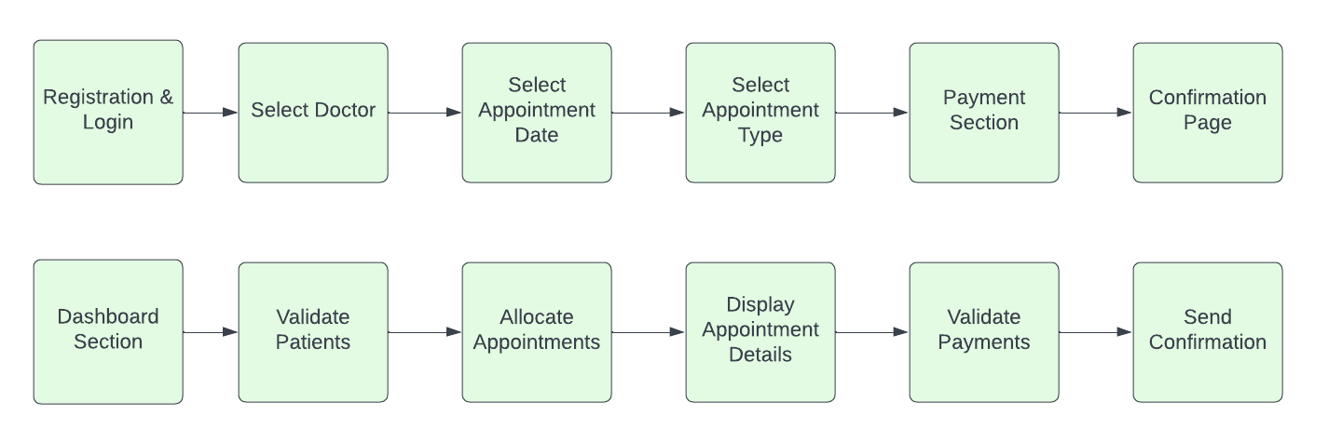
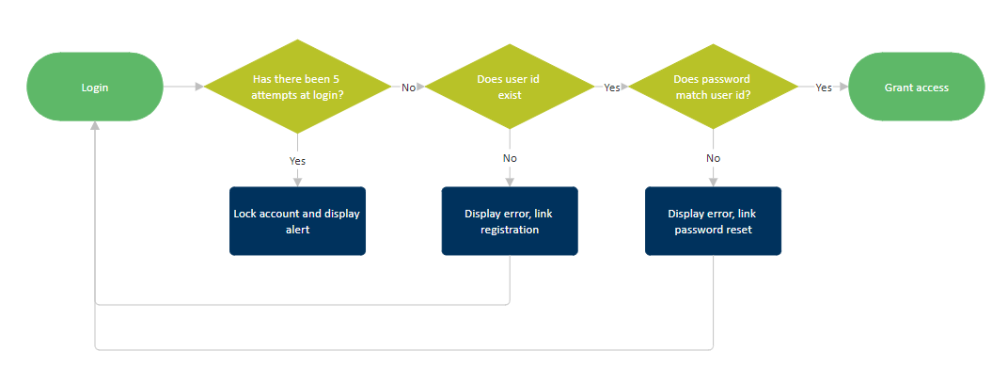
DATAFLOW DIAGRAM
PATIENT
ADMIN
LOGIN Module

Slide 7
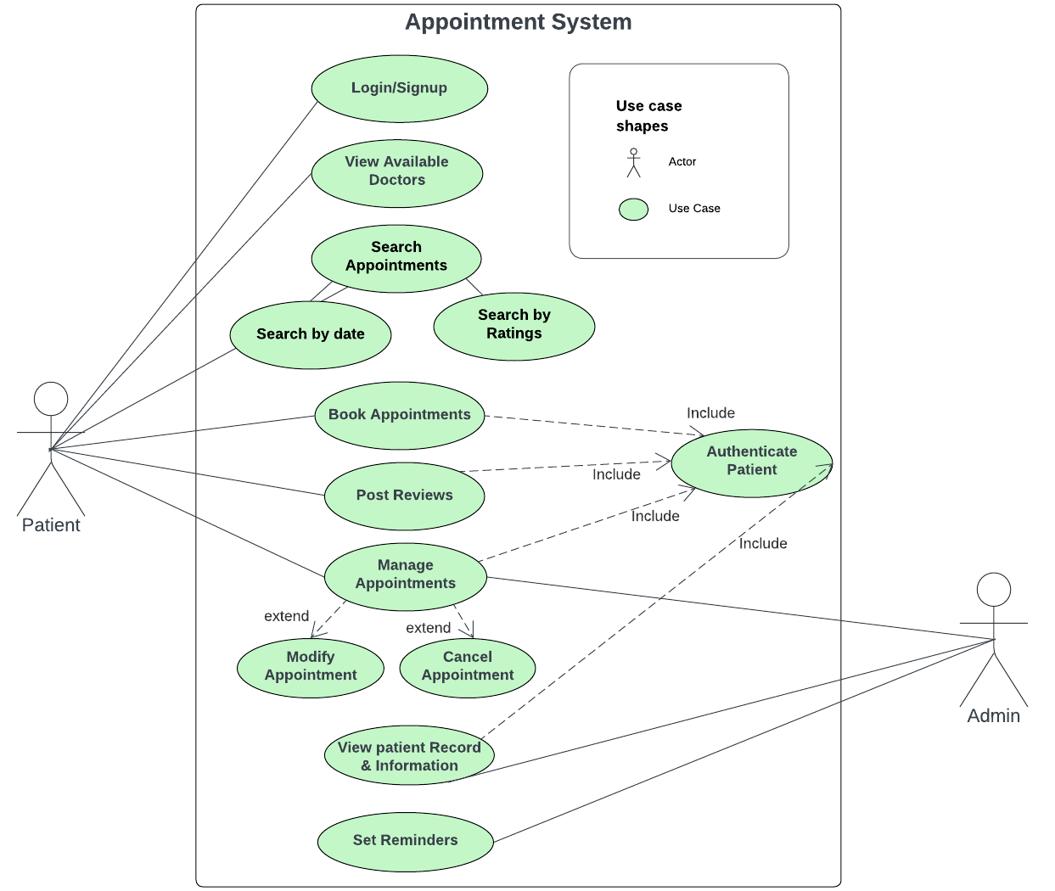
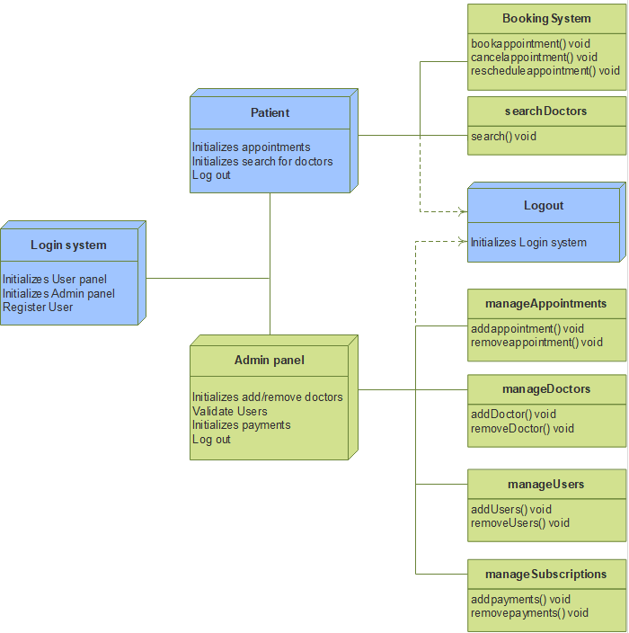
FUNCTIONALITY DIAGRAMS
UML Diagram
Deployment Diagram

Slide 8
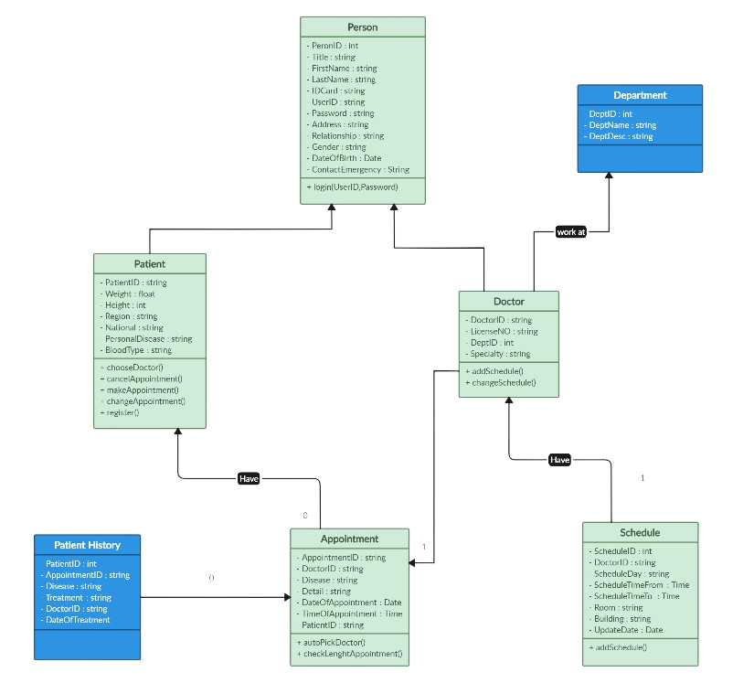
DATABASE ERD

Slide 9
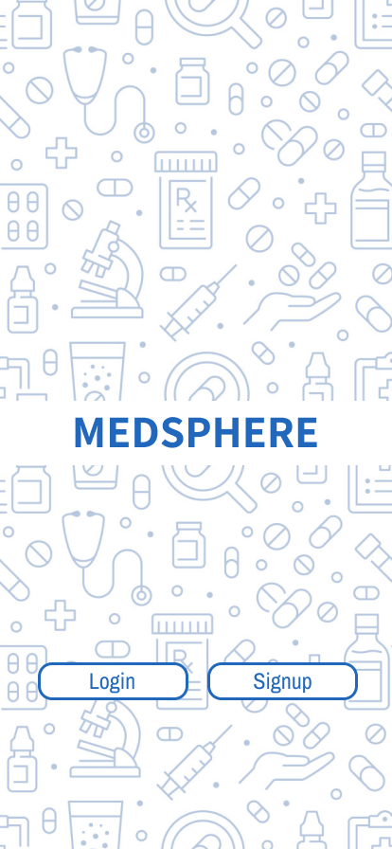
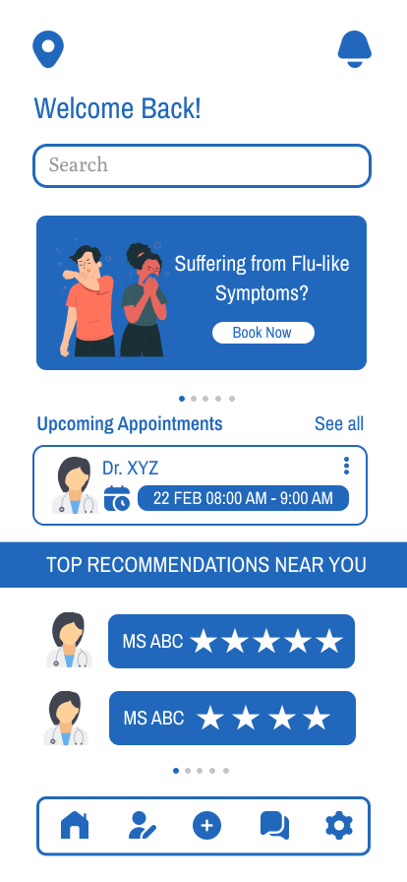
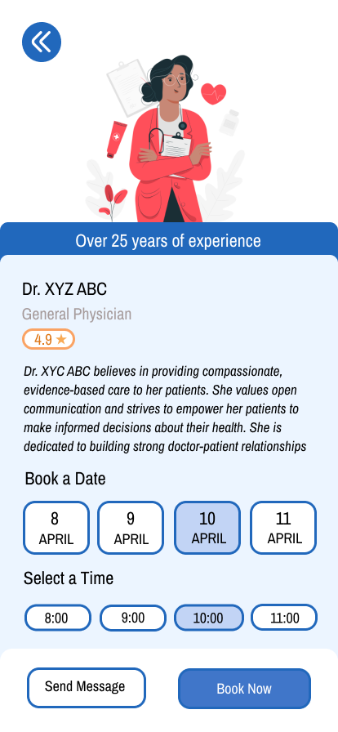
USER INTERFACE DIAGRAM

Slide 10
TEAM MEMBERS & THEIR CONTRIBUTIONS
Adonia Sequeira:
Section 1, 2 & 3 in the System Design Document
The first half of the presentation slides
Ganesh Kumar Rajasekar:
Section 4 & 5 in the System Design Document
The second half of the presentation slides

Slide 11
KEYTAKEAWAYS
Leveraging diagrams and modeling:
Highlights the use of use case diagrams, data flow diagrams, UML diagrams, etc to effectively communicate and document the system's design and data models.
User interface design principles:
Emphasizes the need for a well-designed user interface by considering factors such as user experience, accessibility, and usability across different devices and platforms.
Data management and modeling:
Highlights the importance of proper data design, including data tables, class diagrams, and entity-relationship diagrams, to ensure data integrity, consistency, and efficient data management.

Slide 12
CHALLENGES OF THE SYSTEM
Class Diagrams:
Identifying and defining appropriate classes , attributes and methods.
Ensuring proper relationships between classes.
Data Flow Diagrams:
Identifying and defining all processes, data stores, and data flows accurately.
Managing the level of detail to avoid oversimplification or overcomplication.
Navigation and Flow:
Designing an intuitive navigation system that aligns with users' mental models can be complex.
Ensuring smooth transitions between screens while maintaining coherence can be challenging.

