Slide 1
DepthCLIP
Renrui Zhang*¹, Ziyao Zeng*², Ziyu Guo¹
¹Peking University, ²ShanghaiTech University
Accepted by ACM Multimedia 2022 (Brave New Idea)
*indicates equal contributions

Slide 2
Outline
1. Task
2. Related Works
3. Our DepthCLIP
4. Results & Analysis & Limiations & Future direction
5. Conclusion

Slide 3
Task
Zero-shot Training-free Monocular Depth Estimation
Monocular Depth Estimation:
Infer pixel-wise depth from monocular images
Important in industrial field
Self-driving cars need to infer depth to conduct 3D object detection from monocular images
Since Lidar is expensive and stereo cameras are hard to adjust.
Zero-shot Training-free Transfer
When transfer pre-trained model to a new dataset, we require no extra data nor extra training
To achieve efficient and effective transfer
Important in industrial field
Self-driving cars need to infer depth when entering a complete new environment, and they might have no data nor time to finetune its model

Slide 4
Related Work
Monocular Depth Estimation:
Fully Supervised Method:
ASTransformer, DORN, RPSF, ….
Require pixel-wise depth annotation, costly
Unsupervised Method:
Learn from ego-motion of unlabeled monocular video.
Trains itself with widely available binocular stereo images
Generate paired stereo images of given monocular images, exploit epipolar geometry to solve depth
Require special modality of data
Our DepthCLIP
Differs from all works in this filed
Pretrained with an image classification pre-text task

Slide 5
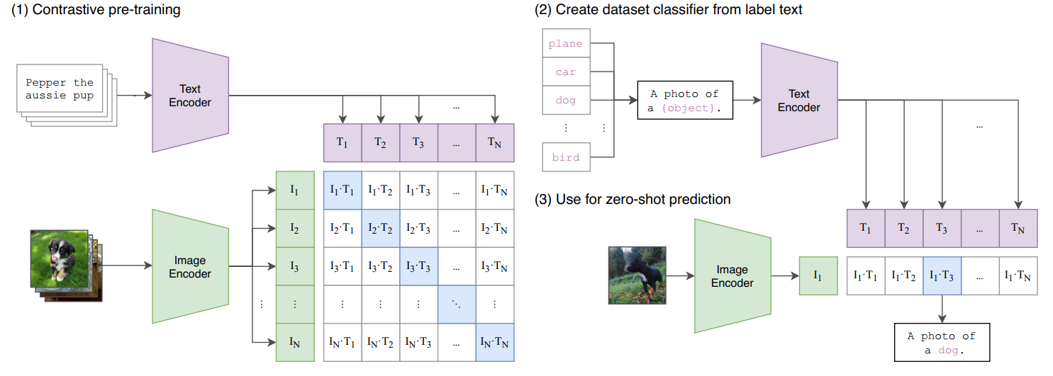
Related Work: CLIP
Group images and text with similar semantic information.
i.e. Understand image using text semantic
Contrastive Language-Image Pretraining
Train
In each batch, encode images and corresponding text into feature space
Maximize cosine similarity between corresponding pair (dog image with “dog”)
Minimize the rest (dog image with “cat” or “cake”)
Test
Form prompts, like “A photo of [class]”, substitute all classes in test dataset
In each batch, calculate similarity between the test image with all prompts
Choose the class who has max prompt-image similarity, as prediction
The dog image would be projected to the neighborhood of “dog”, thus has high similarity with “dog”.

Slide 6
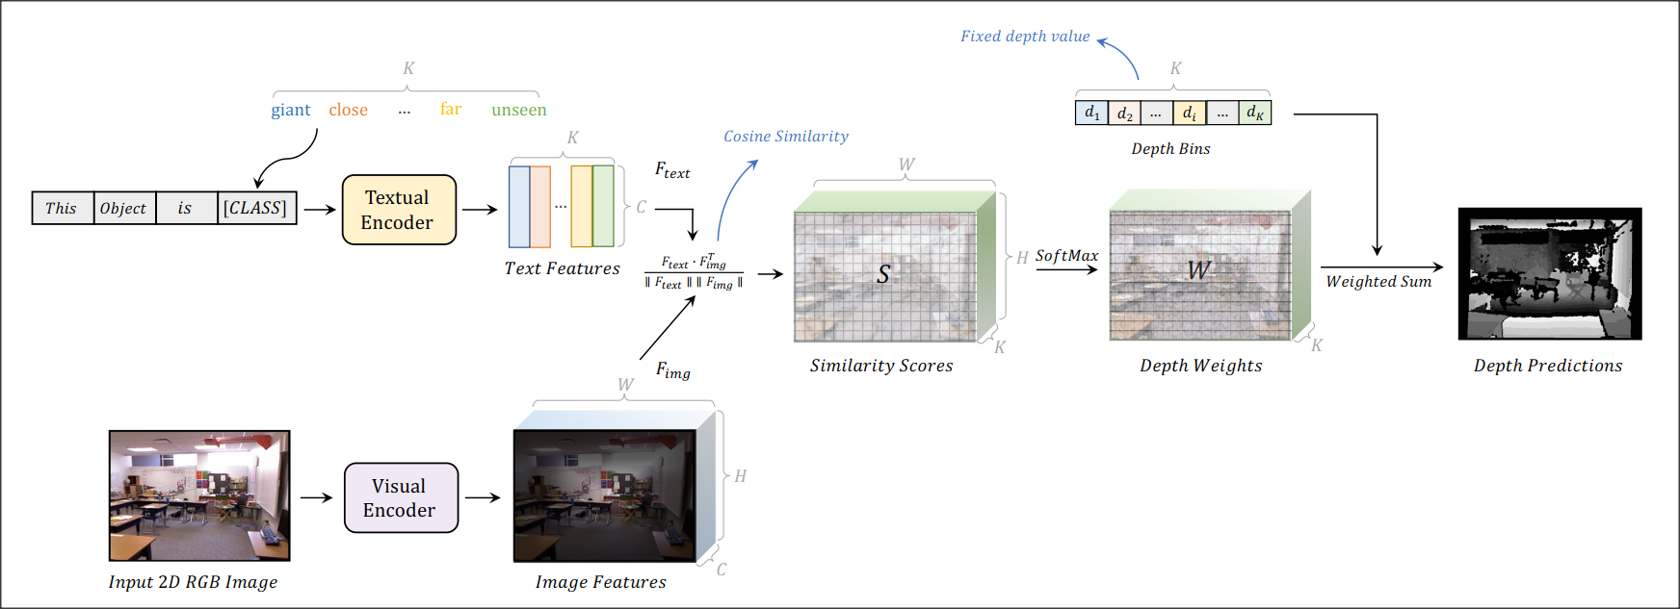
DepthCLIP Pipeline
CLIP has the ability to attach each image with corresponding text with similar semantic meaning.
If a table is close, it would have high similarity of the “close” class
Since during pre-training of CLIP, such a close table has been projected to the neighborhood of the “close” class

Slide 7
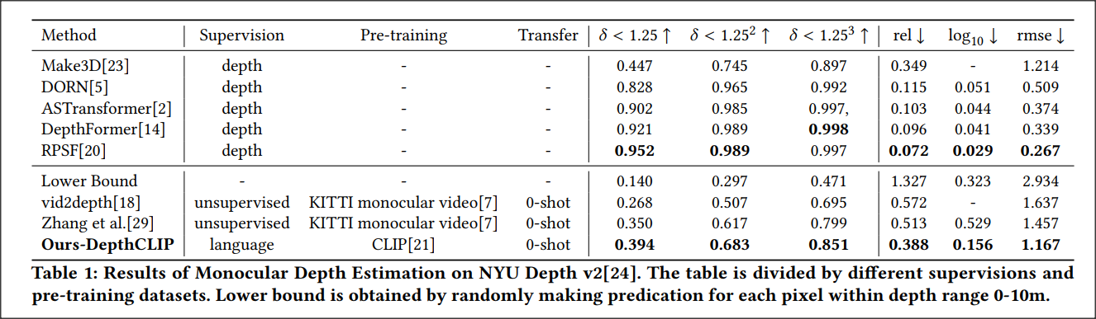
Quantified Results
Exceeds the mathematical lower bound significantly, surpasses some existing unsupervised methods, and even draws near some fully-supervised methods.

Slide 8
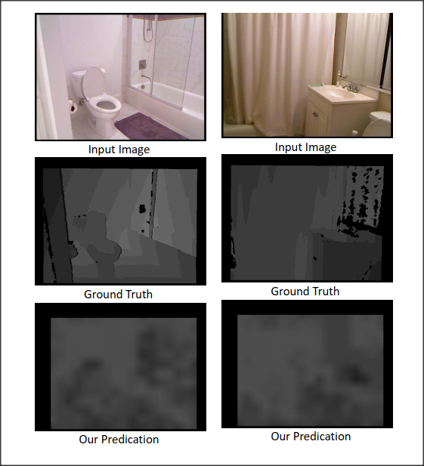
Results Visualization
Could tell contours, predict resonable depth
The background and details are blurred.
CLIP is pre-trained under a classification pre-text task
Details and background that are unimportant for classification would be neglected during feature extraction.
In the future, we could explore pre-trained model with regional pre-text tasks like segmentation

Slide 9
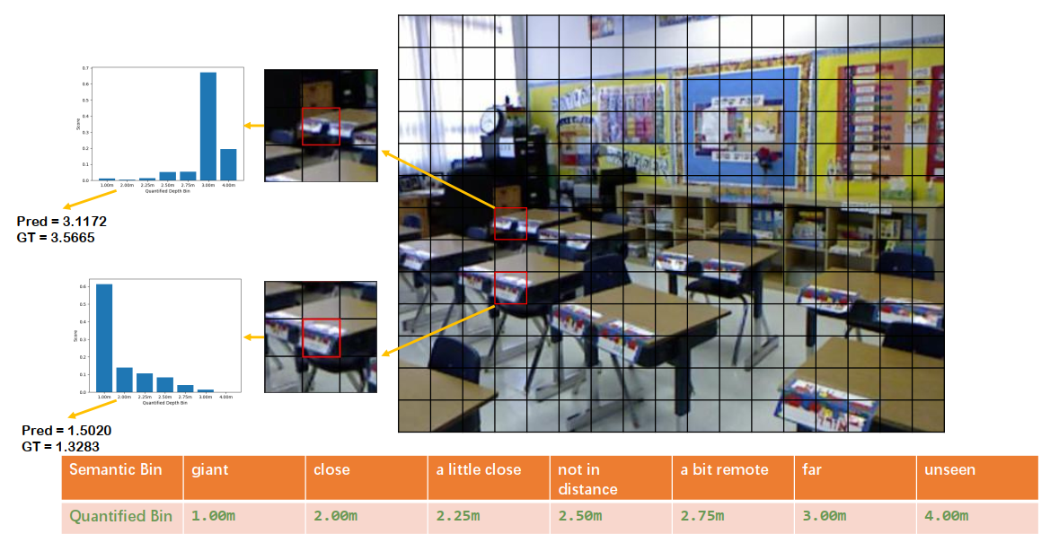
Semantic Bin Response
Different patches have different distance semantic responses
Depth CLIP could distinguish between a close patch and a remote patch, and make proper distance response.

Slide 10
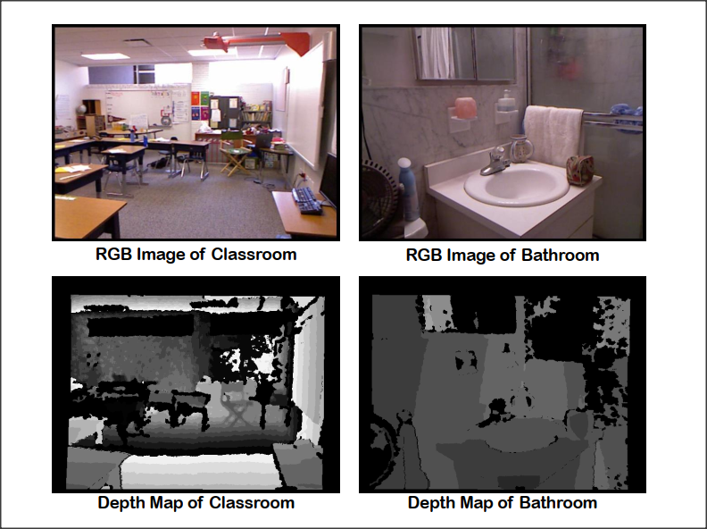
Depth Distribution Gap
Different scenes have different depth distribution
The same depth class should be projected to different depth bins in different scenes.
In major experiments, we project the same depth class to the same depth bin.

Slide 11
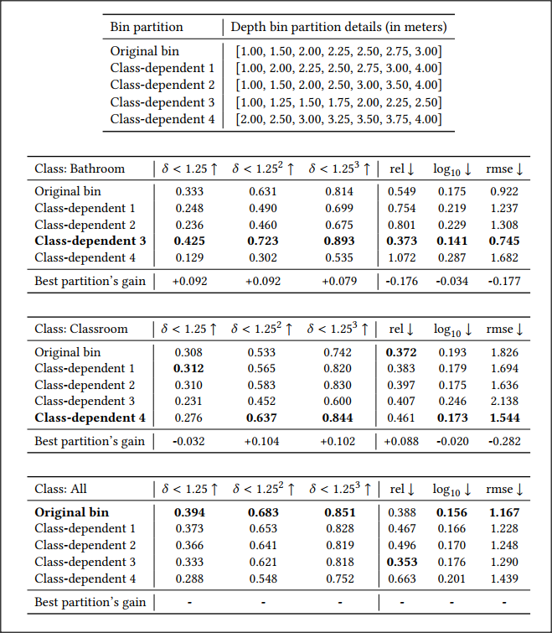
Class-dependent Depth Bin Ablation
DepthCLIP is sensitive to depth bin
Set different bins for different scenes could improve performance
In the future, we could predict scene of the input image first, then use a learnable class-dependent depth bin to achieve a better performance.

Slide 12
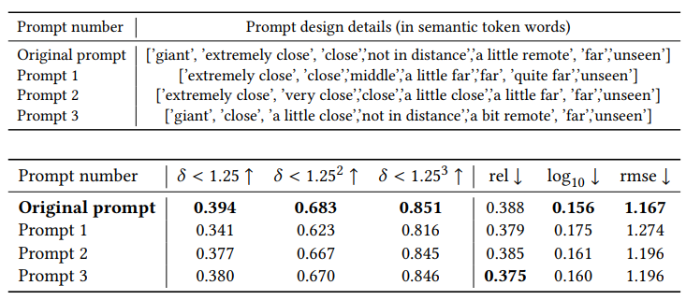
Prompts Ablation
Robust to prompt design
Different prompts could catch the same distance relationship, since only relative distance matters

Slide 13
Conclusion
Without any further training, DepthCLIP could surpass some existing unsupervised methods and even approach some fully-supervised networks.
We are the first to conduct zero-shot training-free adaptation from the semantic language knowledge possessed by a pre-trained model (CLIP), to a downstream task that needs quantified knowledge (monocular depth estimation).
Hope our work could cast a light on the research of bridging semantic vision-language knowledge to the quantified task.

Slide 14
Thanks!

