Slide 1
E-COMMERCE / SEMESTER PROJECT
Lift & Aesthetics
Presentation 2 — Specification & Prototype (Week 7)
PROJECT TEAM & ROLES
• Peca Ana Maria Cristina — Frontend & Product Discovery
• Ploae Darius Adonis Ionut — Backend, Cart & Payments
• Nica David Andrei — Database, Accounts & Admin Panel
TECHNOLOGY STACK: ASP.NET Core 9 / C# • EF Core • MySQL / SQL Server • Stripe Sandbox

Slide 2
MILESTONE 2 — SPECIFICATION & PROTOTYPE
Milestone 2 Objectives & Scope Freezing
Goal: The Specification Is Frozen
P2 Deliverables Checklist
Contractual Baseline for Grading
• What is approved at P2 represents the frozen specification against which Presentation 3 will be graded.
• Any subsequent functional or scope change must be submitted and approved in writing on the course channel.
• Clear architectural and database boundaries established early to guarantee stability.
• Delivers a working prototype proving catalog browsing, database seed loading, and customer shopping flow.
Requirements A1–A12: All 12 core requirements described in 1–2 concise implementation sentences.
Chosen Bonus Features: B1 (Filtered Search), B5 (Discount Codes), and B7 (Wishlist) selected.
Data Model (ERD): Relational database diagram matching actual tables with clean 1:N relations.
System Architecture: Three-tier component diagram with complete API endpoints specification table.
Critical Flow Sequence: UML sequence flow: Checkout -> Stripe Sandbox -> Webhook -> Order & Stock.
UI Wireframes: Clean grayscale wireframes for Catalog, Product, Cart, Checkout, and Admin.
Working Prototype: Live demo with 30+ products read from DB, login, and active checkout flow.

Slide 3
MILESTONE 2 — SPECIFICATION & PROTOTYPE
Requirements Specification: A1 – A4 (Catalog & Accounts)
A1: Product Catalog
A2: Basic Search
Lead: Ana Maria (M1)
• Displays gym products grouped into 4 clear categories (Supplements, Clothing, Equipment, Accessories).
• Each item shows a photo, title, price in LEI, stock availability badge, and direct button to view details or add to cart.
Lead: Ana Maria (M1)
• Allows customers to search the store instantly by typing product names or category keywords.
• Queries the database dynamically and displays matching items or a helpful empty state when no matches exist.
A3: User Accounts & Authentication
A4: Order History
Lead: David Andrei (M3)
• Secure customer registration and login handled by ASP.NET Core Identity with hashed credentials.
• Maintains authenticated sessions and gives users access to personal profiles and account management.
Lead: David Andrei (M3)
• Authenticated members can view their past orders, transaction dates, total amounts, and delivery statuses.
• Provides transparent order tracking and digital receipt summaries for all completed checkouts.

Slide 4
MILESTONE 2 — SPECIFICATION & PROTOTYPE
Requirements Specification: A5 – A8 (Cart, Checkout & Payment)
A5: Shopping Cart
A6: Checkout Flow
Lead: Darius Adonis (M2)
• Stores selected gym products with line item subtotals, quantity increase/decrease buttons, and remove actions.
• The server recalculates all totals, discounts, and item prices on every mutation to prevent client tampering.
Lead: Darius Adonis (M2)
• Collects shipping address and customer contact details through a simple, validated form.
• Calculates delivery costs and locks cart items into an unpaid order record prior to payment submission.
A7: Sandbox Payment Integration
A8: Stock Management
Lead: Darius Adonis (M2)
• Simulates card payments securely using the Stripe test environment without real currency or risks.
• Orders stay in 'PendingPayment' state until Stripe confirms successful charge capture via an async webhook.
Lead: Darius Adonis (M2)
• Decrements available product quantities in the database atomically only upon confirmed webhook payment.
• Prevents overselling and automatically restores inventory if checkout is cancelled or payment fails.

Slide 5
MILESTONE 2 — SPECIFICATION & PROTOTYPE
Requirements Specification: A9 – A12 (Admin, Security & Quality)
A9: Admin Management Panel
A10: Access Control & Security
Lead: David Andrei (M3)
• Administrative interface allowing gym owners to add new products, edit prices, upload images, and delete items.
• Enables store managers to monitor incoming orders and update product stock levels in real time.
Lead: David Andrei (M3)
• Protects admin routes and sensitive actions using role-based authorization attributes ([Authorize(Roles='Admin')]).
• Protects user passwords with cryptographic hashing and uses parameterized EF Core queries against SQL injection.
A11: Responsive Mobile Design
A12: Testing & Quality Checks
Lead: Ana Maria (M1)
• Adaptive CSS grid and flexbox layout designed to look great on mobile smartphones, tablets, and desktop displays.
• Features mobile-friendly navigation, touch-friendly product cards, and easy-to-use checkout inputs.
Lead: Team Shared
• Automated unit tests and manual end-to-end verification of cart totals, coupon calculations, and checkout flows.
• Validates error handling for declined test cards, empty cart checkout attempts, and out-of-stock items.

Slide 6
MILESTONE 2 — SPECIFICATION & PROTOTYPE
Chosen Bonus Features (Official Course Codes)
B1: Filtered Search
B5: Discount Codes / Coupons
B7: Wishlist / Saved Items
Lead: Ana Maria (M1)
• Multi-criteria catalog filtering for easy product discovery.
• Filter by category (Supplements, Apparel, Equipment, Accessories).
• Price range filtering and 'In-Stock Only' availability toggle.
• Sorting by Price (Low to High / High to Low) and Product Name.
• Implemented and demonstrated live in the prototype catalog.
Lead: Darius Adonis (M2)
• Promotional coupon engine validated directly in the shopping cart.
• Supports percentage discounts (e.g. LIFT10 for 10% off) and fixed sums.
• Server checks coupon expiration date, active status, and minimum spend.
• Subtracts discount amount before submitting final order total to Stripe.
Lead: David Andrei (M3) + Ana Maria
• Enables registered lifters to bookmark gear and supplements for later.
• Quick 1-click addition directly from product cards or product detail view.
• Dedicated Wishlist section in User Profile with instant 'Move to Cart' button.

Slide 7
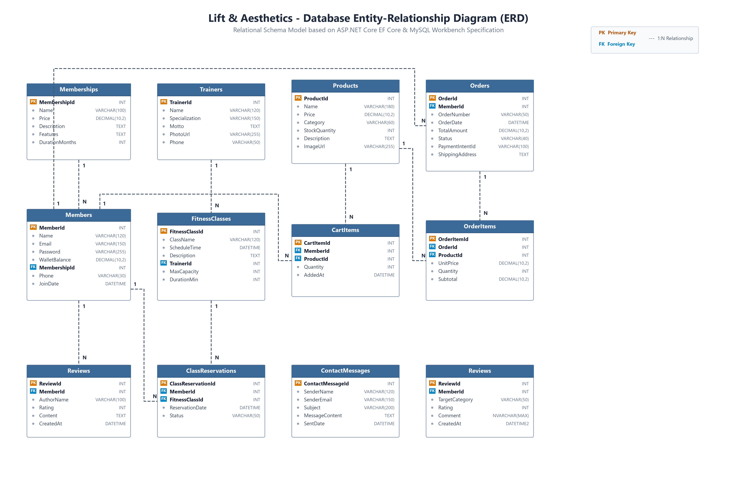
MILESTONE 2 — SPECIFICATION & PROTOTYPE
Database Entity-Relationship Diagram (ERD)
Schema Highlights
• Relational schema matching ASP.NET Core EF Core & MySQL model.
• Primary Keys (PK) & Foreign Keys (FK) enforce referential integrity.
• Products & CartItems: 1:N link tracking quantity per active member.
• Orders & OrderItems: Stores snapshot of unit price at time of purchase.
• Members & Memberships: Links users to their active fitness tier.
• Non-crossing orthogonal relationships for maximum clarity.

Slide 8
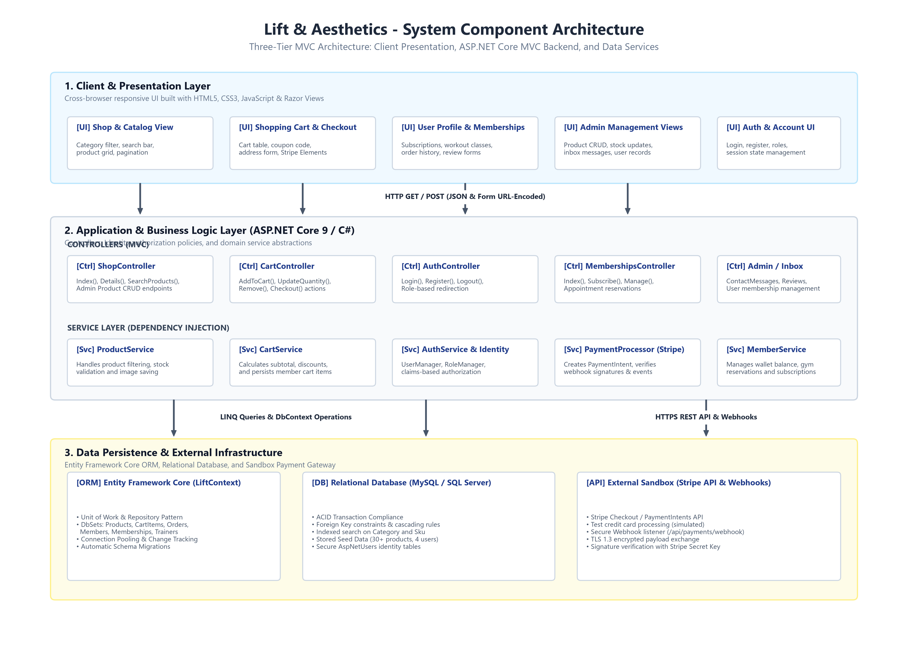
MILESTONE 2 — SPECIFICATION & PROTOTYPE
System Architecture: Three-Tier Component Diagram
Architecture Highlights
• Three-Tier MVC separation of concerns for clean maintainability.
• Client Layer: Responsive Razor Views, HTML5, CSS3, vanilla JS.
• Application Layer: ASP.NET Core Controllers & Dependency Injection Services.
• Data Layer: Entity Framework Core ORM with MySQL / SQL Server.
• Payment Gateway: Stripe Sandbox integration with secure Webhooks.
• Server-authoritative validation prevents client tampering.

Slide 9
MILESTONE 2 — SPECIFICATION & PROTOTYPE
Application Endpoints Specification
Method | Route | Access Level | Action Description
GET | /Shop | Public | Browse product catalog with optional category & keyword search
GET | /Shop/Details/{id} | Public | View detailed product specifications, price, and photo
GET | /Cart | Member | View active shopping cart items, line subtotals, and total
POST | /Cart/AddToCart | Member | Add selected product to member cart or increment quantity
POST | /Cart/UpdateQuantity | Member | Update quantity for a cart line item or validate max stock
POST | /Cart/Remove | Member | Remove an individual product line from the active cart
POST | /Cart/Checkout | Member | Initiate checkout flow, lock order items, create pending order
POST | /api/payments/webhook | Stripe IP | Stripe webhook listener to verify signature and mark order paid
GET | /Auth/Login | Public | Display customer / admin authentication form
POST | /Auth/Login | Public | Authenticate user credentials and establish cookie session
GET | /Shop/Create | Admin | Render product creation form (Admin only)
POST | /Shop/Delete/{id} | Admin | Remove product from store inventory (Admin only)

Slide 10
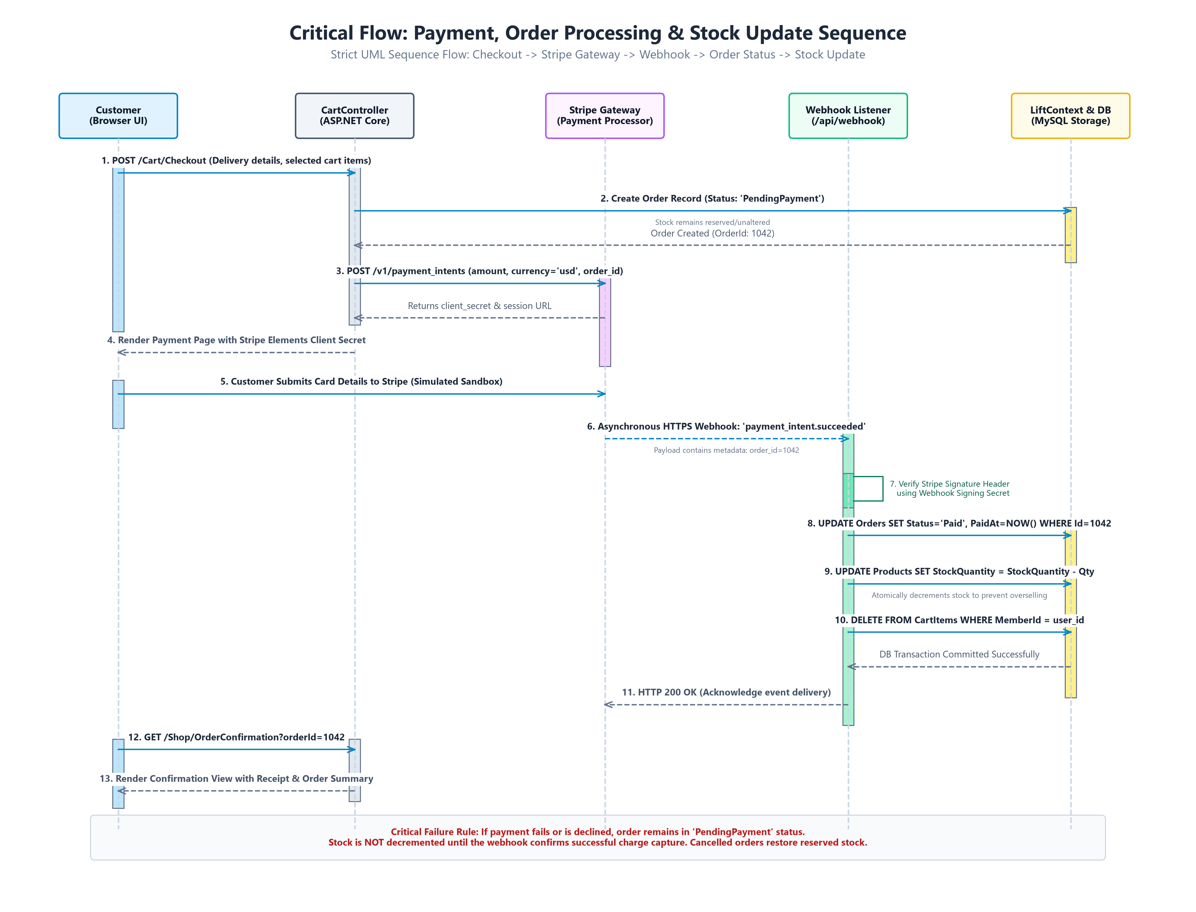
MILESTONE 2 — SPECIFICATION & PROTOTYPE
Critical Flow: Payment, Order Processing & Stock Update
Key Sequence Rules
1. Customer initiates checkout from cart.
2. Server creates 'PendingPayment' order.
3. Stripe PaymentIntent session created.
4. Customer submits card in Stripe sandbox.
5. Asynchronous webhook notifies server.
6. Server verifies HMAC webhook signature.
7. Order marked 'Paid' atomically.
8. Inventory stock decremented in DB.
9. Customer cart cleared upon success.

Slide 11
MILESTONE 2 — SPECIFICATION & PROTOTYPE
Payment & Webhook Reliability Design
Cryptographic Signature Verification
Idempotent Processing
Stock Integrity & Failure Recovery
• All incoming webhook payloads from Stripe are verified against a secret signing key.
• Validates Stripe-Signature HTTP header to ensure notifications cannot be spoofed.
• Rejects any unauthorized or tampered webhook requests immediately with HTTP 400.
• Stripe may deliver webhook events more than once if network latency occurs.
• The webhook listener checks whether the Order is already marked 'Paid' before processing.
• Prevents duplicate charges, double stock decrements, or corrupted database states.
• Inventory stock is only decremented after cryptographic confirmation of payment.
• If customer abandons payment or the test card is declined, stock is NOT reduced.
• Cancelled or expired checkout sessions automatically restore reserved quantities.

Slide 12
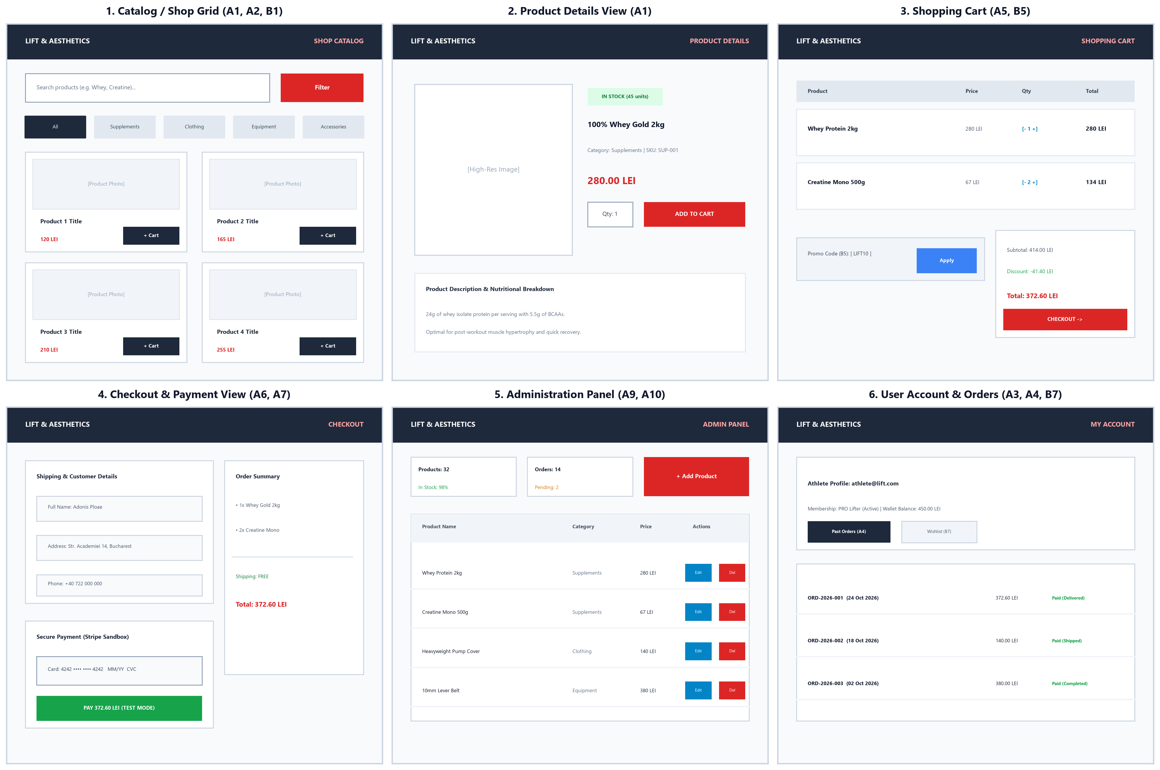
MILESTONE 2 — SPECIFICATION & PROTOTYPE
User Interface Wireframes (Catalog, Cart, Checkout & Admin)
UI Blueprint Focus
1. Catalog Grid: Clear category chips, search bar, product cards with price & photo.
2. Product Details: High-res image, stock status badge, quantity selector, specs.
3. Cart View: Line item controls, coupon code box (B5), clear subtotal breakdown.
4. Checkout: Minimal form, Stripe Elements sandbox card input, order summary sidebar.
5. Admin Panel: Clean product table with Edit/Delete buttons and quick Add Product.
6. My Account: Order history tab and Wishlist saved items (B7).

Slide 13
MILESTONE 2 — SPECIFICATION & PROTOTYPE
Working Prototype & Live Demonstration
Live Demo Scope & Seed Data
Pre-Configured Test Accounts
• Database Seed Loaded: 30+ realistic gym products pre-seeded across 4 distinct categories (Supplements, Clothing, Equipment, Accessories).
• Catalog Browsing: Live demonstration of category navigation and instant search filtering in ShopController.
• Product Details: Viewing pricing, descriptions, and stock quantities directly from database.
• Cart Flow: Adding items to cart, modifying quantities, observing live subtotal calculations.
• Checkout: Initiating simulated checkout with test member account and viewing order states.
Pre-seeded accounts for evaluation (Password: Testing1)
Customer Account 1: athlete@lift.com (pw: Testing1)
Standard athlete role with pre-loaded membership and cart.
Customer Account 2: girl@lift.com (pw: Testing1)
Secondary user account for multi-customer testing.
Store Admin 1: admin@lift.com (pw: Testing1)
Administrative credentials to access /Shop/Create and manage products.
Store Admin 2: alex@lift.com (pw: Testing1)
Secondary administrator for concurrent management testing.

Slide 14
MILESTONE 2 — SPECIFICATION & PROTOTYPE
Team Responsibilities & Work Division
Peca Ana Maria Cristina
Ploae Darius Adonis Ionut
Nica David Andrei
FRONTEND & PRODUCT DISCOVERY
• Catalog layout and category browsing (A1)
• Basic search and filtered search (A2, B1)
• Responsive UI styling for mobile & desktop (A11)
• Wishlist UI integration (B7)
BACKEND, CART & PAYMENTS
• Shopping cart state and server total calculation (A5)
• Checkout delivery information flow (A6)
• Stripe sandbox payment processor integration (A7)
• Webhook listener & stock decrement logic (A8)
• Discount code coupon engine (B5)
DATABASE, SECURITY & ADMIN
• Database schema design, migrations, and seeding
• Customer registration and login authentication (A3)
• Order history and user account dashboard (A4)
• Admin product management CRUD (A9)
• Role authorization and access control (A10)

Slide 15
MILESTONE 2 — SPECIFICATION & PROTOTYPE
Roadmap from P2 to P3 (Final Delivery)
Remaining Implementation Tasks
Summary & Q&A
• Stripe Live Webhook Testing: Finalize local CLI webhook forwarder for live end-to-end payment simulations.
• Admin Order Dispatching: Complete order fulfillment state management (Pending -> Paid -> Shipped -> Delivered).
• Wishlist Finalization (B7): Connect frontend bookmarking directly with user profile DB persistence.
• Coupon Rules (B5): Complete validation for minimum spend constraints and expiration date enforcement.
• Comprehensive Automated Testing (A12): Expand unit tests for cart edge cases and discount computations.
Lift & Aesthetics — Milestone 2 Complete
• Specification is officially frozen for Milestone P3 evaluation.
• Seeded catalog with 30+ products and test accounts ready for demonstration.
• Clean database schema and sequence diagram established.
• Git repository tagged at 'P2' release point.
Thank you! We welcome questions and feedback.

