Slide 1
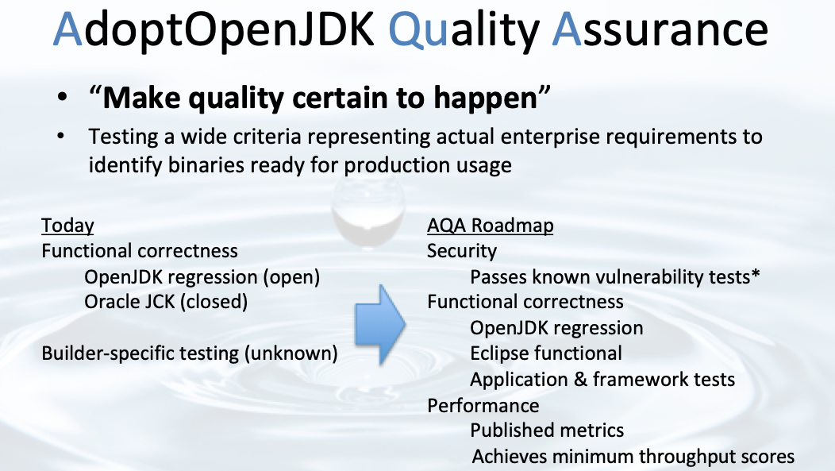

Slide 2
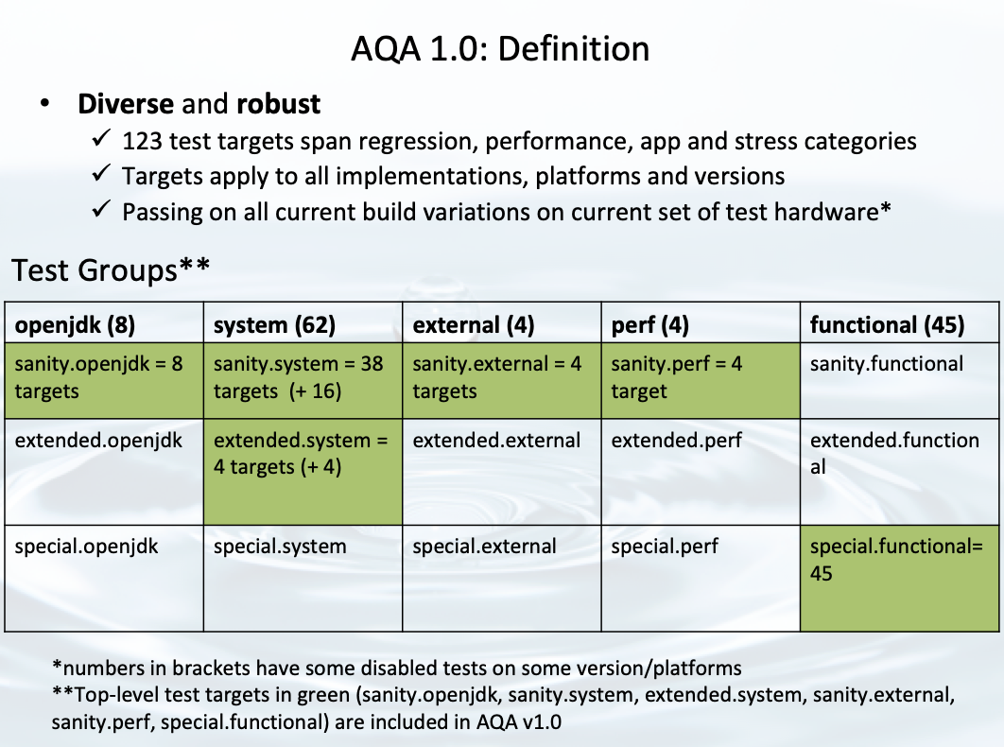

Slide 3
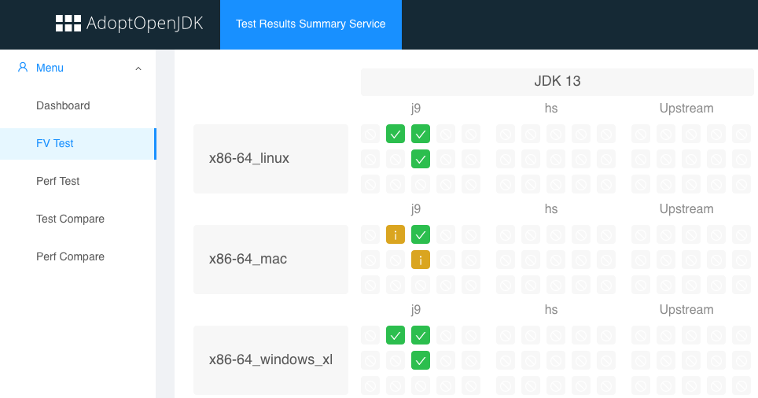
Test Definitions and “Smarter” Triage
TestKitGen :
Pluggable method to define and add new tests to the AQA definition
Test Results Summary Service (https://trss.adoptopenjdk.net)

