Slide 1
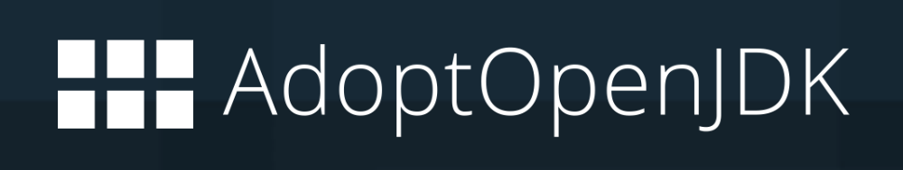













Open-Source Communities
AdoptOpenJDK
Jenkins CI Server
Hotspot
Adopt Website
OpenJ9
Build
Test
Win
xLinux
pLinux
zLinux
macOS
Docker
JDK8 | JDK11 | JDK13
JDK8 | JDK11 | JDK13
JDK8 | JDK11 | JDK13
JDK8 | JDK11 | JDK13
JDK8 | JDK11 | JDK13
JDK8 | JDK11 | JDK13
API
AQA
AQA
Supporters

