Slide 1


Advanced Java
Introduction
Josh Cummings
@jzheaux | tech.joshuacummings.com

Slide 2
What Are We Going to Learn?
Java 8
Concurrency
Networking
CDI
Web Applications
Web Services
JPA
Messaging

Slide 3

Overarching Philosophy
Only 5% of attendees apply what they learn
Immediate application and feedback
Daily In-Class Projects

Slide 4
So, let's begin!

Slide 5
Advanced Java: Day 1
Java 8
Josh Cummings
@jzheaux | tech.joshuacummings.com

Slide 6
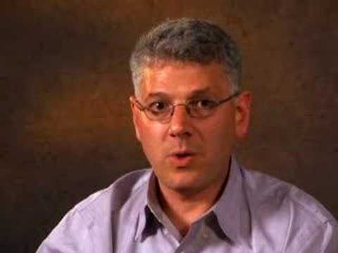
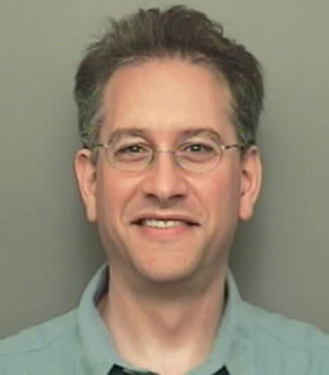
Can you name these two language pioneers?
Josh Bloch
Neal Gafter

Slide 7
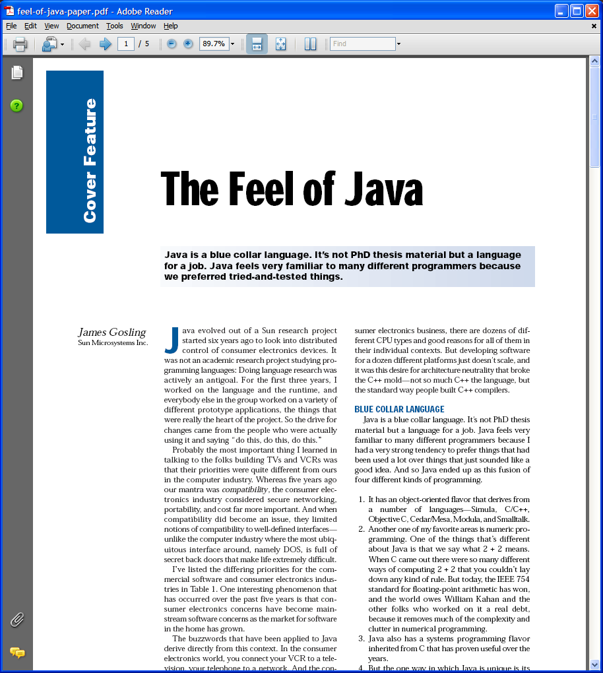
IEEE Computer, June 1997
Notes:
In case the talk wasn’t enough, Here’s an IEEE Computer Article that was based on the talk. As you can see, the Feel of Java is simple: it’s a Blue Collar Language, designed for the working programmer to get a job done. So how are we doing?

Slide 8
CICE v BGGA
Inner Class Sugar
New Resource Management Construct
Functions as Types
Non-local return, break, and continue
Full access to non-final local variables
Library-defined control constructs

Slide 9
sort(list, Comparator<String> (String s1, String s2) {
return s1.length() - s2.length();
});
static Pair<{ => int },{ => int }> joinedCounters(int initial) {
return Pair.<{ => int },{ => int }> of(
{ => initial++ }, { => initial++ });
}
CICE
BGGA

Slide 10

What more info?
http://www.javac.info/bloch-closures-controversy.ppt
https://www.parleys.com/display/PARLEYS/The+Closures+Controversy
http://gafter.blogspot.com/2006/08/closures-for-java.html

Slide 11

What was finally decided?
Need a path to multicore
Parallel-friendly APIs
Concise for Internal Iteration
Empower library developers
It's about time!
Java is lone holdout
No longer a radical idea
Brian Goetz

Slide 12
KEEP
CALM
and
CODE
ON

