Slide 1
What is Foursquare opinion on splitting up Belgium?
SCAPSTONE PROJECT FOR COURSERA IBM DATA SCIENCE SPECIALIZATION

Slide 2

What if we split it?
is a question that is often heard :
In conversation
On the news
By politicians

Slide 3
Can Foursquare tell us how similar Belgium regions are?
The idea of this project is to use Foursquare API to analyse and compare Belgium regions and neighboring countries with machine learning to see if we can spot similarities or dissimilarities.

Slide 4
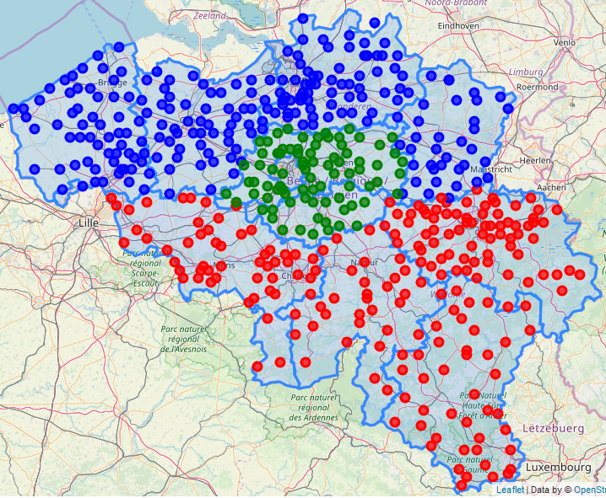
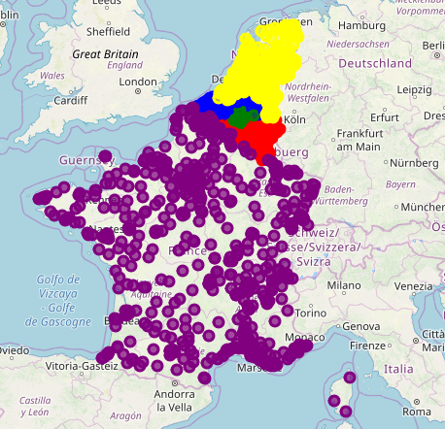
With What data?
Venues data for more than 500 begians cities…
…and more that 1500 when adding France and the Netherlands

Slide 5
How is it going to work?
Each city will have 100 of its venues analyze and their categories will be stored by their frequency.
This will results of a table describing how often a given type of venue appears in the sample of the city taken giving for each city a profile that can be compared to others.
Once this is done, K-means clustering (a machine learning algorithm) is applied to find groups of similar cities within all the data.
We can then observed the proportion of each group in our regions of interest to draw conclusion.

Slide 6
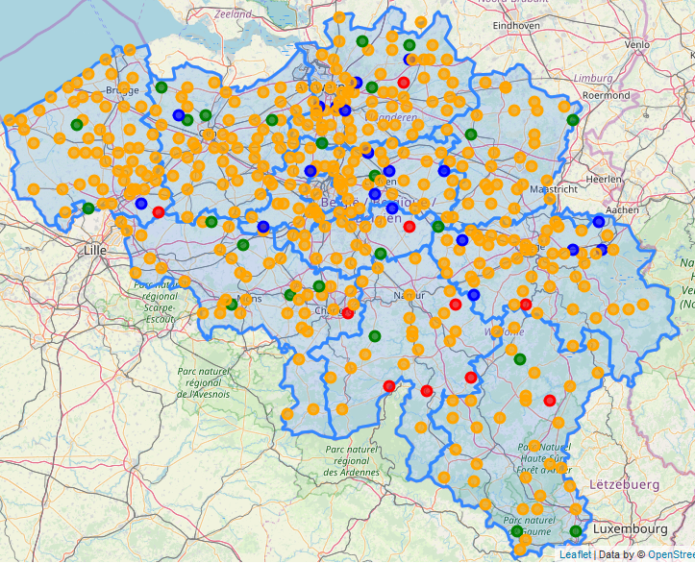
What’s the situation for Belgium?
A lot of similar cities accross all regions:

Slide 7
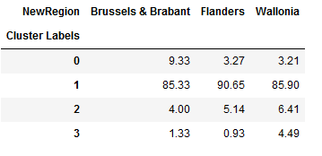
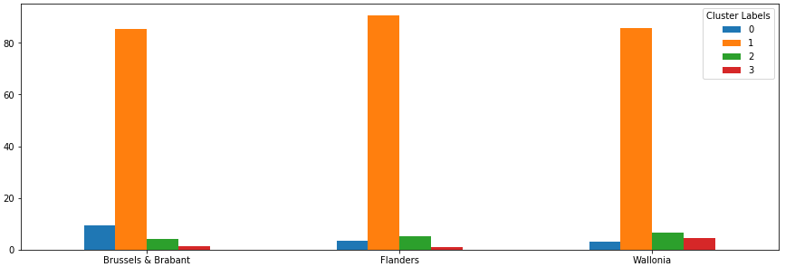
Is there a better way to visualize it?
The results can be summarize in a table or a graph:

Slide 8
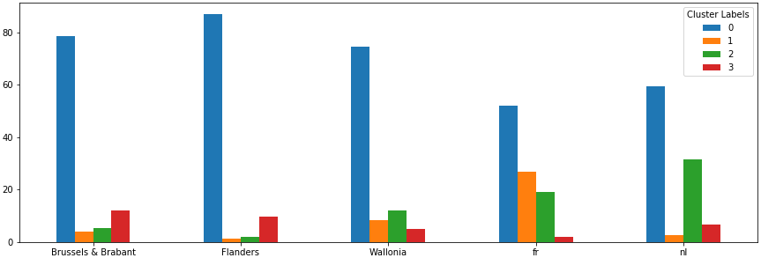
Is the distribution the same withFrance and the Netherlands?
They are similarities, but the results are much different :

Slide 9
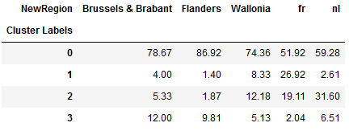
What’s the take away?
Belgian’s regions are not a 100% homogenous entity, there are some differences.
The differences are however much greater when comparing to the country that are often listed as potential new parterns of Belgian’s regions.

Slide 10
Can you list the data you used?
List of cities with positions:
https://www.kaggle.com/max-mind/world-cities-database/downloads/world-cities-database.zip/3
Foursquare API:
https://foursquare.com/
Belgian provinces borders:
digitalwallonia.be

Slide 11

Well that was fun!
Thank you for reading!

