Slide 1
Where’s Waldo?
Comparing Naïve Cross Correlation and 2D FFT by Adrian Lindsey

Slide 2
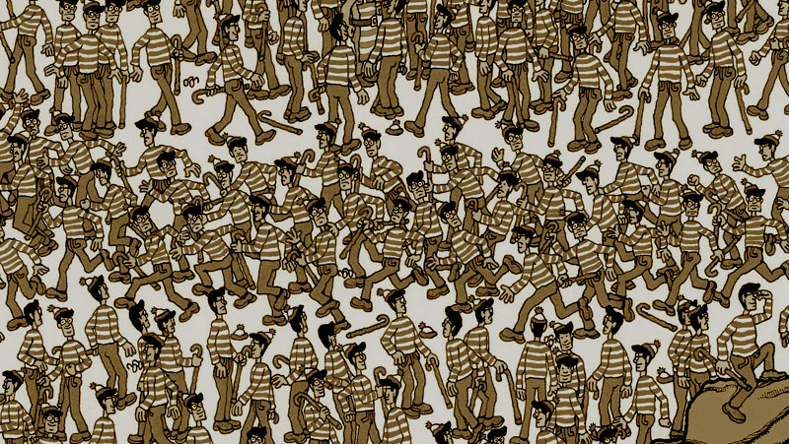

Naïve Cross Correlation
Drag the template (the man himself) across the target (the bigger picture) and calculate the correlation matrix at each step. 2 FOR LOOPS
The $i, j$returned as the max element of the correlation matrix corresponds to the upper left corner of the template overlaying the target. 2 MEANS AND 1 MATRIX MULTIPLICATION
Formula for correlation matrix:
Let A = target, B = template
$$sum(sum\left((A−A_{ave})∗(B−B_{ave})\right))$$
Matlab’s matrix multiplication computational complexity is known to be a little worse than $O(N^{2})$. Since our algorithm performs a matrix multiplication in its innermost loop, we get a complexity of $O({N_{A}N_{B}}^{3})$.

Slide 3
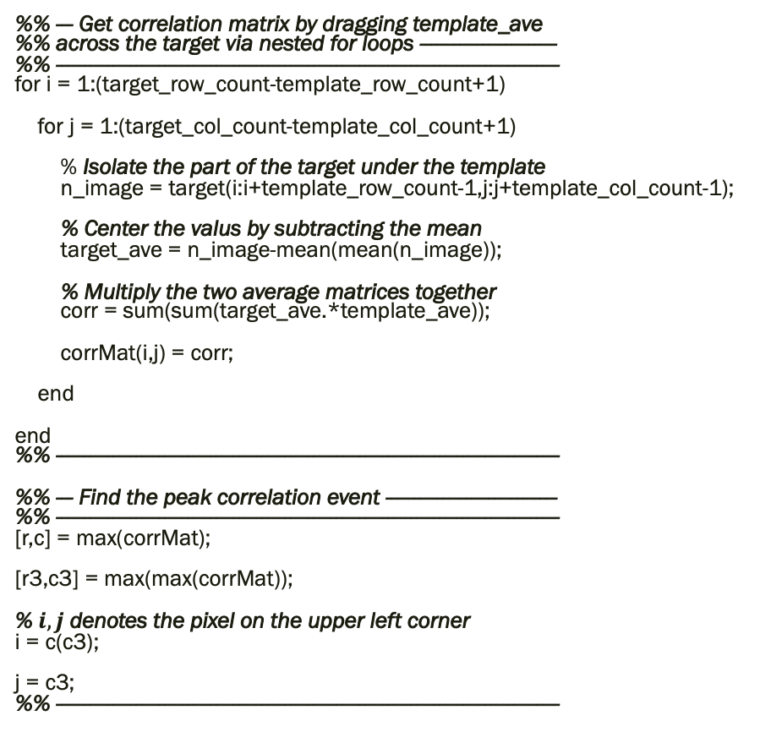
Naïve Cross Correlation Matlab algorithm
%% --- Get correlation matrix by dragging template_ave %% across the target via nested for loops ------------------------ %% ---------------------------------------------------------------------------------------- for i = 1:(target_row_count-template_row_count+1)
for j = 1:(target_col_count-template_col_count+1)
% Isolate the part of the target under the template n_image = target(i:i+template_row_count-1,j:j+template_col_count-1);
% Center the valus by subtracting the mean target_ave = n_image-mean(mean(n_image));
% Multiply the two average matrices together corr = sum(sum(target_ave.*template_ave));
corrMat(i,j) = corr;
end
end %% ----------------------------------------------------------------------------------------
%% --- Find the peak correlation event ------------------------------ %% ---------------------------------------------------------------------------------------- [r,c] = max(corrMat);
[r3,c3] = max(max(corrMat));
% $i, j$ denotes the pixel on the upper left corner i = c(c3);
j = c3; %% ----------------------------------------------------------------------------------------

Slide 4
A little more about Naïve Cross Correlation
In the Real World
This is how your local USPS sorts the mail.
Problem 1
Human must first manually find Waldo and save off his image in order to later find him using naïve cross correlation.
Problem 2
Inflexible to rotated, scaled, targets, templates since images are so simple. Possibly better when looking at higher resolution images.
Problem 3
Can often use multiple templates to represent one object becoming even more computationally expensive.

Slide 5

2D FFT with Cross-Power Spectrum
Perform a 2D FFT on both images padding the template to match target size.
Compute the cross-power spectrum to find the correlation matrix. 2 MATRIX MULTIPLICATIONS
Formula for cross-power spectrum:
Let A’ = fft2(target), B’ = fft2(template)
$$\frac{A′∗conj(B′)}{|A′∗conj(B′)|}$$
and finally inverse FFT and keeping only the real parts.
An FFT computational complexity is known to be $O\left(NlogN\right)$. Since our algorithm requires that we also perform 2 matrix multiplications and take the inverse, our complexity becomes roughly $O\left(2N_{B}logN_{B}+2N_{B}^{2}\right)$.

Slide 6
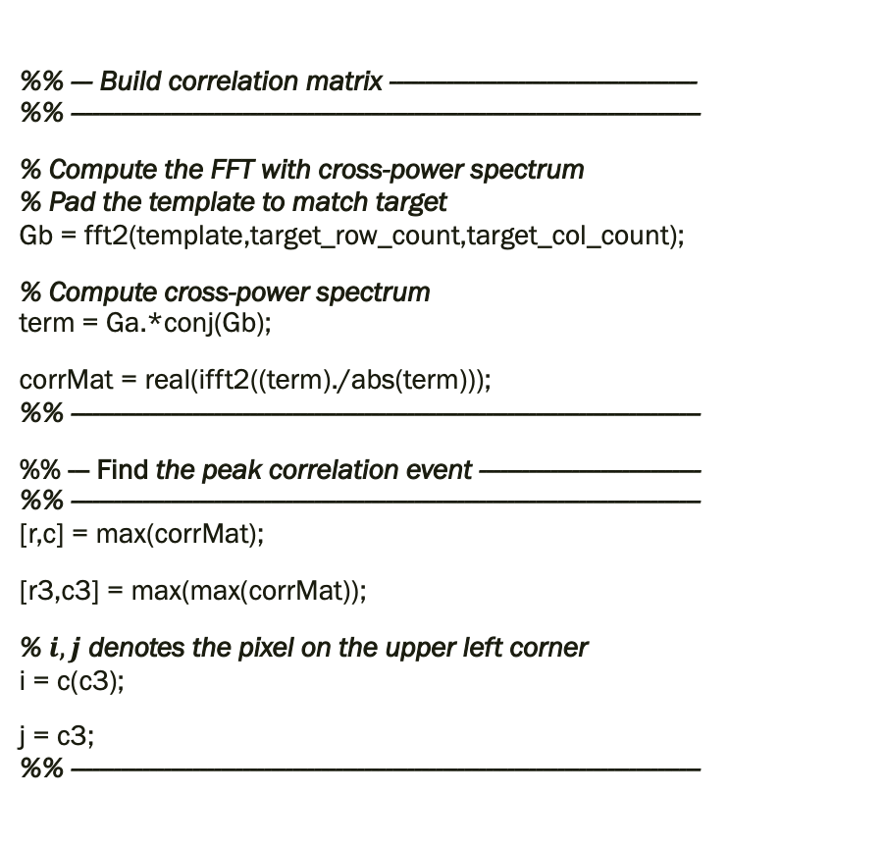
2D FFT with Cross-Power Spectrum Matlab algorithm
%% --- Build correlation matrix ------------------------------------------- %% ----------------------------------------------------------------------------------------
% Compute the FFT with cross-power spectrum % Pad the template to match target Gb = fft2(template,target_row_count,target_col_count);
% Compute cross-power spectrum term = Ga.*conj(Gb);
corrMat = real(ifft2((term)./abs(term))); %% ----------------------------------------------------------------------------------------
%% --- Find the peak correlation event ------------------------------- %% ---------------------------------------------------------------------------------------- [r,c] = max(corrMat);
[r3,c3] = max(max(corrMat));
% $i, j$ denotes the pixel on the upper left corner i = c(c3);
j = c3; %% ----------------------------------------------------------------------------------------

Slide 7
A little more about 2D FFT with Cross-Power Spectrum
In the Real World
This is how we detect whether an image is blurry.
Problem
Still has difficulty with new targets and templates while image resolution is low like what we used to find Waldo.
However, with real world examples, the cross-power spectrum transformations can be sensitive enough to pick up the templates even with some rotation, orientation, and scaling variation. Whereas for Waldo, we’re more likely to find anything resembling the stripes on his favorite shirt.

Slide 8
References
Swaroop, Sharma. “An Overview of Various Template matching Methodologies in Image Processing.” International Journal of Computer Applications. Vol 153 – No 10, November 2016. https://www.ijcaonline.org/archives/volume153/number10/swaroop-2016-ijca-912165.pdf
Reddy, Chatterji. “An FFT-Based Technique for Translation, Rotation, and Scale-Invariant Image Registration.” IEEE Transactions on Image Processing. Vol 5 – No 8, August 1996. https://ieeexplore.ieee.org/stamp/stamp.jsp?tp=&arnumber=506761

