Slide 1
Cubic darts Galactic Games: Fun in a Microgravity Environment!
FELLOW KIDS
Angyal Sándor
Fekete Adrián

Slide 2
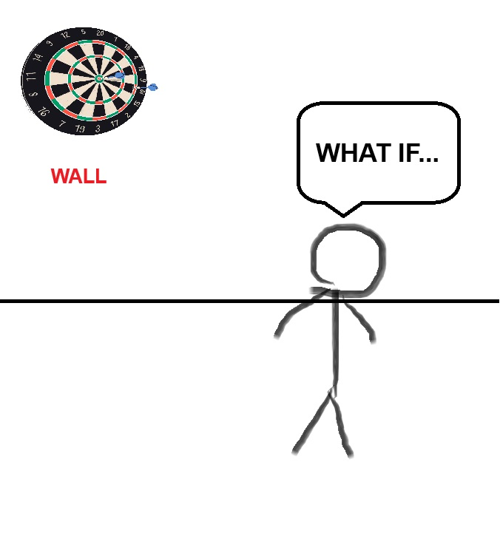
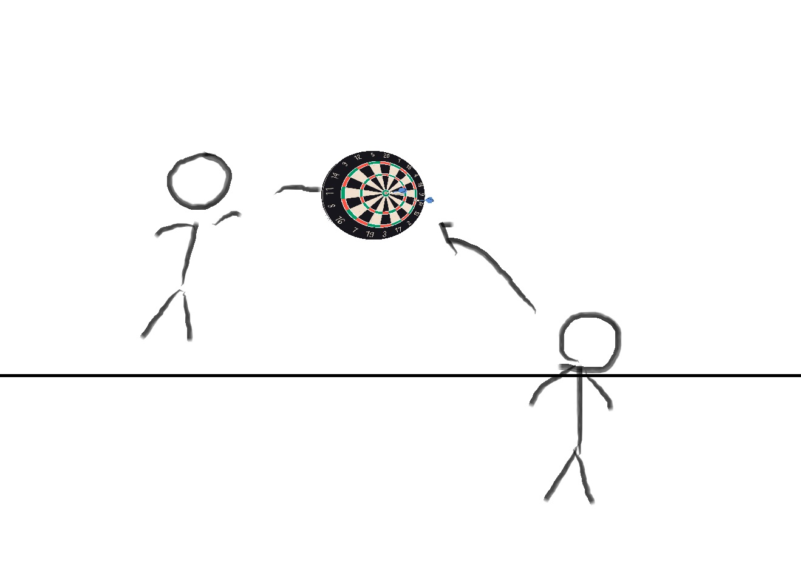
BASE IDEA

Slide 3
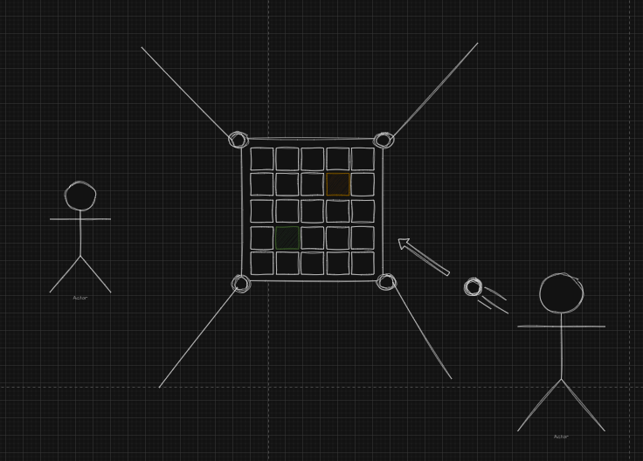
CUBIC DARTS
Two-person game
Microgravity friendly
Physical and mental activity

Slide 4
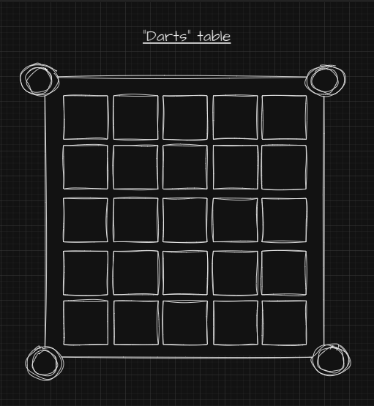
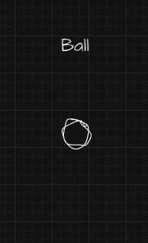
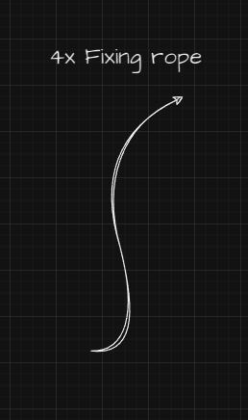
WHAT YOU NEED

Slide 5
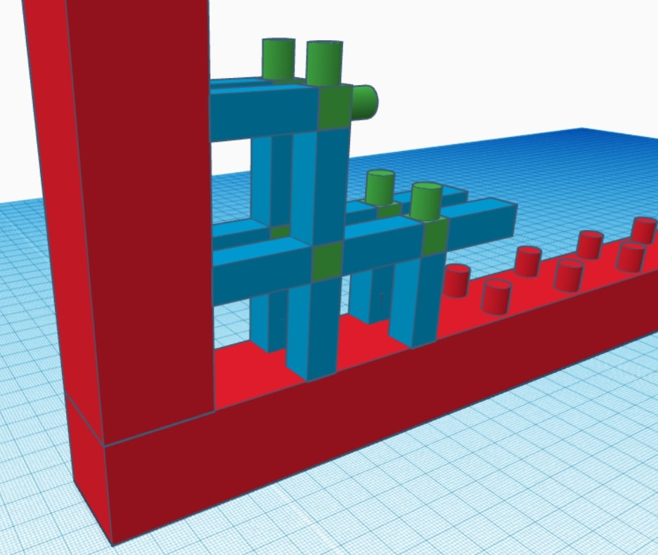
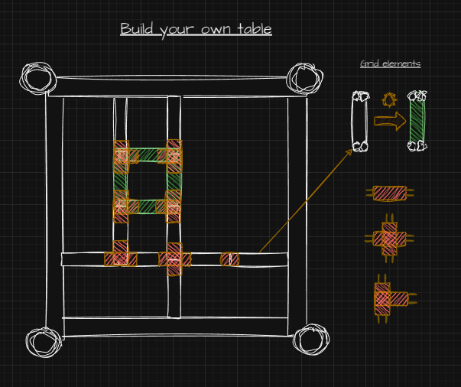
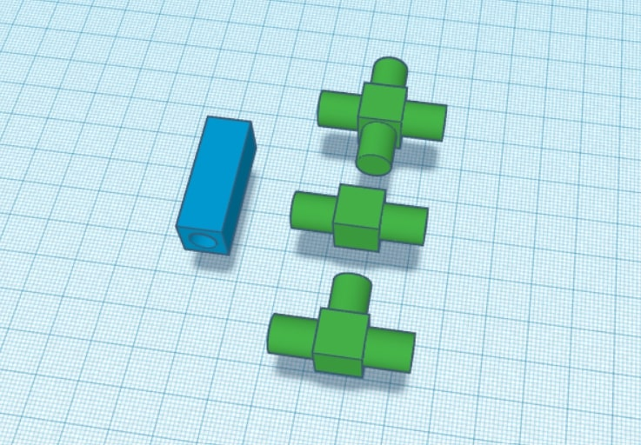
The table
Modular parts
Programmable
Compact

Slide 6
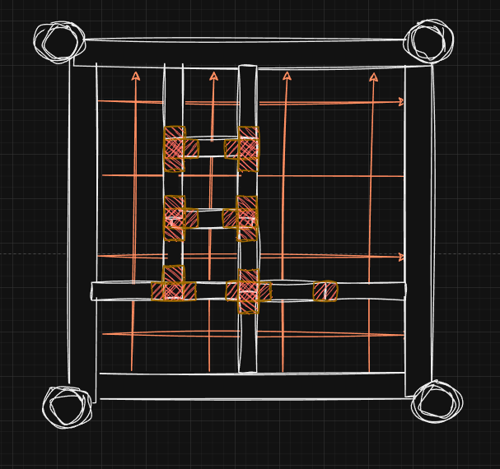
HOW IT WORKS
Laser-based sensing
Creative modes

Slide 7
BENEFITS
Team builder, stress management
Physical activity
Visual coordination development
Research on astronaut performance

