Slide 1
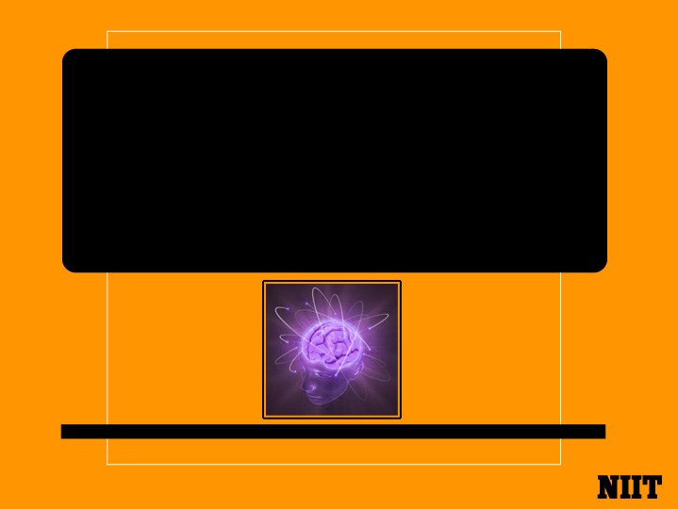
Introduction To Programming Using Python

Slide 2

Objectives
In this session, you will learn to:
Identify the Need for Writing Programs.
Explore Computer Hardware Architecture.
Understand Programming.
Converse with Python.
Notes:
In this session you will learn to identify the need to learn writing program and explore computer hardware architecture. You are going to understand programming and conversing with Python language.

Slide 3
Why Should You Learn to Write Programs?
Writing a program is a creative task.
Programs are written for different purposes, for instance
To automate Reservation System.
To automate Office Work Environment.
To automate Traffic Management System.
To automate Banking Transactions .
Computers are like “personal assistants” who take care of day to day tasks.
A program can be defined as a set of instructions given to a computer to achieve any objective.
Notes:
Writing programs is a very creative activity. We write the programs for many purpose which helps us to automate the task.
We are surrounded in our daily lives with computers ranging from PC, laptops to cell phones. We can think of these computers as our “personal assistants” which takes care of our day to day tasks.
The hardware of computers is built in such a manner which continuously ask us the question, “What would you like me to do next". Programmer add a set of applications to the hardware and instruct the hardware to do specific task.

Slide 4
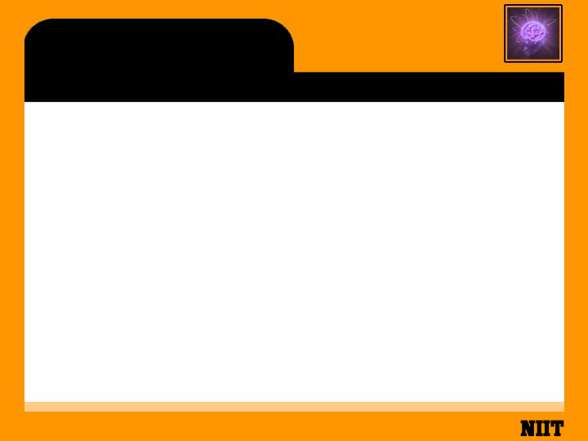
Computer Program
Computers are fast and have a huge amount of memory to store data.
Computers are helpful in automating any type of task related to day to day activities.
Tasks can be automated by giving instructions to the computers.
Instructions can be given to a computer by writing programs.
Repetitive tasks like counting words are very painful for humans, where as computers can do it easily with the help of programs.
Notes:
Our computers are fast and have vast amounts of memory which helps the computer to process and store the data. We manage our task inside the computer with the help of different software.
Software is collection of multiple programs and applications. Computer program is set of instructions implemented by computer programming language.
For example, If we look at the first three paragraphs of any book we are reading and want to count the most commonly used word. While we will be able to read and understand the words in a few seconds but counting them is almost painful because it is not the kind of problem that human minds are designed to solve. For a computer it is very simple job, Computer can complete this job in very less time.

Slide 5
Users Vs Programmers
Users use the tools available in a computer like word processor, spreadsheet and map, whereas programmers learn the computer language and develop those tools.
Programmers use software development tools available in a computer to develop software for the computer.
A Programmer may write the program to automate the task for himself or for any other client.
At the initial stage, there is no difference between a programmer and an end user.
But later, after learning programming language, the programmer can develop the software that can be utilized by end users.
Notes:
Computer or Personal Digital Assistant (PDA) usually contains many different programs from many different groups of programmers, each competing for the attention and interest of user. They try their best to meet our requirements and give us a great user experience in the process. In some situations, when we choose a piece of software, the programmers are directly compensated because of our choice.
In the beginning programmer and the end user of your programs are at same stage. As programmer gains programming skill and develop an ability to write the program.

Slide 6
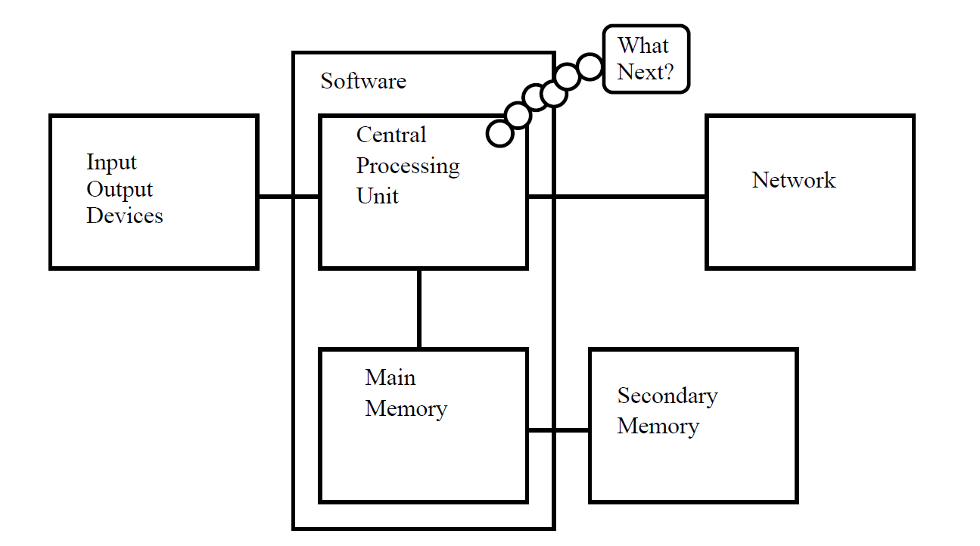
Computer Hardware Architecture
Computer Hardware Components
Notes:
Before Learning any programming language it is important for us to understand how computers are built. In general there are three main components of computer which takes care of INPUT, PROCESSING and OUTPUT.
Various Components of Computer Hardware:
Input Devices.
Output Devices.
Central Processing Unit.
Main Memory.
Secondary Memory.

Slide 7
Computer Hardware Architecture (Contd.)
Defining Computer Hardware Components
Components | Definition
Central Processing Unit[CPU] | It helps in processing the instructions.
Main Memory | It provides storage support during execution of any program in computer . Example: RAM
The Secondary Memory | It helps to store the data permanently inside the computer. Example: Disk drives , flash memory, DVD & CD
The Input and Output Devices | Input device helps user to generate any command or input any data. Output device helps user to get output from computer. Example : Mouse, Keyboard, Monitor & Printer etc.
Notes:
The Central Processing Unit (or CPU) is the part of the computer which helps in processing any task.
The Main Memory is used to store information during the execution of any program. The main memory is nearly as fast as the CPU. But the information stored in the main memory vanishes when the computer is turned off.
The Secondary Memory is also used to store information permanently, but it is much slower than the main memory. The advantage of the secondary memory is that it can store information even when there is no power to the computer. Examples of secondary memory are disk drives or flash memory (typically found in USB sticks and portable music players).
The Input and Output Devices are simply our screen, keyboard, mouse, microphone, speaker, touchpad, etc. They are all of the ways we interact with the computer.
These days, most computers also have a Network Connection to retrieve information over a network.

Slide 8
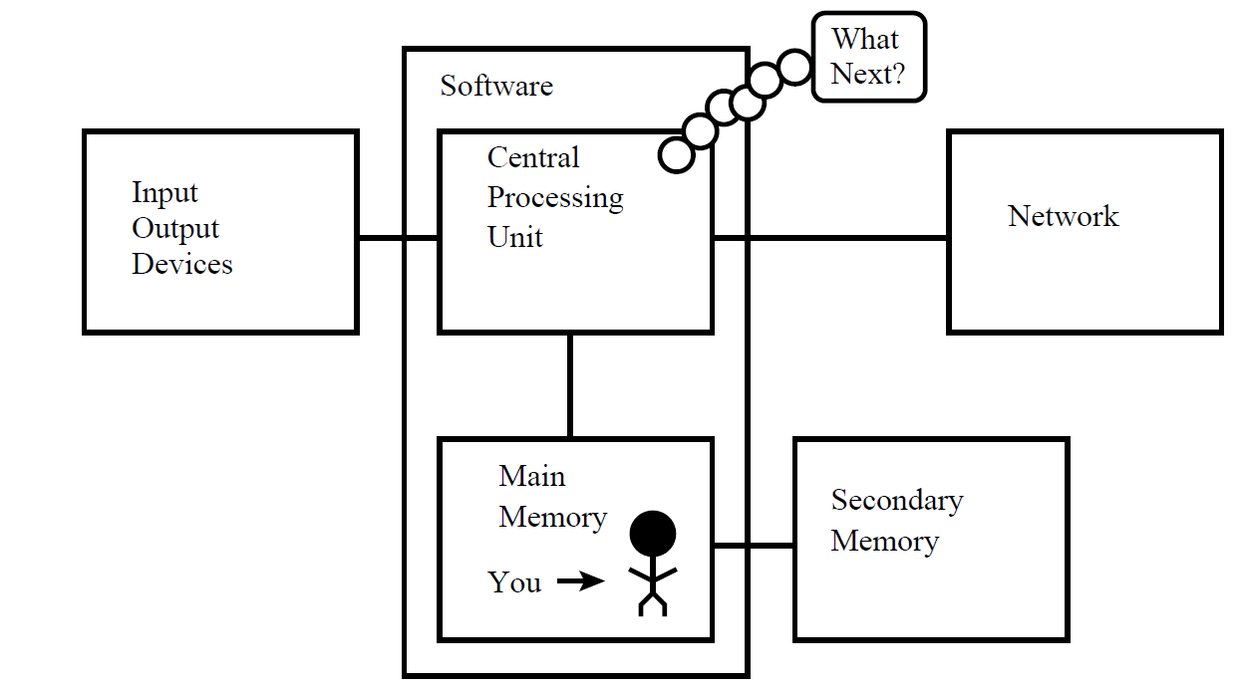
Programmer and Computer Hardware
Programmer needs to coordinate with each of these components to solve the problem.
The data need to be analyzed to arrive at a solution.
Program will mostly be “talking” to the CPU and instructing it what to do next.
Notes:
As a programmer, our job is to use and coordinate each of these components to solve the problem and get the solution.
As a programmer we will mostly be “talking” to the CPU and telling it what to do next. Sometimes we will instruct the CPU to use the main memory, secondary memory, network, or the input/output devices.
We need to be the person who answers the CPU’s “What next?” question. So instead, we must write down our instructions in advance. We call these stored instructions a program and the act of writing these instructions is programming.

Slide 9
Skills Required for Programming
There are two important skills required for programming.
Knowledge of the programming language
The vocabulary and the grammar of the language.
Construct well formed “sentences” in the new language.
Ability to “Tell a Story”
In writing a story, words and sentences need to be combined to convey required logic to the computer.
There is a skill and art in constructing the story and skill in story writing is improved by doing some writing and getting some feedback.
Notes:
We will try to turn you into a person who is skilled in programming. At the end you will be a programmer with the skills to look at any data/information and develop a program to solve the problem.
We need two skills to be a programmer.
First, we need to know the programming language Python. We need to know the vocabulary and the grammar. We need to be able to spell the words in this new language properly and know how to construct well formed “sentences” in this new language.
Second, we need to “tell a story”. In writing a story, we combine words and sentences to convey an idea to the reader. There is a skill and art in constructing the story. In programming, our program is the story and the problem we are trying to solve is the idea.
We will learn the vocabulary and sentences of Python quickly. It will take longer for us to be able to write coherent program to solve a new problem. First we write simple program then slowly we will write complex program over time.

Slide 10
Words and Sentences
Vocabulary are the reserved words that have very special meaning to Python.
Reserved words have one and only one meaning for Python.
A variable provides a named storage that the program can manipulate.
Variables can have any name, but Python reserved words cannot be used.
A sentence starts with a reserved word like ‘print’ followed by a string of text enclosed in single quotes.
Notes:
Python vocabulary is actually pretty small. We call this “vocabulary” the “reserved words”. These are words that have very special meaning to Python. When Python sees these words in a program, they have one and only one meaning to Python.
Later as we write programs we will make up our own words that have meaning to us called variables. We will have great latitude in choosing the names for variables, but we cannot use any of Python’s reserved words as a name for a variable.

Slide 11
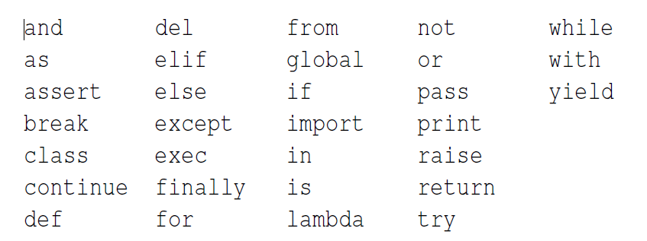
Words and Sentences (Contd.)
Reserved words in Python
Notes:
We will learn these reserved words and how they are used in forth coming session. We will now focus on Python language only. Our sentence starts with reserved word print followed by a string of text of our choosing enclosed in a single quotes.
A simple example of Python message
print ("Hello World")

Slide 12
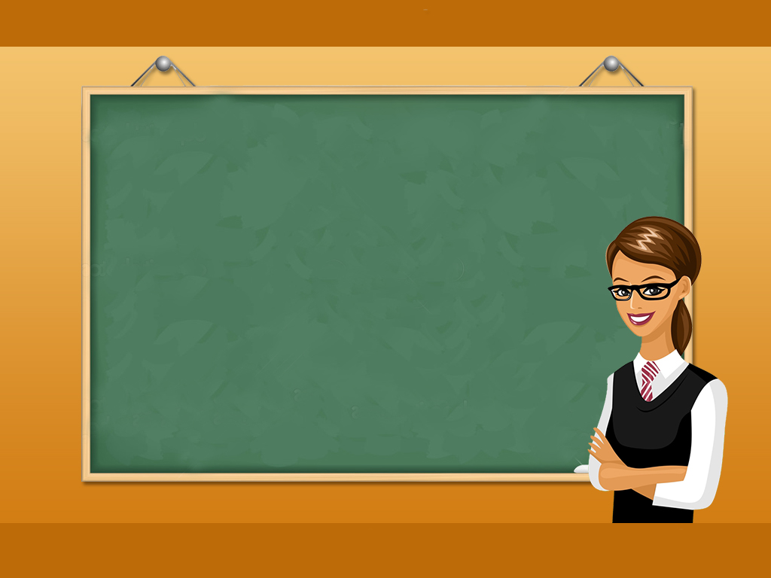
Just a Minute
To learn a programming language, ____________and __________ are required.

Slide 13
Just a Minute
To learn a programming language, ____________and __________ are required.
Answer:
Vocabulary and Grammar

Slide 14
Conversing with Python
To converse with Python, Python software must be installed on the computer.
The following link can be used to install Python. There are certain steps provided to install the python on various platforms.
http://www.pythonlearn.com/install.php
After successful installation, the terminal or command window opens and on typing ‘Python’, the Python interpreter will start executing in the interactive mode.
Notes:
Now that we have a word and a simple sentence that we know in Python, we need to know how to start a conversation with Python to test our new language skills.
Before you can converse with Python, we must first install the Python software on our computer and learn how to start Python on our computer. That is too much detail for this chapter so I suggest that you consult www.pythonlearn.com where I have detailed instructions and screencasts of setting up and starting Python on Macintosh and Windows systems. At some point, we will be in a terminal or command window and we will type python and the Python interpreter will start executing in interactive mode and appear somewhat as follows:
Python 2.6.1 (r261:67515, Jun 24 2010, 21:47:49)
[GCC 4.2.1 (Apple Inc. build 5646)] on darwin
Type "help", "copyright", "credits" or "license" for more information.
>>>
The >>> prompt is the Python interpreter’s way of asking us, “What do you want me to do next?” Python is ready to have a conversation with us. All we have to know is how to speak the Python language.

Slide 15
Activity
Activity : Displaying Hello World
Problem Statement:
Write a program in Python to print ‘Hello World’ on the display screen.
Hint: Use print() to display any content on the display screen.
Notes:
Solution:
In order to do this activity, you need to perform the following tasks:
Create a Python empty project.
Use print() to display ‘Hello World’ on the display screen.
Task 1: Create a Python empty project:
Step 1: Open NetBeans 8.0.2.
Step 2: Click File menu.
Step 3: Select New Project.
Step 4: Select Python from Categories list and Python Project from Projects list.
Step 5: Click Next button.
Step 6: On New Python Project dialog box set the Project Name as CR_Session01_Activity01.
Step 7: Select Project Location by clicking Browse button.
Step 8: Click Finish button.
Task 2: Use print() to display ‘Hello World’ on the display screen:
Step 1: Type the following code:
print("Hello World")
Step 2: Run the program.

Slide 16
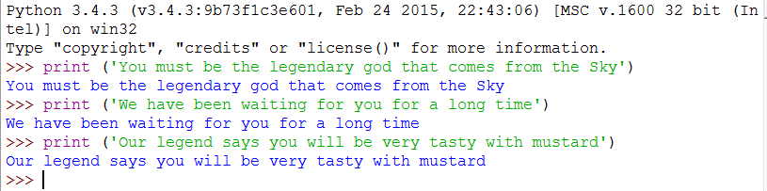
Conversing with Python (Contd.)
Example of a Python Program

Slide 17
Machine Language
Python is a high-level language like other high-level languages such as Java, C++, PHP, Ruby, Basic, and Perl etc.
The actual hardware inside the Central Processing Unit (CPU) does not understand any of these high-level languages.
The CPU understands a language which we call machine language.
Machine language is very complex and very tiresome to write because it is represented all in zero's and ones:
01010001110100100101010000001111
11100110000011101010010101101101
...
Notes:
Python is a high-level language intended to be relatively straightforward for humans to read and write and for computers to read and process. Other high-level languages include Java, C++, PHP, Ruby, Basic, Perl, JavaScript, and many more. The actual hardware inside the Central Processing Unit (CPU) does not understand any of these high-level languages. The CPU understands a language we call machine language. Machine language is very simple and frankly very tiresome to write because it is represented all in zeros and ones:
01010001110100100101010000001111
11100110000011101010010101101101

Slide 18
Machine Language(Contd.)
Machine language is tied to the computer hardware.
Machine language is not portable across different types of hardware.
Programs written in high-level languages can be moved between different computers by using a different interpreter.
To execute the program on a new machine with new hardware, the code need to be recompiled to create the machine language version of the program for the new Machine.
Notes:
Machine language seems quite simple on the surface, given that there are only zeros
and ones, but its syntax is even more complex and far more intricate than Python. So very few programmers ever write machine language. Instead we build various translators to allow programmers to write in high-level languages like Python or JavaScript and these translators convert the programs to machine language for actual execution by the CPU.
Since machine language is tied to the computer hardware, machine language is not
portable across different types of hardware. Programs written in high-level languages can be moved between different computers by using a different interpreter on the new machine or recompiling the code to create a machine language version of the program for the new machine.

Slide 19
Interpreter Vs Compiler
Programming language translators fall into two general categories:
1. Interpreters 2. Compilers
Interpreter reads the source code of the program, line by line, parses the source code, and interprets the instructions.
When Python is run interactively, Python processes every line immediately and is ready for next line.
When Python is run interactively, Python processes every line immediately and is ready for next line.
Notes:
These programming language translators fall into two general categories: (1) interpreters and (2) compilers.
An interpreter reads the source code of the program as written by the programmer, parses the source code, and interprets the instructions on the fly. Python is an interpreter and when we are running Python interactively, we can type a line of Python (a sentence) and Python processes it immediately and is ready for us to type another line of Python.
A compiler needs to be handed the entire program in a file, and then it runs a process to translate the high-level source code into machine language and then the compiler puts the resulting machine language into a file for later execution

Slide 20
Interpreter Vs Compiler (Contd.)
It is not easy to read or write machine language, so it is nice to have interpreters and compilers that allow codes to be written in high-level languages like Python or C
The Python interpreter is written in a high-level language called “C”.
The actual source code for the Python interpreter can be viewed in www.python.org.
So Python is a program itself and it is compiled into machine code
Notes:
It is not easy to read or write machine language, so it is nice that we have interpreters and compilers that allow us to write in high-level languages like Python or C.
Now at this point in our discussion of compilers and interpreters, we should be wondering a bit about the Python interpreter itself. What language is it written in? Is it written in a compiled language? When we type “python”, what exactly is happening?
The Python interpreter is written in a high-level language called “C”. We can look at the actual source code for the Python interpreter by going to www.python.org and working your way to their source code. So Python is a program itself and it is compiled into machine code. When you installed Python on our computer we copied a machine-code copy of the translated Python program onto your system. In Windows, the executable machine code for Python itself is likely in a file with a name like c:\Python27\python.exe.

Slide 21
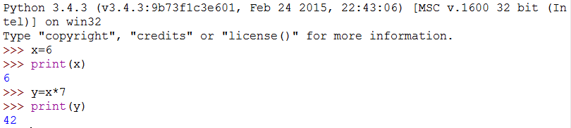
Sample Program
In the above program
x=6 [Assignment]
y=x*7 [Arithmetic Expression ]
print(y) [Printing Statement]
Notes:
Some of the lines of Python tell Python that we want it to remember some value for later. We need to pick a name for that value to be remembered and we can use that symbolic name to retrieve the value later. We use the term variable to refer to the labels we use to refer to this stored data.
>>> x = 6
>>> print x
6
>>> y = x * 7
>>> print y
42
>>>
In this example, we ask Python to remember the value six and use the label x so we can retrieve the value later. We verify that Python has actually remembered the value using print. Then we ask Python to retrieve x and multiply it by seven and put the newly computed value in y. Then we ask Python to print out the value currently in y.

Slide 22
What is a Program?
It is a basic sequence of Python statements that is executed to do a particular task.
Even one line can be a program in Python
Python script will have “.py” extension. So “Hello.py” is a Python script file
The Python language acts as an intermediator between the end user and the programmer
Notes:
When we want to write a program, we use a text editor to write the Python instructions into a file, which is called a script. By convention, Python scripts have names that end with ".py".
We call the Python interpreter and tell it to read its source code from the file “hello.py” instead of prompting us for lines of Python code interactively.
The definition of a program at its most basic is a sequence of Python statements. Even our simple hello.py script is a program. It is a one-line program and is not particularly useful, but in the strictest definition, it is a Python program.

Slide 23
Building Blocks of a Program
These are some of the conceptual patterns that are used to construct a program
Building Blocks | Descriptions
Input | Input will come from the user typing data on the keyboard.
Output | Display the results of the program on a screen or store them in a file.
Sequential Execution | Perform statements one after another in the order in which they are encountered in the script.
Conditional Execution | Check for certain conditions and then execute or skip a sequence of statements.
Repeated Execution | Perform some set of statements repeatedly, usually with some variation.
Reuse | Write a set of instructions once then reuse those instructions in the program.
Notes:
These are the some of the conceptual patterns that we use to construct a program.
Input
This might be reading data from a file, or even some kind of sensor like a microphone or GPS. Input will come from the user typing data on the keyboard.
Output
Display the results of the program on a screen or store them in a file or perhaps write them to a device like a speaker to play music or speak text.
Sequential Execution
Perform statements one after another in the order they are encountered in the script.
Conditional Execution
Check for certain conditions and then execute or skip a sequence of statements.
Repeated execution
Perform some set of statements repeatedly, usually with some variation.
Reuse
Write a set of instructions once and give them a name and then reuse those instructions as needed throughout your program.

Slide 24
Just a Minute
_________is used to execute the program statements line by line

Slide 25
Just a Minute
_________is used to execute the program statements line by line.
Answer:
Interpreter

Slide 26
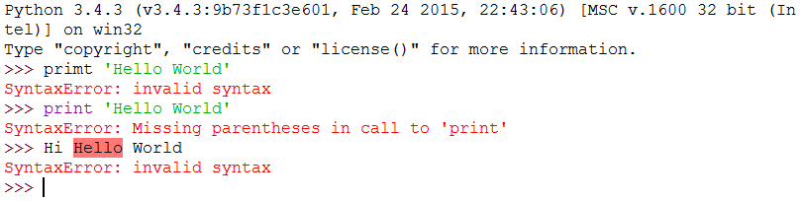
What Could Possibly Go Wrong?
In Python, when programs become increasingly sophisticated, the following types of errors can occur
1. Syntax Error 2. Logic Error 3. Semantic Error
Syntax Errors
A syntax error occurs when the “grammar” rules of Python are violated
The following example shows a syntax error
Notes:
Logic errors: A logic error is when your program has good syntax but there is a mistake in the order of the statements or perhaps a mistake in how the statements relate to one another.
Semantic errors: A semantic error is when your description of the steps to take is syntactically perfect and in the right order, but there is simply a mistake in the program. The program is perfectly correct but it does not do what you intended for it to do.

Slide 27
What Could Possibly Go Wrong? (Contd.)
Logic Errors
A logic error is when the program has good syntax but there is a mistake in the order of the statements.
The following are some of the instances which creates a logic error.
Using the wrong variable name
Indenting a block to the wrong level
Using integer division instead of floating-point division
Making a mistake in a boolean expression
Semantic Errors
A semantic error is when the description of the steps to take is syntactically perfect but the program does not do what it was intended to do.
Notes:
Logic errors: A logic error is when your program has good syntax but there is a mistake in the order of the statements or perhaps a mistake in how the statements relate to one another.
Semantic errors: A semantic error is when your description of the steps to take is syntactically perfect and in the right order, but there is simply a mistake in the program. The program is perfectly correct but it does not do what you intended for it to do.

Slide 28
Just a Minute
A ________ error is when your program has good syntax but there is a mistake in the order of the statements or perhaps a mistake in how the statements relate to one another.

Slide 29
Just a Minute
A ________ error is when your program has good syntax but there is a mistake in the order of the statements or perhaps a mistake in how the statements relate to one another.
Answer:
Logic Error

Slide 30
Summary
In this session, you learned:
Writing programs (or programming) is a very creative and rewarding activity. You can write programs for many reasons, ranging from making your living to solving a difficult data analysis problem, to having fun, to helping someone else solve a problem.
Computer hardware architecture involves various components to execute and define a particular task.
Every programming language has a vocabulary and Grammar.
Interpreter executes code line by line, where as compiler executes the code as a whole.
Program is a set of instructions used to execute a particular task.
There are three types of errors : Syntax, Semantic and Logic Errors.

