Slide 1

Flow of control & String Data Type

Slide 2

Objectives
In this session, you will learn to:
Update variable values.
Use looping constructs.
Define strings.
Implement predefined methods in string.
Implement format operator.

Slide 3
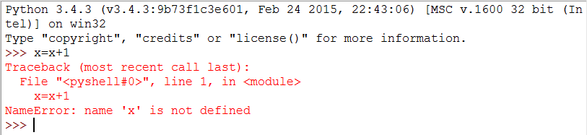
Updating Variable Value
To update value in a variable, it must be first declared with a value.
Code Throws error, because the value of “x” is not declared in the program.
Notes:
A common pattern in assignment statements is that it updates a variable where the new value of the variable depends on the previous assigned data
x = x+1
The above line means “get the current value of x, add 1, and then update x with the new value.” There is an compilation error, If we try to update a variable that does not exists.
Note: Python evaluates the expression from Right to Left.

Slide 4
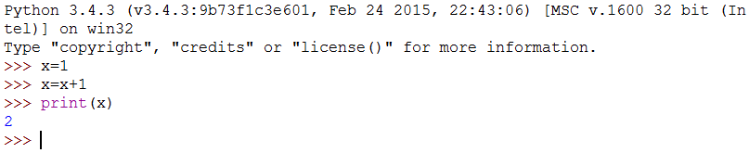
Updating Variable Value(Contd.)
Code works fine, since the value is declared before the updation of the variable
Notes:
Points to Remember:
To use variables in a program,
It must be declared with value assigned(static) or input from the user (dynamic)
Necessary calculation to be done based on the assigned value.

Slide 5
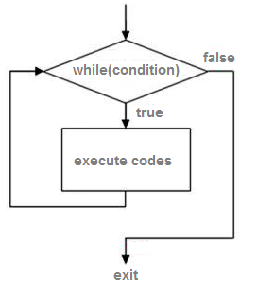
While Statement
While Loop is used to execute a set of instructions for a specified number of times until the condition becomes False.
1. Working of While Loop
Evaluate the condition, yielding True or False.
If the condition is false, exit the while statement and continue execution at the next statement.
If the condition is true, execute the body and then go back to step 1.
Notes:
To implement Iterative Programming we use the concept of Loops. Loop constructs are used to execute one or more lines of code again and again.
The while loop construct executes a block of statements till the condition given in the while loop holds true. The while statement always checks the condition before executing the statements within the loop.
When the execution reaches the last statement in the while loop, the control is passed back to the beginning of the loop. If the condition still holds true, the statements within the loop are executed again. The execution of the statements within the loop continues until the condition evaluates to false.

Slide 6
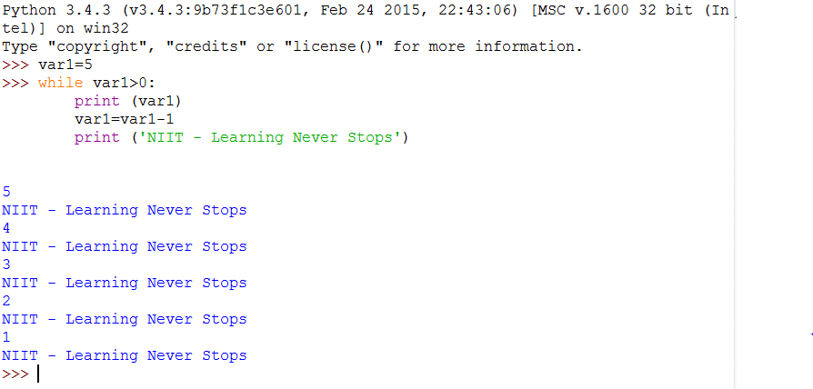
While Statement (Contd.)
Syntax:
While Condition:
statements;
Applying syntax to program
Notes:
Example Program for a while Loop:
Var1=5 //declaring variable var1 with the value 5
While var1>0 //condition : var1>0 , checks if the value of var1 is greater than Zero
print(var1) //prints the value of var1 if it is condition is true
var1=var1-1 //decrements the current value of var1
print(‘NIIT – Learning Never Stops’)
The message “‘NIIT – Learning Never Stops’ gets printed for every iteration and loop stops when the value of the var1 becomes 0. The condition (0>0) becomes fail and loop stops executing.

Slide 7

Just a Minute
Predict the output of the following code:
n = 2
while n >= 10:
if n%2==0:
print n
n = n+1

Slide 8
Just a Minute
Predict the output of the following code:
n = 2
while n >= 10:
if n%2==0:
print n
n = n+1
Answer:
2,4,6,8,10
Notes:
Solution:
2,4,6,8,10

Slide 9

Infinite Loops
Sequence of instructions in a computer program which loops endlessly.
Known as an endless loop or unproductive loop.
.
Reasons:
Loop having no terminating condition.
Having Condition that can never be satisfied
Condition that causes the loop to start over.
Notes:
An infinite loop also known as an endless loop or unproductive loop is a sequence of instructions in a computer program which loops endlessly.
The reason for this can be following
Loop having no terminating condition.
Having Condition that can never be met.
Condition that causes the loop to start over.

Slide 10
Infinite Loops (Contd.)
Example:
-1
-2
-3
-4
-5
-6
-7
-8
-9
-10
-11
-12
-13
.
.
.
>>> var1=-1
>>> while var1<0:
print(var1)
var1=var1-1
Condition will be always true, since the value of var1 is decrementing every time
Output
Notes:
In the above program we kept the condition as var1<0 which will be always true as value of var1 is decremented for every iteration and hence the loop will be infinite.

Slide 11
Infinite Loops (Contd.)
Solution to an infinite loop
Use break Statement.
The break statement is used to exit from the loop.
The break statement prevents the execution of the remaining loop.
while True:
line = raw_input('> ')
if line == 'done':
break
print line
print 'Done!'
Output:
>hello there
hello there
> finished
finished
> done
Done!
Output
Notes:
For example, suppose we want to take input from the user until they type done as given below :
while True:
line = raw_input('> ')
if line == 'done':
break
print line
print 'Done!‘
The loop condition is True, which is always true, so the loop runs repeatedly until it hits the break statement.
Each time through, it prompts the user with an angle bracket. If the user types done, the break statement exits the loop. Otherwise the program echoes whatever
the user types and goes back to the top of the loop.

Slide 12
Finishing Iterations with Continue
Continue Statement
Used to skip all the subsequent instructions and take the control back to the loop.
Sub-bullet1
Sub-bullet2
while True:
line = raw_input('> ')
if line[0] == '#' :
continue
if line == 'done':
break
print line
print 'Done!'
> hello there
hello there
> # don't print this
> print this!
print this!
> done
Done!
Output
Notes:
Continue returns the control to the beginning of the while loop. It rejects all the remaining statements in the current iteration of the loop and moves the control back to the top of the loop.
In the above program all the lines are printed except the one that starts with the hash sign because whenthe continue is executed, it ends the current iteration and jumps back to the while statement to start the next iteration, thus skipping the print statement.

Slide 13
Just a Minute
The __________statement is used to exit from the loop and ________ statement is used to skip instructions and take control to the beginning of the loop.

Slide 14
Just a Minute
The __________statement is used to exit from the loop and ________ statement is used to skip instructions and take control to the beginning of the loop.
Answer:
break and continue

Slide 15
Definite Loops Using “for”
Used to execute a block of statements for a specific number of times.
Used to construct a definite loop.
Syntax:
for <destination> in <source>
statements
print <destination>
Notes:
Sometimes we want to loop through a set of things such as a list of words, the lines in a file, or a list of numbers. When we have a list of things to loop through, we can construct a definite loop using a for statement.
We call the while statement an indefinite loop because it simply loops until some condition becomes False, whereas the for loop is looping through a known set of items so it runs through as many iterations as there are items in the set.
The syntax of a for loop is similar to the while loop in that there is a for statement and a loop body

Slide 16
Definite Loops Using “for” (Contd.)
Example :
Output
Happy New Year: Joseph
Happy New Year: Glenn
Happy New Year: Sally
Done!
friends = ['Joseph', 'Glenn', 'Sally']
for friend in friends:
print 'Happy New Year:', friend
print 'Done!'
Notes:
In the above example for and in are reserved Python keywords, and friend and friends are variables.
In particular, friend is the iteration variable for the for loop. The variable friend changes for each iteration of the loop and controls when the for loop completes. The iteration variable steps successively through the three strings stored in the friends variable.

Slide 17
Loop Patterns
Loops are generally used
To iterate a list of items.
To view content of a file.
To find the largest and smallest data.
These Loops are Constructed by:
1.Initializing one or more variables
2.Performing some computation on each item in the loop body
3.Looking at the resulting variables when the loop completes
Notes:
we use a for or while loop to go through a list of items or the contents of a file and we are looking for something such as the largest or smallest value of the data we scan through. These loops are generally constructed by:
1.Initializing one or more variables before the loop starts.
2.Performing some computation on each item in the loop body, possibly changing the variables in the body of the loop.
3.Looking at the resulting variables when the loop completes

Slide 18
Counting and Summing Loops
Example : To find the number of items in a list, the following loop is to be used.
Output : 154
total = 0
for itervar in [3, 41, 12, 9, 74, 15]:
total = total + itervar
print 'Total: ', total
Notes:
In the above program, we use the iteration variable. We add the actual number (3, 41, 12, etc.) to the running total during each loop iteration. So before the loop starts total is zero because we have not yet seen any values, during the loop total is the running total, and at the end of the loop total is the overall total of all the values in the list.
As the loop executes, total accumulates the sum of the elements; a variable used this way is sometimes called an accumulator

Slide 19
Maximum and Minimum Loops
Example : To find min and max of the given numbers in the list.
smallest = None
for itervar in [3, 41, 12, 9, 74, 15]:
if smallest is None or itervar < smallest:
smallest = itervar
print 'Smallest:', smallest
largest = None
for itervar in [3, 41, 12, 9, 74, 15]:
if largest is None or itervar > largest :
largest = itervar
print 'Largest:', largest
Output
3
3
41
72
Notes:
Explanation:
To find Largest Number:
Before the loop starts, the largest value is None. While the loop is executing, if largest is None then we take the first value we see as the largest so far. We can see in the first iteration when the value of itervar is 3, since largest is None, we immediately set largest to be 3.
After the first iteration, largest is no longer None, so the second part of the compound logical expression that checks itervar > largest triggers only when we
see a value that is larger than the “largest so far”. When we see a new “even larger” value we take that new value for largest. We can see in the program output that
largest progresses from 3 to 41 to 74.
At the end of the loop, we have scanned all of the values and the variable largest now does contain the largest value in the list
To Find Smallest Number:
It is same as finding the maximum number in the list. The condition is itervar<smallest.

Slide 20
Activity
Activity : Implementing Loop
Problem Statement:
Write a program which repeatedly reads numbers until the user enters “done”. Once “done” is entered, print out the total, count, and average of the numbers. If the user enters anything other than a number, detect their mistake using try and except and print an error message and skip to the next number.
For Example, executing the program will look as follows:
Enter a number: 4
Enter a number: 5
Enter a number: bad data
Invalid input
Enter a number: 7
Enter a number: done
16 3 5.33333333333
Hint: Use while loop to accept values from user until the user enters “done”.
Notes:
Solution:
In order to do this activity, you need to perform the following tasks:
Create a Python empty project.
Use while loop to accept user’s input and calculate the average.
Task 1: Create a Python empty project:
Step 1: Open NetBeans 8.0.2.
Step 2: Click File menu.
Step 3: Select New Project.
Step 4: Select Python from Categories list and Python Project from Projects list.
Step 5: Click Next button.
Step 6: On New Python Project dialog box set the Project Name as CR_Session05_Activity01.
Step 7: Select project Location by clicking Browse button.
Step 8: Click Finish button.
Task 2: Use while loop to accept user’s input and calculate the average:
Step 1: Type the following code:
total = 0
count = 0
while ( True ) :
inp = input("Enter a number: ")
if inp == "done" :
break
try:
value = float(inp)
except:
print(“bad data")
continue
total = total + value
count = count + 1
average = total / count
print(total)
print(“ “)
print(count)
print(“ "+str(average))
Step 2: Run the program.

Slide 21
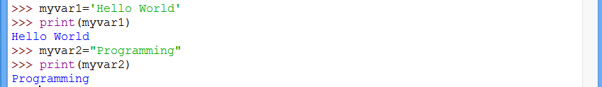
Define String
A string is a sequence of characters .
Single quotes or double quotes are used to represent strings.
Example : A Simple String representation
Notes:
Strings is the most popular types in Python. We can create them simply by enclosing characters in quotes. Python treats single quotes the same as double quotes. Creating strings is as simple as assigning a value to a variable.
1.Using Single Quotes : Myvar1=‘Hello World’
2.Using double quotes : Myvar1=“Hello World”
We can’t use single quotes when a string contains special character like “ ’ ” [Single quotes]. For example :
Myvar1=‘This is Ajay’s Book’
The above statement will give an error as there is a special character “ ’ “ is there. So this type of statement can be written using double quotes.
Myvar1=“This is Ajay’s Book”

Slide 22

Accessing a String
String Representation in memory:
Address/Index
To access the a character from a particular string in the following way.
>>> stdname='Gagan'
>>> letter=stdname[2]
>>> print(letter)
Output
g
Notes:
Python does not support a character type; these are treated as strings of length one, thus also considered a substring.
To access substrings, use the square brackets for slicing along with the index or indices to obtain your substring.

Slide 23
Special String Operators
Table : Special Operators used in String
Operator | Description | Example[ Assume a=“Hello”, b=“Python”]
+ | Concatenation - Adds values on either side of the operator | a + b will give HelloPython
* | Repetition - Creates new strings, concatenating multiple copies of the same string | a*2 will give -HelloHello
[] | Slice - Gives the character from the given index | a[1] will give e
[ : ] | Range Slice - Gives the characters from the given range | a[1:4] will give ell
in | Membership - Returns true if a character exists in the given string | H in a will give 1
not in | Membership - Returns true if a character does not exist in the given string | M not in a will give 1

Slide 24
Traversing a String
Starts at the beginning
Selects each character in turn
Compute Logic
Continue iteration till end of string
Example :
Output
G
e
o
r
g
e
>>> index=0
>>> stdname='George'
>>> while index<len(stdname):
letter=stdname[index]
print(letter)
index=index+1
Notes:
A lot of computations involve processing a string one character at a time. Often they start at the beginning, select each character in turn, do something to it, and continue until the end. This pattern of processing is called a traversal. One way to write a traversal is with a while loop:
This loop traverses the string and displays each letter on a line by itself. The loop condition is index < len(stdname), so when index is equal to the length of the string, the condition is false, and the body of the loop is not executed. The last character accessed is the one with the index len(stdname)-1, which is the last character in the string.

Slide 25
Just a Minute
In Python, Strings starts with Index ____________.

Slide 26
Just a Minute
In Python, Strings starts with Index ____________.
Answer:
Zero

Slide 27
Built-in String Methods
Table : Built in String Methods
SL NO | METHOD NAME | DESCRIPTION
1 | capitalize() | Capitalizes first letter of string
2 | isupper() | Returns true if string has at least one cased character and all cased characters are in uppercase and false otherwise.
3 | istitle() | Returns true if string is properly "titlecased" and false otherwise.
4 | len(string) | Returns the length of the string
5 | lower() | Converts all uppercase letters in string to lowercase.
6 | lstrip() | Removes all leading whitespace in string.
7 | upper() | Converts lowercase letters in string to uppercase.
8 | split(str="", num=string.count(str)) | Splits string according to delimiter str (space if not provided) and returns list of substrings; split into at most num substrings if given.
Notes:
There are number of built in string methods are provided by the python which we can use when we writing the string manipulation related programs.

Slide 28
String Comparison
Strings can be compared using == operator.
CASE (I) CASE(II)
>>> fruit1="Apple"
>>> fruit2="Apple"
>>> if fruit1==fruit2:
print("Both are equal")
>>> fruit1="Apple"
>>> fruit2="Mango"
>>> if fruit1!=fruit2:
print("Both are not equal")
Output
Both are equal
Both are not equal
Notes:
In the above example we have used the “==“ and “!=“ operator . When we are using “==“ operator there is no output as both strings are not equal and in the next both the string are checked with “!=“ operator then it shows the output.

Slide 29
Format Operator
“%” operator allows to construct strings , replacing parts of the strings with the data stored in variables.
“%” operator will work as modulus operator for strings.
“%” operator works as a format operator if the operand is string.
Example
>>> fruits=20
>>> 'There are %d fruits in the basket ' %fruits
'There are 20 fruits in the basket '
Notes:
The format operator, % allows us to construct strings, replacing parts of the strings with the data stored in variables. When applied to integers, % is the modulus operator. But when the first operand is a string, % is the format operator. The first operand is the format string, which contains one or more format sequences that specify how the second operand is formatted. The result is a string.

Slide 30
Activity
Activity : Manipulating String
Problem Statement:
Write a program to prompt any statement with punctuation characters, print the statement after removing all the punctuation characters in lower case by separating individual words.
Hint: Use translate() and lower().
Notes:
Solution:
In order to do this activity, you need to perform the following tasks:
Create a Python empty project.
Use translate() to remove punctuation characters from line.
Use lower() to transform characters in lower case.
Task 1: Create a Python empty project:
Step 1: Open NetBeans 8.0.2.
Step 2: Click File menu.
Step 3: Select New Project.
Step 4: Select Python from Categories list and Python Project from Projects list.
Step 5: Click Next button.
Step 6: On New Python Project dialog box set the Project Name as CR_Session07_Activity01.
Step 7: Select project Location by clicking Browse button.
Step 8: Click Finish button.
Task 2: Use translate() to remove punctuation characters from line, use lower() to transform characters in lower case:
Step 1: Type the following code:
import string
print(string.punctuation)
line=raw_input("Enter any statement with punctuations: ")
line = line.translate(None, string.punctuation)
line = line.lower()
words = line.split()
print(words)
Step 2: Run the program.

Slide 31
Activity
Activity : Slicing the String
Problem Statement:
Write a program to accept the following Python code that stores a string:
str = 'X-DSPAM-Confidence: 0.8475'
Use find and string slicing to extract the portion of the string after the colon character and then use the float function to convert the extracted string into a floating point number.
Hint: Use split() and float().
Prerequisite: For this activity please refer “mbox-short.txt” available in “Data_File_For_Students” folder.
Notes:
Solution:
Prerequisite: For this activity you need to use mbox-short.txt which is available with Data_File_For_Students.
In order to do this activity, you need to perform the following tasks:
Create a Python empty project.
Use split() to split a line into words.
Use continue to continue if condition does not satisfy.
Task 1: Create a Python empty project:
Step 1: Open NetBeans 8.0.2.
Step 2: Click File menu.
Step 3: Select New Project.
Step 4: Select Python from Categories list and Python Project from Projects list.
Step 5: Click Next button.
Step 6: On New Python Project dialog box set the Project Name as CR_Session05_Activity02.
Step 7: Select project Location by clicking Browse button.
Step 8: Click Finish button.
Task 2: Use split() to split a line into words, use continue to continue if condition does not satisfy:
Step 1: Type following code:
str1 = 'X-DSPAM-Confidence: 0.8475'
words = str1.split()
if len(words)!= 2:
exit()
if words[0]!= "X-DSPAM-Confidence:":
exit()
try:
conf = float(words[1])
except:
print("Not a float number.")
print("Spam confidence:"+ str(conf))
Step 2: Run the program.

Slide 32
Summary
In this session you have learned to:
Update variable values.
Use looping constructs.
Define strings.
Implement predefined methods in string.
Implement format operator.

