Slide 1

Working with Files and Exceptions

Slide 2

Objectives
In this session, you will learn to:
Identify the Need of “Data Persistence” in Program.
Open, Read and Write Contents to the File.
Search Content in a File.
Handle Errors in Python.

Slide 3
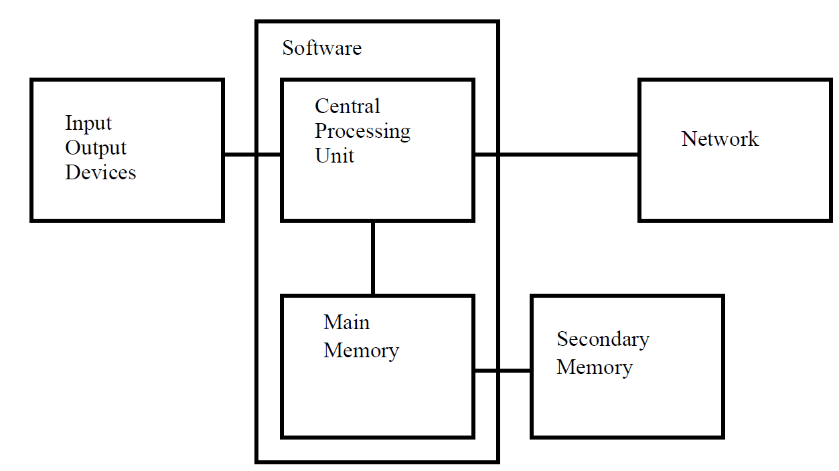
Data Persistence
once the power
is turned off, data stored in CPU or main memory is erased
Secondary
Memory[Files] is not erased even when the power is turned off
Notes:
The CPU and memory are where our software works and runs. Once the power is turned off, anything stored in either the CPU or main memory is erased. However, the Secondary memory is not erased even when the power is turned off. To store data in Secondary memory, the Files are used. Reading and Writing are two important operations to access or retrieve data from the files and store data to the files respectively. Persistence is the ability of an object to store in a permanent location like file or database.

Slide 4




Data Persistence (Contd.)
Persistence is the ability to store data as an object in a permanent location such as a File or a Database.
Writing to a file
Writing to a database
Notes:
Persistence is the ability of an object to store in a permanent location like file or database. In this Chapter we are going to discuss about how to make the data persistent using files.

Slide 5
Data Persistence (Contd.)
File is used to save the data permanently on a disk.
File is a collection of data stored on a disk with a specific name and directory path.
File
Read Data
Write Data
Search Data
Notes:
All programs accept input from a user, process the input, and produce an output. Therefore, all the programming languages support the input and output operations. For example, you need to develop a program for teachers to accept the result information of the students. Your program should save this information in the Result.xls file on the hard disk. You can use the file input and output operations in the program to accept the result from teachers and save it in the file. For information to save permanently on a disk, you can use a file. The file is a collection of data stored on a disk with a specific name and directory path.

Slide 6
Opening Files
File must be opened before reading or writing content.
Syntax:
If the Open command is successful, OS returns a file handle.
If the file does not exists, it fails with a trace back.
open(‘filename’)
Notes:
Opening the file is must before reading or writing Contents. When we open the file it will communicate with our operating system which knows where the data for each file stored.
If the open is successful, the operating system returns us a file handle. The file handle is not the actual data contained in the file, but instead it is a “handle” that we can use to read the data. We are given a handle if the requested file exists and the proper permissions to read the file.

Slide 7
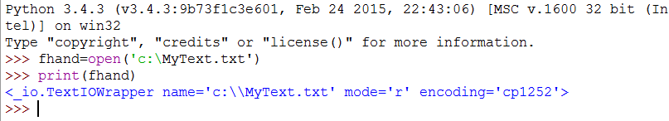
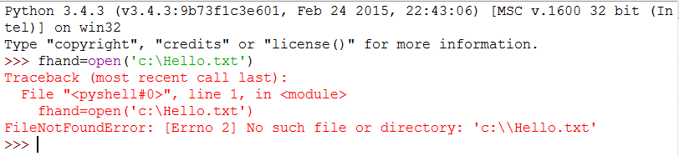
Opening Files (Contd.)
Case (i) : File Exists
Case(ii) : File do not Exists
Notes:
If the file does not exist, open will fail with a traceback and we will not get a handle to access the contents of the file.

Slide 8
Text Files and Lines
Text file
Is treated as a sequence of lines.
“\n” represents the newline character in Python.
It can also be used in text file to represent new line.
Example:
>>> text='Hello\n World!'
>>> print(text)
Output
Hello
World!
Notes:
A Text ﬁle is a Sequence of Lines. To break the ﬁle into lines, there is a special character that represents the “end of the line” called the new line character. Backslash-n (\n)represents the newline character in Python.

Slide 9
Reading Files
Example: Code to Read Data from a File.
fhand = open('mbox.txt')
count = 0
for line in fhand:
count = count + 1
print 'Line Count:', count
For loop
Used as a file handle
Counts the number of lines
Reads only one line at a time
Efficiently read and Count lines in large files
Prints 5, if the file contains 5 lines
Notes:
While the file handle does not contain the data for the file, it is easy to construct a for loop read through and count each of the lines in a file.
We can use the file handle as the sequence in our for loop. Our for loop simply counts the number of lines in the file and prints them out.
When the file is read using a for loop in this manner, Python takes care of splitting the data in the file into separate lines using the newline character. Python reads each line through the newline and includes the newline as the last character in the line variable for each iteration of the for loop.

Slide 10
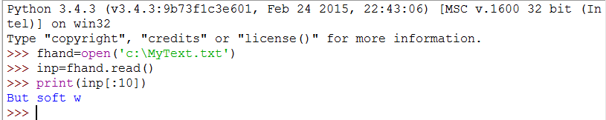
Reading Files (Contd.)
Example : Use string slicing to print out the ﬁrst specific. number of. characters.
Prints 10 Characters from the file Hence the Output is “But soft w” (Space is also considered as character)
Notes:
In the above program, We use string slicing to print out the first 20 characters of the string data stored in inp. When the file is read in this manner, all the characters including all of the lines and newline characters are one big string in the variable inp.

Slide 11
Searching Data in a File
To Search Data
Use if – to specify the conditions.
Use starts with – to specify the exact match required.
Output:
From: stephen.marquard@uct.ac.za
From: louis@media.berkeley.edu
From: zqian@umich.edu
From: rjlowe@iupui.edu
fhand = open('mbox-short.txt')
for line in fhand:
if line.startswith('From:') :
print line
Notes:
When you are searching through data in a file, it is a very common pattern to read through a file, ignoring most of the lines and only processing lines which meet a particular condition. We can combine the pattern for reading a file with string methods to build simple search mechanisms.
If we wanted to read a file and only print out lines which started with the prefix “From:”, we could use the string method starts with to select only those lines with the desired prefix. The output looks great since the only lines we are seeing are those which start with “From:”, but we can see some extra blank lines.
We can remove the extra blank lines using rstrip() method as given below :
fhand = open('mbox-short.txt')
for line in fhand:
line=line.rstrip()
if line.startswith('From:') :
print line

Slide 12
Searching Data in a File (Contd.)
find()
Used to simulate a text editor search that ﬁnds lines wherever the search string is found.
File1.txt
Ramesh@gmail.com
George@outlook.com
Yadav@outlook.com
Shwetha@gmail.com
Parul@yahoo.co.in
>>> fhand=open('E:\\File1.txt')
>>> for line in fhand:
line=line.rstrip()
if line.find('@gmail')==-1:
continue
print (line)
Contents of the file
Output
Ramesh@gmail.com
Shwetha@gmail.com
Notes:
We can use the find string method to simulate a text editor search that finds lines here the search string is anywhere in the line. Since find looks for an occurrence of a string within another string and either returns the position of the string or -1 if the string was not found.
The above program will find the string where "@gmail" appears

Slide 13
Searching Data in a File (Contd.)
Dynamically accept the file name from the user.
File1.txt
Ramesh@gmail.com
George@outlook.com
Yadav@outlook.com
Shwetha@gmail.com
Parul@yahoo.co.in
fname = raw_input('Enter the file name: ')
fhand = open(fname)
count = 0
for line in fhand:
if line.startswith('Subject:') :
count = count + 1
print 'There were', count, 'subject lines in', fname
Contents of the file
Enter the file name : file1.txt
There were 5 Subject lines in file1.txt
Output
Notes:
We can read the file name from the user using raw_input() method if python version below 3 and if it above 3 then we can use input() method. The above program shown as per version 3.4.3.

Slide 14
Writing to a File
write()
It is used to write Content to the file.
To write, File must be opened with the mode “w”.
If the file does not exists, it will create the file and write the data to the file.
If the file exists, the existing data will be overwritten.
Syntax:
fileobj.write(“data”)
>>> fout = open('output.txt', 'w')
>>> print fout
>>> line1 = "This here's the wattle,\n"
>>> fout.write(line1)
output.txt
This here’s the wattle
Notes:
To write a file, we have to open it with mode 'w' as a second parameter. If the file already exists opening it in write mode will clear old data. The write() method is used to write the content to the file. The method will take string as a parameter. The write() method will be called on file handler. Once the writing done we have to close the file. To close the file we need use close() method which also be called on file handler.
To write a file, we have to open it with mode 'w' as a second parameter.
If the file already exists opening it in write mode will clear old data.
The write() method is used to write the content to the file.
The write() method will take string as a parameter.
The write() method will be called on file handler.
Once the writing done we have to close the file.
To close the file we need use close() method which also be called on file handler.

Slide 15

Just a Minute
To read and write data from a file, the mode should be _____and ______.

Slide 16
Just a Minute
To read and write data from a file, the mode should be _____and ______.
Answer:
r and w

Slide 17
Activity
Activity : Opening and Reading Text File
Problem Statement:
Write a program to accept file name from the user and display all the lines containing “Subject:” as first word.
Here is a sample execution of the program:
Enter the file name: mbox-short.txt
There were 27 subject lines in mbox-short.txt
Prerequisite: For this activity please refer to mbox.txt available in “Data_File_For_Students” folder.
Notes:
Solution:
Prerequisite: For this activity you need to use mbox.txt which is available with Data_File_For_Students.
In order to do this activity, you need to perform the following tasks:
Create an empty Python project.
Use open() to open any text file.
Use statswith() to check each line whether starts with specified string or not.
Task 1: Create a Python empty project:
Step 1: Open NetBeans 8.0.2.
Step 2: Click File menu.
Step 3: Select New Project.
Step 4: Select Python from Categories list and Python Project from Projects list.
Step 5: Click Next button.
Step 6: On New Python Project dialog box set the Project Name as CR_Session07_Activity02.
Step 7: Select project Location by clicking Browse button.
Step 8: Click Finish button.
Task 2: Use open() to open any text file,
Task 3: Use statswith() to check each line whether starts with specified string or not:
Step 1: Type the following code:
fname = raw_input("Enter the file name: ")
fhand = open(fname)
count = 0
for line in fhand:
if line.startswith("Subject:") :
count = count + 1
print("There were "+ str(count)+ " subject lines in "+ fname)
Step 2: Run the program.

Slide 18
Handling Exceptions
An Exception is an event, which occurs during the execution of a program that stops the normal flow of the program's instructions.
When Python script raises exception it must either handle or terminate.
Exceptions are handled using the try and except keywords.
Syntax:
Type I :[with exception parameter] Type II: [Without Exception parameter]
try
//Code
except Exception 1:
// error message
except Exception 2:
// error message
else
// success message
try
//Code
except :
// error message
except :
// error message
else
// success message
Notes:
Python provides very important features to handle any unexpected error in our Python programs and to add debugging capabilities.
An exception is an event, which occurs during the execution of a program that stops the normal flow of the program's instructions. Python script encounter a situation that it cannot cope with. It raises an exception.
When Python script raises exception it must either handle or it terminate To handle exception Python provides certain keywords like try and except

Slide 19
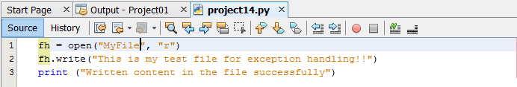
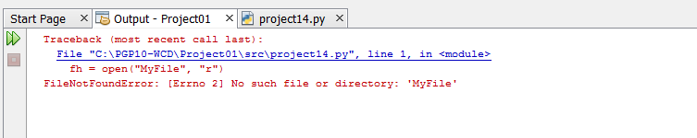
Handling Exceptions (Contd.)
Example : Implementing a Code without Exception Handling.
The above code throws error, which could not be handled by Python Script
Notes:
Example
In the above example we have written code which does not have any implementation of exception handling code. Here we have written we have open the file “MyFile” using “r” mode i.e read mode and we are trying to write the content to the file which is an exception. Hence the program when it is executed then it has stopped and displayed the error message as displaying in output screen.

Slide 20
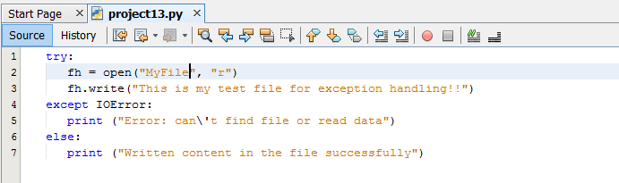

Handling Exceptions (Contd.)
Example : Implementing same code with Exception Handling.
Appropriate error message using try and except keywords
Notes:
Example
In the above example we have written code which is now have implementation of exception handling code. Here we have written code snippet to open the file “MyFile” using “r” mode i.e read mode and we are trying to write the content to the file which is an exception. Hence the program when it is executed then it has executed except: block and print the message “Error can’t find file or read data”.

Slide 21
Handling Exceptions (Contd.)
It is also possible to handle multiple exceptions using single “except” statement.
Syntax:
try
//Code
except (Exception1,[Exception2,[…ExceptionN]]):
// error message
else
// success message
Notes:
We can also use the except statement with multiple exception defined. This type of statement catches all exception which are defined in the except clause.

Slide 22
Just a Minute
To handle errors, we should use _____and ______ keywords.

Slide 23
Just a Minute
To handle errors, we should use _____and ______ keywords.
Answer:
try and except

Slide 24
Activity
Activity : I/O Operation with Exception Handling
Problem Statement:
Modify the program that prompts the user for the file name so that it prints a funny message when the user types in the exact file name “na na boo boo”. The program should behave normally for all other files which exist or does not exist.
Here is a sample execution of the program:
Enter the file name: mbox.txt
There were 1797 subject lines in mbox.txt
Enter the file name: missing.tyxt
File cannot be opened: missing.tyxt
Enter the file name: na na boo boo
NA NA BOO BOO TO YOU - You have been punk'd!
Prerequisite: For this activity please refer to mbox.txt available inside “Data_File_For_Students” folder.
Notes:
Solution:
Prerequisite: For this activity you need to use mbox.txt which is available with Data_File_For_Students.
In order to do this activity, you need to perform the following tasks:
Create a Python empty project.
Use try-except to check for existence of the file.
Task 1: Create a Python empty project:
Step 1: Open NetBeans 8.0.2.
Step 2: Click File menu.
Step 3: Select New Project.
Step 4: Select Python from Categories list and Python Project from Projects list.
Step 5: Click Next button.
Step 6: On New Python Project dialog box set the Project Name as CR_Session08_Activity01.
Step 7: Select project Location by clicking Browse button.
Step 8: Click Finish button.
Task 2: Use try-except to check for existence of the file:
Step 1: Type the following code:
fname = raw_input("Enter the file name: ")
if fname == "na na boo boo" :
print("NA NA BOO BOO TO YOU - You have been punkd!")
exit()
try:
fhand = open(fname)
except:
print("File cannot be opened:"+ fname)
exit()
count = 0
for line in fhand:
if line.startswith("Subject:") :
count = count + 1
print("There were"+ str(count)+ "subject lines in"+ fname)
Step 2: Run the program.

Slide 25
Summary
In this session, you have learned :
The need of “Data Persistence” in Program.
File Handling using the read() and write() methods.
Search data in a file using methods startswith() and find().
Exception handling using the try and except clause.

