Slide 1

List and Dictionaries

Slide 2

Objectives
In this session, you will learn to use:
List.
Understanding List Operations and Methods.
Parsing Lines.
Implementing Objects, Values and Arguments.
Use Dictionaries Functions and Methods.
Differences between Lists and Dictionaries.
Notes:
In this session you will learn to introduction to list , understand the list operation and methods of list , parsing of the lines , object and values and list of arguments. You will also learn to use dictionary , function and methods of dictionary and also difference between lists and dictionaries.

Slide 3
List
Most versatile datatype available in python.
Defined as a sequence of values.
Holds Homogenous set of items.
Indices start at 0.
Lists are Mutable.
Example:
>>>list1=[17,119]
>>>list[1]=90
>>>print list1
[17,90]
>>>list1=[10,20,30,40]
>>>list2=['Harish','Suresh','Kunal','Girish’]
Notes:
List is a most versatile datatype available in python. It is defined as a sequence of values.
List contain values with comma separated between two square brackets. All the items of the list should be of the same type. List indices start at 0.
There are several ways to create a new list. The simplest is to enclose the elements in square brackets.
Example
>>>list1=[10,20,30,40]
>>>list2=['Harish','Suresh','Kunal','Girish]
List that contains no elements is called an empty list. We can create an empty list using empty brackets [].
Example
>>>empty1=[]
Here empty1 is the empty list which does not contain any elements. List are mutable because we can change the order of the items. We can reassign an element in a list.

Slide 4
Traversing List
Traversing means visiting all the elements in the list.
Traversing is required to Search, Update and Delete values from List.
>>>numbers=[10,20,30,40]
>>>for i in range(len(numbers)):
numbers[i]=numbers[i]*2
print(numbers[i])
>>>dept=[‘IT',‘CSE',‘ECE',‘CSE']
>>>for d in dept
print (d)
IT
CSE
ECE
CSE
Output
20
40
60
80
Notes:
The common way to traverse the elements of a list with for loop.

Slide 5
List Operations & Slices
Examples
>>>a=[1,2,3]
>>>b=[4,5,6]
>>>c=a+b
>>>print(c)
Output : [1,2,3,4,5,6]
>>>a=[10,20,30]
>>>a*2
Output:
[10,20,30,10,20,30]
>>> alpha=['a','b','c','d','e','f']
>>> alpha[1:3]
Output :['b', 'c‘]
Operators used in list
+ - used to concatenate the list.
* - used to repeat a list for a number of times.
: - used to check a range of characters.
Notes:
List respond to the "+" operator much like strings they mean concatenation.
Example
>>>a=[1,2,3]
>>>b=[4,5,6]
>>>c=a+b
>>>print(c)
[1,2,3,4,5,6]
In the above example when list a and b has been added and stored in c. Then c has displayed the elements of a and b by concatenating.
List respond to the "*" operator for repeats a list a given number of times.
Example
>>>a=[10,20,30]
>>>a*4
[10,20,30,10,20,30,10,20,30,10,20,30]
In the above example when list a is multiplied by 4 then the elements of list a is printed for four times.
Slice operator also work on lists. Using this operator we can see certain range of characters also.
>>> alpha=['a','b','c','d','e','f']
>>> alpha[1:3]
['b', 'c']
>>> alpha[:4]
['a', 'b', 'c', 'd']
>>> alpha[3:]
['d', 'e', 'f']
>>> alpha[:]
['a', 'b', 'c', 'd', 'e', 'f']
In the above example first alpha[1:3] will displayed the 1st index to until 3rd index. Then in the next alpha[:4] will show the elements from 0th index to until 4th index. Then in the next alpha[3:] will displayed last three elements of the list. And in alpha[:] will display whole list.

Slide 6
List Methods
The following methods are used in Python for manipulating the list:
Method Name | Description
append() | This method is used to add a new element to the end of a list.
extend() | This method is used to take a list as an argument and appends all the elements.
sort() | This method is used to arrange the elements of the list from low to high.
Example
>>> mylist=['A','B','C']
>>> mylist.append('D')
>>> print (mylist)
['A', 'B', 'C', 'D']
Notes:
Python provides methods that operate on lists.
The following are some of the methods which are used for manipulating the list.
append()- This method is used to add a new element to the end of a list.
Example
>>> mylist=['A','B','C']
>>> mylist.append('D')
>>> print (mylist)
['A', 'B', 'C', 'D']
>>>
extend() Method - This method is used to take a list as an argument and appends all the elements.
Example
>>> mylist1=['A','B','C']
>>> mylist2=['D','E']
>>> mylist1.extend(mylist2)
>>> print(mylist1)
['A', 'B', 'C', 'D', 'E']
>>>
sort() -This method is used to arrange the elements of the list from low to high.
Example
>>> mylist1=['D','C','E','B','A']
>>> mylist1.sort()
>>> print(mylist1)
['A', 'B', 'C', 'D', 'E']

Slide 7
List Methods (Contd.)
There are several ways to delete elements from a list.
Ways | Description
pop() method | It modifies the list and returns the element that was removed. If we don't provide an index value then it deletes the last element and returns the value.
del operator | If we do not want to retain the value which we have deleted using an index then we need to use the del operator.
remove() method | If we know the element to be removed then we can use the remove() method.
Example
>>> mylist1=['A','B','C']
>>> element=mylist1.pop(1)
>>> print(mylist1)
['A', 'C']
Notes:
There are several ways to delete elements from a list.
Using pop() method - If we know the index of the element we want we can use pop().
Example
>>> mylist1=['A','B','C']
>>> element=mylist1.pop(1)
>>> print(mylist1)
['A', 'C']
>>> print(element)
B
>>>
pop() modifies the list and returns the element that was removed. If we don't provide an index value then it deletes the last element and returns the value.
Using del operator - If we do not want to retain the value which we have deleted using an index then we need to use del operator.
Example
>>> mylist1=['A','B','C']
>>> del mylist1[1]
>>> print(mylist1)
['A', 'C']
>>>
In the above example we have deleted the 1st index element i.e 'B' from the list.
Using remove() method- If we know the element to be removed then we can use remove() method.
Example
>>> mylist1=['A','B','C']
>>> mylist1.remove('B')
>>> print(mylist1)
['A', 'C']
In the above example we have used remove() method to remove the element 'B' from list.

Slide 8
List Functions
There are a number of built in functions that can be used on lists.
Function Name | Description
sum() | Using this function we can add the elements of the list. It will work only with the numbers.
min() | Using this function we can find the minimum value from the list.
max() | Using this function we can find the maximum value from the list
len() | Using this function we can find the number of elements in the list.
Example
>>> numbers=[10,20,30,40,50]
>>> print(len(numbers))
5
>>> print(max(numbers))
50
Notes:
There are number of built in functions that can be used on lists that allow you to quickly look through a list without writing your own loops.
The below is a small example of using these built in functions.
Examples:
>>> numbers=[10,20,30,40,50]
>>> print(len(numbers))
5
>>> print(max(numbers))
50
>>> print(min(numbers))
10
>>> print(sum(numbers))
150
>>> print(sum(numbers)/len(numbers))
30.0
>>>
From these functions sum() function will work with only numbers. But other functions like max(),len(),min() etc will work with list of strings and other types that can be comparable

Slide 9
String and Its Methods
String Is a sequence of characters.
Methods in Strings
list() is used to convert a string to list of characters.
split() is used to break the string into list of words.
split() takes an optional argument called delimiter which specifies the word boundaries.
>>> str='I am studying in NIIT'
>>> t=str.split()
>>> print(t)
['I', 'am', 'studying', 'in', 'NIIT']
Notes:
A string is sequence of characters.A list is sequence of values of any type.
list() method is used to convert a string to list of characters.
Example
>>> str='NIIT'
>>> ele=list(str)
>>> print ele
['N', 'I', 'I', 'T']
split() method is used to break the string into list of words
Example
>>> str='I am studying in NIIT'
>>> t=str.split()
>>> print(t)
['I', 'am', 'studying', 'in', 'NIIT']
split() method takes and optional argument called delimiter which specifies the word boundaries. A delimiter is a character which differentiate between one word to another in the below example the character "," is separating the words.
Example
>>> str='Harish,Sridhar,Kishore'
>>> delimiter=','
>>> str.split(delimiter)
['Harish', 'Sridhar', 'Kishore']
join() method is the inverse of split. It takes a list of strings and concatenates the elements.join() is a string method.
Example
>>> str=['Delhi','Mumbai','Chennai','Kolkata']
>>> delimiter='-'
>>> delimiter.join(str)
'Delhi-Mumbai-Chennai-Kolkata'
In the above code str list contains four city names with comma separated. Using join() method it will.This method will be executed using a delimiter.

Slide 10
Parsing of Lines
Parsing means, dividing a string into tokens based on some delimiters.
It is used to find a particular word from a file or search a pattern
Example Code:
fhand = open(‘MyText.txt')
for line in fhand:
line = line.rstrip()
if not line.startswith('From ') :
continue
words = line.split()
print words[2]
Contents of MyText.txt
From stephen.marquard@uct.ac.za
Sat Jan 5 09:14:16 2008
Output:
Sat
Notes:
Usually when we are reading a file we want to do something to the lines other than just printing the whole line. Often we want to find the a criteria based line and then parse the line to find some interesting part of the line. For example if we wanted to print out the day of the week from those lines that start with “From ”?
From stephen.marquard@uct.ac.za Sat Jan 5 09:14:16 2008
The split method is very effective when faced with this kind of problem. We can write a small program that looks for lines where the line starts with “From ”, split those lines, and then print out the third word in the line:
fhand = open(‘MyText.txt')
for line in fhand:
line = line.rstrip()
if not line.startswith('From ') :
continue
words = line.split()
print words[2]
The program produces the following output:
Sat

Slide 11
Activity
Activity : Understanding Collection Operations
Problem Statement:
Write a menu based program to insert , remove, sort, extend, reverse and traverse a list of items.
Hint: Define functions to perform different operation of list, such as insertList() and removeList() etc.
Notes:
Solution:
In order to do this activity, you need to perform the following tasks:
Create a Python empty project.
Use while() to create the menu.
Use append(), remove(), extend(), sort(), reverse() to perform list operation.
Task 1: Create a Python empty project:
Step 1: Open NetBeans 8.0.2.
Step 2: Click File menu.
Step 3: Select New Project.
Step 4: Select Python from Categories list and Python Project from Projects list.
Step 5: Click Next button.
Step 6: On New Python Project dialog box set the Project Name as CR_Session08_Activity02.
Step 7: Select project Location by clicking Browse button.
Step 8: Click Finish button.
Task 2: Use while() to create the menu, use append(), remove(), extend(), sort(), reverse() to perform list operation:
Step 1: Type the following code:
def insertList(nameList):
item=raw_input("Enter an item to the list: ")
nameList.append(item)
def removeList(nameList):
item=raw_input("Enter an item you want to remove from the list: ")
nameList.remove(item)
def sortList(nameList):
nameList.sort()
def showList(nameList):
for item in nameList:
print(item)
def extendList(nameList):
nameList1=[23,34,35]
nameList.extend(nameList1)
def reverseList(nameList):
nameList.reverse()
def quitList():
exit()
nameList=[]
while("true"):
print("1. Insert an item into List.")
print("2. Remove an item from List.")
print("3. Sort items of List.")
print("4. Extend List.")
print("5. Reverse List.")
print("6. Display items from List.")
print("7. Quit.")
numC=raw_input("Enter your option: ")
num=int(numC)
if(num==1):
insertList(nameList)
elif(num==2):
removeList(nameList)
elif(num==3):
sortList(nameList)
elif(num==4):
extendList(nameList)
elif(num==5):
reverseList(nameList)
elif(num==6):
showList(nameList)
elif(num==7):
quit()
Step 2: Run the program.

Slide 12
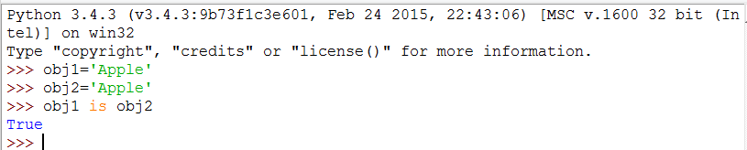
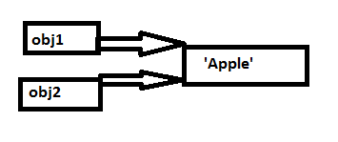
Objects & Values
In python every data is represented as an Object.
Example:
In the preceding example, obj1 and obj2 are pointing to the same string hence they are identical.
Notes:
We know that obj1 and obj2 both refer to a string, but we don't know whether they refer to the same string. To check whether two variables refer to the same object we need to use is operator.
To check whether two variables refer to the same object, we can use the is operator. In the above program we have used the same and we received the output as True. Hence both the objects are pointing to the same string so they are identical

Slide 13
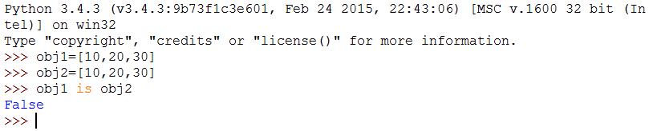
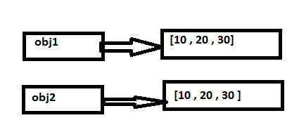
Objects & Values (Contd.)
Example:
In the preceding example obj1 and obj2 are pointing to the same values hence they are equivalent . But they are not identical.
Notes:
In this case we would say that the two lists are equivalent, because they have the same elements, but not identical, because they are not the same object. If two objects are identical, they are also equivalent, but if they are equivalent, they are not necessarily identical.
Until now, we have been using “object” and “value” interchangeably, but it is more precise to say that an object has a value. If you execute obj1 = [10,20,30], obj1 refers to a list object whose value is a particular sequence of elements. If another list has the same elements, we would say it has the same value.

Slide 14
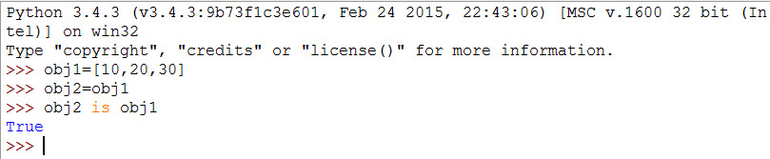
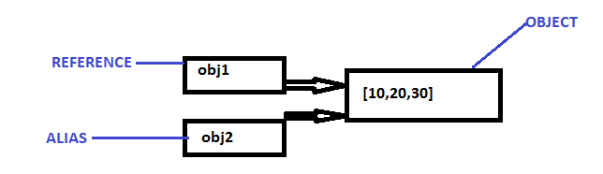
Aliasing
The association of a variable with an object is called a reference.
An object with more than one reference, has more than one name and is called as aliasing.
Notes:
Aliased object is mutable then changes made with one alias affect the other. This behavior can be useful at the same time error-prone.
It is safer to avoid aliasing when we are working with mutable object. String is an immutable object where aliasing is not a problem.

Slide 15
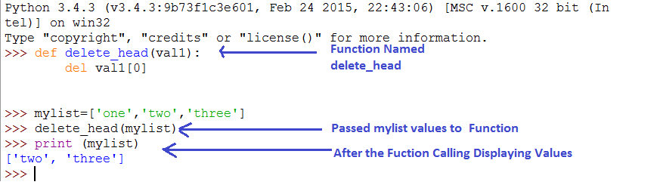
List Arguments
List can be passed as an argument to a function.
Passing a list as an argument to a function gets the reference of the list.
Notes:
When you pass a list to a function, the function gets a reference to the list. If the function modifies a list parameter, the caller sees the change. In the above example, delete_head() method removes the first element from a list.
The parameter val and the variable mylist are aliases for the same object.

Slide 16

Just a Minute
_____ method is used to break the string into list of words.
Notes:
Solution:
Split

Slide 17
Just a Minute
_____ method is used to break the string into list of words.
Answer:
split
Notes:
Solution:
Split

Slide 18

Introduction to Dictionary
Dictionary
It is a “bag” of values, each with its own label.
It contains the values in the form of key-value pair.
Every value in Dictionary is associated with a key.
tissue
candy
perfume
calculator
money
Notes:
A dictionary is like a list, but more general. In a list, the index positions have to be integer but in a dictionary, the indices can be (almost) any type.
We can think of a dictionary as a mapping between a set of indices (which are called keys) and a set of values. Each key maps to a value. The association of a key and a value is called a key-value pair or sometimes an item.
The function dict() creates a new dictionary with no items. Because dict() is the name of a built-in function, we should avoid using it as a variable name.

Slide 19
Characteristics of Dictionary
Dictionaries are Python’s most powerful data collection.
Dictionaries allow us to do fast database-like operations in Python.
Dictionaries have different names in different languages.
Associative Arrays - Perl / PHP.
Properties or Map or HashMap – Java.
Property Bag - C# / . NET.
Dictionary Keys can be of any Python data type.
Because keys are used for indexing, they should be immutable.
Dictionary Values can be of any Python data type.
Values can be mutable or immutable.

Slide 20
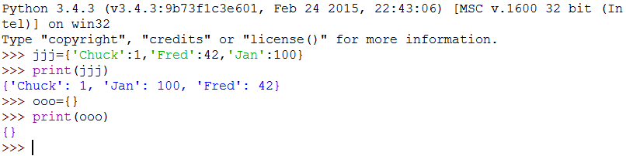
Creating a Dictionary
Dictionary literals use curly braces and have a list of key-value pairs.
You can make an empty dictionary using empty curly braces
Example of a Dictionary
Notes:
The curly brackets, {}, represent an empty dictionary. To add items to the dictionary, we can use square brackets.
In the above program we have “jjj” variable is a dictionary which is having 3 values. And “ooo” variable does not have any values and hence an empty dictionary

Slide 21
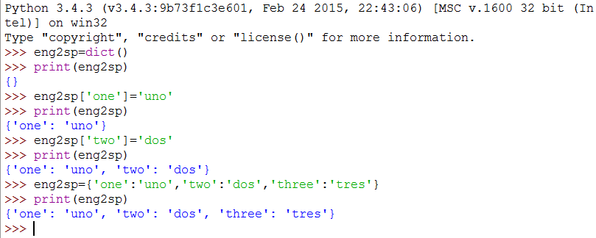
Creating a Dictionary (Contd.)
Lists index their entries based on the position in the list.
In general, the order of items in a dictionary is unpredictable.
Dictionaries are indexed by keys.
Example:
Notes:
The function dict creates a new dictionary with no items. Because dict is the name of a built-in function, you should avoid using it as a variable name.
>>>eng2sp=dict()
>>>print eng2sp
The curly brackets, {}, represent an empty dictionary. To add items to the dictionary, you can use square brackets:
>>>eng2sp['one']='uno'
This line creates an item that maps from the key ’one’ to the value 'uno'. If we print the dictionary again, we see a key-value pair with a colon between the key and value:
>>>print eng2sp
{'one':'uno'}
This output format is also an input format. For example, you can create a new dictionary with three items:
>>>eng2sp={'one':'uno','two':'dos','three':'tres'}
When we print the may be the following output
>>>print eng2sp
{'one':'uno','three':'tres','two':'dos'}
The order of the key-value pairs is not the same. If we type the same example on another computer we might get other results. So in general the order of items of dictionary is unpredictable.

Slide 22
Methods of Dictionary
S.No | Method Name | Description
1 | dict.clear() | Removes all elements of the dictionary ”dict”
2 | dict.copy() | Returns a shallow copy of dictionary ”dict”
3 | dict.fromkeys(seq[, value]) | Returns a new dictionary with keys from a supplied seq and values all set to specified value
4 | dict.get(key, default=None) | Returns value of given key or returns default if key not in dictionary.
5 | dict.has_key(key) | Returns true if key in dictionary ”dict” false otherwise
6 | dict.items() | Returns a list of (key, value) tuple pairs from dictionary “dict”
7 | dict.keys() | Returns list of keys from dictionary “dict”
8 | dict.setdefault(key, default=None) | Similar to get(), but will set dict[key]=default if key is not already in “dict”
9 | dict.update(dict2) | Adds dictionary ”dict2” key-values pairs to ”dict”
10 | dict.values() | Returns list of values from dictionary ”dict”.
Notes:
The above slide shows the different methods for working with dictionary.
Example
copy() Method
The following example shows the usage of copy() method.
>>>dict1={'Name':'Harish','Age':29}
>>>dict2=dict1.copy()
>>>print('New Dictionary:',str(dict2))
The output will be displayed like the following
New Dictionary: {'Age':29,'Name':'Harish'}

Slide 23

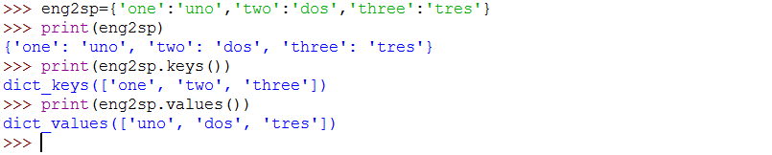
Keys and Values
The keys() method returns a list of the keys in a dictionary.
The values() method returns a list of the values.
Notes:
Properties of Dictionary Keys
Dictionary values have no restrictions. They can be any arbitrary python object either standard objects or user-defined objects. There are two important points to remember about dictionary keys.
1.More than one entry per key not allowed. Which means no duplicate key is allowed. When duplicate keys encountered during assignment.
2.Keys must be immutable. Which means you can use strings, numbers or tuples as dictionary keys but something like ['key'] is not allowed.
keys() method
- This method keys() returns a list of all the available keys in the dictionary.
values() method
- The method values() returns a list of all the values available in a given dictionary.

Slide 24
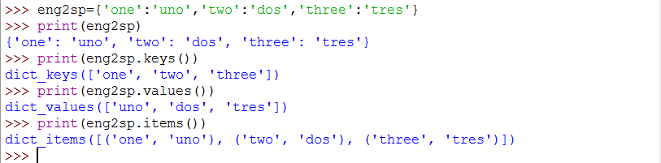
Keys and Values (Contd.)
The items() method returns a list of tuple pairs of the key-value pairs in a dictionary.
Notes:
items() method
The method items() returns a list of dicts (key,value) tuple pairs.
The above program will display the key and value pair of the dictionary.

Slide 25
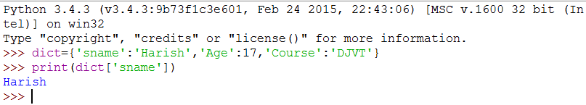
Keys and Values (Contd.)
To access dictionary elements, you can use the familiar square brackets along with the key to obtain its value.
Example:
Notes:
The above is a sample example to access a particular element of dictionary using a key.

Slide 26
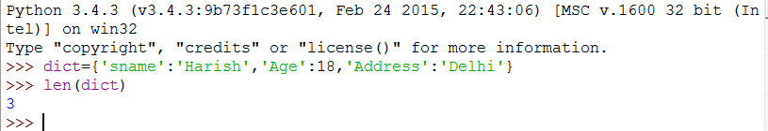
Len() Function
The len() function works on dictionaries.
Len() returns the number of key-value pair.
Example:
Notes:
In the above example it has shown len() function uses. This function will work on dictionaries. This will return the number of key and value pair. There is a snippet of code which displays the same.

Slide 27
“in” Operator
The “in” Operator works differently for dictionaries than for other sequences as below
It tells whether data appears as a key in the dictionary.
It can be used to check whether a value exists in a dictionary.
values() method
It checks the values existing in a dictionary.
It will return the result as a List.
Notes:
The in operator works differently for dictionaries than for other sequences. The in operator works on dictionaries. It tells whether something appears as a key in the dictionary. The in operator can be used to check whether a value existing in dictionary.
To check the values existing in a dictionary we need use values() method. The values() method will return as a List.

Slide 28
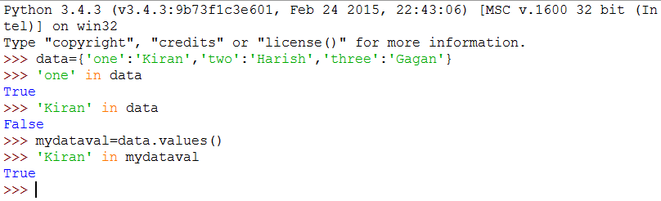
“in” Operator (Contd.)
Example:
Notes:
The above example explaining how in operator works on dictionary. Here the in operator is used to check whether a particular key or value exist in the dictionary or not. In operator will return true or false value.

Slide 29
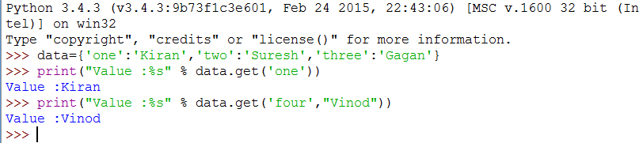
“get()” Method for Dictionary
The method get() returns a value for the given key.
If key is not available, it returns default value “None”.
key- This is the key to be searched in the dictionary.
default - This is the value to be returned in case key does not exist.
Example:
Notes:
Get() Method
The method get() returns a value for the given key. If key is not available then returns default value None.
Syntax :
dict.get(key,default=None)
The parameter explained in below.
key -This is the Key to be searched in the dictionary.
default -This is the Value to be returned in case key does not exist.
The above snippet of code displays the values by giving the key value using get() method.

Slide 30
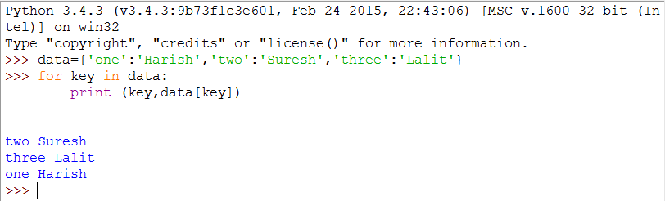
Traversing a Dictionary
We can write a “for” loop that goes through all the entries in a dictionary, such as keys and values.
If a dictionary uses in a “for” statement, it traverses the keys of the dictionary.
This loop prints each key and the corresponding value.
Example:
Notes:
Even though dictionaries are not stored in order, we can write a for loop that goes through all the entries in a dictionary - actually it goes through all of the keys in the dictionary and looks up the values.
If a dictionary uses in a for statement, it traverses the keys of the dictionary.
In the above code snippet the for loop prints each key and the corresponding value.

Slide 31
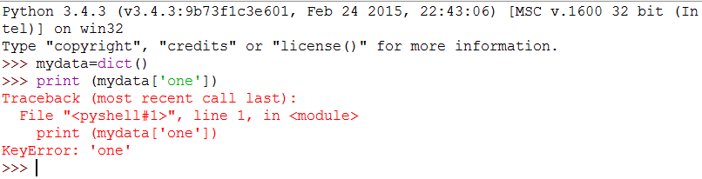
Dictionary Traceback
It is an error to reference a key which is not in the dictionary.
We can use the “in” operator to see if a key is in the dictionary.
Notes:
It is an error to reference a key which is not in the dictionary. We can use the in operator to see if a key is in the dictionary. The above examples show how an error comes when we are trying to print a value based on key value which is not existing in a empty dictionary.

Slide 32
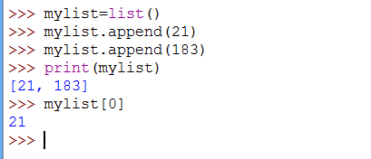
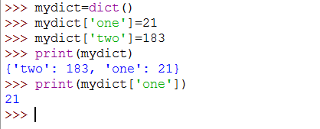
List vs Dictionary
LIST | DICTIONARY
List is list of values. Starting from zero. | It is an index of words and each of them has a definition.
We can add the element index wise. | Element can be added in Dictionary in the form of key-value pair.
Notes:
The above slide shows the difference between the list and dictionary.
The slides shows the two snippet of code which show the difference between the list and dictionary. The snippet of code shows how to add elements to the list and dictionary and display it. The snippet code also shows how to access a particular element of a list or dictionary.

Slide 33
Just a Minute
Predict the output of the following Code:
Data={‘Apple’,’Orange’,’Grapes’}
‘Apple’ in Data
Notes:
Solution:
True

Slide 34
Just a Minute
Predict the output of the following Code:
Data={‘Apple’,’Orange’,’Grapes’}
‘Apple’ in Data
Answer:
True
Notes:
Solution:
True

Slide 35
Activity
Activity : Implementing Dictionary Collection
Problem Statement:
Write a program to create two dictionary objects named states and cities with the following items:
States : Cities :
'Oregon': 'OR' 'CA': 'San Francisco'
'Florida': 'FL' 'MI': 'Detroit'
'California': 'CA' 'FL': 'Jacksonville'
'New York': 'NY'
'Michigan': 'MI'
In addition add more two items to the cities dictionary(NY-New York, OR-Portland). Then print the details available in cities dictionary using keys and values.
Notes:
Solution:
In order to do this activity, you need to perform the following tasks:
Create a Python empty project.
Create a mapping of state to abbreviation, Create a basic set of states and some cities in them and Add some more cities.
Task 1: Create a Python empty project:
Step 1: Open NetBeans 8.0.2.
Step 2: Click File menu.
Step 3: Select New Project.
Step 4: Select Python from Categories list and Python Project from Projects list.
Step 5: Click Next button.
Step 6: On New Python Project dialog box set the Project Name as CR_Session10_Exercise01.
Step 7: Select project Location by clicking Browse button.
Step 8: Click Finish button.
Task 2: Create a mapping of state to abbreviation, create a basic set of states and some cities in them, add some more cities:
Step 1: Type the following code:
# create a mapping of state to abbreviation
states = {
'Oregon': 'OR',
'Florida': 'FL',
'California': 'CA',
'New York': 'NY',
'Michigan': 'MI'
}
# create a basic set of states and some cities in them
cities = {
'CA': 'San Francisco',
'MI': 'Detroit',
'FL': 'Jacksonville'
}
# add some more cities
cities['NY'] = 'New York'
cities['OR'] = 'Portland'
# print out some cities
print '-' * 10
print "NY State has: ", cities['NY']
print "OR State has: ", cities['OR']
# print some states
print '-' * 10
print "Michigan's abbreviation is: ", states['Michigan']
print "Florida's abbreviation is: ", states['Florida']
# do it by using the state then cities dict
print '-' * 10
print "Michigan has: ", cities[states['Michigan']]
print "Florida has: ", cities[states['Florida']]
# print every state abbreviation
print '-' * 10
for state, abbrev in states.items():
print "%s is abbreviated %s" % (state, abbrev)
# print every city in state
print '-' * 10
for abbrev, city in cities.items():
print "%s has the city %s" % (abbrev, city)
Step 2: Run the program.

Slide 36
Summary
In this session we have learned:
Parsing means dividing a string into tokens based on some delimiters.
An object comprises both data members (class variables and instance variables) and methods.
An object with more than one reference has more than one name and hence the object is said to be aliased.
Creating a dictionary.
Different methods in a dictionary.
“in” operator for checking the keys existing in dictionary.
Traversing through the Dictionary.
Differences between List and Dictionary.

