Slide 1
Time Series Analysis
Presented By
Adri Saha
Big Data Analytics

Slide 2
What is Time Series Analysis?
Social and economic conditions are always changing, requiring data analysts to assess and predict their impact. Accurate forecasting techniques are crucial for supporting business, operations, technology, and research. Better and less biased forecasts can significantly improve performance across various fields.
Time Series Analysis uses statistical methods to understand and predict quantitative variables. It helps organizations make data-driven decisions, improve efficiency, and adapt to changing conditions effectively.
Examples: Sales, Financial KPIs, Resource allocation, Logistics, Sensor measurements

Slide 3

Why analyze Time series data?
Graphical and numerical summary: Displays data points over time.
Interpretation of series features: Analyzes patterns like seasonality, trends, and relationships with other data series.
Forecasting: Predicts future values of the series like at t+1,t+2,…,t+n).
Hypothesis testing and simulation: Compares different scenarios to evaluate outcomes.

Slide 4





Applications of TSA
Manufacturing
Predictive maintenance: Enhances operational efficiency.
Shipped packages forecasting: Supports workforce planning.
Sales forecasting during promotions: Optimizes warehouse management.
Claims prediction: Helps determine suitable insurance policies.
Energy load forecasting: Improves planning and trading strategies.
Logistics & Transportation
Retail grocery
Insurance
Energy & Utilities

Slide 5

Key Components in TSA
A time series is a collection of data over a longer amount of time that frequently shows patterns of long-term changes (trends) and short-term fluctuations (seasonality and cycles).
Trends
Seasonality and cyclic patterns
- Stationarity and non-stationarity
- Autocorrelation and moving averages
- Decomposing a time series

Slide 6
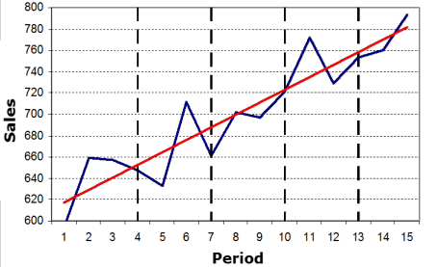
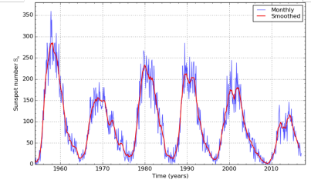
Trends
Cycle
The trend in a time series represents the overall direction of the data over a long period. It indicates whether there is a sustained long-term increase or decrease in the values.
The trend does not have to be linear; it can also be exponential or follow other functional forms.
Long-term, regular fluctuations by repeated upward or downward swings.
Duration: Vary, usually from 2 to 20 or even thirty years.
Detection can be challenging to identify, as it is often confused with the trend component.

Slide 7

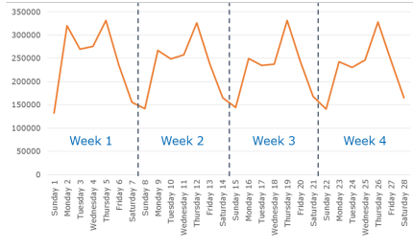
Seasonality
Patterns: Repeating patterns at fixed intervals (E.g. daily, monthly, yearly).
01.
02.
Predictable: Occurs due to factors like weather, holidays, or economic cycles.
Example: Weekly seasonality (Newspaper daily sales)

Slide 8

Testing for Stationarity
Mean: E(Yt) = μ
Variance: var(Yt) = E( Yt – μ)2 = σ2
Covariance: γk = E[(Yt – μ)(Yt-k – μ)2
Forms of Stationarity: weak, strong (strict), super (Engle, Hendry, & Richard 1983)

Slide 9
Types of Stationary
If the mean and variance of a time series remain constant throughout time and the covariance between two time points varies only on their distance from one another, then the time series is considered to be weakly stationary.
A time series is strongly stationary if the joint distribution of any set of points in the series depends only on the gaps between them and not on the specific time at which they occur.
If a weakly stationary series follows a normal (Gaussian) distribution, it is also considered strongly stationary. This is why we often check whether a time series follows a normal distribution.

Slide 10
Stationary Vs Non-Stationary
Similarly to significant occurrences like 9/11 and Watergate, shocks only have short-term effects on a stationary series until it eventually recovers to its long-term average. However, for a non-stationary series, shocks cause permanent shifts away from the long-term average.
A stationary series has a variance or data spread which does not change over time. However, over time, the variance of a non-stationary series grows and becomes infinite.

Slide 11
Autocorrelation
Correlation of a signal with a delayed copy of itself
Helps identify repeating patterns or seasonality
Tools: Autocorrelation Function (ACF), Partial Autocorrelation Function (PACF)

Slide 12
Auto Correlated Function (ACF) Example (Presidential Approval)

Slide 13
Autocorrelated Functions (ACF)
The ACF shows how persistent a variable is over its relative delays.
ρ_{k} = γ_{k} / γ₀ = covariance at lag k
variance
ρ_{k} = E[(y_{t} – μ)(y_{t-k} – μ)]²
E[(y_{t} – μ)²]
ACF (0) = 1, ACF (k) = ACF (-k)
Explanation
The approval series shows a long-lasting effect. Even though it doesn't have a unit root, it has long memory, meaning that shocks to the series last for at least 12 months.
If the ACF (Autocorrelation Function) shows a hyperbolic pattern, it might mean the series is fractionally integrated.
Notes:
Presidential Approval

Slide 14

Time Series Decomposition
Breaking Down a Time Series:
Time series can be decomposed into:
Trend component
Seasonal component
Remainder (residual)
This helps in understanding underlying patterns and making forecasts.

Slide 15
Moving Averages
Used for smoothing time series and identifying trends.
01.
02.
03.
Simple Moving Average (SMA)
Weighted Moving Average (WMA)
Exponential Moving Average (EMA)

Slide 16



Working Flow
Data Collection: Gather time-based data.
Data Preprocessing: Clean and prepare the data (handling missing values, normalization).
Exploratory Analysis: Visualize data to identify trends, seasonality, and patterns.
Modeling: Choose and apply suitable algorithms.
Validation: Test the model's accuracy.
Prediction: Use the model to forecast future data points.
Evaluation: Assess model performance and refine it as needed.

Slide 17
Some TSA models
01.
Traditional
Exponential smoothing (ETS)
ARIMA models
SARIMA (Seasonal ARIMA)
Advanced
Prophet Model
Spectral analysis
Machine/deep learning models
Random Forest, SVM
LSTM (Long Short-Term Memory Networks)
02.
03.

Slide 18
Exponential Smoothing
Methods
Simple Exponential Smoothing
Double Exponential Smoothing (Holt's method)
Triple Exponential Smoothing (Holt-Winters' method)

Slide 19
Exponential Smoothing Vs ARIMA
Exponential smoothing methods are concerned with describing the level of data, trend, and seasonality, whereas ARIMA models try to identify and explain the autocorrelations in the data.
ARIMA Model describes how past observations of a target variable are statistically correlated with its future values.
Flexible forecasting model that can be applied to time series data by making it stationary through methods like differencing and lagging. An ARIMA model includes:
Autoregressive (AR): Captures relationships with past values.
Moving Average (MA): Accounts for past forecast errors.
Integration (I): Handles the differencing needed to make the series stationary.
So that the model is called ARIMA (Auto Regressive Integrated Moving Average).

Slide 20
How ARIMA Works
Step 1: Identification: Find out if there is a stationary series. Use differencing if not.
Step 2: Model Selection: Choose AR, I, and MA terms (parameters p, d, q) using techniques like ACF and PACF plots.
Step 3: Estimation: Fit the ARIMA model to the data.
Step 4: Forecasting: Use the fitted model to predict future values
Eg: ARIMA(1,1,1): Uses 1 lag for autoregression, 1 differencing to make the series stationary, and 1 lag for the moving average.

Slide 21
Seasonal ARIMA (SARIMA)
Handling Seasonality with SARIMA:
Extension of ARIMA for seasonal time series
Incorporates seasonal differencing
Useful for data with clear seasonal patterns.

Slide 22
Long Short-Term Memory (LSTM)
LSTM Networks for Time Series:
Type of Recurrent Neural Network (RNN)
Capable of learning long-term dependencies
Useful for complex time series with multiple input variables.

Slide 23
ARIMA (Auto Regressive Integrated Moving Average):
Focused on single series estimation
Widely used for forecasting.
Combines autoregression, differencing, and moving average.
SARIMA (Seasonal ARIMA):
Extension of ARIMA.
Accounts for seasonality in data.
LSTM (Long Short-Term Memory Networks):
A type of recurrent neural network.
Effective for handling long-term dependencies in time series data.

Slide 24
Prophet Model
Facebook's Prophet Model:
Designed for business forecasting
Handles daily observations with strong seasonal effects
Robust to missing data and shifts in trend

Slide 25
Time Series Cross-Validation
Traditional cross-validation doesn't work for time series
Use techniques like rolling forecast origin
Metrics: Mean Absolute Error (MAE), Root Mean Squared Error (RMSE)

Slide 26
Handling Missing Data
Dealing with Missing Values:
Linear interpolation
Last observation carried forward (LOCF)
Mean/median imputation
More advanced methods: multiple imputation, KNN imputation

Slide 27
Feature Engineering for Time Series
Creating Relevant Features:
Lag features
Rolling window statistics
Date-based features (day of week, month, etc.)
Domain-specific indicators

Slide 28

Multivariate Time Series
Analyzing Multiple Time Series:
Vector Autoregression (VAR)
Dynamic Factor Models
Multivariate LSTM networks

Slide 29

Advanced Topic : VAR
VAR (Vector Autoregression) is a helpful model in which all variables are viewed as endogenous (they influence one another).
If there are 3 variables, the model creates 3 equations, each including lags of all the variables.
Once the system is estimated, you can analyze how one variable reacts when another variable experiences a shock (a sudden change from its average).

Slide 30
Time Series Clustering
Grouping Similar Time Series:
Dynamic Time Warping (DTW) for similarity measurement
K-means clustering with DTW
Hierarchical clustering of time series

Slide 31
Future Trends in TSA
Emerging Directions:
Deep learning approaches for complex time series
Integration with big data technologies.
Real-time analysis and forecasting.
Explainable AI in time series forecasting

Slide 32


Presented by Adri Saha
Thank you very much!

Slide 33
RESOURCES
M. de Gooijer, G. Ray, and M. Schmidt, "A Comprehensive Review on Time Series Forecasting Using Deep Learning," ScienceDirect, 2021. Available at: https://www.sciencedirect.com/science/article/pii/S0169207021001758.
Penn State Eberly College of Science, "Lesson 1: Introduction to Time Series Analysis," STAT 510, Available at: https://online.stat.psu.edu/stat510/lesson/1/1.2.
Stack Exchange, "Weakly Stationary Gaussian AR(1) Process is Strict Stationary?" Available at: https://stats.stackexchange.com/questions/483463/.
Hyndman, R. J. and Athanasopoulos, G., "Stationarity," Forecasting: Principles and Practice, 2nd ed., Available at: https://otexts.com/fpp2/stationarity.html.

