Slide 1
Introduction to Git and GitHub
Workshop Lead: Adrien Osakwe
September 25th, 2024

Slide 2

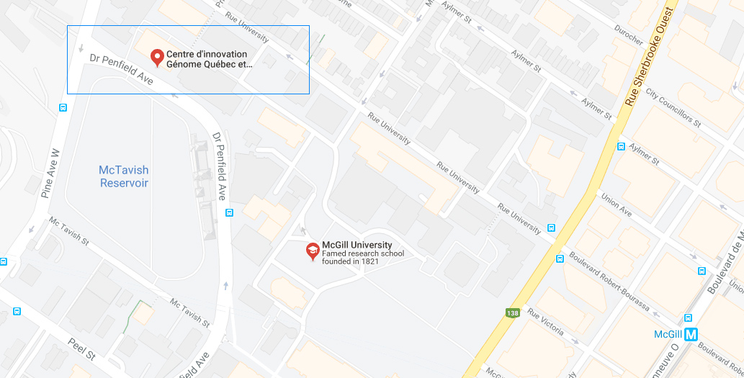
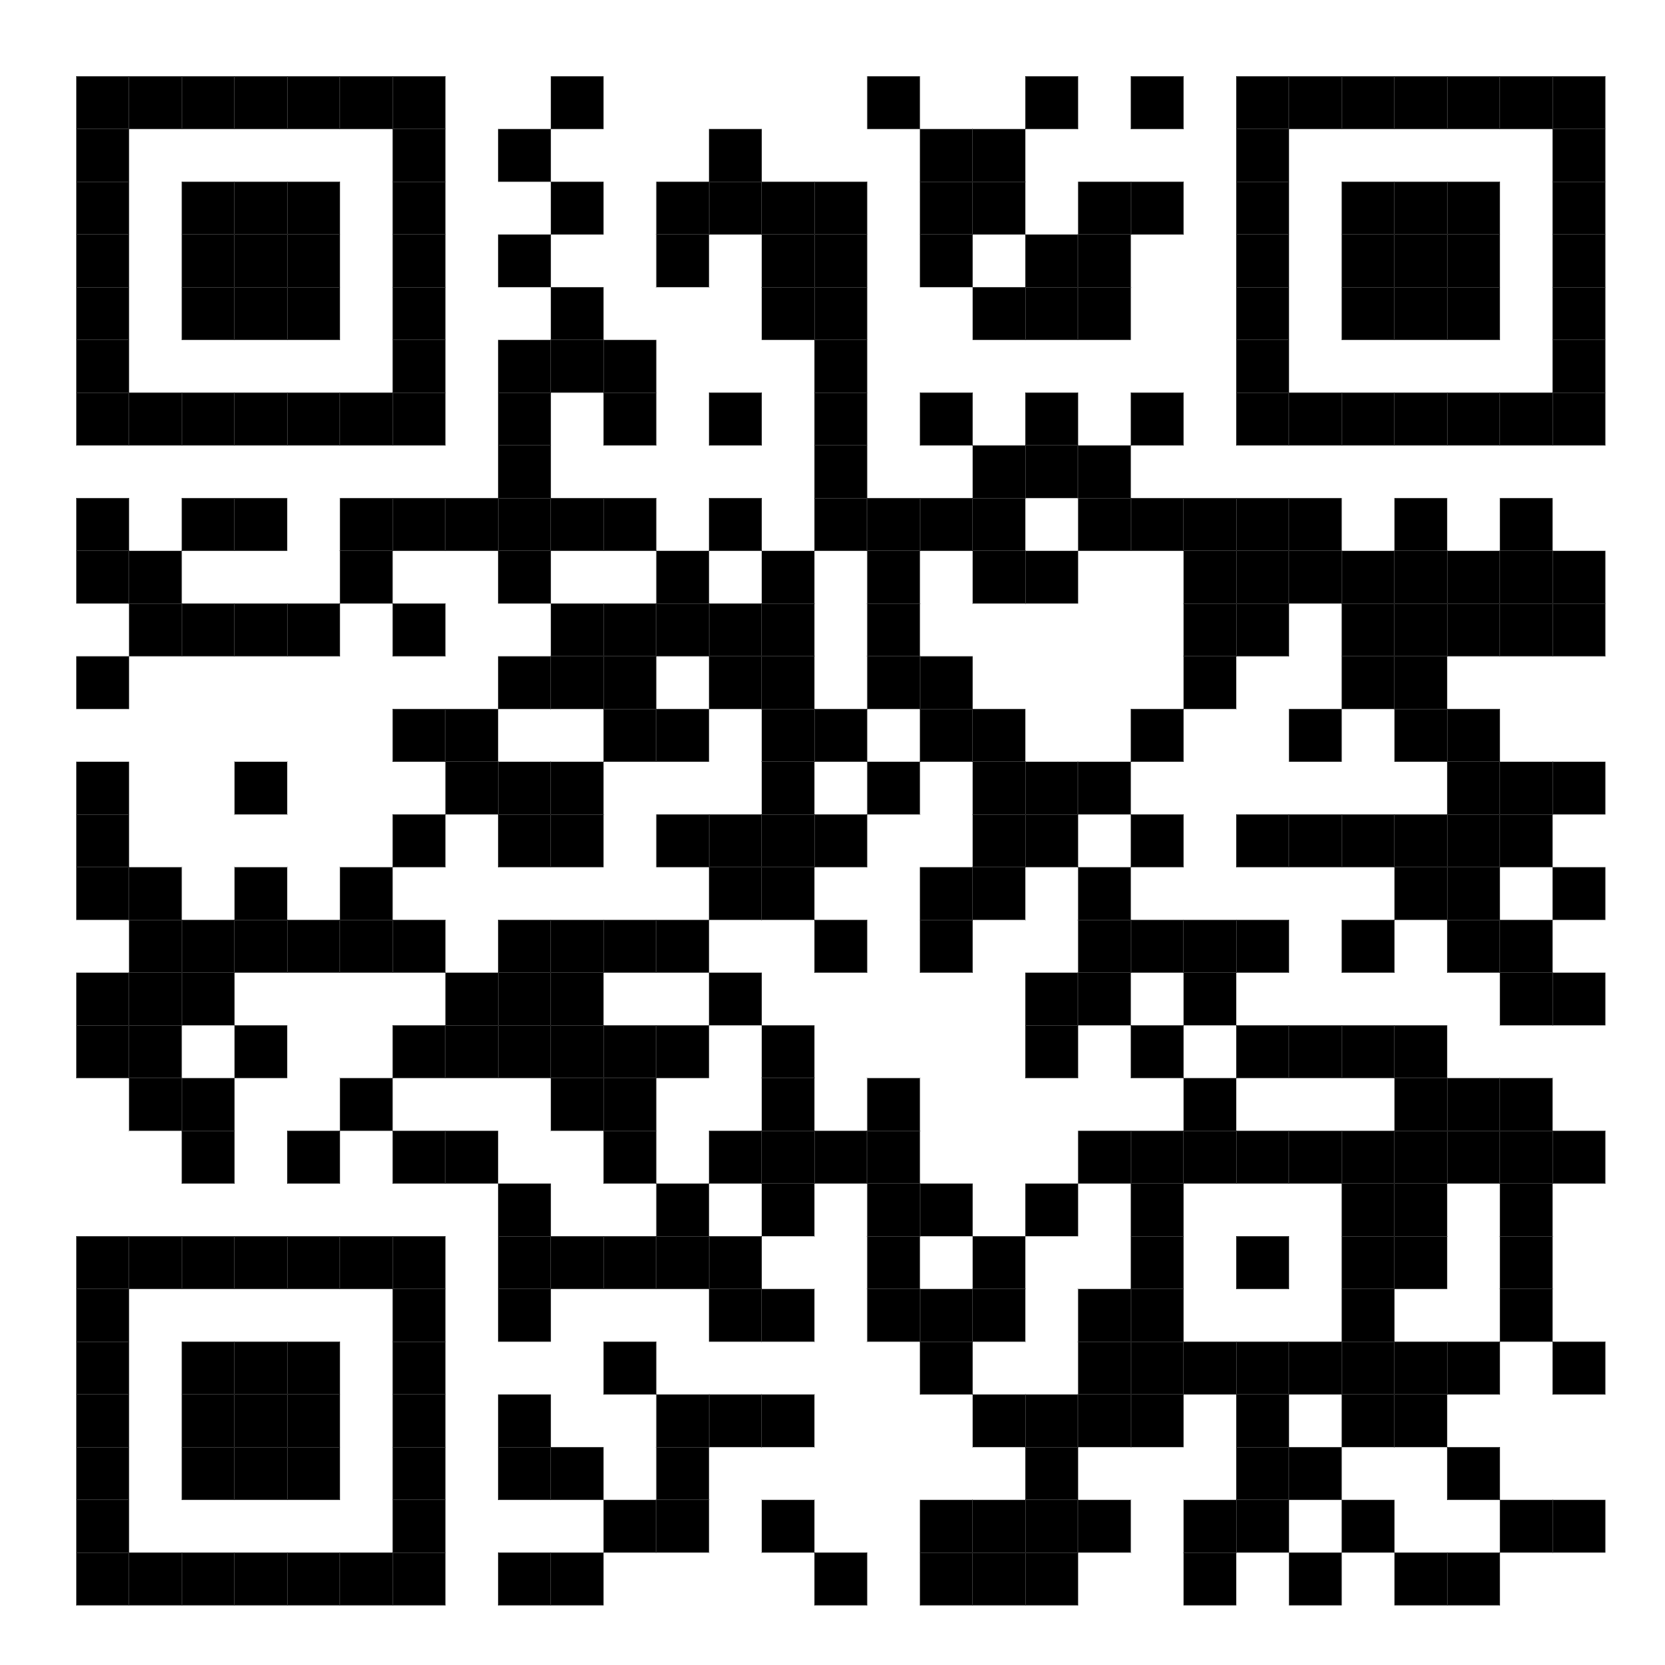
Mission statement: deliver quality workshops designed to help biomedical researchers develop the skills they need to succeed.
Location: 740 Dr. Penfield Avenue, Montreal, Quebec
Scan the QR code to sign up
for our mailing list
Contact: workshop-micm@mcgill.ca

Slide 3
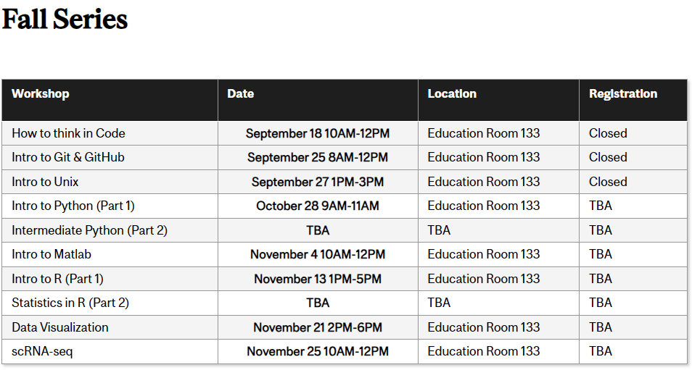
https://www.mcgill.ca/micm/training/workshops-series

Slide 4
Outline for this workshop:
Intro to Git and Version Control Systems
Basic Git functions
Advanced Git functions
Working with GitHub
Group Activity
Miscellaneous Features
Conclusions

Slide 5
Hands-on Activities:
Quick Review Polls
Git/GitHub exercises
What you will need:
GitHub Desktop App and GitHub Account
A Text editor
UNIX-based Command Line (time-allowing)

Slide 6
What you WILL learn
Basic theory and features behind Git and GitHub
How to manage local and remote repositories
What you will NOT learn
How to code
Data Analysis Pipelines

Slide 7
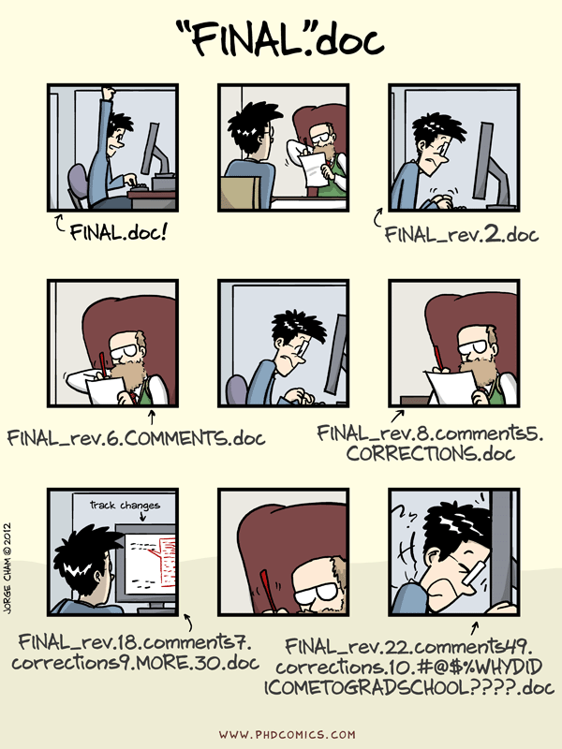

Slide 8
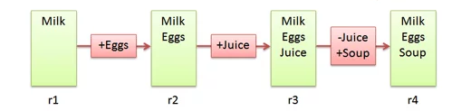
Version Control Systems
Make it easier to document changes
Less confusion
Like an unlimited “undo” button
Groceries.txt
Notes:
Source: https://betterexplained.com/articles/a-visual-guide-to-version-control/

Slide 9

Git
A type of version control system
Open-source
Most popular VCS currently in use
Creates a “Git Repository” which stores all the modified instances of your project

Slide 10
What kind of files does Git track?
Can track any file but works best for pure text files (.txt,.R,.py etc.)
Word/PowerPoint are in binary; Git cannot display the changes occurring in these files
Still useful for storing such files, just cannot use all of Git’s features
Markdown and LaTeX can be used instead of these binary files

Slide 11
Git vs. GitHub
A version control system
Works locally and remotely
Is open-source
A server that hosts Git repositories
Works solely as a cloud-based service
Owned by Microsoft

Slide 12
Working Directory ≠ Git Repository
Working directory is your project folder
Git Repository is a hidden file stored inside your working directory
The Git Repository contains the staging area and your commit history/local repository

Slide 13
Git Repository
Git Pipeline
Working
Directory
Staging
Area
Local Repository
Add
Commit
Code.py
*New*
Code.py
*New*
Code.py
*New*
Code.py
TRACKED
Code.py
*Modified*
Code.py
*Modified*
Code.py
*Modified*
Notes:
https://www.google.com/url?sa=i&url=https%3A%2F%2Fcourses.csail.mit.edu%2F6.S194%2F13%2Flessons%2F03-git%2Fgit-commands-and-metaphors.html&psig=AOvVaw0eLwNte0CymnSwNKJIL7Zi&ust=1654357234965000&source=images&cd=vfe&ved=0CAwQjRxqFwoTCLifgozPkfgCFQAAAAAdAAAAABAk

Slide 14
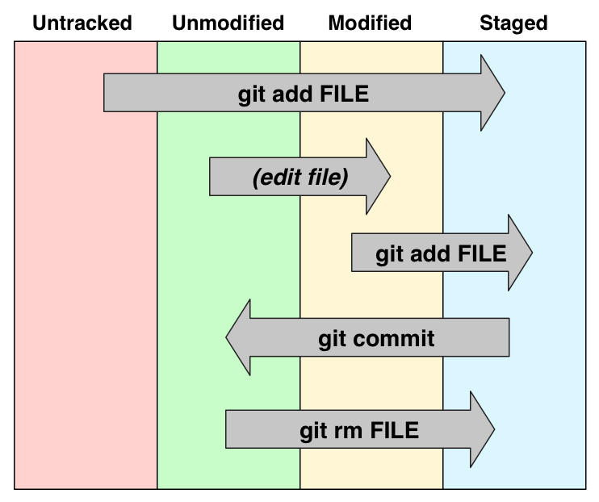

Slide 15
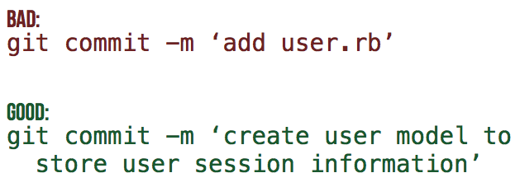
Commit Messages
Every commit MUST have an attached message/description
This helps others identify what changes have been made and why
[filename added/changed ; what change ; why]
Notes:
Need an activity here

Slide 16
Poll #1
T/F – Both untracked and modified files must be added to the staging area
T/F - GitHub is a type of VCS
T/F – The repository keeps track of changes by storing each version of a file/project
Notes:
T
Staging Area
F

Slide 17
Summary
Untracked or modified files are first added to the staging area
Changes that have been staged can then be committed to the local repository
Commits can then be used to revert to previous instances of the project or simply to keep track of what changes have been made

Slide 18
Part II – Basic Git Features

Slide 19
Activity #0 – Initialize a Git Repository
Notes:
Make a new git repo through desktop App
Add a file to the directory
Return to desktop app and track the file
Create it, edit it, move it, remove it

Slide 20
Activity #0 – Initialize a Git Repository
Create a new Git Repository (File → new repo OR “create a new repository on your hard drive”)
Open the generated project folder, what do you see?
Notes:
Make a new git repo through desktop App
Add a file to the directory
Return to desktop app and track the file
Create it, edit it, move it, remove it

Slide 21
Activity #1 – Create and track a Text File with Git
Notes:
Make a new git repo through desktop App
Add a file to the directory
Return to desktop app and track the file
Create it, edit it, move it, remove it

Slide 22
Activity #1 – Create and track a Text File with Git
Create a text file (or code script) in the project folder
Open the GitHub Desktop App and add + commit the file to track it.
Look at your commit history to see your commit!
Modify the file and commit the changes. Try and make informative commit messages!
Notes:
Make a new git repo through desktop App
Add a file to the directory
Return to desktop app and track the file
Create it, edit it, move it, remove it

Slide 23
Activity #2 – Revert a file to a previous commit
Notes:
Edit your text file with an error
Go to desktop app and reset the file to the previous commit
Repeat BUT this time commit it
Revert changes of the commit

Slide 24
Activity #2 – Revert a file to a previous commit
Make an unwanted change to your file
Use your commit history to revert to the previous commit
Make another unwanted change and commit it
Now use your commit history to revert the commit!
Extra: Try using the reset feature – when would this be helpful?
Notes:
Edit your text file with an error
Go to desktop app and reset the file to the previous commit
Repeat BUT this time commit it
Revert changes of the commit

Slide 25
Poll #2
T/F – After initialisation, a project folder becomes a git repository
T/F – After making a commit, you cannot revert to a previous version of your repository
Is it possible for two commits to have the same ID?
Notes:
T
F
No

Slide 26
Part III – Advanced Git Features

Slide 27
What if you want to test out a new feature without affecting your current version of the code?
Branching

Slide 28
What is a Branch?
A specific “timeline” of your commit history
Allows us to implement new features without harming viable releases
New Feature
Debugged New Feature
Dev
Main/Master
Initial Commit
Debug Commit
Release 1.0.0
Patched Release

Slide 29
Activity #3 – Create a new branch
Notes:
Create new branch and make changes

Slide 30
Activity #3 – Create a new branch
Click the “current branch” button and select “new branch”
Make changes to your file in the new branch and commit it
Switch back to the main branch and open the file, what do you notice?
Notes:
Create new branch and make changes

Slide 31
Now that your test feature works, you might want to make it part of your official release
Merge

Slide 32
What is a Merge?
Action that will “merge” the commits from one branch into another
New Feature
Debugged New Feature
New Feature + Patch
Dev
Main/Master
Release 1.0.0
Patched Release
Release 1.1.0

Slide 33
Activity #4 – Merging Branches

Slide 34
Activity #4 – Merging Branches
Switch to the main branch
Open the branch menu
Select the “choose a branch to merge into main” button and select your second branch.
Compare the branches again, the file should now be identical in both!

Slide 35
Merging is not the only way to combine branches
Rebasing

Slide 36
Rebasing
Instead of merging the other branch’s changes as a new commit, rebasing rewrites the target branch’s commit history to add the commits directly
New Feature
Debugged New Feature
Dev
Release 1.0.0
Patched Release
Debugged New Feature
Main/Master
New Feature
Patched Release

Slide 37
Conflicts
If branches have competing commits, git will raise a conflict and not be able to merge/rebase
Can occur if:
Both branches edit the same line
Both added a file of the same name
One branch edited a file, the other deleted it

Slide 38
Activity #5 – Resolving Conflicts

Slide 39
Activity #5 – Resolving Conflicts
In both branches, make a change on the same line and commit it
Try and merge your second branch into the main
When the merge conflict occurs, open the text file and resolve the issue
Try to merge again
Look at your commit history, how is your resolved merge shown in the commit?

Slide 40
Poll #3
What is the purpose of a merge/rebase?
T/F – Merging branches with changes in the same file will ALWAYS create a merge conflict
How could we prevent conflicts from occurring?
Notes:
Make a more streamlined commit history
F
Use different files

Slide 41
Summary
Branches can be used to develop new features without affecting a previous, viable version of your code
Merges or Rebases can be used to combine the commits of two different branches
Conflicts prevent branches from being combined

Slide 42
Part IV – Hosting Projects on GitHub

Slide 43
GitHub Interface
Notes:
On this slide I can just open GitHub and explore the different features and options

Slide 44
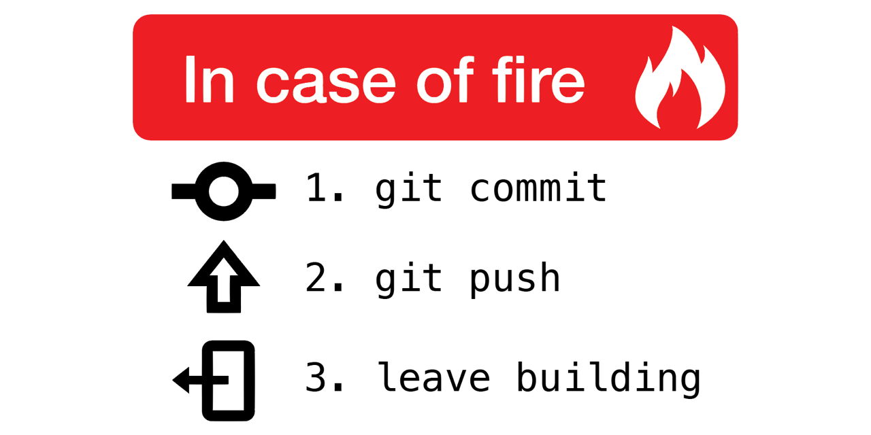
Why use remote repositories like GitHub?
Backup for your code
Can access the repository from anywhere
Collaborations
Easy to keep track of changes made by you and collaborators
Open Science
Easy to access, download and use others’ code
Easy to discuss with users of your code

Slide 45
Pushing and Pulling
Push: Updates your remote repository with recent commits from your local repository
Pull: Updates your local repository with recent commits from your remote repository

Slide 46
Local-Remote Pipeline
Working
Directory
Staging
Area
Local Repository
Remote Repository
Add
Commit
Code.py
*New*
Code.py
*New*
Code.py
*New*
Code.py
TRACKED
Notes:
https://www.google.com/url?sa=i&url=https%3A%2F%2Fcourses.csail.mit.edu%2F6.S194%2F13%2Flessons%2F03-git%2Fgit-commands-and-metaphors.html&psig=AOvVaw0eLwNte0CymnSwNKJIL7Zi&ust=1654357234965000&source=images&cd=vfe&ved=0CAwQjRxqFwoTCLifgozPkfgCFQAAAAAdAAAAABAk

Slide 47
Local-Remote Pipeline
Working
Directory
Staging
Area
Local Repository
Remote Repository
Pull
Push
Code.py
*New*
Code.py
*New*
Code.py
*Modified*
Code.py
TRACKED
Code.py
*Modified*
Code.py
*Modified*
Notes:
https://www.google.com/url?sa=i&url=https%3A%2F%2Fcourses.csail.mit.edu%2F6.S194%2F13%2Flessons%2F03-git%2Fgit-commands-and-metaphors.html&psig=AOvVaw0eLwNte0CymnSwNKJIL7Zi&ust=1654357234965000&source=images&cd=vfe&ved=0CAwQjRxqFwoTCLifgozPkfgCFQAAAAAdAAAAABAk

Slide 48
Activity #6 – Pushing commits to GitHub

Slide 49
Activity #6 – Pushing commits to GitHub
Click the “Publish Repository” button
Now open your GitHub account in the browser and find your repository. See if your commit history is the same as in your local repo.

Slide 50
Activity #7 – Pulling Commits from GitHub

Slide 51
Activity #7 – Pulling Commits from GitHub
From the GitHub website, open your file and select the edit option
Make a change to the file and commit it.
Return to the desktop app and do Repository -> Pull
Look at your commit history and your file, what do you see?

Slide 52
Create a local copy of a GitHub Repository
“Cloning”
Usually done to use published code
Reproduce results
Use code on a dataset of interest
Creates a direct link to the original repository
Anything changes you push will affect the original repository
Any changes in the original repo can be pulled into your clone

Slide 53
Cloning a Repository
Working
Directory
Local Repository
Remote Repository
Clone
Code.py
*New*
Code.py
*New*
Code.py
*Modified*
Code.py
*Modified*
Code.py
*Modified*
Notes:
https://www.google.com/url?sa=i&url=https%3A%2F%2Fcourses.csail.mit.edu%2F6.S194%2F13%2Flessons%2F03-git%2Fgit-commands-and-metaphors.html&psig=AOvVaw0eLwNte0CymnSwNKJIL7Zi&ust=1654357234965000&source=images&cd=vfe&ved=0CAwQjRxqFwoTCLifgozPkfgCFQAAAAAdAAAAABAk

Slide 54
Activity #8 – Clone a Repository
- Find a GitHub repo that interests you and clone it!

Slide 55
Activity #8 – Clone a Repository
Go to the GitHub website and search for a repo that interests you.
Copy the repo’s URL
In the Desktop App, do File → Clone a repository and paste the URL.
Open the cloned repo and explore!

Slide 56
Contributing to projects
We saw earlier that we can create merge conflicts
How can we regulate this when working in teams?
Forks & Pull Requests

Slide 57
Create a remote copy of a GitHub Repository
“Fork”
Usually used to contribute to published code
Can then edit the forked repository locally
Can then push local changes to your forked copy
When your changes are done, you can make a pull request to add your changes to the original repo
Much safer way to contribute to source code

Slide 58
Forking a Repository
All on GitHub
You
Collaborator
Working
Directory
Local Repository
Forked Remote Repository
Original Remote Repository
Clone
Fork
Code.py
*New*
Code.py
*New*
Code.py
*New*
Code.py
*New*
Code.py
*Modified*
Code.py
*Modified*
Code.py
*Modified*
Code.py
*Modified*
Push
Pull Req.
Notes:
https://www.google.com/url?sa=i&url=https%3A%2F%2Fcourses.csail.mit.edu%2F6.S194%2F13%2Flessons%2F03-git%2Fgit-commands-and-metaphors.html&psig=AOvVaw0eLwNte0CymnSwNKJIL7Zi&ust=1654357234965000&source=images&cd=vfe&ved=0CAwQjRxqFwoTCLifgozPkfgCFQAAAAAdAAAAABAk

Slide 59
Activity #9 – Fork a Repo and make a Pull Request
- Fork the repo I made for this course and add a text file to it. Then, make a pull request!

Slide 60
Activity #9 – Fork a Repo and make a Pull Request
Open the link in chat to access the repo I made.
https://github.com/aosakwe/GitHub_Practice
Click the “fork” button
Clone your forked copy to your computer and add a text file with one thing you have learned today. Commit the file.
Push the commit to your forked repo.
On the GitHub website. Look at your forked repo and select the “create Pull Request” button

Slide 61
Poll #4
What command lets you update your remote repo with local changes?
T/F - Cloning a repository is the best way to contribute new features
T/F – You will always be able to push changes from a cloned repo to the original
What is the advantage of using a Pull Request prior to merging changes from a contributor?
Notes:
Push
F
F
Control over additions

Slide 62
Summary
GitHub provides a framework to store and document code
Push/Pull commands allow you to transfer commits between local and remote repositories
Forks/Pull Requests help manage code contributions

Slide 63
Important: Using GitHub is NOT a replacement for good communication:
Ensures everyone is using the latest version of a file
Helps keep track of what changes were made and by who
Good Practices:
Have certain user(s) in charge of approving Pull Requests
Set a standard format for commit messages

Slide 64
Part V – Group Activity

Slide 65
Split into teams based on preferred language (R, Python, other, none)
Activities (Data Analysis // Database curation) store in ‘Team Project’ folder for this workshop’s repo.
https://github.com/aosakwe/MiCM_IntroToGitHub
Task – as a team. Using the base files in the repo, create a fork and collaborate to extend it using pull requests.
Ideas: Function to filter specific columns, plot specific columns etc.
Notes:
Note: in future share zip files for projects to reduce fork #

Slide 66
Part VI – Miscellaneous Features

Slide 67
Using Git on the Command Line

Slide 68
Using the Command Line:
Direct interaction with Git
Allows you to use Git on an HPC server (e.g: ComputeCanada)
Provides more tools than third-party software
But:
Can have a steep learning curve depending on experience with UNIX

Slide 69
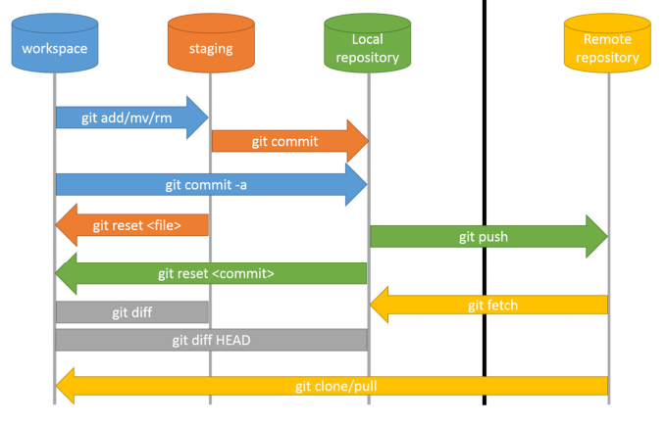

Slide 70
Activity #10 – Initialize Repo with git commands
Open Command Line and switch to Desktop: cd Desktop/
Make a new directory: mkdir Git_Practice
Initialize git repository: git init
Check the status of your repository: git status

Slide 71
Activity #11 – Commit a new file with git commands
Create a new txt file in the repo with vim or through your text editor
From the command line, check your repo status: git status (do you see the new file?)
Stage the new file: git add file_name
Check your repo status: git status
Commit the file: git commit –m “Commit Message”
Check your repo status: git status
Check your Commit History: git log
Rename your branch: git branch –M main

Slide 72
Activity #12 – Create a new branch
Check your current branches: git branch
Create new branch: git branch new_branch_name
Check your current branches: git branch
Switch to new branch: git checkout new_branch_name
Edit your file and commit it
Check your commit history: git log

Slide 73
Activity #13.1 – Revert a Modification/Commit
Make a change to a file
Check the repo status: git status
Restore the previous version of file: git restore file_name
Make the change again, but stage it this time: git add file_name
Unstage the file: git reset file_name

Slide 74
Activity #13.2 – Revert a Modification/Commit
Make a change and commit it
git add file_name
git commit –m “commit message”
Get the commit ID from your commit history: git log
Revert your current commit: git revert commit_id
Check your file: have the changes been reverted?

Slide 75
Activity #14.1 – Push to Remote Repository
On the GitHub website, click on your profile in the top right corner and select “settings”
Select “Developer settings” at the bottom of the page
Under the “Personal access tokens” menu, click generate new token.
Select the “repo” scope and generate token.
SAVE the token somewhere (or you will have to make a new one)

Slide 76
Activity #14.2 – Push to Remote Repository
On the GitHub website, create a new repository
Do NOT create a README file
Copy paste the repo’s URL
In the command line, link your local and remote repo: git remote add origin URL
Push your main branch: git push -u origin main
Check your remote repo: are the files there?

Slide 77
GitHub Pages

Slide 78
GitHub Actions

Slide 79
Part VII – Conclusion

Slide 80
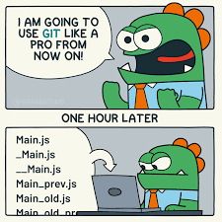
What have we learned?
What VCS, Git and GitHub are
Why they are so useful
How to undertake basic tasks in a local and remote repository
How services like GitHub improve code collaboration and Open Science

Slide 81
What next?
Practice makes perfect!
Track your hobby projects
Track your research
Use open-access code or software from publications
Consider trying Git on the command line

Slide 82
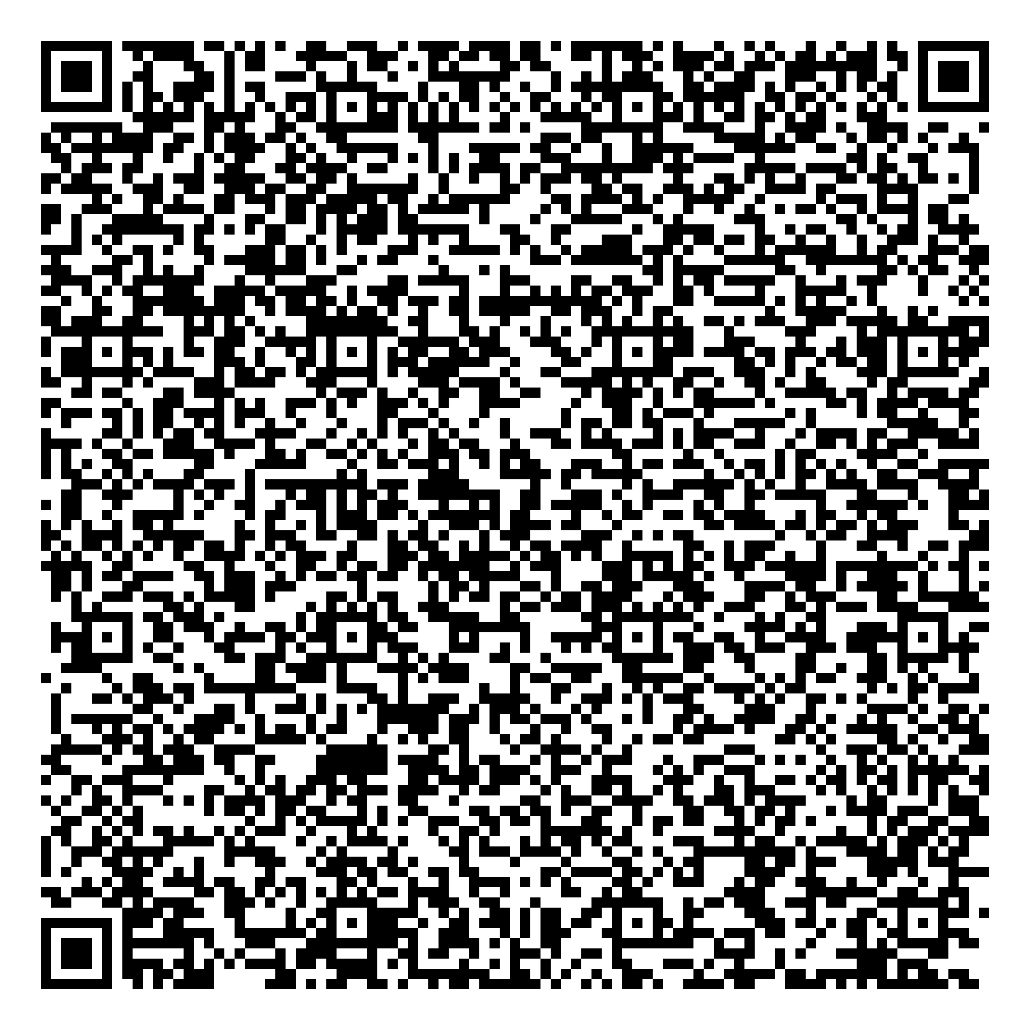


Thank you for attending!
1
2
3
Scan the QR code to confirm you attended today’s workshop.
Fill out the feedback survey in the next 72h.
Get recognition for this workshop on your
co-curricular record.

Slide 83
Image Sources
https://betterexplained.com/articles/a-visual-guide-to-version-control/
https://github.com/qw3rtman/git-fire
https://walkingrandomly.com/?p=6653

