Slide 1
Introduction to GitHub
Instructor: Adrien Osakwe
June 22nd 2022

Slide 2
Notes:
The McGill initiative on Computational Medicine was formed in 2017 and aims to deliver inter-disciplinary research programs and empower the use of data in health research and health care delivery
Located at the Genome Center
They have a newsletter were you can subscribe to
more info on the web site

Slide 3
Topics for this workshop:
Part I – Intro to Git and Version Control Systems
Part II – Basic Git functions
Part III – Advanced Git functions
Part IV – Working with GitHub

Slide 4
What you will need:
GitHub Desktop App
A Text editor
Hands-on Activities
Quick Review Polls
Git-based activities

Slide 5
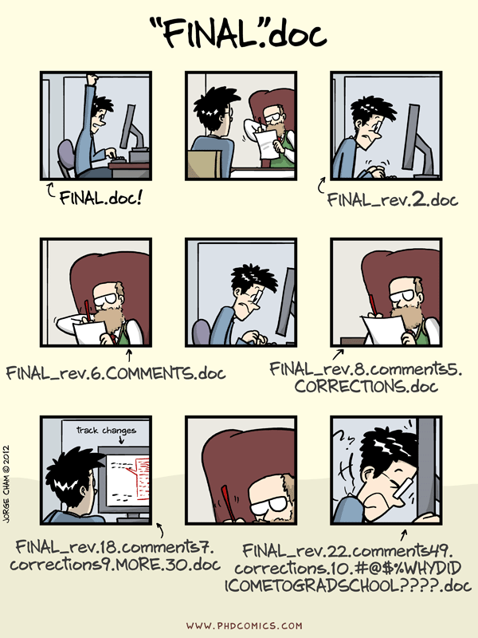

Slide 6
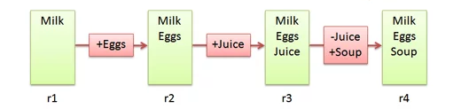
Version Control Systems
Make it easier to document changes
Less confusion
Image Source: BetterExplained
Notes:
Source: https://betterexplained.com/articles/a-visual-guide-to-version-control/

Slide 7
Git
A type of version control system

Slide 8
Git vs. GitHub
A version control system
A server that hosts git repositories

Slide 9
Git Pipeline
Working Directory ≠ Git Repository
Working directory is your project folder
Git Repository is a hidden file stored inside your working directory
The Git Repository contains the staging area and your commit history

Slide 10
Git Repository
Git Pipeline
Working
Directory
Staging
Area
Local Repository
Add
Commit
Code.py
*New*
Code.py
*New*
Code.py
*New*
Code.py
*Modified*
Code.py
*Modified*
Code.py
*Modified*
Notes:
https://www.google.com/url?sa=i&url=https%3A%2F%2Fcourses.csail.mit.edu%2F6.S194%2F13%2Flessons%2F03-git%2Fgit-commands-and-metaphors.html&psig=AOvVaw0eLwNte0CymnSwNKJIL7Zi&ust=1654357234965000&source=images&cd=vfe&ved=0CAwQjRxqFwoTCLifgozPkfgCFQAAAAAdAAAAABAk

Slide 11
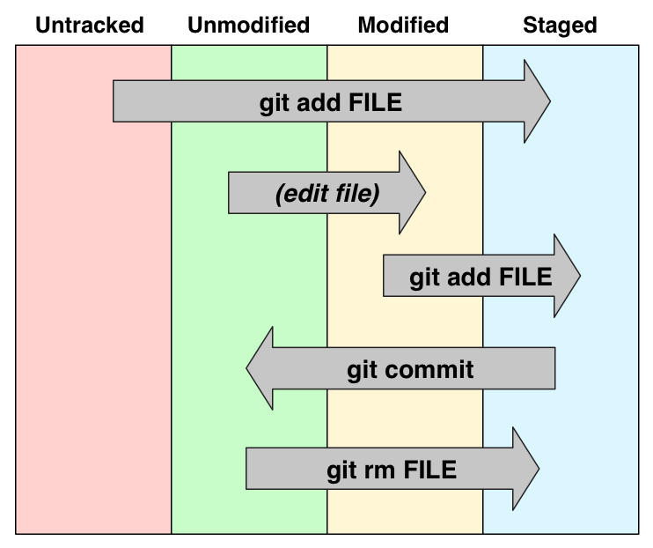

Slide 12
Summary
Have to start tracking files after creating the git repository
Untracked or modified files are first added to the staging area
Changes that have been staged can then be committed to the local repository

Slide 13
Part II – Basic Git Features

Slide 14
Activity #1 – Create and track a Text File with Git

Slide 15
Poll #1

Slide 16
Part III – Advanced Git Features

Slide 17
Add a file and track it
Edit the file
New edit with a mistake
Rebase the edit
Branching

Slide 18
Activity #2 – Create a new branch

Slide 19
Poll #2

Slide 20
Activity #3 – Merging Branches

Slide 21
Poll #2

Slide 22
Part IV – Hosting Projects on GitHub

Slide 23
Why use remote repositories like GitHub?
Backup for your code
Collaborations
Open Science

Slide 24
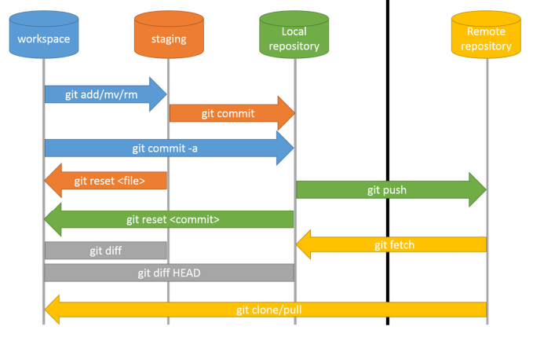

Slide 25
Pushing and Pulling
Cloning other repos
Forking

Slide 26
Part V – Conclusion

Slide 27
What have we learned?
What VCS, Git and GitHub are
Why VCS are so useful
How to undertake basic tasks in a local and remote repository
How services like GitHub improve code collaboration and Open Science

Slide 28
What next?

