Slide 1
Introduction to Git and GitHub
Instructor: Adrien Osakwe
June 22nd 2022

Slide 2
Notes:
The McGill initiative on Computational Medicine was formed in 2017 and aims to deliver inter-disciplinary research programs and empower the use of data in health research and health care delivery
Located at the Genome Center
They have a newsletter were you can subscribe to
more info on the web site

Slide 3
Outline for this workshop:
Intro to Git and Version Control Systems
Basic Git functions
Advanced Git functions
Working with GitHub
Conclusions

Slide 4
Hands-on Activities:
Quick Review Polls
Git/GitHub exercises
What you will need:
GitHub Desktop App
A Text editor
Note: Feel free to complete the workshop through the terminal

Slide 5
What you WILL learn
Basic theory and features behind Git and GitHub
How to manage local and remote repositories
What you will NOT learn
How to code
Data Analysis

Slide 6
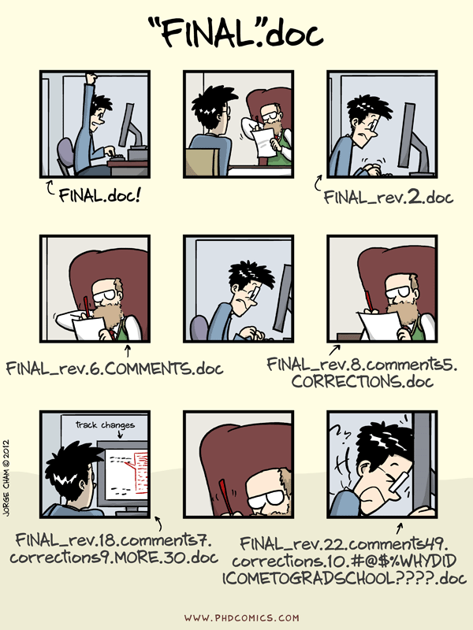

Slide 7
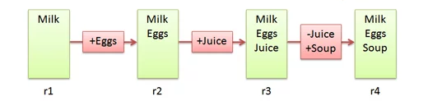
Version Control Systems
Make it easier to document changes
Less confusion
Like an unlimited “undo” button
Groceries.txt
Notes:
Source: https://betterexplained.com/articles/a-visual-guide-to-version-control/

Slide 8

Git
A type of version control system
Open-source
Most popular VCS currently in use
Creates a “Git Repository” which stores all the modified instances of your project

Slide 9
Git vs. GitHub
A version control system
Works locally and remotely
Is open-source
A server that hosts Git repositories
Works solely as a cloud-based service
Owned by Microsoft

Slide 10
Working Directory ≠ Git Repository
Working directory is your project folder
Git Repository is a hidden file stored inside your working directory
The Git Repository contains the staging area and your commit history/local repository

Slide 11
Git Repository
Git Pipeline
Working
Directory
Staging
Area
Local Repository
Add
Commit
Code.py
*New*
Code.py
*New*
Code.py
*New*
Code.py
TRACKED
Code.py
*Modified*
Code.py
*Modified*
Code.py
*Modified*
Notes:
https://www.google.com/url?sa=i&url=https%3A%2F%2Fcourses.csail.mit.edu%2F6.S194%2F13%2Flessons%2F03-git%2Fgit-commands-and-metaphors.html&psig=AOvVaw0eLwNte0CymnSwNKJIL7Zi&ust=1654357234965000&source=images&cd=vfe&ved=0CAwQjRxqFwoTCLifgozPkfgCFQAAAAAdAAAAABAk

Slide 12
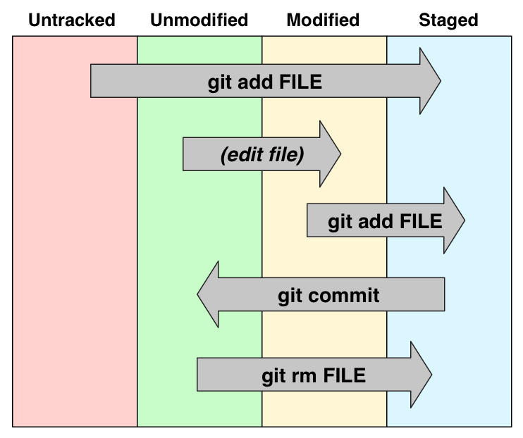

Slide 13
What is a commit?
A commit is a saved instance of your project
It has a unique ID and can be used to revert your project to a previous version
Each commit keeps track of all modifications made since the previous commit

Slide 14
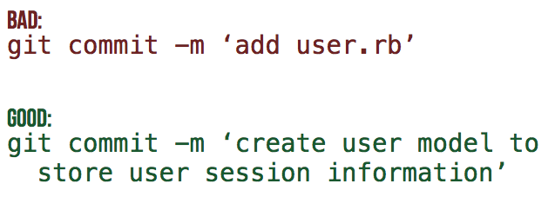
Commit Messages
Every commit MUST have an attached message/description
This helps others identify what changes have been made and why
[filename added/changed ; what change ; why]
Notes:
Need an activity here

Slide 15
Summary
Untracked or modified files are first added to the staging area
Changes that have been staged can then be committed to the local repository
Commits can then be used to revert to previous instances of the project or simply to keep track of what changes have been made

Slide 16
Poll #1
T/F – Both untracked and modified files must be added to the staging area
Where are pending changes kept prior to committing them? – staging area
T/F - GitHub is a type of VCS

Slide 17
Part II – Basic Git Features

Slide 18
Activity #0 – Initialize a Git Repository
Notes:
Make a new git repo through desktop App
Add a file to the directory
Return to desktop app and track the file
Create it, edit it, move it, remove it

Slide 19
Activity #1 – Create and track a Text File with Git
Notes:
Make a new git repo through desktop App
Add a file to the directory
Return to desktop app and track the file
Create it, edit it, move it, remove it

Slide 20
Activity #2 – Revert a text file to a previous commit
Notes:
Edit your text file with an error
Go to desktop app and reset the file to the previous commit
Repeat BUT this time commit it
Revert changes of the commit

Slide 21
Poll #2
T/F – After initialisation, a project folder becomes a git repository
Where in the git repository is a modification stored after it is “added”?
Is it possible for two commits to have the same ID?

Slide 22
Part III – Advanced Git Features

Slide 23
What if you want to test out a new feature without affecting your current version of the code?
Branching

Slide 24
What is a Branch?
A specific “timeline” of your commit history
Allows us to implement new features without harming viable releases
New Feature
Debugged New Feature
Dev
Main/Master
Initial Commit
Debug Commit
Release 1.0.0
Patched Release

Slide 25
Activity #3 – Create a new branch
Notes:
Create new branch and make changes

Slide 26
Now that your test feature works, you might want to make it part of your official release
Merge

Slide 27
What is a Merge?
Action that will “merge” the commits from one branch into another
New Feature
Debugged New Feature
New Feature + Patch
Dev
Main/Master
Release 1.0.0
Patched Release
Release 1.1.0

Slide 28
Activity #4 – Merging Branches

Slide 29
Merging is not the only way to combine branches
Rebasing

Slide 30
Rebasing
Instead of merging the other branch’s changes as a new commit, rebasing rewrites the target branch’s commit history to add the commits directly
New Feature
Debugged New Feature
Dev
Main/Master
Release 1.0.0
Patched Release
New Feature
Debugged New Feature

Slide 31
Conflicts
If branches have competing commits, git will raise a conflict and not be able to merge/rebase
Can occur if:
Both branches edit the same line
Both added a file of the same name
One branch edited a file, the other deleted it

Slide 32
Activity #5 – Resolving Conflicts

Slide 33
Summary
Branches can be used to develop new features without affecting a previous, viable version of your code
Merges or Rebases can be used to combine the commits of two different branches
Conflicts prevent branches from being combined

Slide 34
Poll #3
When could it be more useful to rebase a branch instead of merging?
T/F – Merging branches with changes in the same file will ALWAYS create a merge conflict
How could we prevent conflicts from occurring?

Slide 35
Part IV – Hosting Projects on GitHub

Slide 36
GitHub Interface
Notes:
On this slide I can just open GitHub and explore the different features and options

Slide 37
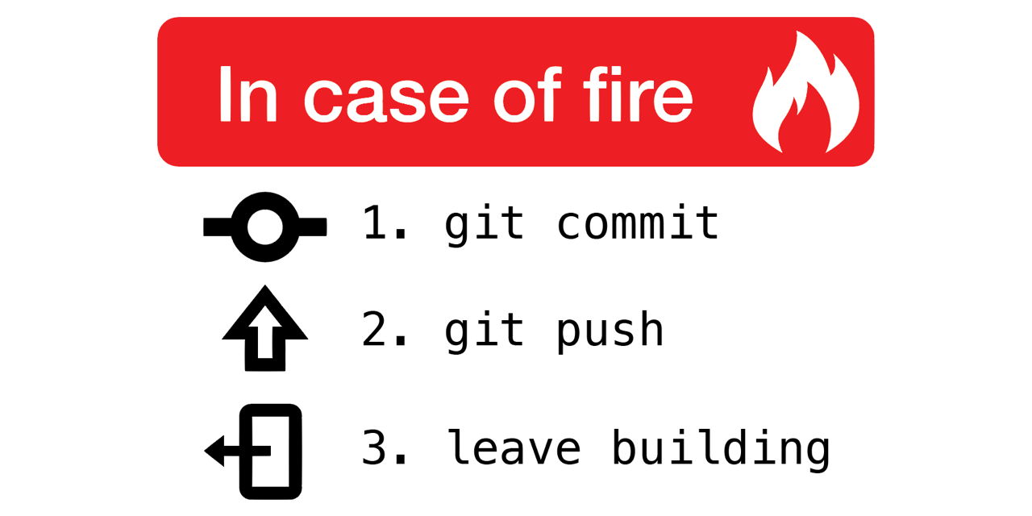
Why use remote repositories like GitHub?
Backup for your code
Can access the repository from anywhere
Collaborations
Easy to keep track of changes made by you and collaborators
Open Science
Easy to access, download and use others’ code
Easy to discuss with users of your code

Slide 38
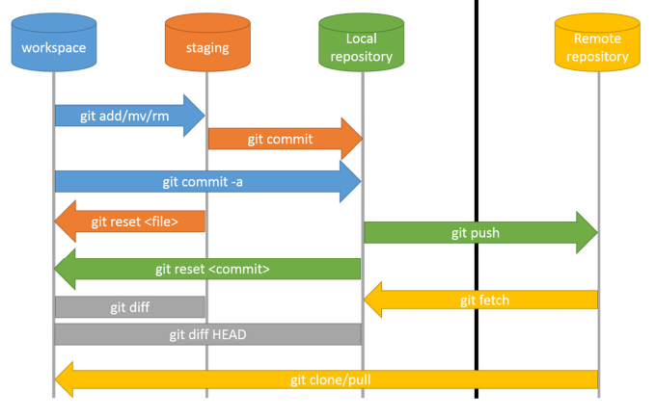

Slide 39
Pushing and Pulling
Push: Updates your remote repository with recent commits from your local repository
Pull: Updates your local repository with recent commits from your remote repository

Slide 40
Activity #6 – Pushing commits to GitHub

Slide 41
Activity #7 – Pulling Commits from GitHub

Slide 42
Create a local copy of a GitHub Repository
“Cloning”
Usually done to use published code
Reproduce results
Use code on a dataset of interest
Creates a direct link to the original repository
Anything changes you push will affect the original repository
Any changes in the original repo can be pulled into your clone

Slide 43
Activity #8 – Clone a Repository
- Find a GitHub repo that interests you and clone it!

Slide 44
Create a remote copy of a GitHub Repository
“Fork”
Usually used to contribute to published code
Can then edit the forked repository locally
Can then push local changes to your forked copy
When your changes are done, you can make a pull request to add your changes to the original repo
Much safer way to contribute to source code

Slide 45
Activity #9 – Fork a Repo and make a Pull Request
- Fork the repo I made for this course and add a text file to it. Then, make a pull request!

Slide 46
Poll #4
What command lets you update your remote repo with local changes?
T/F - Cloning a repository is the best way to contribute new features
T/F – You will always be able to push changes from a cloned repo to the original
What is the advantage of using a Pull Request prior to merging changes from a contributor?

Slide 47
Part V – Conclusion

Slide 48
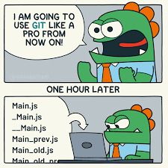
What have we learned?
What VCS, Git and GitHub are
Why they are so useful
How to undertake basic tasks in a local and remote repository
How services like GitHub improve code collaboration and Open Science

Slide 49
What next?
Just use Git!
Track your hobby projects
Track your research
Use open-access code or software from publications
Consider trying Git on the command line

Slide 50
Questions?

Slide 51
Image Sources
https://betterexplained.com/articles/a-visual-guide-to-version-control/
https://github.com/qw3rtman/git-fire
https://walkingrandomly.com/?p=6653

