Slide 1
Introduction to Git and GitHub
Instructor: Adrien Osakwe
June 22nd 2022

Slide 2
Notes:
The McGill initiative on Computational Medicine was formed in 2017 and aims to deliver inter-disciplinary research programs and empower the use of data in health research and health care delivery
Located at the Genome Center
They have a newsletter were you can subscribe to
more info on the web site

Slide 3
Outline for this workshop:
Intro to Git and Version Control Systems
Basic Git functions
Advanced Git functions
Working with GitHub
Conclusions

Slide 4
Hands-on Activities:
Quick Review Polls
Git/GitHub exercises
What you will need:
GitHub Desktop App
A Text editor
Note: Feel free to complete the workshop through the terminal

Slide 5
What you WILL learn
Basic theory and features behind Git and GitHub
How to manage local and remote repositories
What you will NOT learn
How to code
Data Analysis

Slide 6
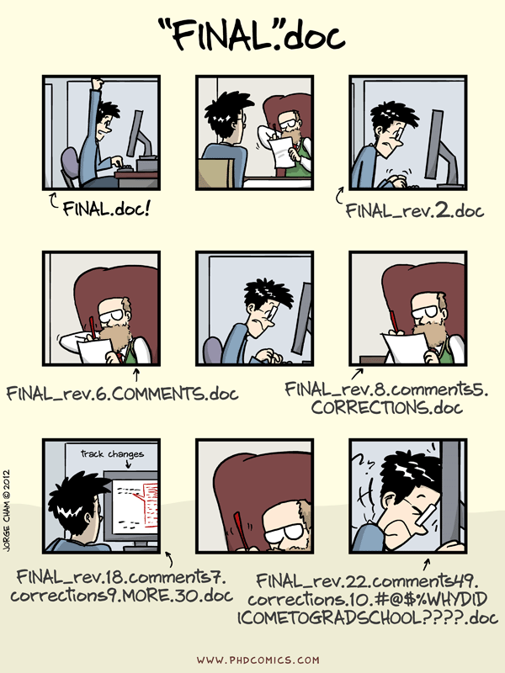

Slide 7
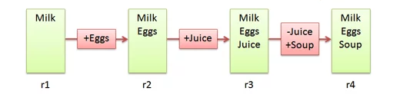
Version Control Systems
Make it easier to document changes
Less confusion
Like an unlimited “undo” button
Groceries.txt
Notes:
Source: https://betterexplained.com/articles/a-visual-guide-to-version-control/

Slide 8

Git
A type of version control system
Open-source
Most popular VCS currently in use
Creates a “Git Repository” which stores all the modified instances of your project

Slide 9
What kind of files does Git track?
Can track any file, but works best for pure text files (.txt,.R,.py etc.)
Word documents, PowerPoint slides are in binary; Git has no support for displaying the changes occurring in these files
Still useful for storing such files, just doesn’t make the most of all of Git’s features
Markdown and LaTeX can be used instead of these binary files

Slide 10
Git vs. GitHub
A version control system
Works locally and remotely
Is open-source
A server that hosts Git repositories
Works solely as a cloud-based service
Owned by Microsoft

Slide 11
Working Directory ≠ Git Repository
Working directory is your project folder
Git Repository is a hidden file stored inside your working directory
The Git Repository contains the staging area and your commit history/local repository

Slide 12
Git Repository
Git Pipeline
Working
Directory
Staging
Area
Local Repository
Add
Commit
Code.py
*New*
Code.py
*New*
Code.py
*New*
Code.py
TRACKED
Code.py
*Modified*
Code.py
*Modified*
Code.py
*Modified*
Notes:
https://www.google.com/url?sa=i&url=https%3A%2F%2Fcourses.csail.mit.edu%2F6.S194%2F13%2Flessons%2F03-git%2Fgit-commands-and-metaphors.html&psig=AOvVaw0eLwNte0CymnSwNKJIL7Zi&ust=1654357234965000&source=images&cd=vfe&ved=0CAwQjRxqFwoTCLifgozPkfgCFQAAAAAdAAAAABAk

Slide 13
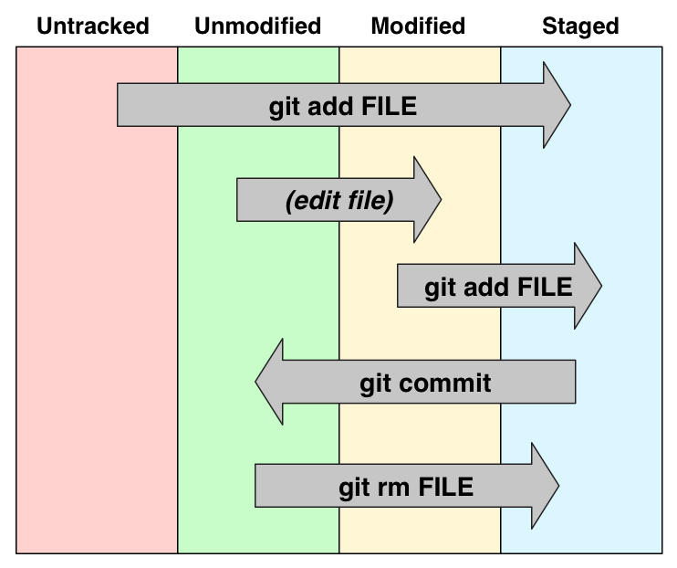

Slide 14
What is a commit?
A commit is a saved instance of your project
It has a unique ID and can be used to revert your project to a previous version
Each commit keeps track of all modifications made since the previous commit

Slide 15
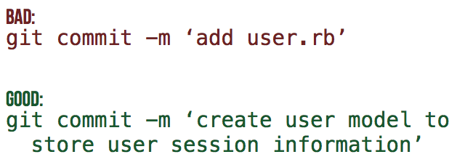
Commit Messages
Every commit MUST have an attached message/description
This helps others identify what changes have been made and why
[filename added/changed ; what change ; why]
Notes:
Need an activity here

Slide 16
Summary
Untracked or modified files are first added to the staging area
Changes that have been staged can then be committed to the local repository
Commits can then be used to revert to previous instances of the project or simply to keep track of what changes have been made

Slide 17
Poll #1
T/F – Both untracked and modified files must be added to the staging area
Where are pending changes kept prior to committing them? – staging area
T/F - GitHub is a type of VCS

Slide 18
Part II – Basic Git Features

Slide 19
Activity #0 – Initialize a Git Repository
Notes:
Make a new git repo through desktop App
Add a file to the directory
Return to desktop app and track the file
Create it, edit it, move it, remove it

Slide 20
Activity #0 – Initialize a Git Repository
Create a new Git Repository (File → new repo OR “create a new repository on your hard drive)
Open the generated project folder, what do you see?
Notes:
Make a new git repo through desktop App
Add a file to the directory
Return to desktop app and track the file
Create it, edit it, move it, remove it

Slide 21
Activity #1 – Create and track a Text File with Git
Notes:
Make a new git repo through desktop App
Add a file to the directory
Return to desktop app and track the file
Create it, edit it, move it, remove it

Slide 22
Activity #1 – Create and track a Text File with Git
Create a text file (or code script) in the project folder
Open the GitHub Desktop App and add + commit the file to track it.
Look at your commit history to see your commit!
Modify the file and commit the changes. Try and make informative commit messages!
Notes:
Make a new git repo through desktop App
Add a file to the directory
Return to desktop app and track the file
Create it, edit it, move it, remove it

Slide 23
Activity #2 – Revert a file to a previous commit
Notes:
Edit your text file with an error
Go to desktop app and reset the file to the previous commit
Repeat BUT this time commit it
Revert changes of the commit

Slide 24
Activity #2 – Revert a file to a previous commit
Make an unwanted change to your file
Use your commit history to revert to the previous commit
Make another unwanted change and commit it
Now use your commit history to revert the commit!
Notes:
Edit your text file with an error
Go to desktop app and reset the file to the previous commit
Repeat BUT this time commit it
Revert changes of the commit

Slide 25
Poll #2
T/F – After initialisation, a project folder becomes a git repository
Where in the git repository is a modification stored after it is “added”?
Is it possible for two commits to have the same ID?

Slide 26
Part III – Advanced Git Features

Slide 27
What if you want to test out a new feature without affecting your current version of the code?
Branching

Slide 28
What is a Branch?
A specific “timeline” of your commit history
Allows us to implement new features without harming viable releases
New Feature
Debugged New Feature
Dev
Main/Master
Initial Commit
Debug Commit
Release 1.0.0
Patched Release

Slide 29
Activity #3 – Create a new branch
Notes:
Create new branch and make changes

Slide 30
Activity #3 – Create a new branch
Click the “current branch” button and select “new branch”
Make changes to your file in the new branch and commit it
Switch back to the main branch and open the file, what do you notice?
Notes:
Create new branch and make changes

Slide 31
Now that your test feature works, you might want to make it part of your official release
Merge

Slide 32
What is a Merge?
Action that will “merge” the commits from one branch into another
New Feature
Debugged New Feature
New Feature + Patch
Dev
Main/Master
Release 1.0.0
Patched Release
Release 1.1.0

Slide 33
Activity #4 – Merging Branches

Slide 34
Activity #4 – Merging Branches
Switch to the main branch
Open the branch menu
Select the “choose a branch to merge into main” button and select your second branch.
Compare the branches again, the file should now be identical in both!

Slide 35
Merging is not the only way to combine branches
Rebasing

Slide 36
Rebasing
Instead of merging the other branch’s changes as a new commit, rebasing rewrites the target branch’s commit history to add the commits directly
New Feature
Debugged New Feature
Dev
Main/Master
Release 1.0.0
Patched Release
New Feature
Debugged New Feature

Slide 37
Conflicts
If branches have competing commits, git will raise a conflict and not be able to merge/rebase
Can occur if:
Both branches edit the same line
Both added a file of the same name
One branch edited a file, the other deleted it

Slide 38
Activity #5 – Resolving Conflicts

Slide 39
Activity #5 – Resolving Conflicts
In both branches, make a change on the same line and commit it
Try and merge your second branch into the main
When the merge conflict occurs, open the text file and resolve the issue
Try to merge again
Look at your commit history, how is your resolved merge shown in the commit?

Slide 40
Summary
Branches can be used to develop new features without affecting a previous, viable version of your code
Merges or Rebases can be used to combine the commits of two different branches
Conflicts prevent branches from being combined

Slide 41
Poll #3
When could it be more useful to rebase a branch instead of merging?
T/F – Merging branches with changes in the same file will ALWAYS create a merge conflict
How could we prevent conflicts from occurring?

Slide 42
Part IV – Hosting Projects on GitHub

Slide 43
GitHub Interface
Notes:
On this slide I can just open GitHub and explore the different features and options

Slide 44
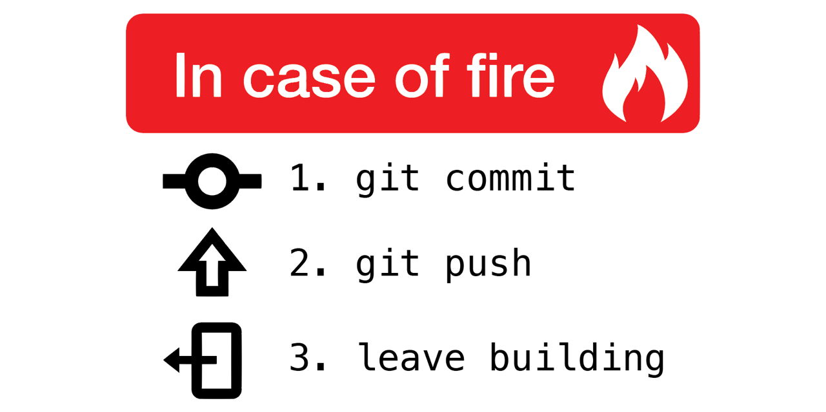
Why use remote repositories like GitHub?
Backup for your code
Can access the repository from anywhere
Collaborations
Easy to keep track of changes made by you and collaborators
Open Science
Easy to access, download and use others’ code
Easy to discuss with users of your code

Slide 45
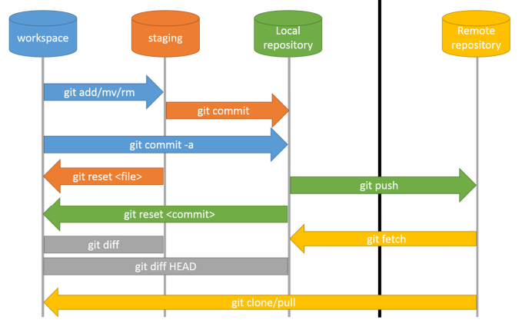

Slide 46
Pushing and Pulling
Push: Updates your remote repository with recent commits from your local repository
Pull: Updates your local repository with recent commits from your remote repository

Slide 47
Activity #6 – Pushing commits to GitHub

Slide 48
Activity #6 – Pushing commits to GitHub
Click the “Publish Repository” button
Now open your GitHub account in the browser and find your repository. See if your commit history is the same as in your local repo.

Slide 49
Activity #7 – Pulling Commits from GitHub

Slide 50
Activity #7 – Pulling Commits from GitHub
From the GitHub website, open your file and select the edit option
Make a change to the file and commit it.
Return to the desktop app and do Repository -> Pull
Look at your commit history and your file, what do you see?

Slide 51
Create a local copy of a GitHub Repository
“Cloning”
Usually done to use published code
Reproduce results
Use code on a dataset of interest
Creates a direct link to the original repository
Anything changes you push will affect the original repository
Any changes in the original repo can be pulled into your clone

Slide 52
Activity #8 – Clone a Repository
- Find a GitHub repo that interests you and clone it!

Slide 53
Activity #8 – Clone a Repository
Go to the GitHub website and search for a repo that interests you.
Copy the repo’s URL
In the Desktop App, do File → Clone a repository and paste the URL.
Open the cloned repo and explore!

Slide 54
Create a remote copy of a GitHub Repository
“Fork”
Usually used to contribute to published code
Can then edit the forked repository locally
Can then push local changes to your forked copy
When your changes are done, you can make a pull request to add your changes to the original repo
Much safer way to contribute to source code

Slide 55
Activity #9 – Fork a Repo and make a Pull Request
- Fork the repo I made for this course and add a text file to it. Then, make a pull request!

Slide 56
Activity #9 – Fork a Repo and make a Pull Request
Open the link in chat to access the repo I made.
Click the “fork” button
Clone your forked copy to your computer and add a text file with one thing you have learned today. Commit the file.
Push the commit to your forked repo.
On the GitHub website. Look at your forked repo and select the “create Pull Request” button

Slide 57
Poll #4
What command lets you update your remote repo with local changes?
T/F - Cloning a repository is the best way to contribute new features
T/F – You will always be able to push changes from a cloned repo to the original
What is the advantage of using a Pull Request prior to merging changes from a contributor?

Slide 58
Part V – Conclusion

Slide 59
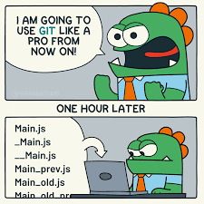
What have we learned?
What VCS, Git and GitHub are
Why they are so useful
How to undertake basic tasks in a local and remote repository
How services like GitHub improve code collaboration and Open Science

Slide 60
What next?
Just use Git!
Track your hobby projects
Track your research
Use open-access code or software from publications
Consider trying Git on the command line

Slide 61
Questions?

Slide 62
Image Sources
https://betterexplained.com/articles/a-visual-guide-to-version-control/
https://github.com/qw3rtman/git-fire
https://walkingrandomly.com/?p=6653

