Slide 1
Introduction to GitHub
Instructor: Adrien Osakwe
June 22nd 2022

Slide 2
Notes:
The McGill initiative on Computational Medicine was formed in 2017 and aims to deliver inter-disciplinary research programs and empower the use of data in health research and health care delivery
Located at the Genome Center
They have a newsletter were you can subscribe to
more info on the web site

Slide 3
Topics for this workshop:
Part I – Intro to Git and Version Control Systems
Part II – Basic Git functions
Part III – Advanced Git functions
Part IV – Working with GitHub

Slide 4
What you will need:
GitHub Desktop App
A Text editor
Hands-on Activities
Quick Review Polls
Git-based activities

Slide 5
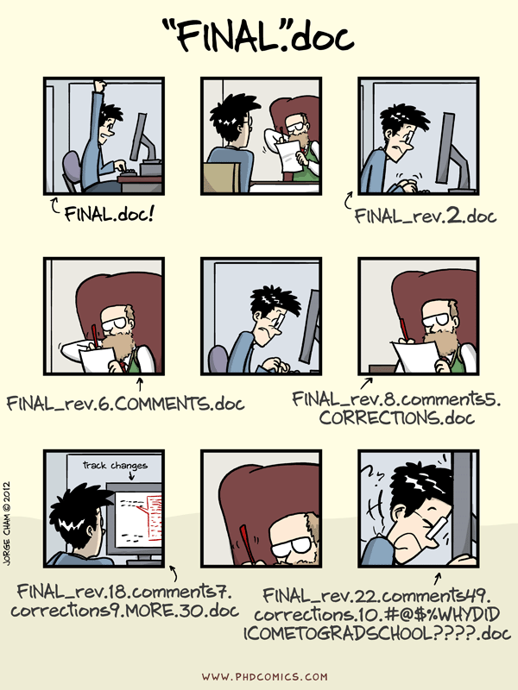

Slide 6
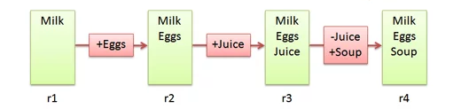
Version Control Systems
Make it easier to document changes
Less confusion
Groceries.txt
Image Source: BetterExplained
Notes:
Source: https://betterexplained.com/articles/a-visual-guide-to-version-control/

Slide 7

Git
A type of version control system
Made by Linus Torvalds for Linux
Open-source
Most popular VCS currently in use
Create a “Git Repository” which stores all the modified instances of your project

Slide 8
Git vs. GitHub
A version control system
Works locally and remotely
Is open-source
A server that hosts git repositories
Works solely as a cloud-based service
Owned by Microsoft

Slide 9
Git Pipeline
Working Directory ≠ Git Repository
Working directory is your project folder
Git Repository is a hidden file stored inside your working directory
The Git Repository contains the staging area and your commit history

Slide 10
Git Repository
Git Pipeline
Working
Directory
Staging
Area
Local Repository
Add
Commit
Code.py
*New*
Code.py
*New*
Code.py
*New*
Code.py
*Modified*
Code.py
*Modified*
Code.py
*Modified*
Notes:
https://www.google.com/url?sa=i&url=https%3A%2F%2Fcourses.csail.mit.edu%2F6.S194%2F13%2Flessons%2F03-git%2Fgit-commands-and-metaphors.html&psig=AOvVaw0eLwNte0CymnSwNKJIL7Zi&ust=1654357234965000&source=images&cd=vfe&ved=0CAwQjRxqFwoTCLifgozPkfgCFQAAAAAdAAAAABAk

Slide 11
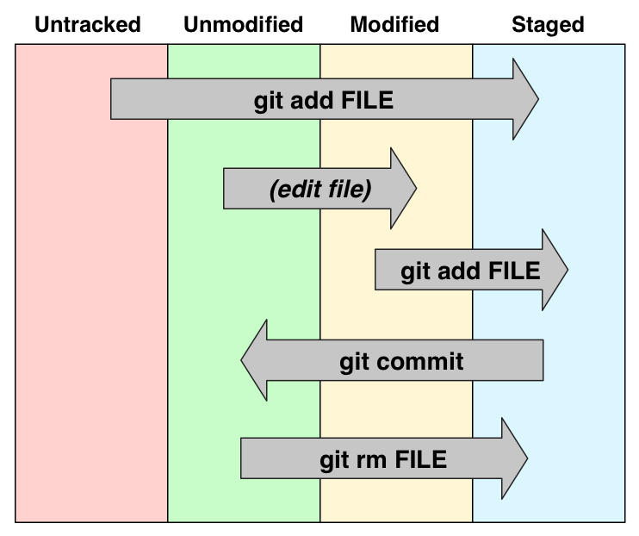

Slide 12
What is a commit?
A commit is a saved instance of your project
It has a unique ID and can be used to revert your project to a previous version
Each commit keeps track of all modifications made since the previous commit

Slide 13
Summary
Untracked or modified files are first added to the staging area
Changes that have been staged can then be committed to the local repository
Commits can then be used to revert to previous instances of the project or simply to keep track of what changes have been made

Slide 14
Part II – Basic Git Features

Slide 15
Activity #1 – Create and track a Text File with Git
Notes:
Create it, edit it, move it, remove it

Slide 16
Poll #1
T/F – After initialisation, a project folder becomes a git repository
Where in the git repository is a modification stored after it is “added”?
Is it possible for two commits to have the same ID?

Slide 17
Activity #2 – Revert a text file to a previous commit

Slide 18
Part III – Advanced Git Features

Slide 19
Branching
Merging

Slide 20
Activity #3 – Create a new branch
Notes:
Create new branch and make changes

Slide 21
Poll #2

Slide 22
Activity #4 – Merging Branches

Slide 23
Poll #2

Slide 24
Activity #5 – Merging Branches with different histories

Slide 25
Part IV – Hosting Projects on GitHub

Slide 26
Why use remote repositories like GitHub?
Backup for your code
Collaborations
Open Science

Slide 27
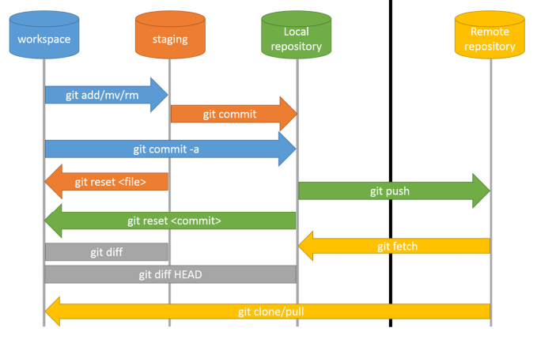

Slide 28
Pushing and Pulling
Cloning other repos
Forking

Slide 29
Activity #6 – Pushing commits to GitHub

Slide 30
Activity #7 – Pulling Commits from GitHub

Slide 31
Activity #8 – Clone a Repository
- Find a GitHub repo that interests you and clone it!

Slide 32
Activity #9 – Fork a Repo and make a Pull Request
- For the repo I made for this course and add a text file to it. Then, make a pull request!

Slide 33
Part V – Conclusion

Slide 34
What have we learned?
What VCS, Git and GitHub are
Why VCS are so useful
How to undertake basic tasks in a local and remote repository
How services like GitHub improve code collaboration and Open Science

Slide 35
What next?
Just use Git!
Track your hobby projects
Track your research
Access open-access code or software from publications

Slide 36
References
https://betterexplained.com/articles/a-visual-guide-to-version-control/

