Slide 1
Popularität von Musik
Analyse von Spotify Musik

Slide 2
Datensatz
track_id
track_name
track_artist
track_popularity
track_album_id
track_album_name
track_album_release_date
playlist_name
playlist_id
playlist_genre
playlist_subgenre
Danceability
Danceability
Energy
Key
Loudness
Mode
Speechiness
Acousticness
Instrumentalness
Liveness
Valence
Tempo
duration_ms

Slide 3
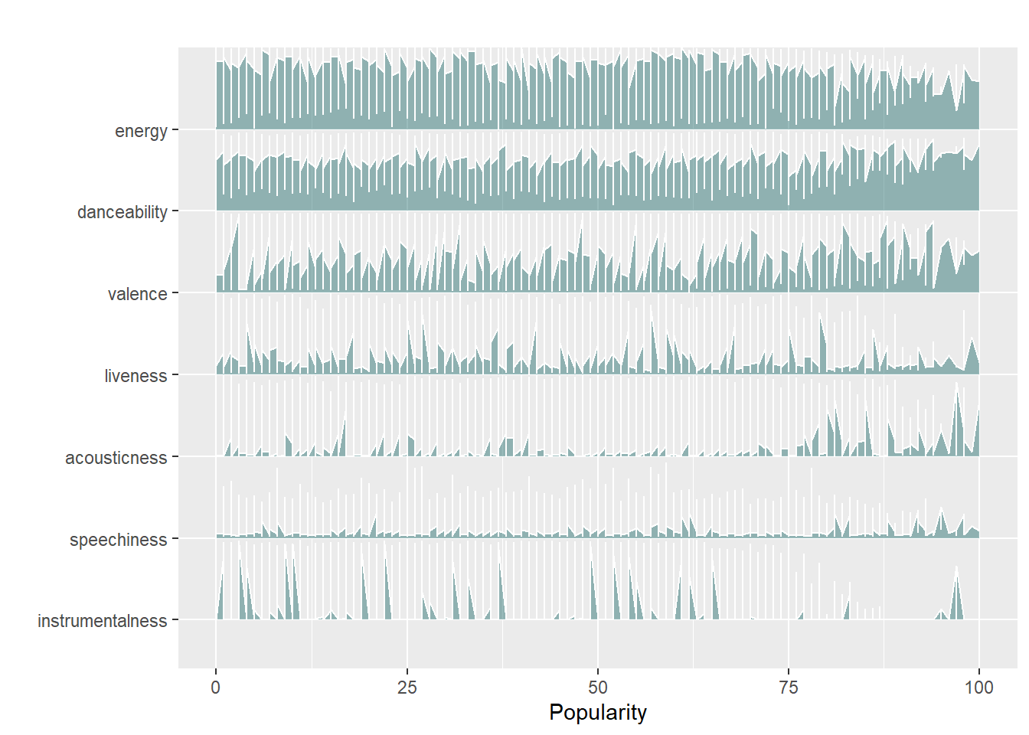
Indikatoren für Popularität

