Slide 1








Semantic Web, Linked Data and Knowledge Graphs
Group 17

Slide 2
Linked Data generation process
Define resource naming strategy
Resource naming strategy
Select data source
Develop ontology
Ontology
Data source
Ontology
Obtain access to data source
Access data
Analyse data source
Transform data source
Schema, data
RDF data
Analyse licensing of the data source
Link with other datasets
Linked dataset
License

Slide 3

Data set
Selection of the data source: https://datos.madrid.es/
Obtaining access to data source: cvs files
Analysing licensing of the data source: The general conditions allow reusing the documents for comercial and non comercial purposes.
Licensing details: https://datos.madrid.es/portal/site/egob/menuitem.400a817358ce98c34e937436a8a409a0/?vgnextoid=b4c412b9ace9f310VgnVCM100000171f5a0aRCRD
4. Analysing data source:
Calidad del aire. Datos en tiempo real: Estación, Magnitud, Año, Mes, Día, H1, H2, etc.
Calidad del aire. Estaciones de control: Código, Estación, Dirección, Coordenadas, etc.
Callejero Oficial del Ayuntamiento de Madrid: Código Vía, Nombre Vía, Distrito, Barrio, Coordenadas, etc.

Slide 4

Resource Naming Strategy
At this point we had to choose a URI form (hash or slash), a domain for the URIs, a path for the URIs, and pattern for ontology classes and properties in the ontology, as well as for individuals.
Purpose | Name
Domain: | http://group17.org/
Ontological terms path: | http://group17.org/ontology/Pollution#
Individuals path: | http://group17.org/resource/
Ontological terms pattern: | http://group17.org/ontology/Pollution#<term_name>
Individuals pattern: | http://group17.org/ontology/Pollution/resource/<resource_type>/<resource_name>

Slide 5
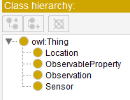
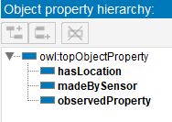
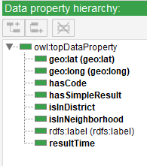

Ontology
Our ontology integrates classes and properties from different ontologies like, for example, geo or sosa (Semantic Sensor Network Ontology).

Slide 6
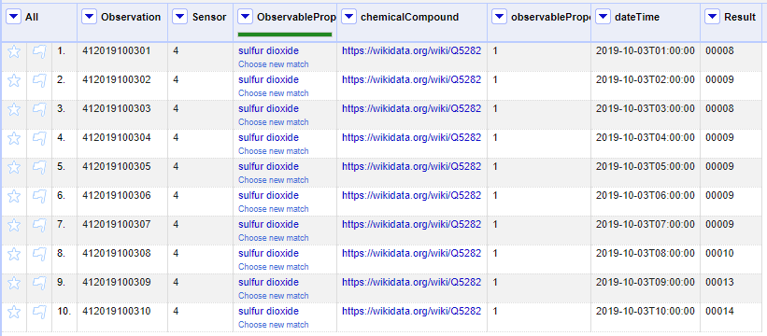
Data transformation
In order to Analyse and Transform the data in our 3 csv files we modified the projects in OpenRefine.
Calidad del aire. Datos en tiempo real → Observations
Hour columns into rows
Creation of the identifier for Observations
dateTime column unifying time and date columns
Reconciliation with Wikidata ‘chemical compound’
New columna with the reconciliation results

Slide 7
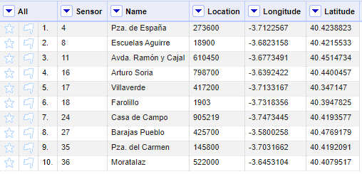
Data transformation
Initial columns:
CODIGO CODIGO_CORTO
ESTACION DIRECCION
LONGITUD_ETRS89
LATITUD_ETRS89
ALTITUD COD_TIPO
NOM_TIPO
NO2
SO2
CO
PM10
PM2_5
O3
BTX HC
COD_VIA
VIA_CLASE
VIA_PAR
VIA_NOMBRE
Fecha alta
COORDENADA_X_ETRS89
COORDENADA_Y_ETRS89
LONGITUD
LATITUD
Calidad del aire. Estaciones de control → Sensors

Slide 8
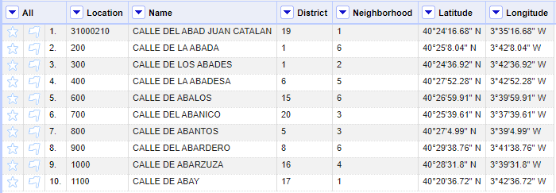
Data transformation
Initial columns:
COD_VIA
VIA_CLASE
VIA_PAR
VIA_NOMBRE
VIA_NOMBRE_ACENTOS
CLASE_APP
NUMERO
CALIFICADOR
TIPO_NDP
COD_NDP
DISTRITO
BARRIO
COD_POSTAL
UTMX_ED
UTMY_ED
UTMX_ETRS
UTMY_ETRS
LATITUD
LONGITUD
ANGULO_ROTULACION
Calidad del aire. Estaciones de control → Sensors

Slide 9

Data linking
We applied Reconciliation to the column ObservableProperty, which contains the gas that is being measured by the sensor in a particular observation.
We matched every gas in this column to the Wikidata result for the chemical compound.

Slide 10
Demo time!

Slide 11
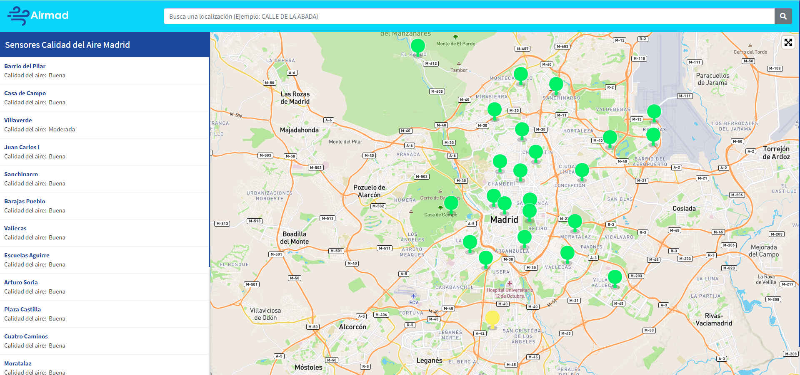
Demo screenshots
Search input
Sensor marker
Sensors list

Slide 12
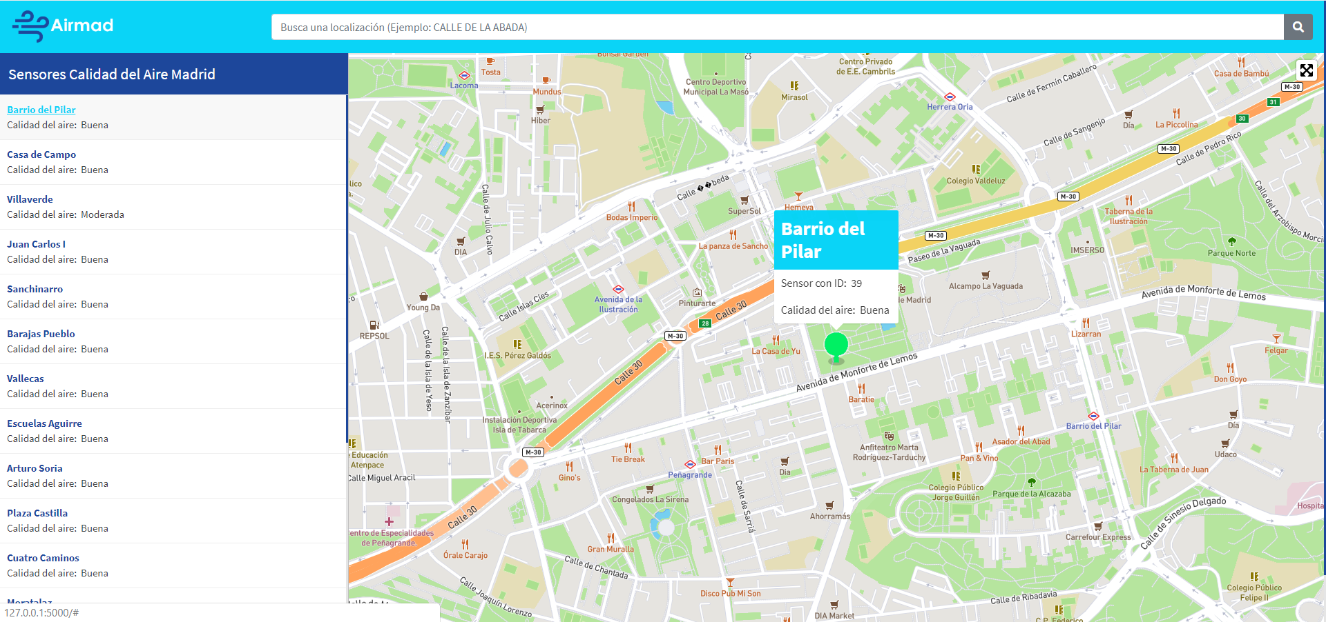
Demo screenshots
Sensor ID
Sensor marker
Air quality
Sensor selection

Slide 13
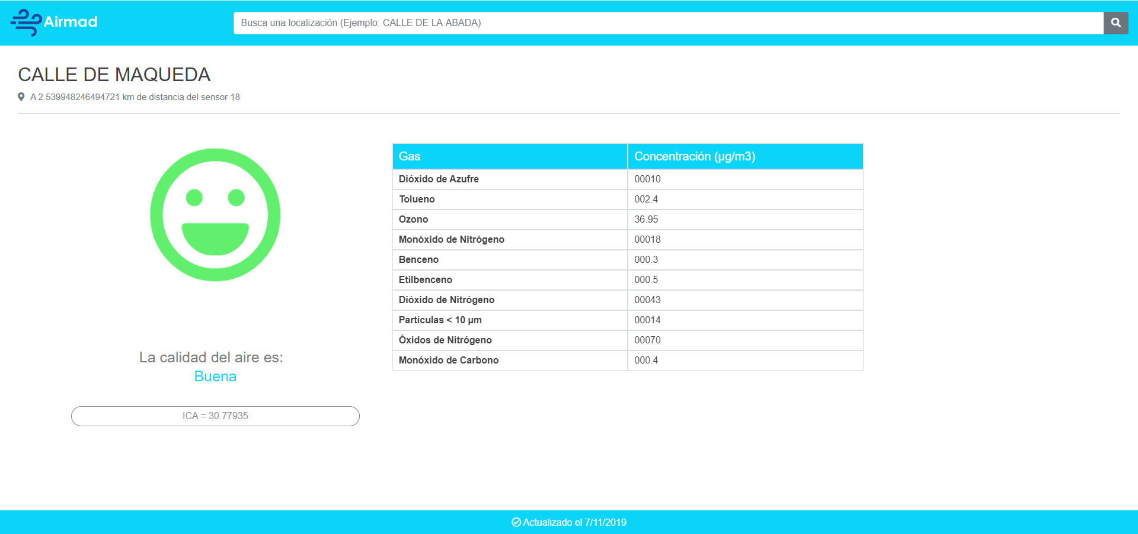
Demo screenshots
Gas measured
Measurement values
Distance from the street to the closest sensor
Air quality according to ICA levels
Air quality index

Slide 14
References and Sources:
Portal de datos abiertos del Ayuntamiento de Madrid. Calidad del Aire. Datos en tiempo real. https://datos.madrid.es/sites/v/index.jsp?vgnextoid=41e01e007c9db410VgnVCM2000000c205a0aRCRD&vgnextchannel=374512b9ace9f310VgnVCM100000171f5a0aRCRD
Portal de datos abiertos del Ayuntamiento de Madrid. Calidad del Aire. Calidad del aire. Estaciones de control.
https://datos.madrid.es/sites/v/index.jsp?vgnextoid=9e42c176313eb410VgnVCM1000000b205a0aRCRD&vgnextchannel=374512b9ace9f310VgnVCM100000171f5a0aRCRD
Portal de datos abiertos del Ayuntamiento de Madrid. Calidad del Aire. Callejero Oficial del Ayuntamiento de Madrid.
https://datos.madrid.es/sites/v/index.jsp?vgnextoid=b3c41f3cf6a6c410VgnVCM2000000c205a0aRCRD&vgnextchannel=374512b9ace9f310VgnVCM100000171f5a0aRCRD
Portal de datos abiertos del Ayuntamiento de Madrid. Acerca de Datos de Abiertos. Condiciones de Uso.
https://datos.madrid.es/portal/site/egob/menuitem.400a817358ce98c34e937436a8a409a0/?vgnextoid=b4c412b9ace9f310VgnVCM100000171f5a0aRCRD

