Slide 1


Adrià Rosselló Martínez
08/20/2026

Slide 2

Outline
Executive Summary
Introduction
Methodology
Results
Conclusion
Appendix

Slide 3
Executive Summary
Methodology: data collection via the SpaceX API and web scraping of Wikipedia, data wrangling to build the landing-success label, EDA with SQL and visualization, geospatial analysis with Folium, and predictive modeling with 4 classification algorithms (Logistic Regression, SVM, Decision Tree, KNN) tuned with GridSearchCV.
Results: across 90 historical Falcon 9 launches, the overall first-stage landing success rate is 66.7%. KSC LC-39A is the site with the highest success rate (76.9%). Success rate clearly improves with flight number and over the years (from 0% in 2010-2014 to 77.8% in 2017).
The best classification model (Decision Tree) reaches 87.5% cross-validation accuracy; all 4 models tie at 83.3% accuracy on the test set.

Slide 4
Introduction
SpaceX markets Falcon 9 launches at a cost of ~$62M, compared to more than $165M for other providers — the savings come largely from reusing the first stage of the rocket.
If we can predict whether the first stage will land successfully, we can estimate the cost of a launch — key information for another company to compete with SpaceX for a launch contract.
Questions this project aims to answer: which variables (launch site, orbit, payload mass, flight number, booster version) drive landing success? Has the success rate improved over time? Which model best predicts the landing outcome?

Slide 5

Section 1

Slide 6
Methodology
Data collection methodology: launch records were pulled from the public SpaceX REST API (rocket, launchpad, payload, core data) and combined with a web-scraped Falcon 9/Falcon Heavy launch table from Wikipedia.
Data wrangling: built the binary target Class (1 = successful landing, 0 = failed) from the raw Outcome field, and handled missing values (PayloadMass imputed with the mean, LandingPad kept null when no attempt was made).
Exploratory data analysis (EDA) using visualization and SQL: examined how flight number, payload mass, orbit, and launch site relate to landing success, both graphically (matplotlib/seaborn) and via SQL queries on a SQLite database.
Interactive visual analytics using Folium and Plotly Dash: built an interactive map of launch sites and outcomes, and a dashboard to explore success rate by site and payload range.
Predictive analysis using classification models: standardized features, split train/test (80/20), and built, tuned (GridSearchCV, cv=10) and evaluated 4 classification models — Logistic Regression, SVM, Decision Tree, and KNN — to find the best predictor of landing success.

Slide 7
Data Collection
Two complementary data sources were combined to build the launch dataset:
SpaceX REST API (api.spacexdata.com): GET requests to retrieve rocket, launchpad, payload, and core details for every historical launch, filtered down to Falcon 9 only.
Web scraping (Wikipedia): BeautifulSoup was used to parse the 'List of Falcon 9 and Falcon Heavy launches' page and extract flight number, date, site, payload, orbit, customer, and outcome for each launch.
The two sources were merged and cleaned (missing-value imputation) into a single dataset used for all downstream analysis and modeling.

Slide 8
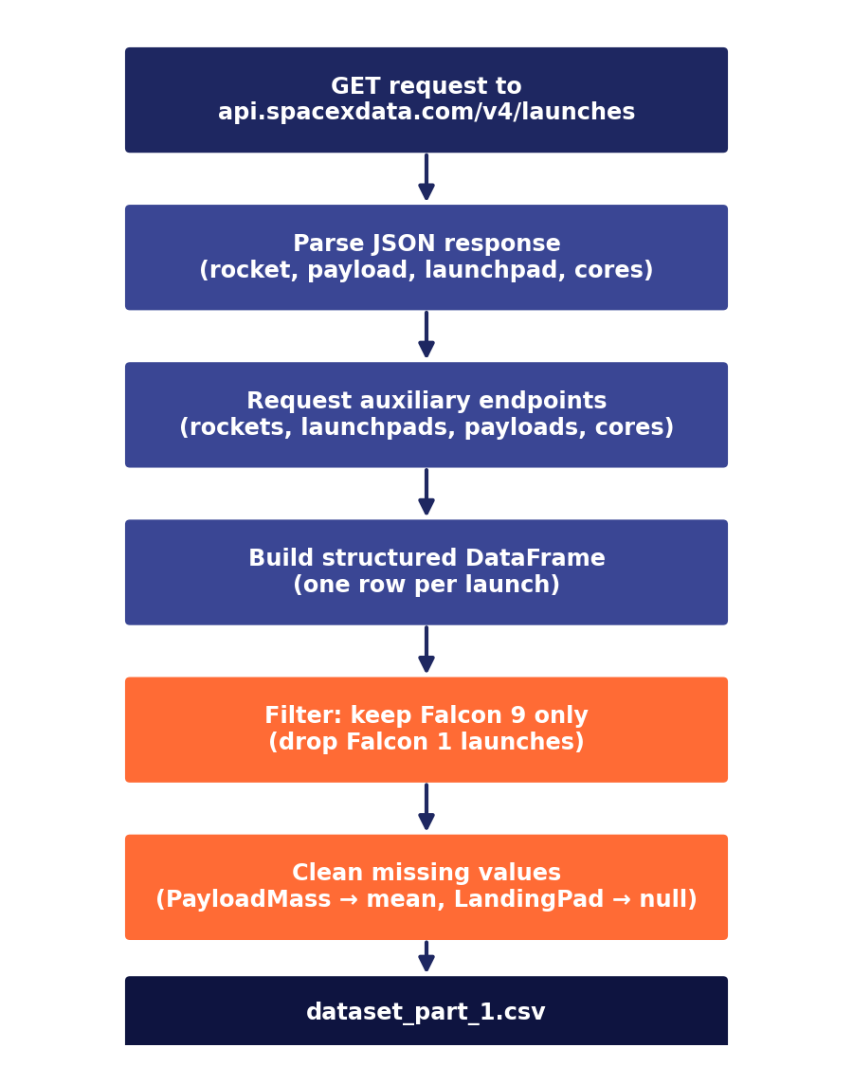
Data Collection – SpaceX API
GET requests were made to the public SpaceX API (api.spacexdata.com) to obtain the historical launch record.
Rocket, launchpad, payload, and core information was extracted for each launch.
Launches were filtered down to Falcon 9 only (Falcon 1 launches were dropped).
Missing-value cleanup: PayloadMass was imputed with the mean; LandingPad was kept as null when no landing attempt occurred.

Slide 9
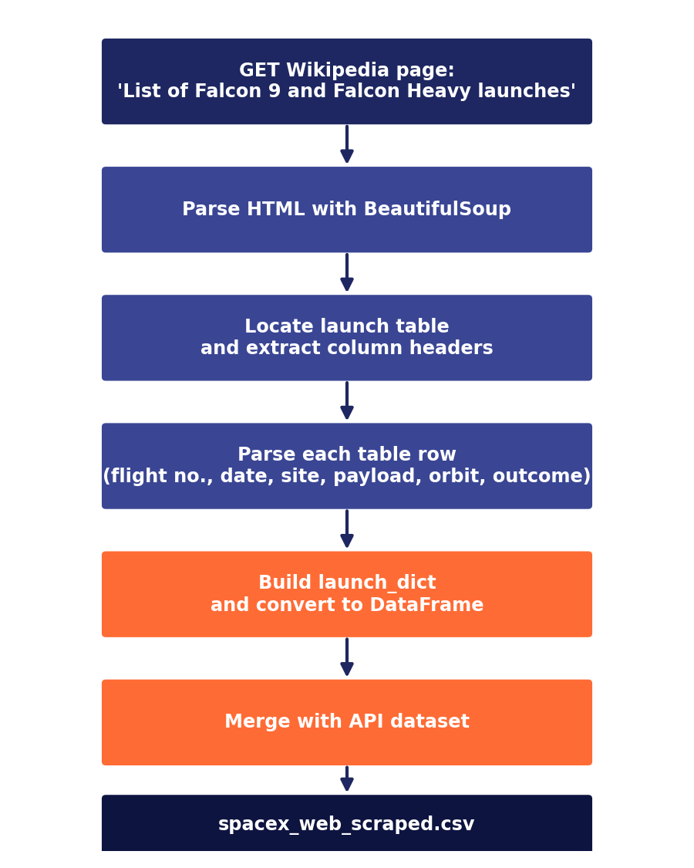
Data Collection - Scraping
BeautifulSoup was used to extract the historical Falcon 9 and Falcon Heavy launch table from Wikipedia (snapshot from June 9, 2021).
The page connection was verified (extracted title: 'List of Falcon 9 and Falcon Heavy launches').
Columns extracted: Flight No., Date and time, Launch site, Payload, Payload mass, Orbit, Customer, Launch outcome.
Output: dataset combined with the API data to enrich the launch history.

Slide 10
Data Wrangling
Final dataset: 90 Falcon 9 launches, with variables such as FlightNumber, PayloadMass, Orbit, LaunchSite, Outcome, GridFins, Reused, Legs, LandingPad, Block, among others.
Distribution by launch site: CCAFS SLC-40 (55), KSC LC-39A (22), VAFB SLC-4E (13).
Distribution by orbit: GTO (27), ISS (21), VLEO (14), PO (9), LEO (7), SSO (5), and other minor orbits.
The target variable Class (1 = successful landing, 0 = failed) was created from the Outcome column, classifying as failure the outcomes 'False ASDS/Ocean/RTLS' and 'None ASDS/None'.
Overall landing success rate: 66.7% (Class.mean()). Only relevant missing values: LandingPad, with 28.9% nulls.

Slide 11
EDA with Data Visualization
Scatter plots of FlightNumber and PayloadMass against LaunchSite and Orbit, to detect landing-success patterns.
Bar chart of success rate by orbit type, and line chart of the yearly success trend.
Key finding: the higher the flight number, the higher the probability of success; the heavier the payload, the lower the probability of success.
VAFB SLC-4E did not launch heavy payloads (>10,000 kg). With heavy payloads, Polar, LEO and ISS orbits show a higher success rate; GTO shows no clear pattern.
Feature engineering: one-hot encoding (get_dummies) on Orbit, LaunchSite, LandingPad and Serial, producing an 80-column dataset ready for modeling.

Slide 12
EDA with SQL
The dataset (101 records) was loaded into a SQLite database and 10 business questions were answered via SQL queries.
4 unique launch sites; total payload mass for NASA (CRS) missions: 45,596 kg; average payload mass of the F9 v1.1 booster: 2,928.4 kg.
First successful ground-pad landing: December 22, 2015.
100 of 101 missions (99%) were classified as mission success; 12 F9 B5 booster versions carried the maximum payload mass.
Ranking of landing outcomes (2010-2017): 'No attempt' was the most frequent (10), followed by drone-ship successes and failures (5 each).

Slide 13
Build an Interactive Map with Folium
Markers were added for each of the 4 launch sites, with circles showing their name.
A MarkerCluster with markers colored green (success) or red (failure) was used to visualize each launch's outcome by site.
Lines (PolyLine) were drawn from the CCAFS LC-40 site to the nearest coastline, railway, and highway, with the distance calculated.
Finding: the nearest coastline to CCAFS LC-40 is only 0.94 km away — launch sites sit close to the equator and to the coast, which eases orbital trajectories and allows safe aborts over the ocean.

Slide 14
Build a Dashboard with Plotly Dash
An interactive dashboard (spacex-dash-app.py) was built with a dropdown to select the launch site and a range slider for payload mass.
A pie chart with the total number of successful launches per site, and the success/failure breakdown for the selected site.
An interactive scatter plot of Payload vs. launch outcome (class), filterable by payload mass range, to identify which payload range maximizes the success rate.
Goal: allow interactive exploration of which site/payload combinations have the highest probability of a successful landing.

Slide 15
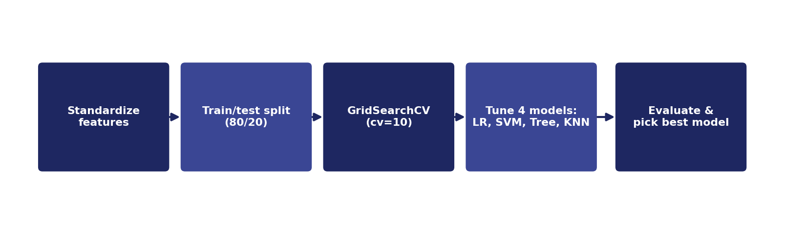
Predictive Analysis (Classification)
Numerical features were standardized and the dataset was split into train/test (80/20, random_state=2, 18 test samples).
4 models were trained and tuned with GridSearchCV (cv=10): Logistic Regression, SVM, Decision Tree and KNN.
Best cross-validation accuracy: Decision Tree with 87.5% (max_depth=4, criterion='gini').
On the test set, all 4 models tied at 83.3% accuracy — the tie was broken by prioritizing the cross-validation result.

Slide 16
Results
Exploratory data analysis results: landing success rate improves with flight number and over time (0% in 2010-2014 to 77.8% in 2017); heavier payloads reduce success probability; KSC LC-39A has the highest site success rate (76.9%).
Interactive analytics: a Folium map located the 4 launch sites and color-coded their outcomes, and a Plotly Dash dashboard let us filter successful launches by site and payload mass range.
Predictive analysis results: 4 classification models were tuned with GridSearchCV; Decision Tree achieved the best cross-validation accuracy (87.5%), while all 4 models tied at 83.3% accuracy on the test set.

Slide 17

Section 2

Slide 18
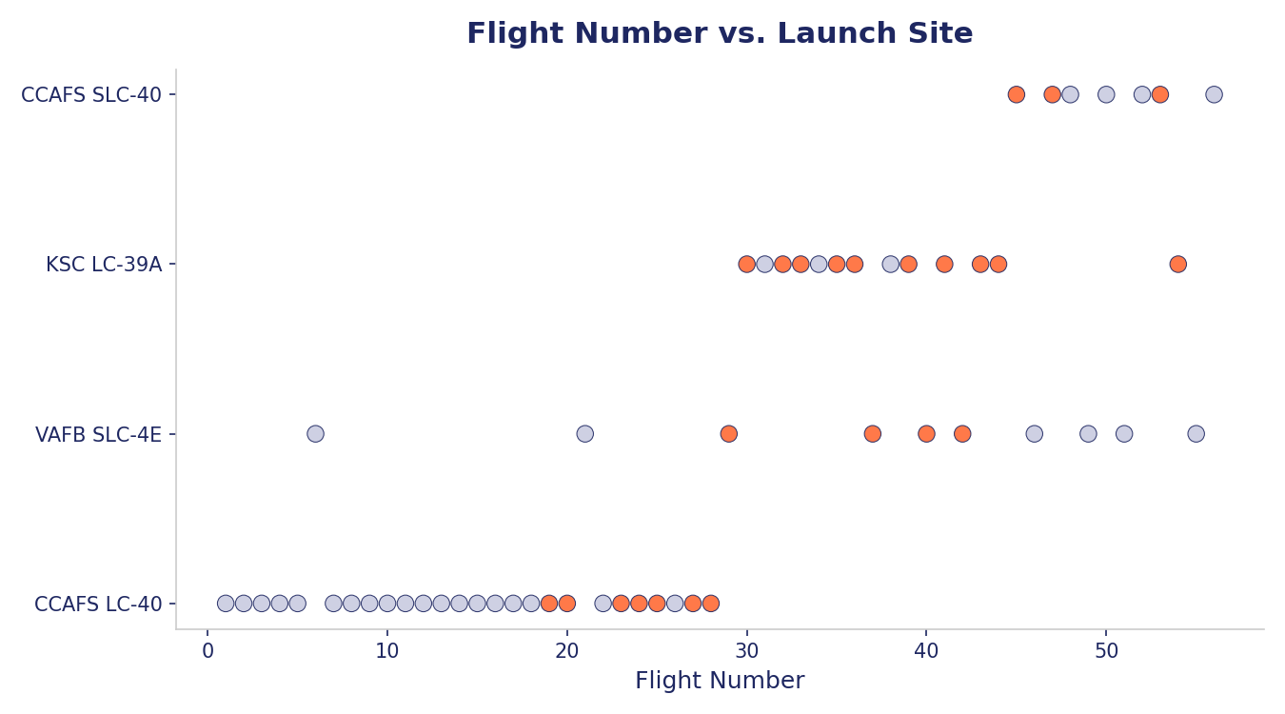
Flight Number vs. Launch Site
Scatter plot of Flight Number vs. Launch Site, colored by outcome (orange = success).
As the flight number increases, the first stage lands successfully more often — reflecting SpaceX's accumulated learning throughout the program.

Slide 19
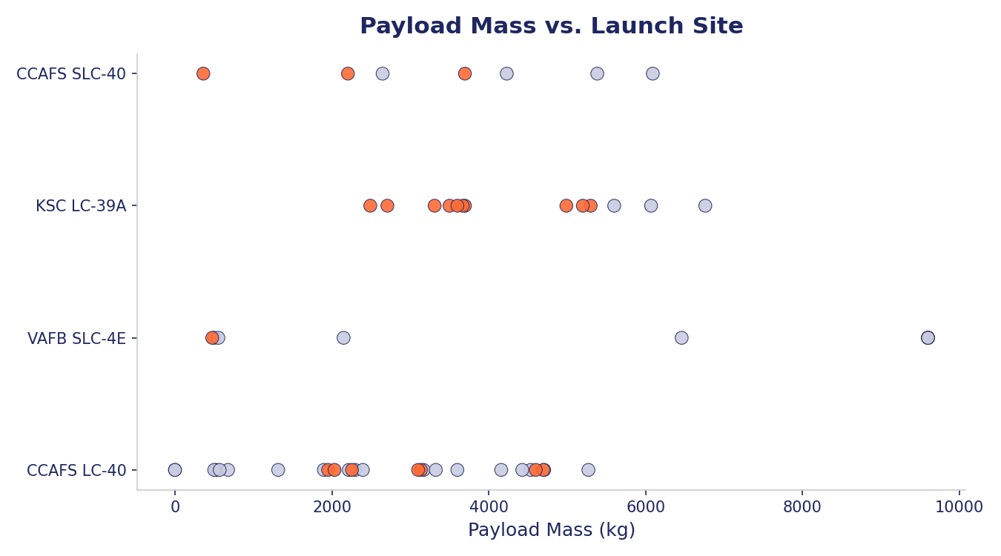
Payload vs. Launch Site
Scatter plot of payload mass vs. Launch Site, colored by outcome.
VAFB SLC-4E has no heavy payloads (>10,000 kg). The heavier the payload, the lower the probability of a successful landing at several sites.

Slide 20
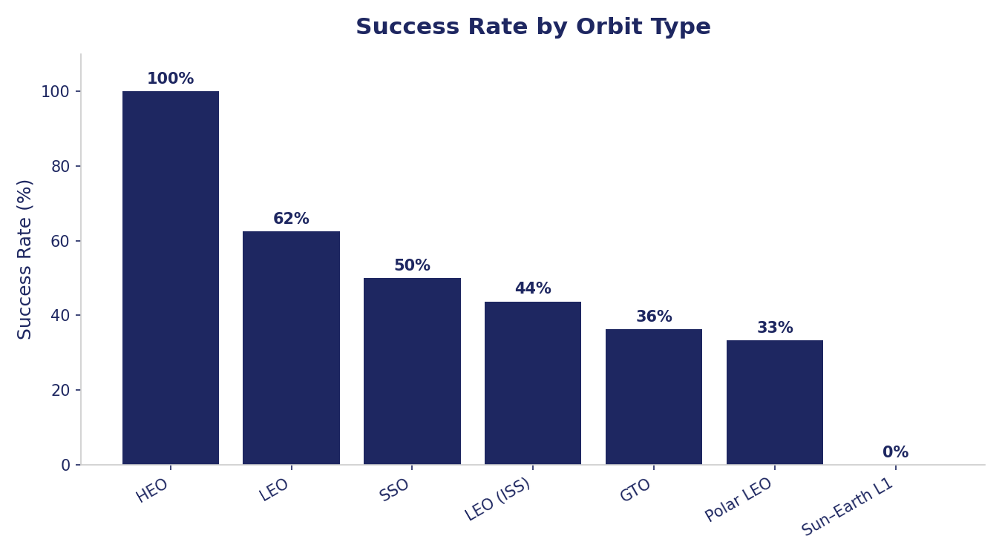
Success Rate vs. Orbit Type
Landing success rate by orbit type (data: spacex_launch_geo.csv).
HEO and LEO show the highest rates; GTO and Polar LEO the lowest — consistent with the greater difficulty of recovering the first stage on more energetic missions.

Slide 21
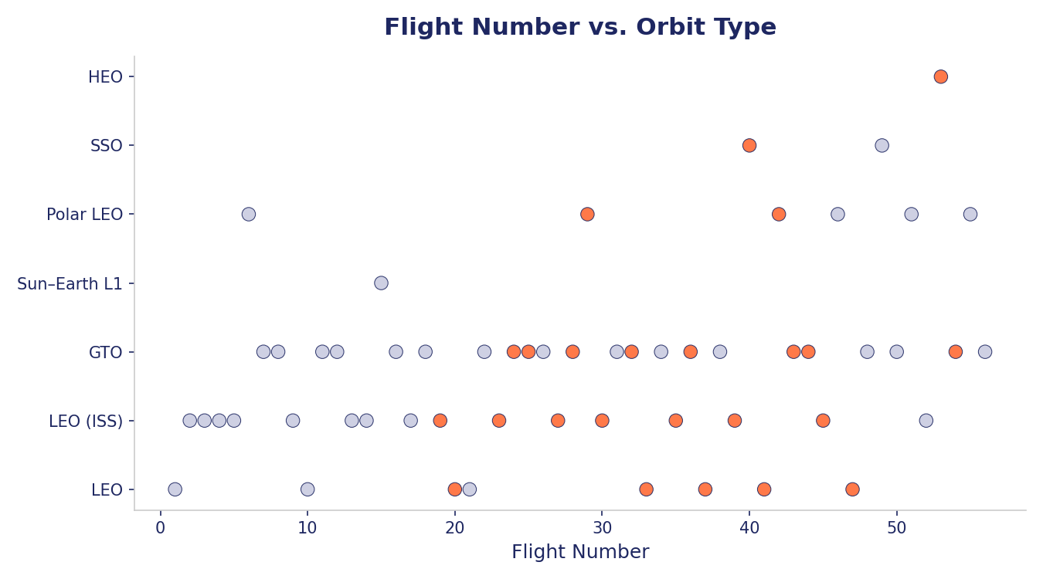
Flight Number vs. Orbit Type
Scatter plot of flight number vs. orbit type, colored by outcome.
In LEO, success is correlated with flight number (improves over time); in GTO there is no clear relationship.

Slide 22
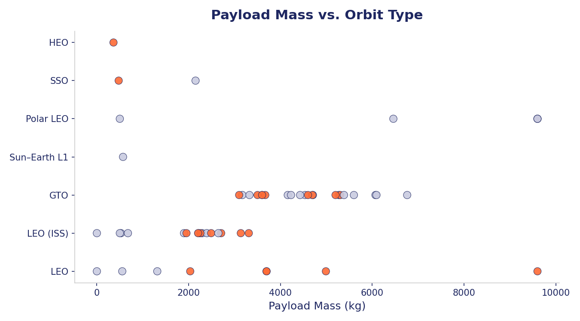
Payload vs. Orbit Type
Scatter plot of payload mass vs. orbit type, colored by outcome.
With heavy payloads, Polar, LEO and ISS orbits show a higher success rate; GTO results are mixed with no clear pattern.

Slide 23
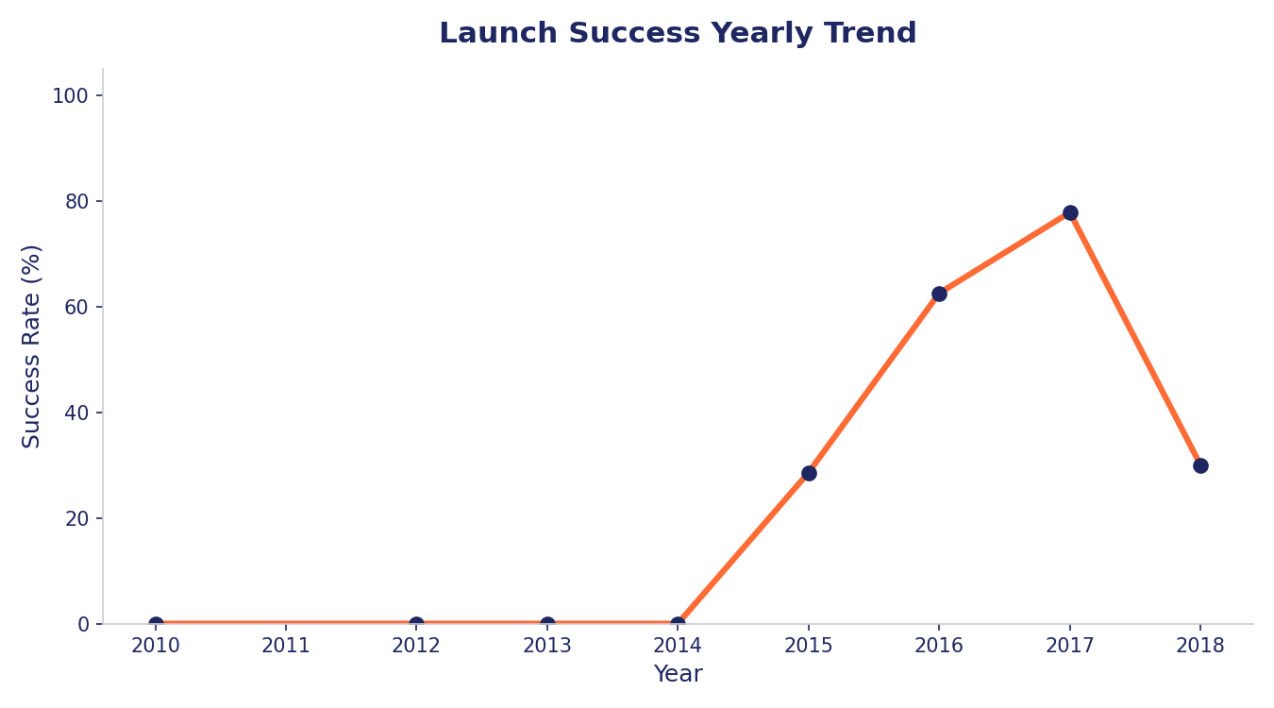
Launch Success Yearly Trend
Yearly trend of the landing success rate (2010-2018).
The success rate went from 0% between 2010-2014 to 77.8% in 2017 — clear evidence of SpaceX's learning curve in rocket reuse.

Slide 24
All Launch Site Names
Query: SELECT DISTINCT Launch_Site FROM SPACEXTABLE
Result: 4 unique launch sites — CCAFS LC-40, CCAFS SLC-40, KSC LC-39A, VAFB SLC-4E.
Every Falcon 9 launch in the dataset departs from these 4 pads, 3 on the East Coast (Florida) and 1 on the West Coast (California).

Slide 25
Launch Site Names Begin with 'CCA'
Query: SELECT * FROM SPACEXTABLE WHERE Launch_Site LIKE 'CCA%' LIMIT 5
Result: first 5 records of launches from CCAFS (Cape Canaveral) pads.
These launches correspond to the earliest missions of the program, including the Dragon capsule qualification mission.

Slide 26
Total Payload Mass
Query: SELECT SUM(PAYLOAD_MASS__KG_) FROM SPACEXTABLE WHERE Customer = 'NASA (CRS)'
Result: 45,596 kg total payload mass carried on NASA Commercial Resupply (CRS) missions.
NASA is one of the program's main recurring customers.

Slide 27
Average Payload Mass by F9 v1.1
Query: SELECT AVG(PAYLOAD_MASS__KG_) FROM SPACEXTABLE WHERE Booster_Version = 'F9 v1.1'
Result: 2,928.4 kg average payload mass for the F9 v1.1 booster version.
This value serves as a baseline against later versions (Block 5), which carry considerably heavier payloads.

Slide 28
First Successful Ground Landing Date
Query: SELECT MIN(Date) FROM SPACEXTABLE WHERE Landing_Outcome = 'Success (ground pad)'
Result: December 22, 2015 — the date of the first successful ground-pad landing.
This milestone marked the first-ever successful vertical landing of an orbital rocket first stage.

Slide 29
Successful Drone Ship Landing with Payload between 4000 and 6000
Query: boosters with a successful drone-ship landing and payload between 4,000 and 6,000 kg.
Result: F9 FT B1022, F9 FT B1026, F9 FT B1021.2, F9 FT B1031.2.
All belong to the 'Full Thrust' (FT) generation, which established reuse on ocean drone-ship platforms.

Slide 30
Total Number of Successful and Failure Mission Outcomes
Query: count of Mission_Outcome grouped by mission result.
Result: 98 'Success' missions, 2 additional success variants, and 1 'Failure (in flight)' — out of 101 total records.
99% of missions accomplished their main objective (delivering the payload), regardless of whether the 1st stage landed successfully.

Slide 31
Boosters Carried Maximum Payload
Query: boosters that carried the maximum payload mass recorded in the dataset.
Result: 12 distinct boosters, all from the F9 B5 generation (B1048.4, B1049.4, B1051.3, B1056.4, among others).
The B5 version, the newest and most reusable, handles the heaviest payloads in the program.

Slide 32
2015 Launch Records
Query: drone-ship landing failures during 2015, with booster and launch site.
Result: 2 failures — January (F9 v1.1 B1012, CCAFS LC-40) and April (F9 v1.1 B1015, CCAFS LC-40).
Both cases correspond to the earliest drone-ship landing attempts, before the technique was perfected.

Slide 33
Rank Landing Outcomes Between 2010-06-04 and 2017-03-20
Query: ranking of landing outcomes between 2010-06-04 and 2017-03-20, in descending order.
Result (top): 'No attempt' (10), 'Success (drone ship)' (5), 'Failure (drone ship)' (5), 'Success (ground pad)' (3), 'Controlled (ocean)' (3).
In the program's early years, launches with no recovery attempt dominate; drone-ship and ground-pad successes grow in later years.

Slide 34

Section 3

Slide 35
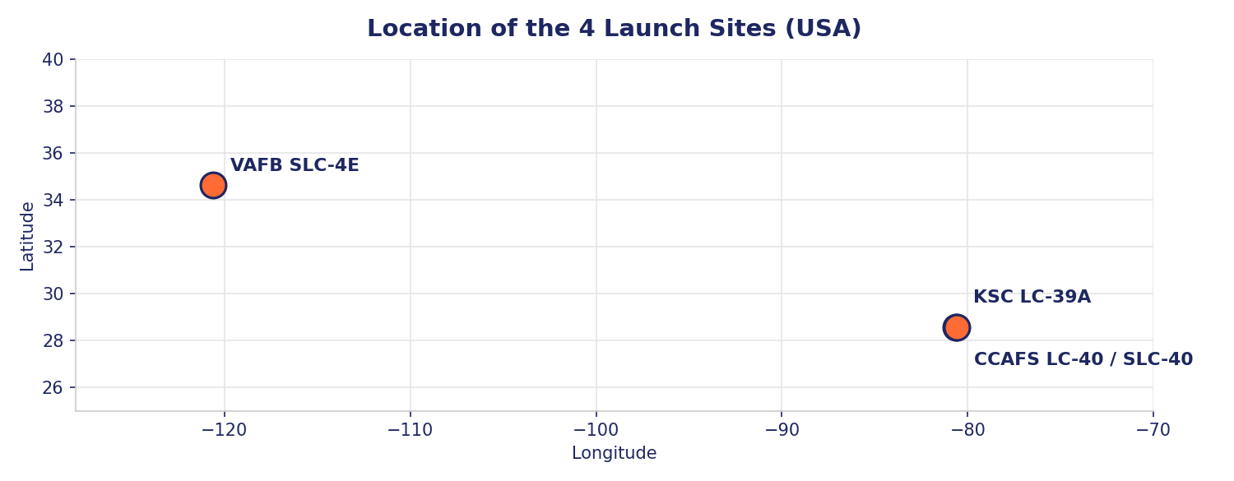
Global Map of Launch Sites
The 4 Falcon 9 launch sites (3 in Florida, 1 in California) were marked with markers and identifying circles on a Folium map.
All sites sit close to the coast and at low latitude, which eases eastward orbital trajectories and allows safe aborts over the ocean.

Slide 36
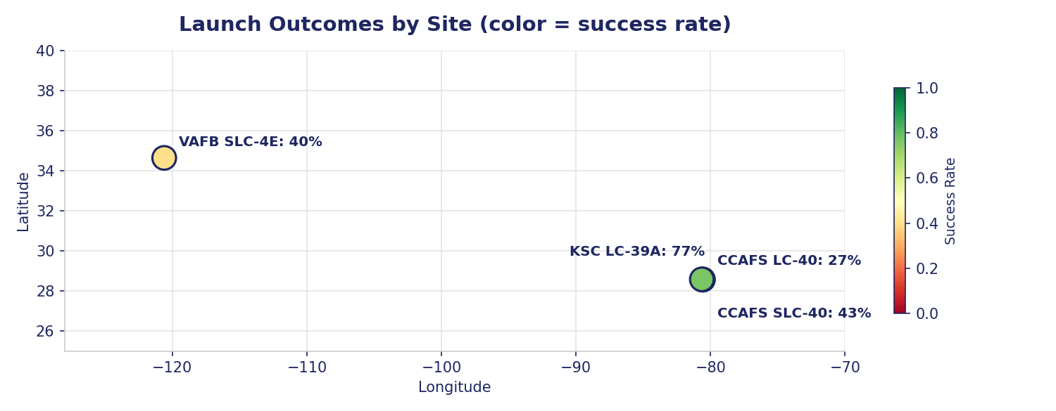
Launch Outcomes by Site
Each site was color-coded by its landing success rate using a MarkerCluster with green (success) and red (failure) markers.
KSC LC-39A stands out with the highest success rate (76.9%); CCAFS LC-40 has the lowest (26.9%) — likely tied to the program's earliest phases.

Slide 37
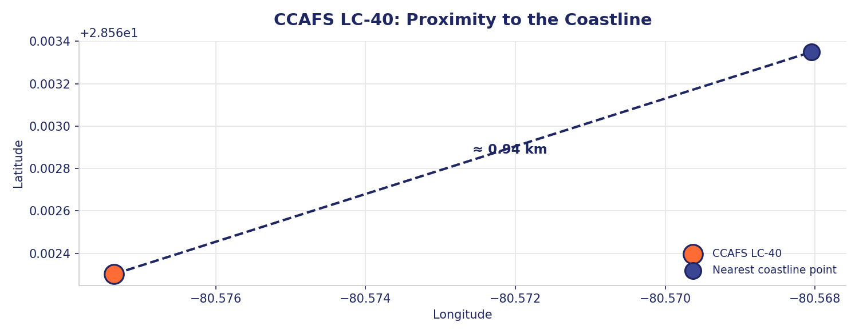
CCAFS LC-40 Proximity to the Coastline
The distance from the launch site to the nearest coastline, railway, and highway was computed using lines (PolyLine) and the geographic (Haversine) distance formula.
Finding: the nearest coastline is only 0.94 km from the site — proximity to the ocean allows safe aborts and clear launch trajectories.

Slide 38

Section 4

Slide 39
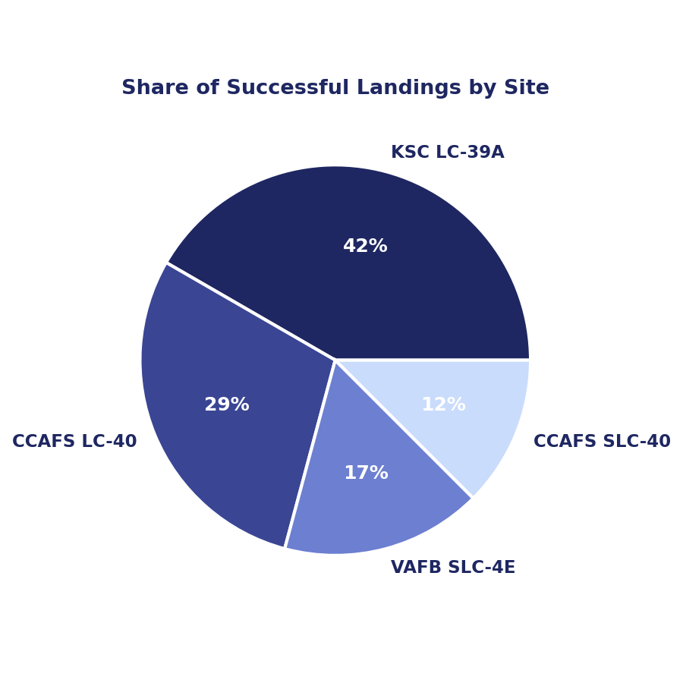
Successful Launches by Site
Pie chart from the interactive dashboard (spacex-dash-app.py) showing the split of successful launches across the 4 sites.
KSC LC-39A accounts for 43% of all successful landings, followed by CCAFS LC-40 (30%).

Slide 40
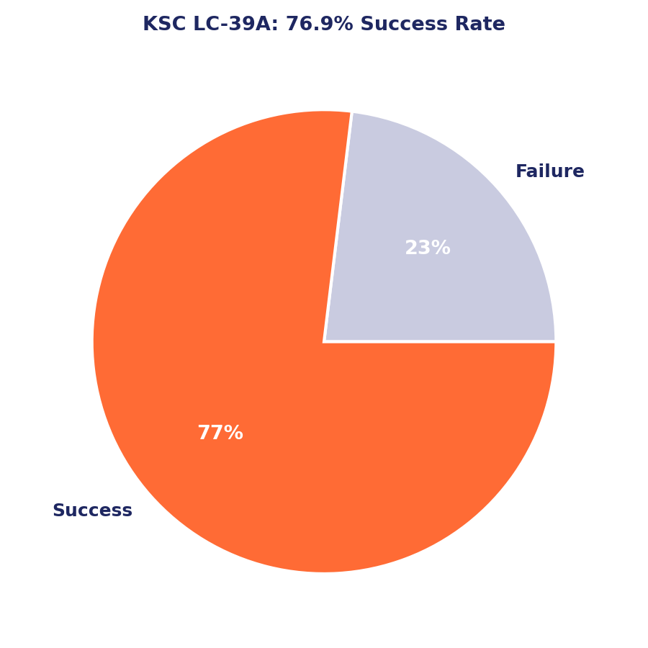
KSC LC-39A: Highest Success Rate Site
Filtering the dashboard by the site with the best success ratio confirms KSC LC-39A reaches a 76.9% landing success rate.
This site is preferentially used for more recent missions, with more mature booster technology (Block 5).

Slide 41
Payload vs. Launch Outcome
Interactive scatter of Payload vs. outcome, filterable by mass range.
Light-to-medium payloads (0-6,000 kg) and FT/B5 boosters show the highest success rate.

Slide 42

Section 5

Slide 43
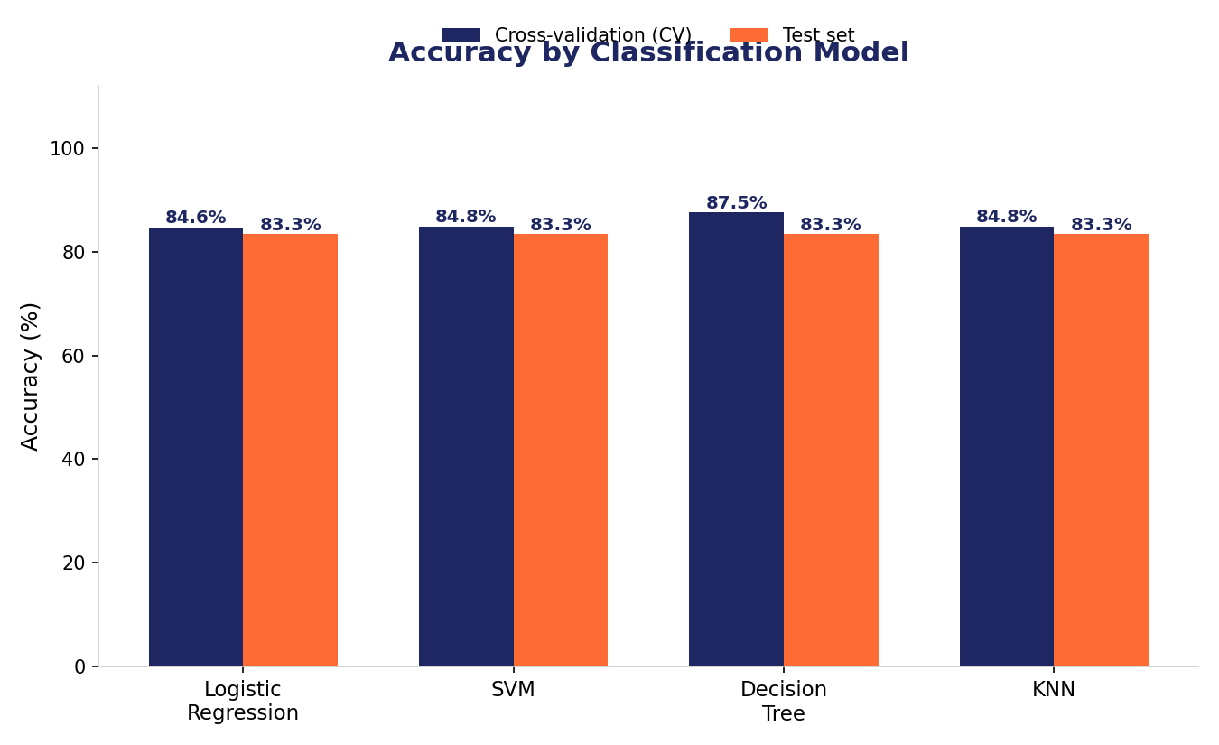
Classification Accuracy
Accuracy comparison across the 4 models, in cross-validation (CV=10) and on the test set.
Best CV accuracy: Decision Tree at 87.5%.
On test, all 4 models tie at 83.3% accuracy (14 of 18 correct predictions).

Slide 44
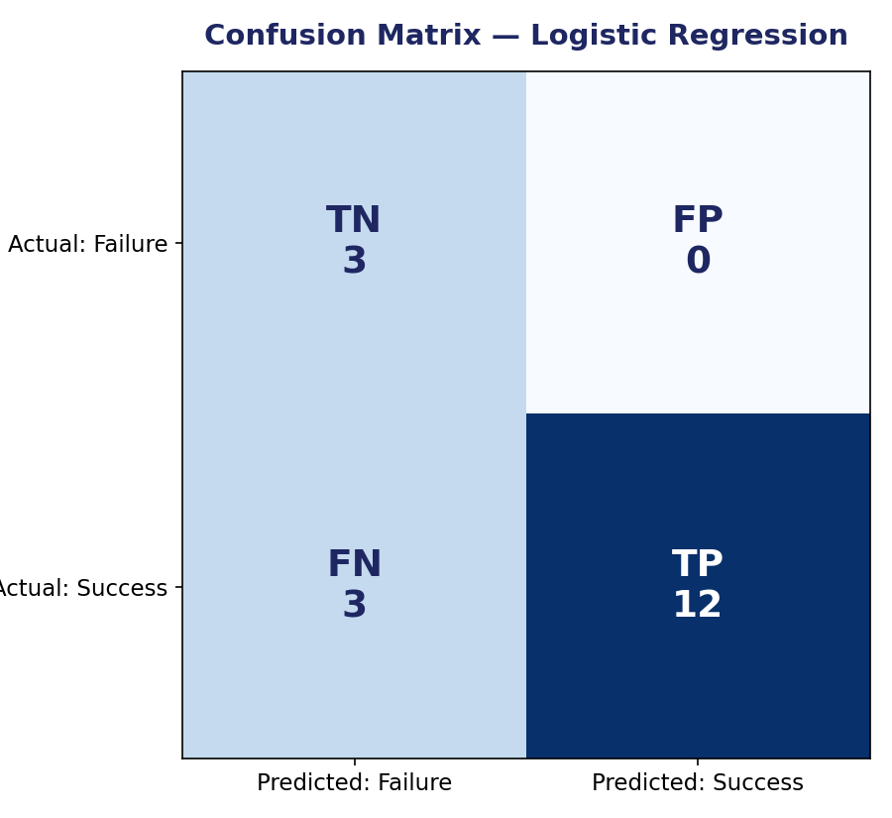
Confusion Matrix
Confusion matrix of the Logistic Regression model on the test set (n=18).
12 true positives and 3 true negatives; 3 false negatives and 0 false positives in this run — the model tends to be conservative, predicting failure.
All 4 models share similar test performance; Decision Tree is recommended as the final model for its better cross-validation generalization.

Slide 45
Conclusions
Across 90 Falcon 9 launches, the overall 1st-stage landing success rate is 66.7%, with a clear upward trend year over year (0% in 2010-2014 → 77.8% in 2017).
KSC LC-39A is the site with the highest success rate (76.9%); payload mass and target orbit are key drivers of the outcome.
Flight number and launch year are strongly related to success, reflecting SpaceX's learning curve.
The Decision Tree model (87.5% CV accuracy) is best suited to predict landing success, although all 4 models evaluated show similar test performance (83.3%).
These predictions allow estimating the real cost of a SpaceX launch — valuable information for a competitor to bid against SpaceX in an informed way.

Slide 46
Appendix
Project notebooks: data collection (SpaceX API), web scraping (Wikipedia), data wrangling, EDA with SQL, EDA with visualization, interactive map with Folium, dashboard with Plotly Dash, and predictive modeling (classification).
Data sources: api.spacexdata.com, Wikipedia (list of Falcon 9/Falcon Heavy launches), and derived files (dataset_part_1.csv, dataset_part_2.csv, dataset_part_3.csv, Spacex.csv).
Dashboard: spacex-dash-app.py (Plotly Dash) — site dropdown + payload range slider.
Classification models evaluated: Logistic Regression, SVM, Decision Tree, K-Nearest Neighbors, all tuned with GridSearchCV (cv=10).

