Slide 1
Implementing acceleration structures to optimize a sphere tracing ray marcher
Musschoot Adriaan
Supervisor – Samyn Koen
Coach – Geeroms Kasper

Slide 2
Sphere tracing
For each pixel cast ray
March forward along ray
Retrieve the distance value to the scene
Objects represented by SDFs

Slide 3
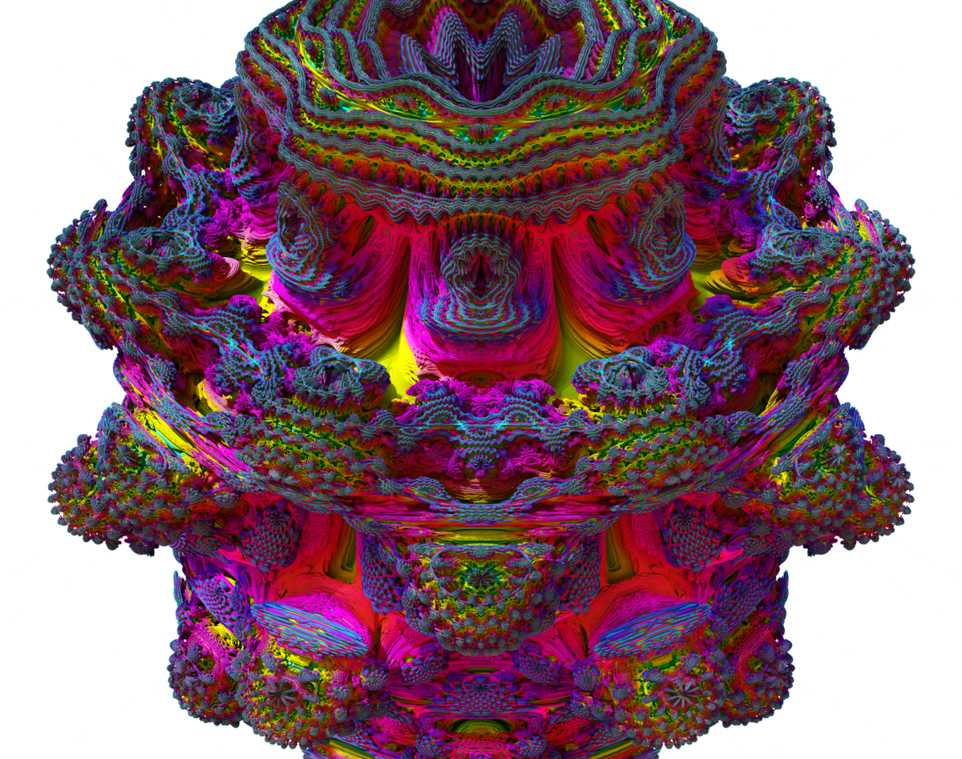
Sphere tracing problem
Many steps for each ray
Heavy computations

