Slide 1
Implementing acceleration structures to optimize a sphere tracing ray marcher
Musschoot Adriaan
Supervisor – Samyn Koen
Coach – Geeroms Kasper

Slide 2
Sphere tracing
For each pixel cast ray
March forward along ray
Retrieve the distance value to the scene
Objects represented by SDFs
Small memory footprint

Slide 3
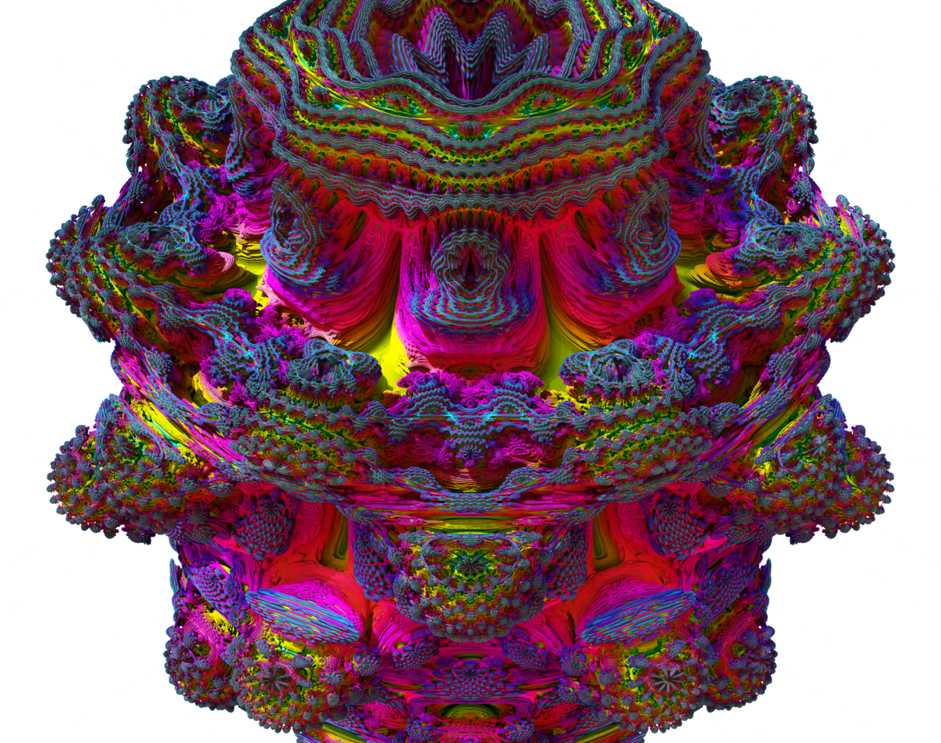
Sphere tracing is slow
Many steps for each ray
Heavy computations complex shapes

Slide 4
Acceleration structures
AABB
BVH

Slide 5
Acceleration structures
AABB
BVH

Slide 6
Constructing AABB

