Slide 1
Implementing acceleration structures to optimize a sphere tracing ray marcher
Musschoot Adriaan
Supervisor – Samyn Koen
Coach – Geeroms Kasper

Slide 2
Sphere tracing
For each pixel cast ray
March forward along ray
Retrieve the distance value to the scene
Objects represented by SDFs
Small memory footprint

Slide 3
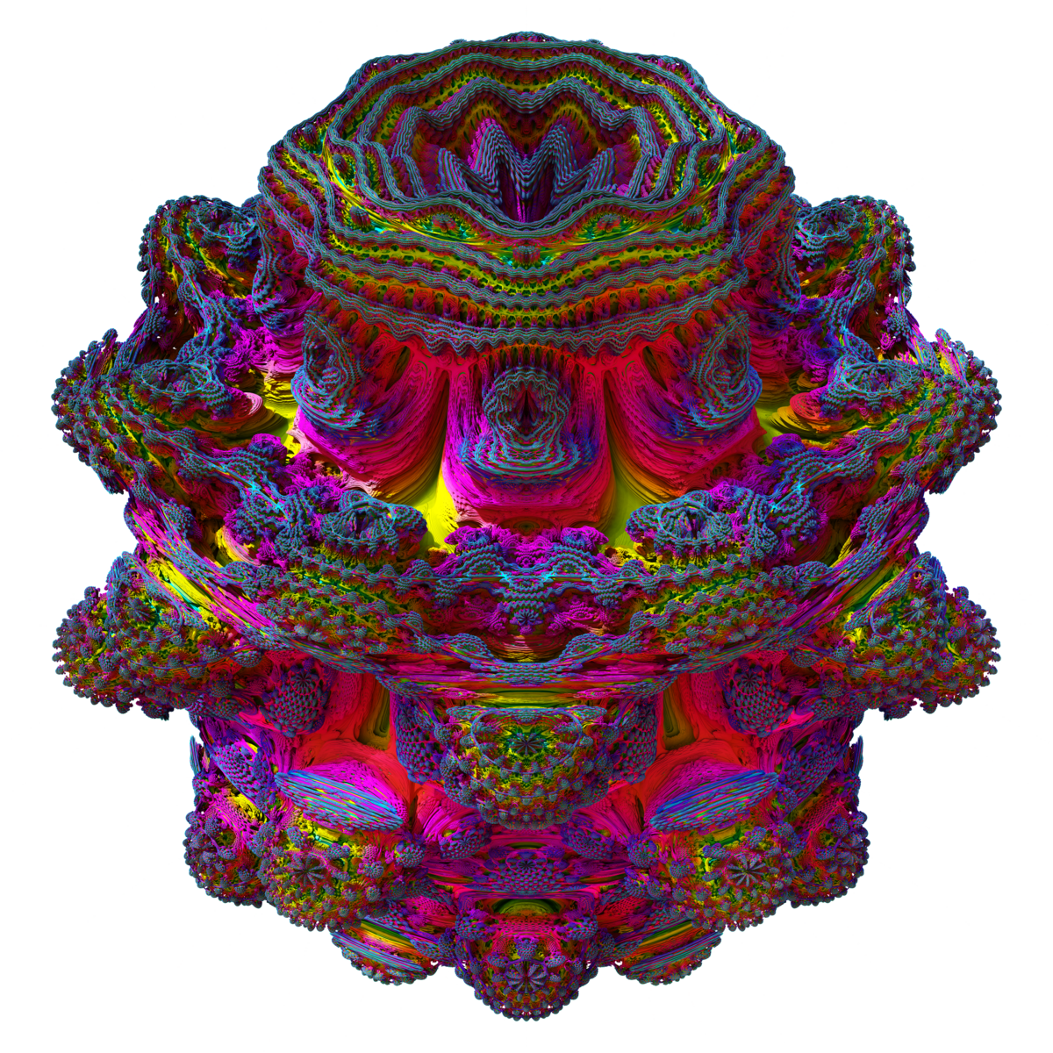
Sphere tracing is slow
Many steps for each ray
Heavy computations complex shapes

Slide 4
Acceleration structures
AABB // early out
BVH-tree

Slide 5
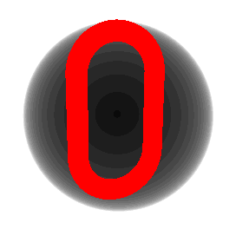

Early out
Sphere
Box

Slide 6
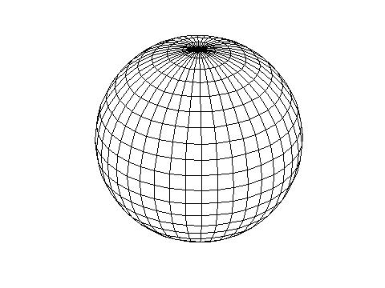
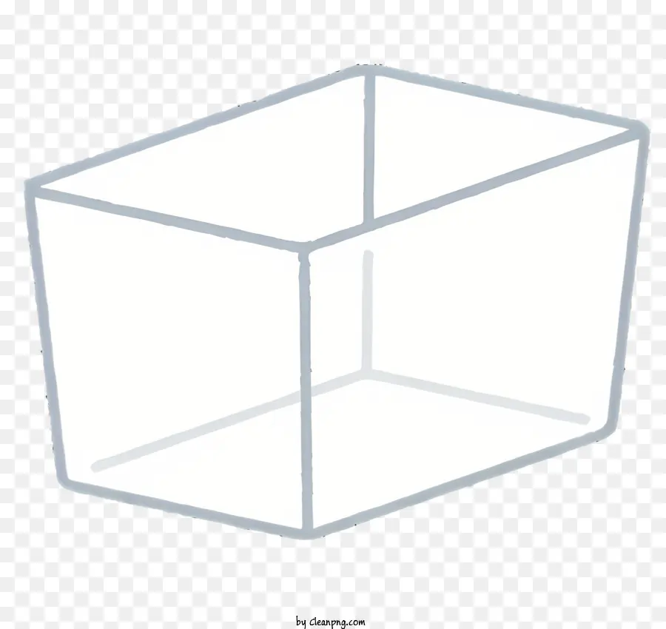
Early out construction
Sphere
Box
Enclose SDF in sphere of points
Shrink sphere
Enclose SDF in each axis and each direction in wall of points
March each wall towards centre

Slide 7
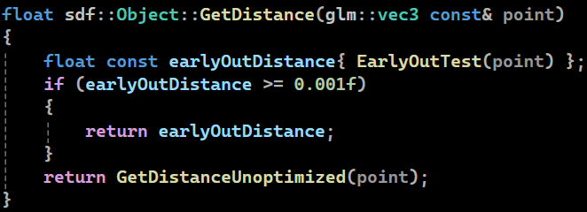
Early out usage

Slide 8

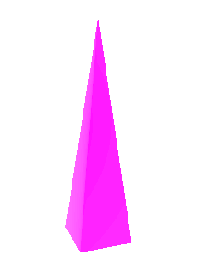
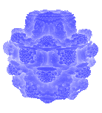
Comparison early out
Object | Link | Pyramid | Mandelbulb
No early out | 0.0108ms | 0.0132ms | 0.0469ms
Sphere early out | 0.0098ms | 0.0143ms | 0.0112ms
Box early out | 0.0094ms | 0.0106ms | 0.0139ms

Slide 9
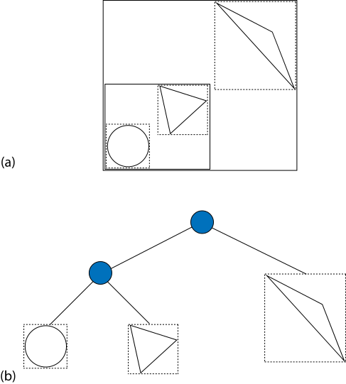
BVH-tree

Slide 10
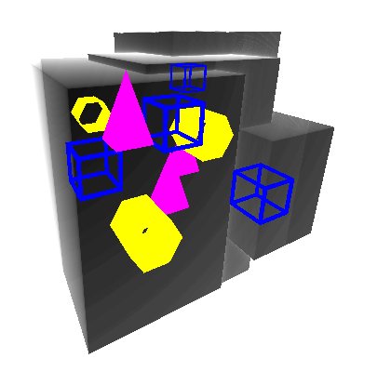
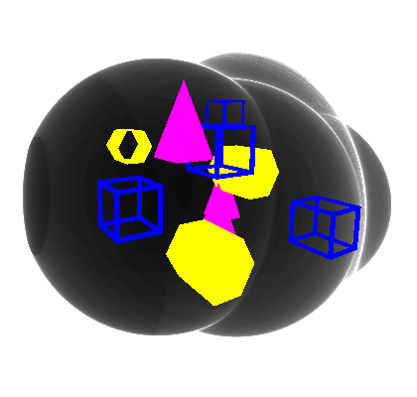
BVH-tree
Sphere
Box

Slide 11
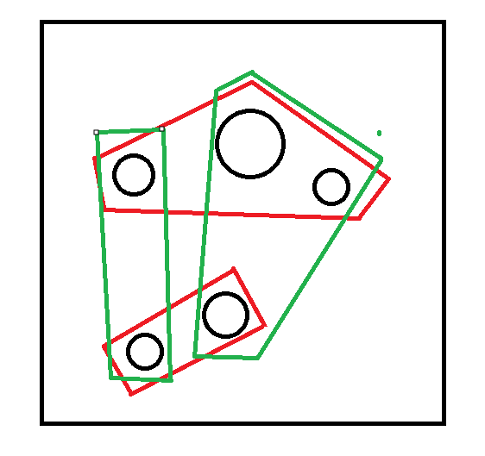
BVH-tree construction
For every node
Origin
Sphere radius / box extent
Surface area heuristic
Repeated until singular object remains

Slide 12
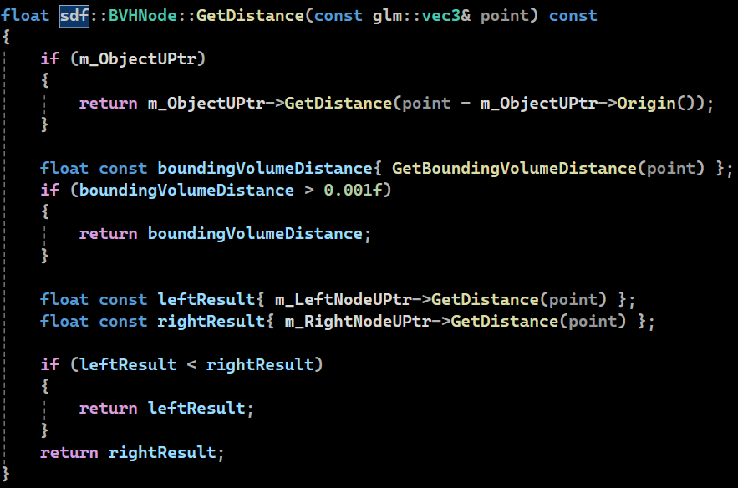
BVH-tree usage

Slide 13
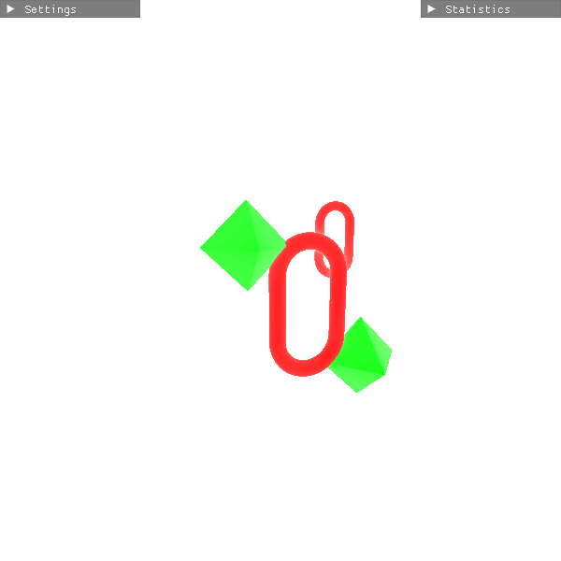
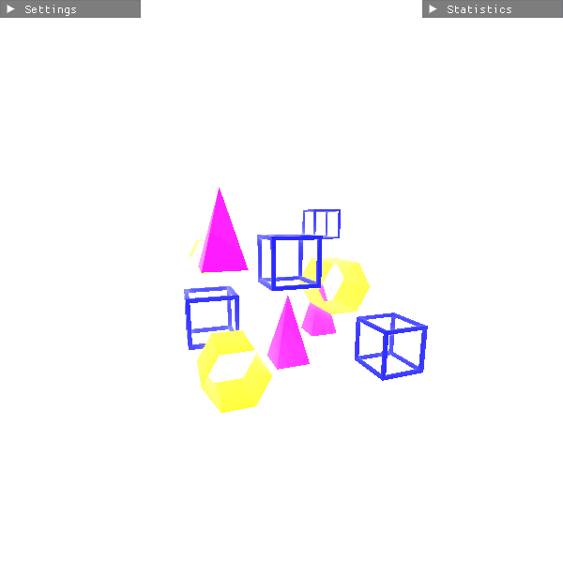
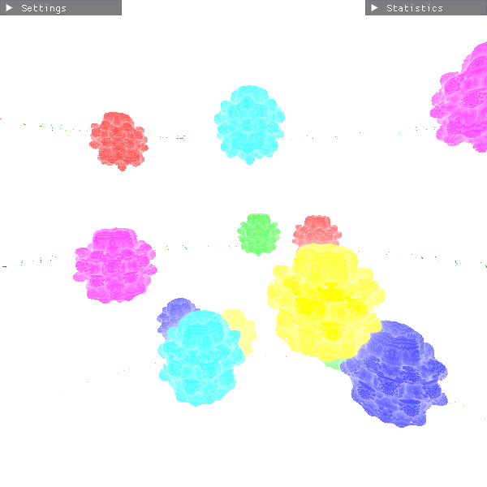
Comparison early out
Scene complexity | Simple | Medium | Complex
No BVH-Tree | 0.0208ms | 0.0232ms | 0.0869ms
Sphere BVH-Tree | 0.0108ms | 0.0143ms | 0.0237ms
Box BVH-Tree | 0.0094ms | 0.0107ms | 0.0211ms

Slide 14
Conclusion
Early out → object dependent
BVH-tree → always faster even in simple scenes
Only tested in static scenarios
Construction and approximation once at the start

