Slide 1
Implementing acceleration structures to optimize a sphere tracing ray marcher
Musschoot Adriaan
Supervisor – Samyn Koen
Coach – Geeroms Kasper

Slide 2
Sphere tracing
For each pixel cast ray
March forward along ray
Retrieve the distance value to the scene
Objects represented by SDFs
Small memory footprint

Slide 3
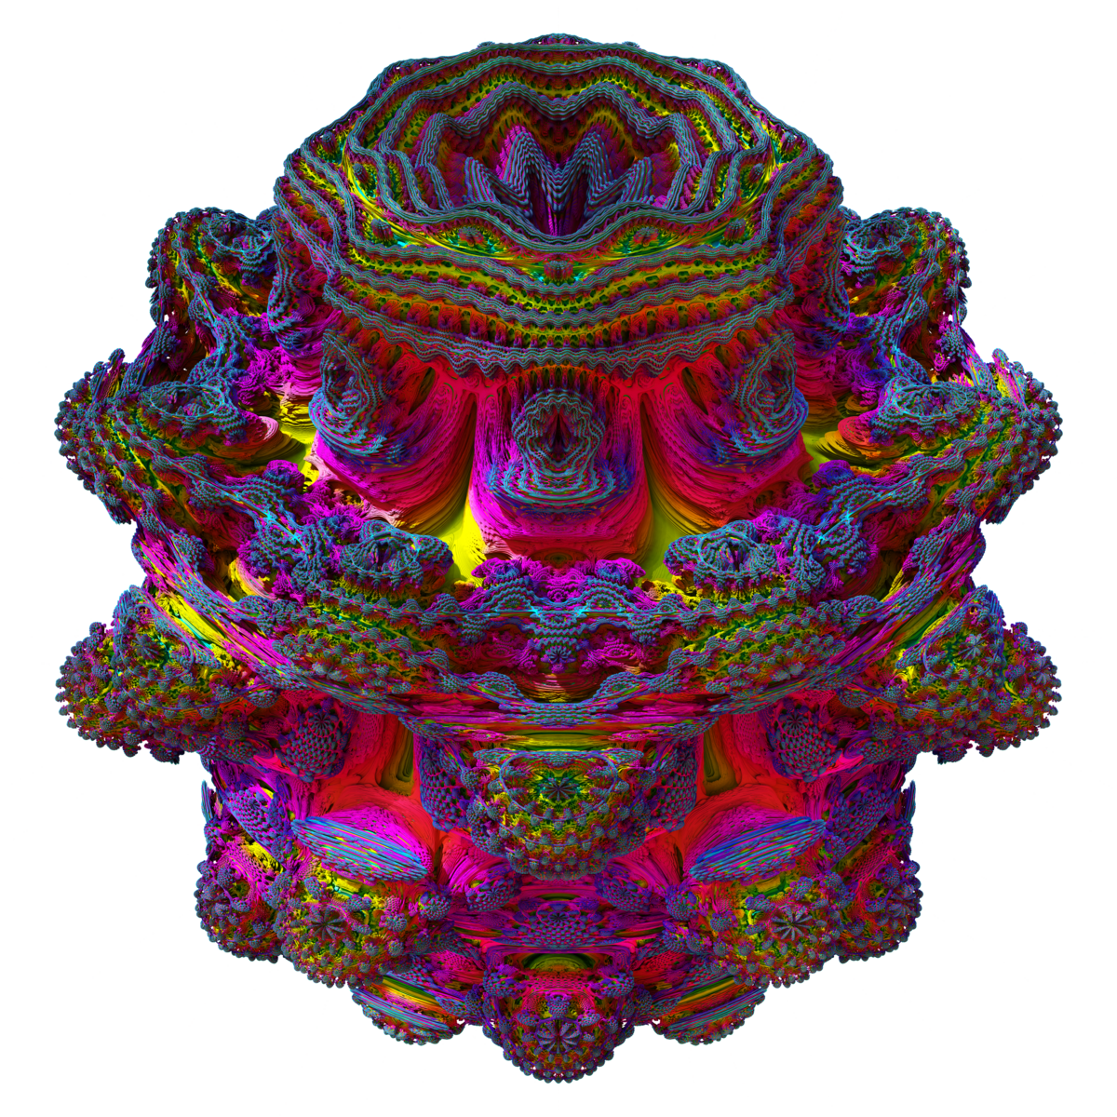
Sphere tracing is slow
Many steps for each ray
Heavy computations complex shapes

Slide 4
Acceleration structures
AABB
BVH

Slide 5
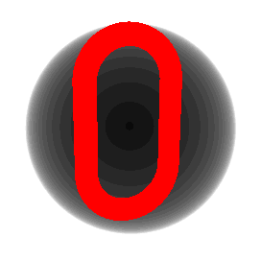

AABB // early out
Sphere
Box

Slide 6
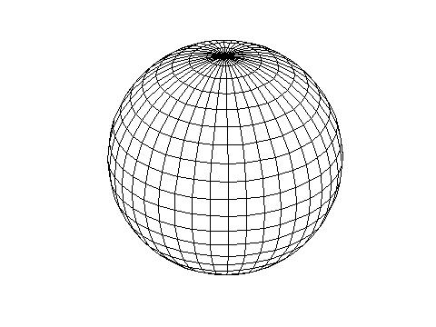
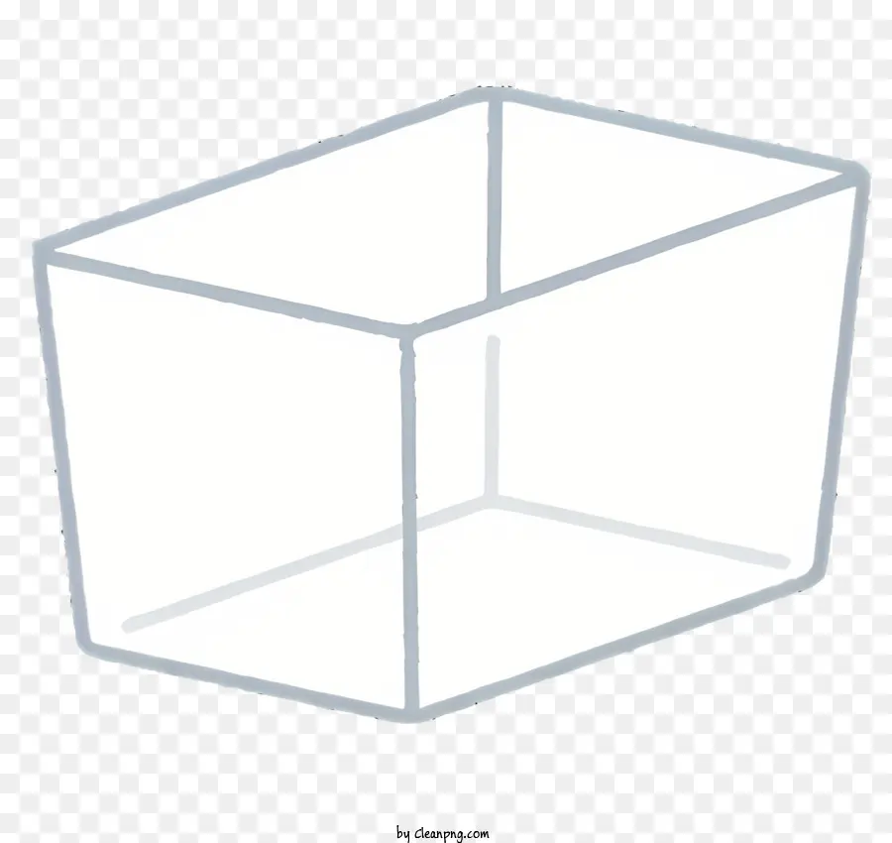
Constructing AABB // early out
Sphere
Box
Enclose SDF in sphere of points
Shrink sphere
Enclose SDF in each axis and each direction in wall of points
March each wall towards centre

Slide 7
Comparison
Sphere
Box
Cheapest calculation
Link: 0.0098ms
BoxFrame: 0.0100ms
MandelBulb: 0.0112ms
Closer to the SDF boundaries
Link: 0.0094ms
BoxFrame: 0.0105ms
MandelBulb: 0.0139ms

