Slide 1
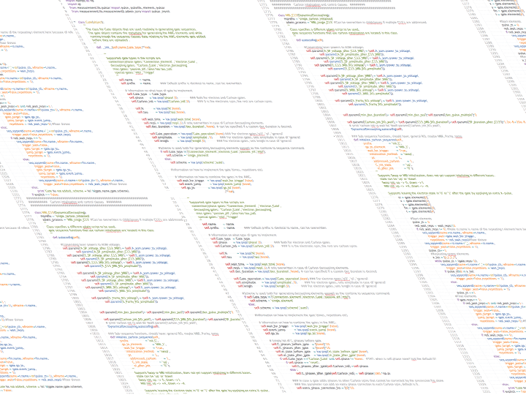

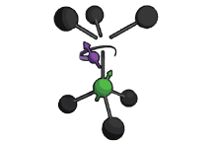

Parity Measurements on Weakly Coupled Carbon Spins in Diamond

Slide 2
A Quantum Computer promises an exponential speedup over conventional computers

Slide 3
Quantum Error Correction is essential in building a scalable quantum computer

Slide 4
The Nitrogen Vacancy Center is a promising candidate for building a Quantum Computer

Slide 5
We Address Weakly Coupled Carbons in order to find enough suitable qubits

Slide 6
We Perform a Parity Measurement by Mapping the State of the Carbon on the electron

Slide 7
In Order to Implement Quantum Error Correction we need to be correct the outcome of a parity measurement

