Slide 1
Computer Forensics
Hard Drive Format

Slide 2
Hard Drive Partitioning
Boot process starts in ROM.
Eventually, loads master boot record from booting device.
MBR located at well-known location.

Slide 3
Hard Drive Partitioning (Windows Only)
MBR located always in the first sector of booting device.
Cylinder 0, Head 0, Sector 1

Slide 4
MBR Structure
First part bootstrap program.
Is loaded into memory, then relocates itself in order to make room for another copy.
Starting at offset 0x1be 16B partition table
Last two bytes of sector are 0x55 and 0xaa.

Slide 5
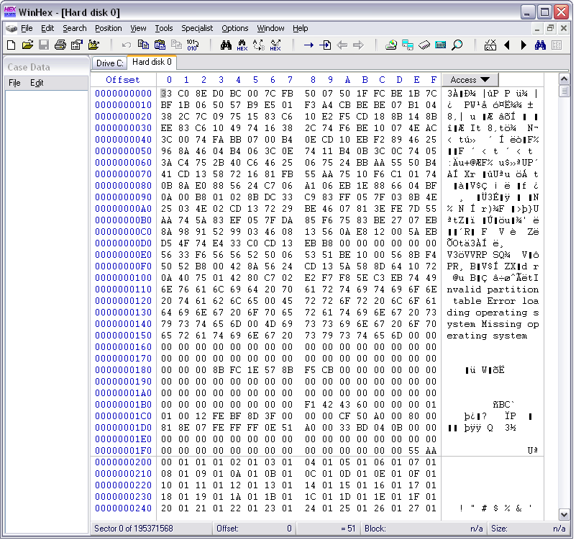

Slide 6
Partition Table Entry
Byte 0: active (0x80) or inactive (0x00)
Bytes 1-3: Start of Partition
Byte 4: Partition Type
Bytes 5-7: End of Partition
Bytes 8-12: LBA address of start sector relative to start of disk in little endian
Bytes 13-16: Number of sectors in the partition

Slide 7
Partition Table Example
00 01 01 00 DE FE 3F 04 3F 00 00 00 86 39 01 00
Byte 1: 00 = inactive (not bootable)
Only one partitions on a windows system should be bootable.

Slide 8
Partition Table Example
00 01 01 00 DE FE 3F 04 3F 00 00 00 86 39 01 00
Bytes 1-3: Split up as
| h7-h0 | c9 c8 s5-s0 | c7-c0 |
In binary, we have
0000 0001 0000 0001 0000 0000
h7h6h5h4 h3h2h1h0 c9c8s5s4 s3s2s1s0 c7c6c5c4 c3c2c1c0
So: H=1, C = 0, S = 0x1 = 1.

Slide 9
Partition Table Example
00 01 01 00 DE FE 3F 04 3F 00 00 00 86 39 01 00
Byte 4: Partition Type 0xDE.
Look this one up in a table. It is a Dell PowerEdge Server utilities (FAT fs)
0x01 | 12b FAT Partition
0x04 | 16b FAT Partition
0x05 | Extended Partition
0x06 | BIGDOS FAT
0x07 | NTFS

Slide 10
Partition Table Example
00 01 01 00 DE FE 3F 04 3F 00 00 00 86 39 01 00
Bytes 5-7: End of Partition
Split up as | h7-h0 | c9 c8 s5-s0 | c7-c0 |
1111 1110 0011 1111 0000 0100
So: h=0xE, c=0x04, s = 0x3f

Slide 11
Partition Table Example
00 01 01 00 DE FE 3F 04 3F 00 00 00 86 39 01 00
Bytes 8-12: LBA 3F 00 00 00 in Little Endian
That is 00 00 00 3F is the real start LBA
Go to Sector 63 and find indeed the FAT boot sector.

Slide 12
Partition Table Example
00 01 01 00 DE FE 3F 04 3F 00 00 00 86 39 01 00
Bytes 13-16: Number of Sectors in the partition (in Little Endian).
Value is 0X 86 39 01 00.
Translate into true value:
0x 00 01 39 86 = 80,262 sectors

Slide 13
Partition Table Example
We have a Dell partition of size 40MB. This partition is invisible to Windows and could be used to hide data.
Dell uses this area to help with recovery from OS disasters.

Slide 14
Master Boot Record
By creating a partition and then editing the MBR I can create hidden partitions.
The data on these hidden partitions is not visible from Windows.

Slide 15
Master Boot Record
The partitions do not have to fill up the disk completely, there can be unused sectors (which could contain hidden data.)

Slide 16
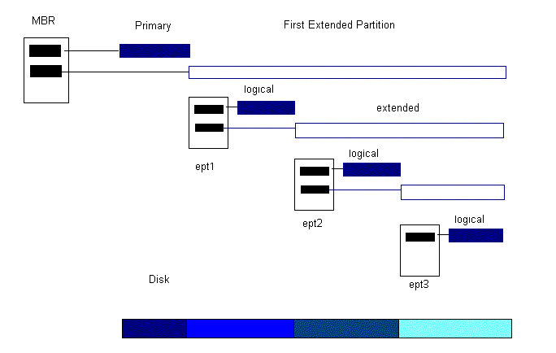
Extended Partitions
Overcome the four partition limit.

Slide 17
Extended Partitions
Marked by a partition code of 0x05 or 0x0f.
First sector of an extended partition contains a partition table with up to two entries.
Extended partition is a container for secondary extended partition.

Slide 18
Extended Partitions
First sector contains partition table, structured like MBR
Entries are 16B with the same structure
First entry is for primary extended partition.
Optional second entry is for secondary, extended partition.

Slide 19
Extended Partitions
Primary extended partition contains the secondary extended partition.

Slide 20
Extended Partitions

Slide 21
Unassigned sectors
Many sectors on a disk are not assigned to a partition.
Cannot be seen from OS.
Good hiding place for a virus.

Slide 22
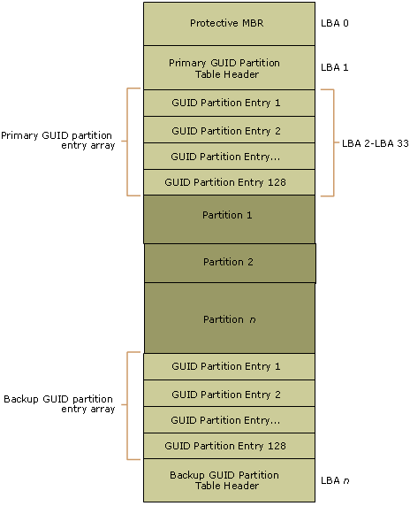
GUID
GUID Partition Table (GPT)
Part of the Extensible Firmware Interface

Slide 23
GUID
EFI (Extensible Firmware Interface) is Intel’s proposed replacement for the PC BIOS
Morphed into UEFI (Unified …)
Is used in some BIOS systems to overcome limitations of the MBR partition table
MBR uses 32 bits for storing LBA size information
Gives a maximum of 2.2·10¹² B

Slide 24
GUID
Partition Area
Partition Table
Backup
Area
Protective
MBR
GPT Header

Slide 25
GUID
Supported by most unix systems for RW and boot
Only supported on Windows-32 for RW since Windows Server 2003 SP1
Supported by Windows 64 for RW and for boot with UEFI

Slide 26
GUID Partition Table
At LBA 0: traditional MBR
But protective of following GPT table
Single partition of type 0xEE spans whole disk
If the OS boots through BIOS, the first sector holds bootloader code

Slide 27
GUID Partition Table
LBA 1: Partition Table Header / GPT Header
0-7: Signature Value “EFI PART”
8-11: Version
12-15: Size of header
16-19: Checksum
24-31: LBA of current GPT header
32-39: LBA of alternative GPT header
40-47: Start of partition area
48-55: LBA of end of partition area
56-71: Disk GUID
72-79: Start of partition table
80:83: Number of entries in partition table
84-87: Size of entries in partition table
88-91: CRC of partition table

Slide 28
GUID Partition Table
GPT partition table entry
0-15: Partition type GUID
16-31: Unique partition GUID
32-39: Start (LBA) of partition
40-47: End of partition
48-55: Partition attributes
56-127: Partition name (Unicode)

Slide 29
Apple Partitions
File System
Partition 1
File System
Partition 2
File System
Partition 3
Partition Map

Slide 30
Apple Partitions
Partition map structure located at beginning of disk
Firmware contains boot code
Each entry (512B) describes starting sector, size, type, and gives volume name
First entry describes partition map itself

Slide 31
Other Partition Schemes
BSD partition
Can be located inside a DOS partition
Sun Solaris Slices

Slide 32
File System Analysis

Slide 33
Categories
File System Category
General file system information:
Sizes, performance tuning
Content Category
Actual content of a file
Metadata Category
Data that describes a file
Location, Size, Times & Dates,

Slide 34
Categories
File name category
Used for human-system interface
Application category
Data for special functions such as
Quota, file system journals

Slide 35
Essential & Non-Essential Data
Essential data are needed for the functioning of the file system
Are trustworthy
Non-Essential data:
Example: Access times
Trustworthiness depends on OS
Example: Create time tunneling in Windows
If a file is deleted and a new file created within 15 sec, then the new file obtains the create time of the original file

Slide 36
Wiping Techniques
Most wiping is for content only
“Secure deletes” wipe content
Most wiping software uses OS interface
Which can optimize away wiping writes

Slide 37
FAT

Slide 38
FAT
“File Allocation Table” gives the name.
3 different varieties, FAT12, FAT16, FAT32 in order to accommodate growing disk capacity
Tightly packed data structure

Slide 39
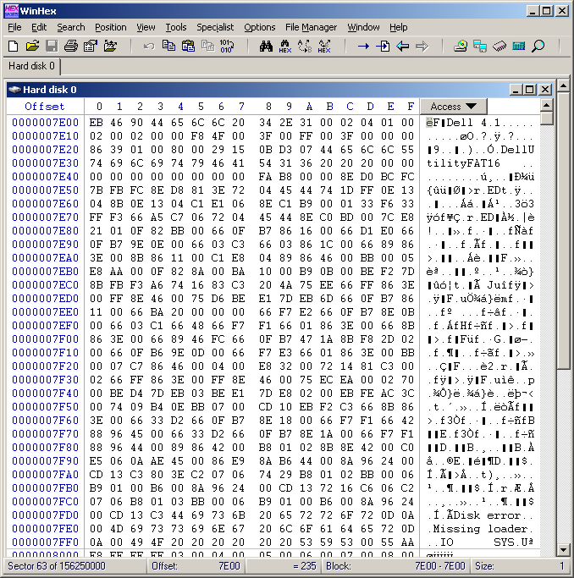
FAT Boot Sector
Occupies the first sector in the partition or on the floppy.

Slide 40
FAT Boot Sector
Jump instruction (EB 34 90)
OEM Manufacturer name
BIOS Parameter Block (BPB)
Extended BPB
Bootstrap code
End of Sector Marker (in reality a signature)

Slide 41
BPB
Learn how to read it.
Field Definition in Lecture Notes
http://www.ntfs.com/fat-partition-sector.htm

Slide 42
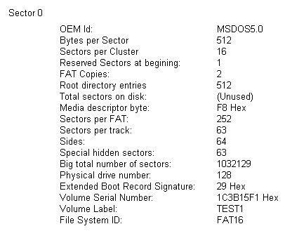
BPB
There are utilities that translate the data

Slide 43

BPB
The data allows us to draw a picture of the partition:

Slide 44
FAT File System
File Allocation Table (FAT)
Resides at the beginning of the volume
Two copies of the table
Three variants
FAT12
FAT16
FAT32
Allocation in clusters.
Clusters number is a power of two < 2¹⁶

Slide 45

FAT File System
Root directory
Maintains file names, location, characteristics, …
File Allocation Table (FAT)
Allows files longer than a single cluster

Slide 46
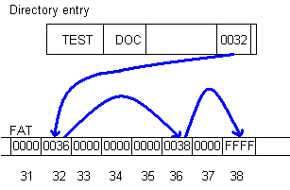
FAT Principle
Root directory gives first cluster
FAT gives subsequent ones in a simple table
Use FFFF to mark end of file.

Slide 47
Cluster Size
Large clusters waste disk space because only a single file can live in a cluster.
Small clusters make it hard to allocate clusters to files contiguously and lead to large FAT.

Slide 48
FAT Table
To save space, limit size of entry.
That limits total number of clusters.
FAT 12: 12 bit FAT entries
FAT 16: 16 bit FAT entries
FAT 32: 32 bit FAT entries

Slide 49
FAT Table Entry
FAT 12 FAT 16 Meaning
000 0000 available
001 0001 not used
FF0 FFF0-FFF6 reserved
FF8-FFF FFF7 bad cluster
0xhhh 0xhhhh next cluster used by file

Slide 50
Root Directory
A fixed length file (in FAT16, FAT32)
Entries are 32B long.
Subdirectories are files of same format.

Slide 51
Root Directory Entries
Offset | Length | Meaning
0x00 | 8B | File Name
0x08 | 3B | Extension
0x0b | 1B | File Attribute
0x0c | 10B | Reserved: (Create time, date, access date in FAT 32)
0x16 | 2B | Time of last change
0x18 | 2B | Date of last change
0x1a | 2B | First cluster
0x1c | 4B | File size.

Slide 52
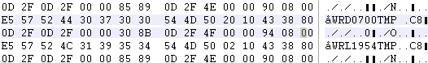
Root Directory Example
This is a deleted file ?wrd0700.tmp
Size is 00 08 94 00
First cluster is 00 4E
Multiply with the cluster size to find the sector.

Slide 53
Root Directory Entries
File Name: First character means
0x00: Entry never used, end of directory
0xe5: File deleted
0x2e: Directory

Slide 54
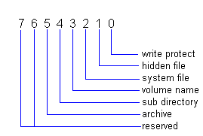
Root Directory Entries
File Attribute

Slide 55
Root Directory Entries
Hidden file: not displayed.
System file: special treatment for deletion.
Volume: Name of the volume if this bit is set. Rest of the name is in the reserved portion.
Subdirectory: File is not a file but a directory (looks like the root directory).

Slide 56

Root Directory Entries
Time and Date of Access

Slide 57
FAT
Deleted files / directories with entries intact can be easily reconstructed.
If entry is overwritten, then pieces might be found in the FAT.
Large storage devices make it impossible to do it without a tool.

Slide 58
FAT 32 Root Directory
Uses 4B to store the files first cluster.
Adds access date and modification date and time
Modification, Access, Creation (MAC) give important hints during an investigation

Slide 59
FAT 32 Root Directory
0x00 | 8B | File Name, padded with zeroes
0x08 | 3B | 3 byte extension
0x0b | 1B | File attribute
0x0c | 1B | Reserved
0x0d | 1B | Millisecond stamp at file creation time.
0x0e | 2B | File creation time.
0x10 | 2B | File creation date.
0x12 | 2B | File access date.
0x14 | 2B | High word of file’s first cluster
0x16 | 2B | Last write time.
0x18 | 2B | Last write date.
0x1a | 2B | Low word of the file’s first cluster
0x1c | 4B | File size in bytes.

Slide 60
Long File Names
Support for long file names needs to be backwards compatible.
Long file names should be stored next to the corresponding short entry.
Disk utilities should not misdiagnose long file name entries as faulty
Unicode support

Slide 61
Long File Name Entries
Encode long file name in several long entries
Precede immediately short entry
Have entry order number.
Last entry order number is or’d with 0x40 to mark it.

Slide 62
Long File Name Support
Create a 8B short file name from long one.
Calculate checksum from short name and store in all long records

Slide 63
Long File Name Entries
0x00 | 1B | Entry order number.
0x01 | 10B | Characters 1-5 of name entry.
0x0b | 1B | File Attribute. MUST be 0F.
0x0c | 1B | Should be 00.
0x0d | 1B | Checksum of short file name.
0x0e | 12B | Characters 6-11 of name entry.
0x1a | 2B | MUST be 00 00 to be compatible.
0x1c | 4c | Characters 12-13 of name entry.

Slide 64
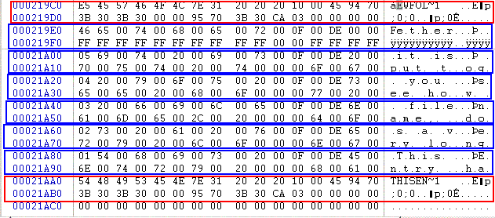
Long File Name Entries
Entry Order Number
Attribute

Slide 65
Subdirectories
Are files with the same structure as root directory.
Contain two special entries
.. Has name “..” and refers to parent directory
. Has name “.” and refers to itself.

Slide 66
FAT Example

Slide 67
Computer Forensics
Investigation
of a
USB Storage Device
(FAT16)

Slide 68
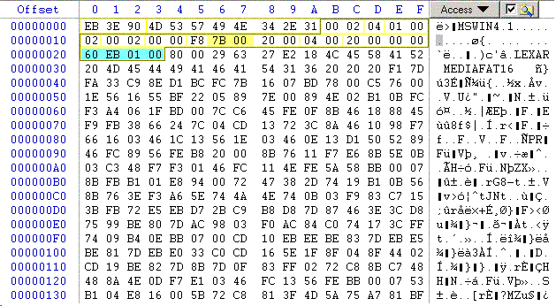
USB Storage Example
Identify FAT Boot Sector (Sector 0)
Find BPB

Slide 69
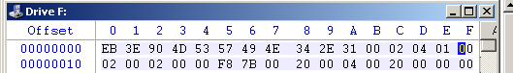
USB Storage Example
0B-0C: Bytes per Sector (little endian)
00 02 → 02 00 = 512_{decimal}
0D: Sectors per Cluster: 04
10: Number of FATs: 02

Slide 70

USB Storage Example
06-07: Size of FAT is 00 7B sectors
There are two FATs
Conclusion:
Root Directory starts at sector 1+7B+7B
Go to sector 247

Slide 71
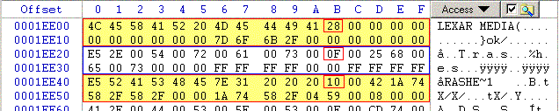
USB Storage Root Directory
Three entries.
Top: a short entry.
Then a long followed by the associated short entry.

Slide 72
USB Storage Root Directory
First Entry
File attribute is 28 -> 0010 1000 b
Volume marker is set
Archive marker is set
Volume Label
Name is Lexar Media

Slide 73
USB Storage Root Directory
Time field is 7D 6F.
Translated from little endian 6F 7D.
Binary 0100 1111 0111 1101.
Hour is 01001 -> 13.
Minute is 111011 -> 51.
Creation time is 13:51.

Slide 74
USB Storage Device Root Directory
Date field is 6B 2F.
Translated from little endian 2F 6B.
In binary 0010 1111 0110 1011.
Year is 001 0111 = 23 after 1980 ->2003
Month is 1011 = 11 = November
Day is 01011 = 11.
Formatted on the 11/11/2003.

Slide 75
USB Storage Device Root Directory
First cluster is 00 00, obviously.
File size is 00 00 00 00.

Slide 76

USB Storage Device Root Directory
Next two entries: a deleted long and short record.
File attribute 0F (long entry)
File attribute 10 (directory)
Leading byte 0xE5 (deleted)

Slide 77
USB Storage Device Root Directory
Long entry file name: .Trashes
Short entry file name: TRASHE~1
Created by MACs
Deleted on 10/24/2003
582F -> 2F 58 -> 0010 1111 0101 1000

Slide 78
USB Storage Device Root Directory
First cluster is 04 59 -> 0x 5904 -> 22788
Size is 00 00 08 00 -> 0x 00 08 00 00 = 2048.

Slide 79
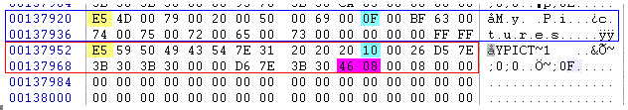
USB Storage Device Root Directory
Go through the directory to find interesting entries.
At the end, a deleted directory called My Pictures.
Starts at cluster 0x0846

Slide 80
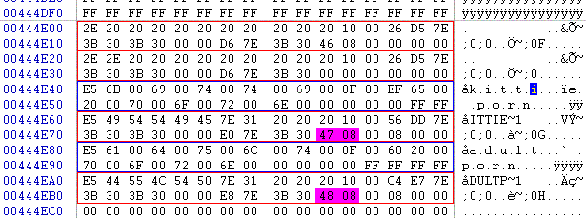
USB Storage Device Directory
Go to this sector:
Two deleted directories kittieporn and adultporn
First starts at cluster 0x4708

Slide 81
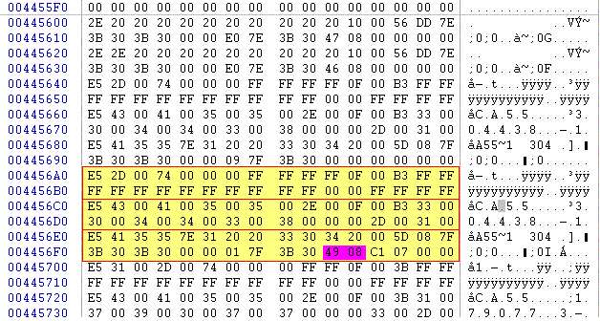
USB Storage Device Directory
Sounds interesting: Go to sector 0x0849

Slide 82
USB Storage Device Directory Entry
File is called “CAT55.304438-1-t”
Size is 0x07C1 = 1985, fits into 1 cluster
Starts at cluster 0x849.

Slide 83
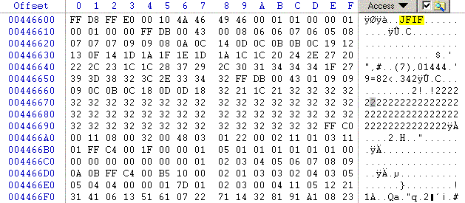
USB Storage Device Deleted File
Magic number JFIF tells us that this is a JPEG file.
Go to file

Slide 84
USB Storage Device Deleted File
Most files have these magic markers.
Learn how to identify them.

Slide 85
USB Storage Device Deleted File
Use Winhex to save this block into a file.
Change file extension to JPG.
Now we can look at it.
Indeed, minors in a seductive position and completely naked!

Slide 86

USB Storage Device Deleted File

Slide 87
Recovering Files
This was easy because we just followed directory entries.
WinHex actually calculates a lot of the values that we distilled by hand.
Reconstructs directory entries on its own.
But has no generic file previewer

Slide 88
Recovering Files
If directory entry is overwritten:
Look for sectors in slack space.
Look for files that have not been overwritten.
Try to splice pieces of the file together from the FAT.
Use pattern recognition software to guess file type.
Result is frequently useful.

Slide 89
Recovering Files
Text files:
Search for Words in the Duplicate.
Learn how word processors store files.
Interesting finds, especially in old MS Word formats.

Slide 90
NTFS File System

Slide 91
NTFS Concepts
Everything is a file
Master File Table (MFT) is the heart of NTFS
Each file and directory has an (at least) 1KB entry in the MFT
MFT
Entry
Header
Attribute
Attribute
Attribute
Unused
Space

Slide 92
NTFS Concepts
First entry in the MFT is called $MFT and describes itself
Starting address of MFT is in the boot sector
Everything else is in the $MFT entry
Allocation is in clusters
Size of clusters is defined in the boot sector

Slide 93
MFT entry
MFT Entry
Size is given in the boot sector
But in all windows systems equal to 1KB
First 42B contain 12 fields
Rest is unstructured and used for attributes
First entry is the signature:
FILE for a valid entry
BAAD for an erroneous entry
Flag field ($BITMAP) tells whether entry is used and a directory

Slide 94
MFT Entry
A file with too many attributes can take up more than one entry
First entry is the base file record
Rest contains the base file record address in their contents

Slide 95
MFT Entry
Addresses:
48b address for each entry File Number
Maximum address is size of MFT / size of entry
16b sequence number
Incremented whenever the entry is reused
16b sequence number followed by file number gives 64 b file-reference address

Slide 96
MFT Entry
(File System) Metadata Files
Store system’s administrative data
First 16 entries reserved for them
$MFT: Entry for MFT
$MFTMirr: Backup MFT
$LogFile: Journal for metadata transactions
$Volume: Volume information
$AttrDef: Definitions used for attributes
-: Root directory
$Bitmap: Allocation status of clusters
$Boot: Boot sector and boot code
$BadClus: Clusters with bad sectors
$Secure: Info on security and access control
$Upcase: Uppercase versions of Unicode characters
$Extend: Directory containing files for optional extensions

Slide 97
MFT Entry
MFT
Entry
Header
Attr.
Header
Attribute
Attr.
Header
Attribute
Attr.
Header
Attribute
Unused

Slide 98
MFT Entry
Attribute Headers
Identifies type of attribute, size, name
Flags to tell whether value is compressed or encrypted

Slide 99
MFT Entry
Attributes
Can be “resident”
Inside the entry
Can be “non-resident”
Stored in external clusters
Header will give the cluster addresses
Stored in Cluster Runs
Sets of consecutive clusters
Virtual Cluster Numbers start with end of MFT
Logical Cluster Numbers correspond to LBA

Slide 100
MFT Entry
Since attributes have a 16b identifier, there can be 2¹⁶ of them
If there is an overflow, can use additional MFT entries
Main MFT entry becomes the base entry
Others have the base entry’s address in their MFT entry field

Slide 101
MFT Entry
Sparse attributes
Non-resident $DATA can be flagged as a sparse attribute
Zero clusters are replaced with zero runs

Slide 102
MFT Entry
Compressed attributes
Non-resident $DATA can be compressed by the file system
Attribute header flag identifies compression
$STANDARD_INFORMATION and $FILE_NAME attributes also give that information

Slide 103
MFT Entry
Encrypted attributes
Windows allows $DATA to be encrypted
Only the contents are encrypted, not the attribute header
A directory chosen to be encrypted only has the files encrypted
$LOGGED_UTILITY_STREAM attribute is created for the file, which contains the key
Algorithm is DESX
Each MFT entry has its own key, the file encryption key (FEK)
File encryption key is stored in encrypted form
For each user, FEK is encrypted with public key in the data decryption fields of $LOGGED_UTILITY_STREAM

Slide 104
NTFS Analysis
$MFT file contains the Master File Table
$MFTMIRR is its backup copy
With entries for, at least
$MFT, $MFTMIRR, $LogFile, $Volume
Recovery tool can determine MFT layout and size, use the $LogFile to recover file system, and obtain version and status from $Volume

Slide 105
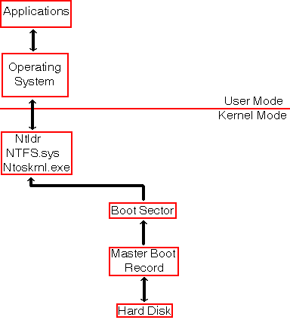
NTFS Architecture

Slide 106

NTFS Layout

Slide 107
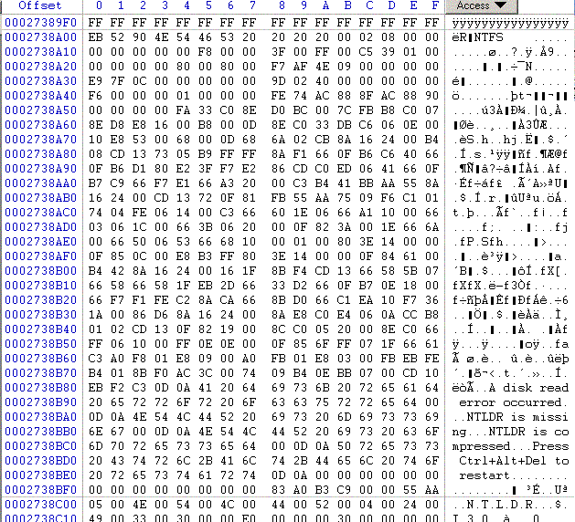
NTFS Boot Sector
Notice that the end of sector marker is 55 AA.
You can look for this to find boot sectors for NTFS and DOS.

Slide 108
NTFS Boot Sector
0x00 3B Jump Instruction
0x03 8B OEM ID
0x0B 25B BPB
0x24 48B Extended BPB
0x54 426B Bootstrap Code.
0x1FE 2B End of Sector Marker

Slide 109
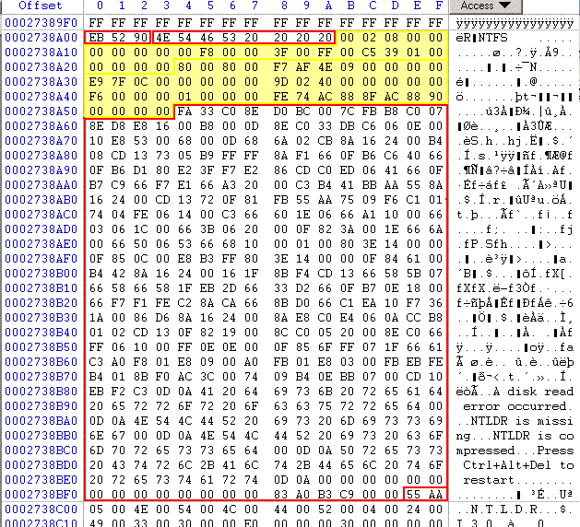
NTSF Boot Sector

Slide 110
NTSF Boot Sector
Many fields are not important, but:
0x0B, Bytes per sector.
0x0D Sectors per Cluster
0x15 Media descriptor. F8: HD; F0: HD Floppy
0x28 Total sectors.
0x30 Logical cluster number for the MFT
0x38 Logical cluster number copy of the MFT
0x40 Clusters per MFT Record.
0x48 Volume serial

Slide 111
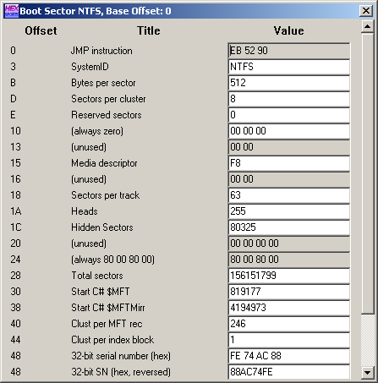
NTFS Boot Sector
WinHex allows access to an interpreted NTFS Boot Sector.
Use the Access Tab.

Slide 112
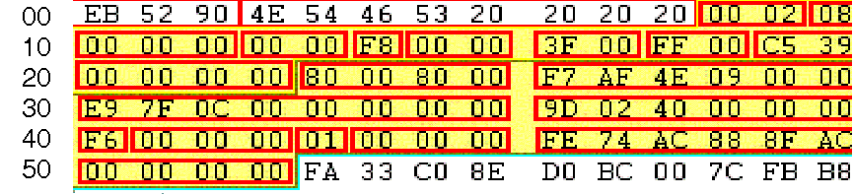
NTFS BPB
0x0B Bytes per sector: 00 02 → 0200 = 512 decimal
0x0D Sectors per cluster: 0x 08
0x0E Reserved sectors 0x 00 00

Slide 113
NTFS BPB
0x15: Media Descriptor: F8 is hard drive, F0 is floppy.
0x28 Total number of sectors: F7AF4E0900000000 → 000000094EAFF7 → 156,151,799 sectors, i.e. ~80GB

Slide 114
NTFS BPB
0x30: Logical cluster number for MFT copy 1: cluster C07FE9 (File $MFT)
0x38: Logical cluster number for MFT copy 2: cluster 40029D

Slide 115
NTFS BPB
0x40: Clusters per MFT record: F6
0x48: Volume Serial Number

Slide 116
NTFS Master File Table
First four entries are replicated, so that MFT can be repaired
First 16 records are reserved for metadata files, their name begins with a dollar sign ($)

Slide 117
NTFS Master File Table
Master file table $MFT.
Master file table mirror $MftMirr.
Log file $LogFile.
Volume $Volume Attribute definitions $AttrDef.
The root folder “.”
Cluster bitmap $Bitmap
Boot sector $Boot (located at the beginning of partition)
Bad cluster file $BadClus
Security file $Secure
Upcase table $Upcase
NTFS extension file $Extend, that is used for future use.

Slide 118
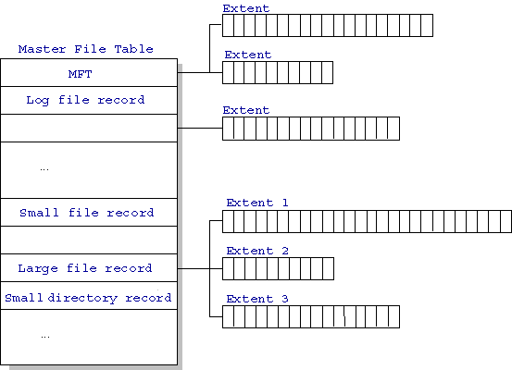
NTFS Master File Table

Slide 119
MFT Record Structure
Entries are 1KB each
Entries contain
File Attributes
Location Data

Slide 120
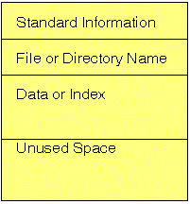
MFT Records
Small Files (<900B) are contained completely in the MFT entry.

Slide 121
MFT Records
Folders contain index data.
Small folders reside within the MFT record
Larger folders have an index structure to other data blocks. They use a B-tree structure.

Slide 122
MFT Record
Each MFT record is addressed by a 48 bit MFT entry value.
First entry has address 0.
Each MFT entry has a 16 bit sequence number that is incremented when the entry is allocated.
MFT entry value and sequence number combined yield 64b file reference address.

Slide 123
MFT Record
NTFS uses the file reference address to refer to MTF entries.
When the system crashes during allocation, then the sequence number describes whether the MTF entry belonged to the previous file or to the current one.

Slide 124
MFT Record
MFT entry attributes are loosely defined.
Each attribute is preceded by the attribute header.
The attribute header identifies
Type of attribute.
Size.
Name.

Slide 125
MFT Record Structure
The attribute header gives basic information about the attribute.
A resident attribute is stored in the MFT entry.
A non-resident entry is stored in a cluster outside the MFT.

Slide 126
MFT Record Structure
Resident attributes are stored in MFT record.
Non-resident attributes are stored in cluster runs.
Cluster run consists of consecutive clusters and are identified by starting cluster and run length.
NTFS distinguishes between Virtual Cluster Numbers and Logical Cluster Numbers.
LCN * (#sectors in cluster) = sector number
LCN 0 is first cluster in the volume (boot sector).
VCN 0 refers to the first cluster in a cluster run.

Slide 127
MFT Record Structure
MFT entry header has a fixed structure

Slide 128
MFT Record Structure
0x00 - 0x03: Magic Number: "FILE"
0x04-0x05: Offset to the update sequence.
0x06-0x07: Number of entries in fixup array
0x08-0x0f: $LogFile Sequence Number (LSN)
0x10-0x11: Sequence number
0x12 - 0x13: Hard link count
0x14-0x15: Offset to first attribute

Slide 129
MFT Record Structure
0x16 - 0x17: Flags: 0x01: record in use, 0x02 directory.
0x18-0x1b: Used size of MFT entry
0x1c-0x1f: Allocated size of MFT entry.
0x20-0x27: File reference to the base FILE record
0x28-0x29: Next attribute ID
0x2a-0x2b: (XP) Align to 4B boundary
0x2c-ox2f: (XP) Number of this MFT record
0x30-0x100: Attributes and fixup value

Slide 130
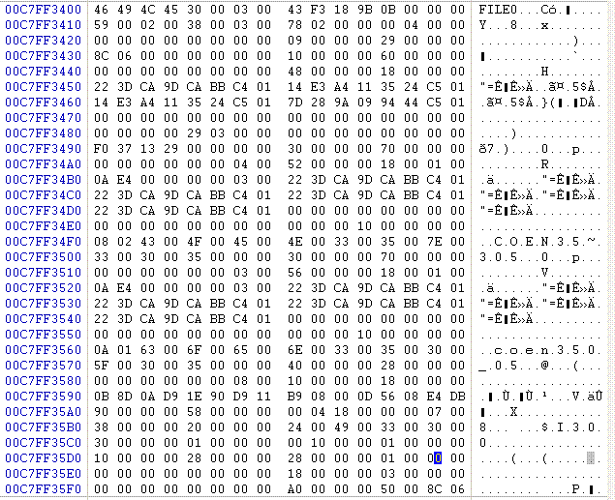
MFT Record Structure
EXAMPLE 1:
A directory entry

Slide 131
MFT Record
MFT records start with “FILE”. A bad cluster would start with “BAAD”

Slide 132
MFT Record
Bytes 4-5: Offset to update sequence.
Bytes 6-7: Number of entries in fixup array
Bytes 8-f: Log file sequence number
Bytes 0x10-0x11: Sequence number: 59 00

Slide 133
MFT Record
Bytes 0x12-0x13: 2 – hard link count
Bytes 0x14-0x15: Offset to first attribute: 0x 38
Bytes 0x16-0x17: Flags: In use and contains a directory 0x 0001 | 0x 0002

Slide 134

MFT Record
Bytes 0x14 – 0x15: First attribute starts at 0x 38 00 → 0x 00 38

Slide 135
MFT List of possible attributes
Defined in $AttrDef entry of MFT, but default is:
0x10 STANDARD_INFORMATION
0x20$ATTRIBUTE_LIST
0x30$FILE_NAME0
X40 (NT) $VOLUME_VERSION (2K) $OBJECT_ID
0x50 $SECURITY_DESCRIPTOR
0x60$VOLUME_NAME
0x70 $VOLUME_INFORMATION
0x80$DATA
0x90$INDEX_ROOT
0xA0$INDEX_ALLOCATION
0xB0$BITMAP
0xC0 (NT) $SYMBOLIC_LINK, (2K) $REPARSE_POINT
0xD0$EA_INFORMATION
0xE0$EA0xF0NT$PROPERTY_SET
0x100 (2K) $LOGGED_UTILITY_STREAM

Slide 136
MFT Attribute Layout
Attributes can be resident or non-resident.
Beginning is always the same:
0x00 Attribute Type Identifier
0x04 Length of Attribute
0x08 non-resident flag
0x09 length of name
0x0a offset to name
0x0c flags

Slide 137
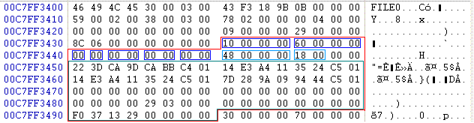
MFT Attribute Example
Attribute is of type 00 00 00 10.
Standard Information
Attribute is 0x 00 00 00 60 bytes long.
Attribute is resident (0x00)
Contents are 0x 00 00 00 48 bytes long and start at offset 0x 00 18.

Slide 138
MFT Attribute Example
Standard Info Attribute Layout
0x00 | 8 |  | File Creation Time
0x08 | 8 |  | File Alteration Time
0x10 | 8 |  | MFT Change
0x18 | 8 |  | File Read Time
0x20 | 4 |  | DOS File Permissions
0x24 | 4 |  | Maximum number of versions
0x28 | 4 |  | Version number
0x2C | 4 |  | Class ID
0x30 | 4 | 2K | Owner ID

Slide 139
MFT Attribute Example
This allows us to extract the file access times just as for DOS.
Time values are in 100 nanoseconds since January 1, 1601 UTC.

Slide 140
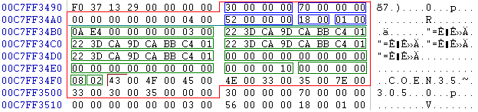
MFT Attribute Example
Second entry has attribute number 00 00 00 03 → 300000.
$FILE_NAME attribute
Total attribute length is 70 B.
Contents start at offset 18B

Slide 141
MFT Attribute Example
The content layout for the $FILE_NAME attribute is:
0x00 File reference to parent directory
0x08 File creation time
0x10 File modification time
0x20 File access time
0x28 Allocated size of file
0x30 Real size of file
0x38 Flags
0x40 File name length in unicode characters
0x42 File name in unicode

Slide 142
MFT Attribute Example
Obviously, this is a short file name.

Slide 143
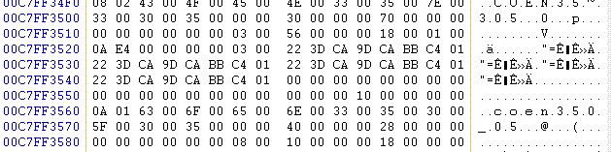
MFT Attribute Example
Third attribute is also a file name, but this time the complete entry

Slide 144
NTFS Example

Slide 145
NTFS Example
Use WinHex to go directly to the partition.
WinHex will read the boot sector and allow easier navigation.

Slide 146
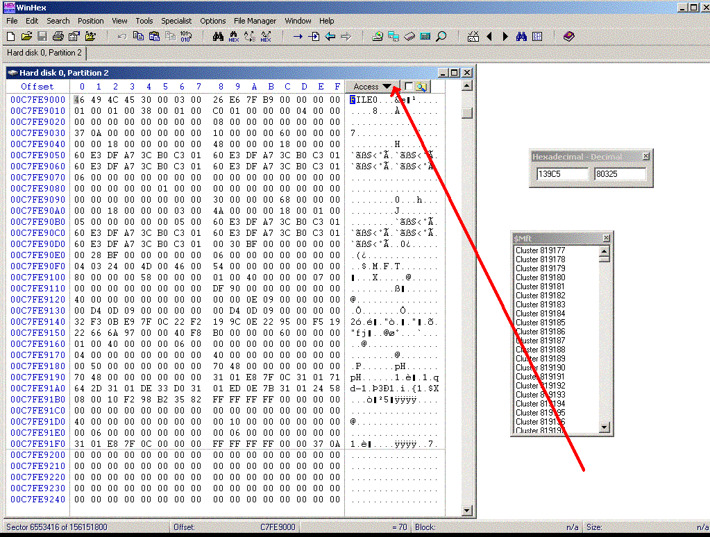

Slide 147
NTFS Example
Disassembling MFT entries by hand is difficult.
Use tools.
WinHex allows you to look at the file structure.

Slide 148
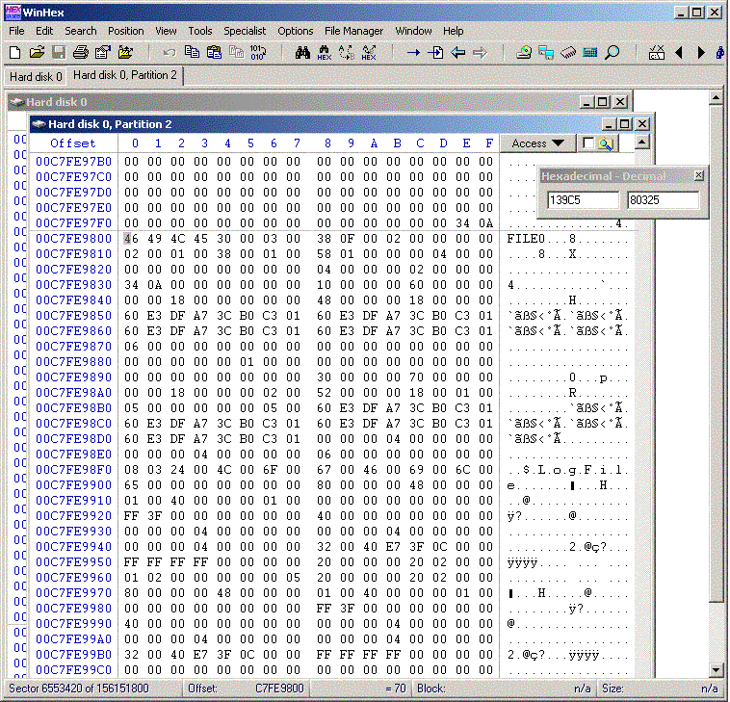

Slide 149
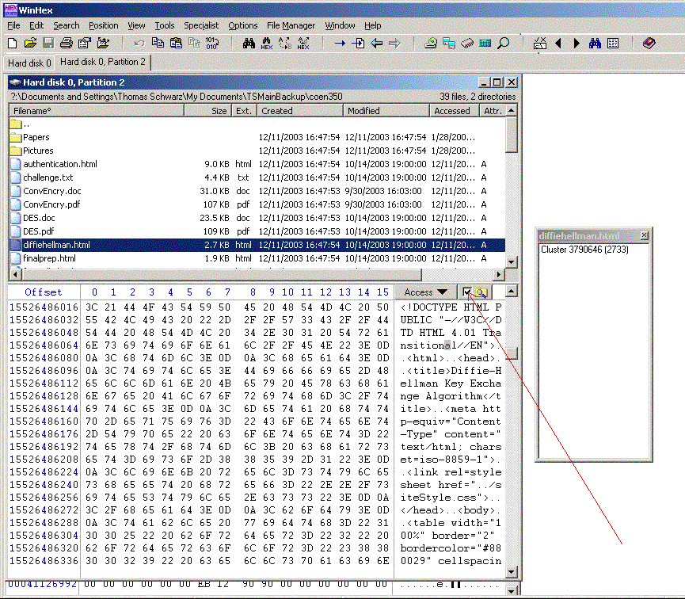

Slide 150
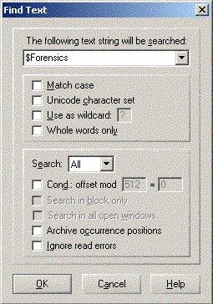
NTFS Example
WinHex allows to search for strings

Slide 151

NTFS Example
But string searches can take a long time.

Slide 152
Unix File Systems

Slide 153
Unix File System
Increasingly important
Linux
MacOS X
Bewildering variety on a laptop
Linux versions
Free BSD
Open BSD
Mac

Slide 154
Unix File Systems
Almost everything is a file.
File has properties such as
File type and access permissions.
Link count.
Ownership & group membership.
Date and time of last modification.
File name.

Slide 155
Unix File System
Owners can change many of these data
Including modification time.

Slide 156
Unix File System
Based on Inodes.
More flexible than tables.

Slide 157
Inodes
i_mode (directory IFDIR, block special file (IFBLK), character special file (IFCHR), or regular file (IFREG)
i_nlink
i_uid (user id)
i_gid (group id)
i_size (file size in bytes)
i_addr (an array that holds addresses of blocks)
i_mtime (modification time & date)
i_atime (access time & date)

Slide 158
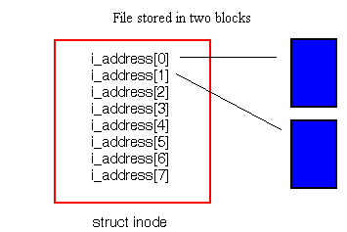
Inodes

Slide 159
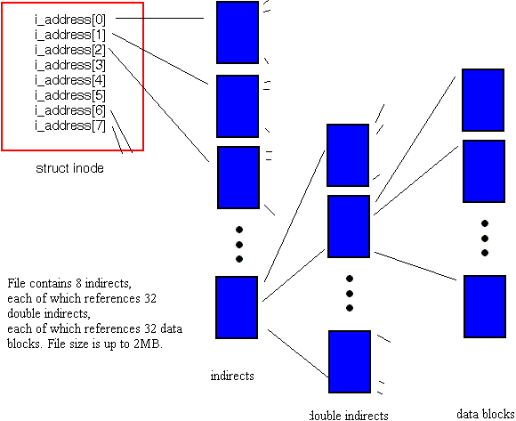
Inodes

Slide 160
Unix File System
Classical Unix used a file table to mediate between users and their open files.
File table had references to the inodes of open files.

Slide 161
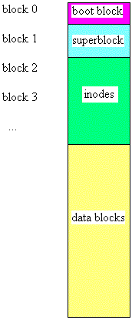
Unix File System
On-Disk Layout.
Superblock contains data on the file system.

Slide 162
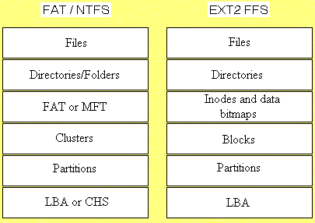
Unix File System

Slide 163
Unix File Systems
First versions of Unix had a single file system.
Unix System V Release 3.0 introduced File System Switch architecture.
No longer a tight coupling between kernel and file system.

Slide 164
Unix File Systems
SunOS elaborated on this idea.
Clear split between file system-dependent and file system-independent kernel.
Intermediary layer is the VFS / VOP / veneer layer.
Allows disk file systems such as 4.2 BSD FFS, MS-DOS, NFS, RFS.

Slide 165

Unix File Systems
Disk Layout not uniform.
Ext2 (Linux) file system layout.

Slide 166
Journaling File Systems
File systems use caching in order to speed up operations.
An unclean dismount can leave the file system in an unclean state.
Journaling file system can keep a log, so that they can simply replay the log in order to bring the file system into a consistent state.

Slide 167
Journaling File Systems
Log can contain
Only records of changes to metadata.
Records of changes to metadata and client data.
New values of blocks.
Research Effort.
Not successfully implemented.

Slide 168
Journaling File Systems
ext3 (adds journal to ext2) for Linux
JFS
ReiserFS
XFS
…

Slide 169
Journaling File Systems
Interesting opportunity for forensic investigation.
Unfortunately, log entries get purged if too old.

Slide 170
EXT Details
Ext2
Ext3

Slide 171
EXT Details
Overview

Slide 172
EXT Details
Ext superblock:
Located 1024 B from start of the file system.
Backups of superblock are usually stored in the first block of each block group.
Contains basic information:
Block size
Total number of blocks
Number of reserved blocks

Slide 173
EXT Details: EXT SuperBlock
Byte | Description
0-3B | Number of inodes in file system
4-7B | Number of blocks in file system
8-11B | Number of blocks reserved to prevent file system from filling up
12-15B | Number of unallocated blocks.
16-19B | Number of unallocated inodes.
20-23B | Block where block group 0 starts
24-27B | Block size. (Saved as the number of places to shift 1,024 to the left).
28-31B | Fragment size. (Saved as the number of places to shift 1,024 to the left).
32-35B | Number of blocks in each group.
36-39B | Number of fragments in each block group
40-43B | Number of inodes in each block group.
44-47B | Last mount time.
48-51B | Last written time.
52-53B | Current mount time.
54-55B | Maximum mount count

Slide 174
EXT Details: EXT SuperBlock
Byte | Description
56-57B | Signature 0xef53
58-59B | File system state
60-61B | Error handling method
62-63B | Minor Version
64-67B | Last consistency check time.
68-71B | Interval between forced consistency checks
72-75B | Creator OS
76-79B | Major version
80-81B | UID that can use reserved blocks.
82-83B | GID that can use reserved blocks.
84-87B | First non-reserved inode in file system
88-89B | Size of each inode structure
90-91B | Block group that this superblock is part of (if this is the backup copy)
92-95B | Compatibility feature flags
96-99B | Incompatbile feature flags

Slide 175
EXT Details: EXT SuperBlock
Byte | Description
100-103 | Read only feature flags
104-119 | File system ID
120-135 | Volume name
136-199 | Path were last mounted on
200-203 | Algorithm usage bitmap
204 | Number of blocks to preallocate for files.
205 | Number of blocks to preallocate for directories
208-223 | Journal ID
224-227 | Journal Inode
228-231 | Journal device
232-235 | Head of orphan inode list
236-1023 | Unused

Slide 176
EXT Details
Group Descriptor Table
In the block following superblock
Describes all block groups in the system

Slide 177
EXT Details
Group Descriptor Table Entries
0-3 starting block address of block bitmap
4-7 starting block address of inode bitmap
8-11 starting block address of inode table
12-13 number of unallocated blocks in group
14-15 number of unallocated inodes in group
16-17 number of directories in group

Slide 178
EXT Details
Total number of blocks includes Reserved area and all groups.
Blocks per group determines size of group.

Slide 179
EXT Details
Block Group Descriptor Table
Located in block following the superblock
Basic layout of a block group:
Block bitmap takes exactly one block.
Inode bitmap manages allocation status of inodes.

Slide 180
EXT Details
Number of blocks = bits in bitmap = bits in a block (namely the bitmap block).
Size of block determines number of blocks in a block group!
Inode bitmap starting address contained in block descriptor table.
Size of Inode bitmap given by #inodes per group divided by 8.
Block group descriptor table gives starting block for inode table.
Size of inode table = 128B * number of inodes.

Slide 181
EXT Details
Boot Code
If exists, will be in the 1024B before the superblock.
Many Linux systems have a boot loader in the MBR.
In this case, there will be no additional boot code.

Slide 182
EXT Details
Data stored in blocks.
Typical block sizes are 1,024B; 2048B; or 4096B
Allocation status of a block determined by the group’s block bitmap

Slide 183
EXT Details
Analyzing content:
Locate any block
Read its contents
Determine its allocation status
First block starts in the first sector of the file system. Block size is given by superblock.

Slide 184
EXT Details
Determining allocation status:
Determine the block group to which the block belongs.
Locate the groups entry in the group descriptor table to find out where the block bitmap is stored.
Process the block bitmap to find out whether this block is allocated or not.

Slide 185
EXT Details
To find all unallocated blocks:
Systematically go through the block bitmap and look for 0 bit entries.
Status of reserved sectors at the beginning is less clear since there are no bitmap entries for them.

Slide 186
EXT Details
Metadata is stored in the inode data structure.
All inodes have the same size specified in the superblock.
Inodes have addresses starting with 1.
Inodes in each group are in a table with address given by the group descriptor.
group = (inode – 1) / INODES_PER_GROUP

Slide 187
EXT Details
Inodes 1 – 10 are typically reserved.
Superblock has the value of the first non-reserved inode.
Inode 1 keeps track of bad blocks.
Inode 2 contains the root directory
Journal uses Inode 8
First user file in Inode 11, typically for lost+found

Slide 188
EXT Details
Inode can store the address of the first 12 data blocks of a file.
For larger files, we use double indirect and triple indirect block pointers

Slide 189
EXT Details
Allocation Algorithms
Block group:
Non-directories are allocated in the same block group as parent directory, if possible.
Directory entries are put into underutilized groups.
Contents of allocated inode are cleared and MAC times set to the current system time.
Deleted files have their inode link value decremented.
If the link value is zero, then it is unallocated.
If a process still has the file open, it becomes an orphan file and is linked to the superblock.

Slide 190
EXT Details
Inode Structure
0-1 File Mode (type and permissions)
2-3 Lower 16 bits of user ID
4-7 Lower 32 bits of size in bytes
8-11 Access Time
12-15 Change Time
16-19 Modification Time
20-23 Deletion Time

Slide 191
EXT Details
Inode Structure
24-25 Lower 16 bits of group ID
26-27 Link count
28-31 Sector count
32-35 Flags
36-39 Unused
40 – 87 12 direct block pointers
88-91 1 single indirect block pointer
92-95 1 double indirect block pointer

Slide 192
EXT Details
Inode Structure
96-99 1 indirect block pointer
100 – 103 Generation number (NFS)
104 – 107 Extended attribute block
108 – 111 Upper 32 bits of size / Directory ACL
112 – 115 Block address of fragment
116 Fragment index in block

Slide 193
EXT Details
Inode Structure
117 Fragment Size
118 – 119 Unused
120 – 121 Upper 16 bits of user ID
122 – 123 Upper 16 bits of group ID
124 – 127 Ununsed

Slide 194
EXT Details
Inode Structure
Permission flags of the file mode field
0x001 Other – execute permission
0x002 Other – write permission
0x004 Other – read permission
0x008 Group – execute permission
0x010 Group – write permission
0x020 Group – read permission
0x040 User – execute permission
0x080 User – write permission
0x100 User – read permission

Slide 195
EXT Details
Inode Structure
Flags for bits 9 – 11 of the file mode field
0x200 Sticky bit (save text image)
0x400 Set Group ID
0x800 Set User ID

Slide 196
EXT Details
Inode Structure
File mode field
These are values not flags
0x1000 FIFO
0x2000 Character device
0x4000 Directory
0x6000 Block device
0x8000 Regular file
0xA000 Symbolic link
0xC000 Unix socket

Slide 197
EXT Details
Time Values
Are stored as seconds since January 1, 1970, Universal Standard Time
Get ready for the Year 2038 problem.

Slide 198
EXT Details
Linux updates (in general)
A-time, when the content of file / directory is read.
For a file:
If a process reads the file.
When the file is copied.
When the file is moved to a new volume.
But not if the file is moved within a volume.
For a directory
When a directory listing is done.
When a file or subdirectory is opened.

Slide 199
EXT Details
Linux updates (in general)
M-time, when the content of file / directory is modified.
For a file:
If file contents change.
For a directory
When a file is created or deleted inside the directory.
When a file is copied, the M-time is not changed.
However, when a file is copied to a network drive, the network server might consider it a new file and reset the M-time to the current time.

Slide 200
EXT Details
Linux updates (in general)
C-time corresponds to the last inode change.
When file / directory is created.
When permissions change.
When contents change.
D-time is set only if a file is deleted.
When a file is created, then D-time is set to 0.

Slide 201
EXT Details
Unallocated inodes contain temporary data.
M-, C-, D-time values might show when the file was deleted.
Users can change A- and M-time with the touch command.

Slide 202
EXT Details
Linux fills slack space (unused bytes of block) with zeroes.
Data from deleted files will only exist in unallocated blocks.
File size and allocated blocks will probably be wiped from unallocated inode entries.

Slide 203
EXT Details
Linux file hiding technique:
Have a process open a file for reading or writing.
Delete the file name.
Link count for the inode is zero, but inode is not unallocated.
The file system should add the orphan inode to a list in the superblock.

Slide 204
EXT Details
Directory Structure
A directory entry consists of
A variable length name.
The inode number with the metadata of the entry.
The original byte allocation is as follows:
0-3 Inode value
4-5 Length of entry
6-7 Length of name
8- Name in ASCII

Slide 205
EXT Details
Directory Structure
The improved byte allocation is as follows:
0-3 Inode value
4-5 Length of entry
6 Length of name (up to 255 now)
7 File type
0 unknown
1 regular file
2 directory
3 character device
4 block device
5 FIFO
6 Unix Socket
7 Symbolic link
8- Name in ASCII

Slide 206
EXT Details
The record entry length allows the file system to find the next entry in a directory.
If a directory entry is deleted, then the previous entries length is increased.

Slide 207
EXT Details
When FS is created, a Linux user can decide to use hash trees instead.
Directory entries are no longer in an unsorted list.
A directory using a hash tree contains multiple blocks, the nodes in the tree.
First block contains the “.” and “..” directory entries.

Slide 208
EXT Details
Links
Hard link: an additional file/directory name.
Implemented by another directory entry pointing to the same inode.
Link count in inode is incremented.
Directory link count is ≥ 2 + number of subdirectories
File system cannot distinguish between the first and the second name of file.

Slide 209
EXT Details
Links
Soft link: an additional file/directory name.
Implemented by a directory entry pointing to another inode.
Inode points to a file, that contains the path to the original file.

Slide 210
EXT Details
Mount Point Example
FS1 has directory /dir1.
If FS2 is mounted on /dir1 and a user changed into /dir1, then only FS2 is shown.

Slide 211
EXT Details
EXT hiding technique uses a directory (containing the files to be hidden) as a mount point.
Forensics tools tend to not give mount points.
Consequentially, this hiding technique falls flat for forensics tools.

Slide 212
EXT3
EXT3 journal located at inode 8 (typically)
Journal records transactions
Block updates about to occur.
Log of update after the fact.
Two modes:
Only metadata blocks are journaled.
Metadata and data blocks are journaled.

Slide 213
EXT Details
Ext3 Journal gives additional information about recent events.

Slide 214
Links
http://www.nondot.org/sabre/os/files/FileSystems/ext2fs/
http://www.nongnu.org/ext2-doc/

Slide 215
Antedating Evidence

Slide 216
Timestamp analysis
Central to intrusion and criminal investigations
Interest is around time of incident
Timestamps are the most important mean to order events (e.g. in the file system)
But are attacked by “anti-forensic tools”
Resetting clock can be used for framing
Not in a big organization with time servers

Slide 217
Sequence Number Causality
Many digital systems use sequence numbers
Can be strictly increasing
Can wrap around
Example: NTFS
Journal file transactions are labeled with a Logical Sequence Number
Functionality depends on LSN strictly increasing
Journal file has limited size
Entries are quickly overwritten
But: NTFS stores LSN in the file metadata
Since LSN is strictly increasing, this allows us to order chronologically events
Independent of time stamps

Slide 218
Allocation Sequence Causality
First-fit allocation stores new item in first available storage location
Data items can be deleted and space becomes reusable
Overwritten data is irretrievable
Sometimes: Use of generation markers
Generation marker is increased with each reuse
NTFS: MFT entry numbers

Slide 219
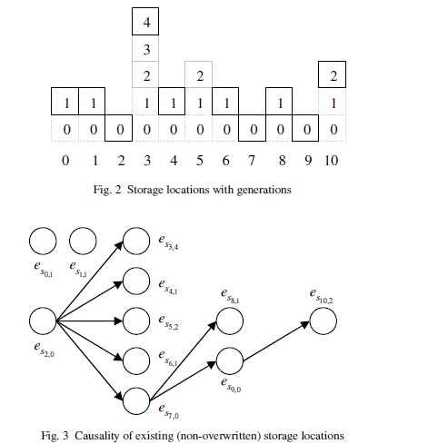
Allocation Sequence Causality
Can be used to generate temporal sequence between events
Willassen: Finding Evidence of Antedating in Digital Investigations, ARES 2008

Slide 220
Allocation Sequence Causality
NTFS MFT uses first-fit storage with generation markers (entry-sequence number)
Implement a checker
Is (recovered) time consistent with markers

Slide 221
Log Entries
Systems maintains many logs
Events are added in logs at the end
If logs can be trusted:
Order of two events in the log give order of events in time
Logs can have time stamps on entries
Time stamps need to be consistent with entries

Slide 222
Probable Orderings
Inode numbers are usually allocated in series
Allows using inode numbers to find file creation events at the same time

