Slide 1
File System Journal Forensics
Matthew Seyer
G-C Partners, LLC

Slide 2
What is File System Journaling
Records File System Metadata Changes
Optionally Can Retain More Depending on File System Options
Allows File System to Return to a Clean State

Slide 3
Popular Journaling File Systems
NTFS
Ext3
Ext4
HFS+
JFS

Slide 4
Journaling Types
Transaction Based
NTFS
Redo and Undo Operations (Before and After)
Block/Sector Based
Ext3, Ext4, HFS+
Blocks with Changes (Redo Operations Only)

Slide 5
Journal Forensics
Journal Depicts Recent Events
Only as far back as the journal records
Use Volume Shadow Snapshots to extend timeframe
Events are Determined Via Operation Signatures
Determine Application Signatures

Slide 6
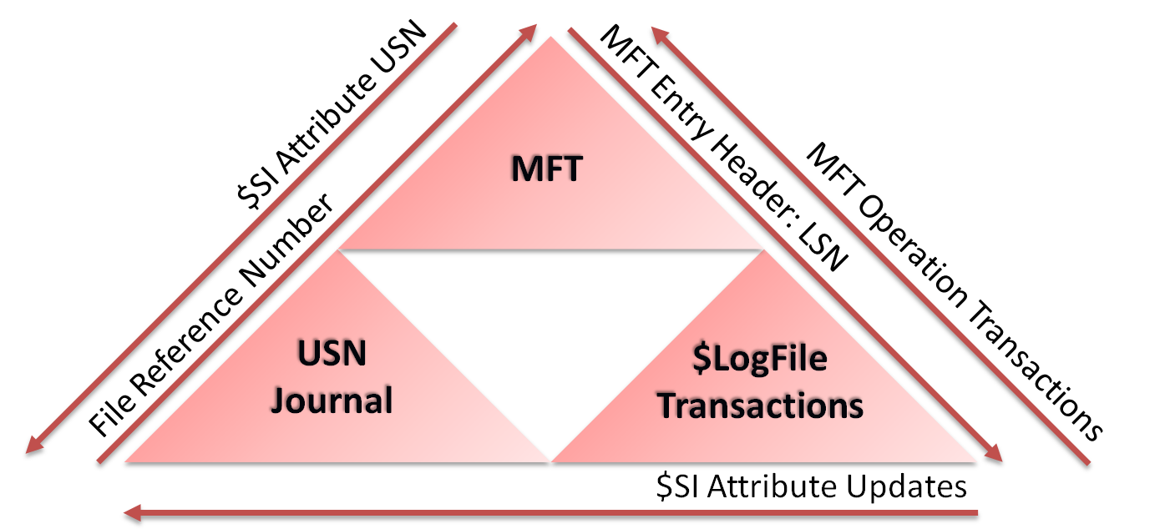
NTFS Journal Analysis

Slide 7
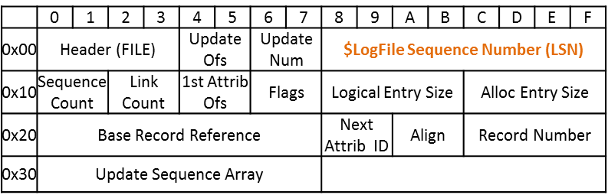
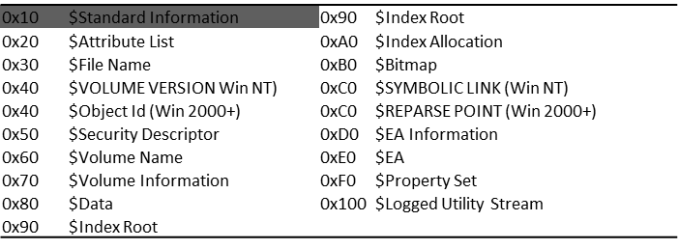
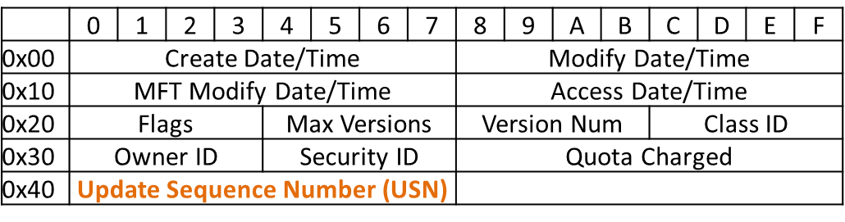
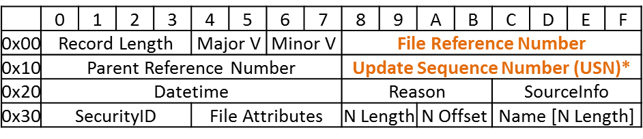
NTFS Linkages
MFT Record Header
MFT Attributes
Standard Information Attribute
USN Record Entry

Slide 8
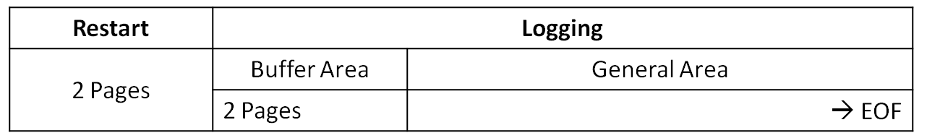
NTFS Journal ($LogFile)
$LogFile is split into pages
Generally 4096 bytes
Two Sections: Restart and Logging
Great Paper on the $LogFile’s Structure
A Dig into the $LogFile
http://forensicinsight.org/wp-content/uploads/2012/05/INSIGHT_A-Dig-into-the-LogFile.pdf

Slide 9
$LogFile Structures
Restart Header
 | 0 | 1 | 2 | 3 | 4 | 5 | 6 | 7 | 8 | 9 | A | B | C | D | E | F
0x00 | RSTR |  |  |  | Update Seq. Offset |  | Update Seq. Count |  | Check Disk LSN
0x10 | System Page Size |  |  |  | Log Page Size |  |  |  | Restart Offset |  | Minor Version |  | Major Version
0x20 | Update Sequence Array
0x30 | Current LSN |  |  |  |  |  |  |  | Log Client |  | Client List |  | Flags
0x40 | UNKNOWN
0x50
0x60
0x70 | Oldest LSN |  |  |  |  |  |  |  | Restart LSN

Slide 10
$LogFile Structures
Page Header
 | 0 | 1 | 2 | 3 | 4 | 5 | 6 | 7 | 8 | 9 | A | B | C | D | E | F
0x00 | “RCRD” (signature) |  |  |  | Update Sequence Offset |  | Update Sequence Count |  | Last LSN or File Offset
0x10 | Flags |  |  |  | Page Count |  | Page Position |  | Next Record Offset |  | Word Align |  | DWord Align
0x20 | Last End LSN
0x30 | Update Sequence Array
Page Count: Number of pages that are used for the transaction run. Page Position: The current page number of a transaction run. Next Record Offset: Offset of last LSN on the page. Last LSN: Last overall LSN on page (includes the overlapping LSNs). Last End LSN: Last complete LSN on page. Update Sequence Array: Array containing the update sequences for replacement. The first two bytes of the value is the Update Sequence Value. These are used every 512 bytes.

Slide 11
$LogFile Structures
LSN Record Header
 | 0 | 1 | 2 | 3 | 4 | 5 | 6 | 7 | 8 | 9 | A | B | C | D | E | F
0x00 | Current LSN |  |  |  |  |  |  |  | Previous LSN
0x10 | Client Undo LSN |  |  |  |  |  |  |  | Client Data Length |  |  |  | Client ID
0x20 | Record Type |  |  |  | Transaction ID |  |  |  | Flags |  | Alignment or Reserved
0x30 | Redo OP |  | Undo OP |  | Redo Offset |  | Redo Length |  | Undo Offset |  | Undo Length |  | Target Attribute |  | LCNs to Follow
0x40 | Record Offset |  | Attribute Offset |  | MFT Cluster Index |  | Alignment or Reserved |  | Target VCN |  |  |  | Alignment or Reserved
0x50 | Target LCN |  |  |  | Alignment or Reserved

Slide 12
$LogFile Structures
LSN Record Header
Current LSN: The LSN of the current record. Previous LSN: The LSN of the previous record. Client Undo LSN: Usually the same as Previous LSN. Client Data Length: Length of the LSN record starting at Record Offset. Record Type: 0x01 is a General Record, and 0x02 is a Check Point Record. Flags: 0X00 Record does not overlap next page, 0x01 Record does overlap. Redo Op: Redo operation code. Undo Op: Undo operation code. Redo Offset: Offset to start of redo data (starting from Redo Op offset). Redo Length: Length of redo data. Undo Offset: Offset to start of undo data (starting from Redo Op offset). Undo Length: Length of undo data. LCNs to Follow: 0x01 LCNs follow LSN Header, 0x00 no LCNs follow LSN Header. Record Offset: The MFT record offset if change affects an MFT record, otherwise 0x00. Attribute Offset: The offset of the attribute effected if an MFT record. Target LCN: Redo/Undo data’s logical cluster number on disk.

Slide 13
LSN Record Data
Determined by Redo and Undo Operation
Noop | 0x00 | DeleteDirtyClusters | 0x0A | ClearBitsInNonresidentBitMap | 0x16
CompensationLogRecord | 0x01 | SetNewAttributeSizes | 0x0B | PrepareTransaction | 0x19
InitializeFileRecordSegment | 0x02 | AddIndexEntryRoot | 0x0C | CommitTransaction | 0x1A
DeallocateFileRecordSegment | 0x03 | DeleteIndexEntryRoot | 0x0D | ForgetTransaction | 0x1B
WriteEndOfFileRecordSegment | 0x04 | AddIndexEntryAllocation | 0x0E | OpenNonresidentAttribute | 0x1C
CreateAttribute | 0x05 | DeleteIndexEntryAllocation | 0x0F | DirtyPageTableDump | 0x1F
DeleteAttribute | 0x06 | SetIndexEntryVcnAllocation | 0x12 | TransactionTableDump | 0x20
UpdateResidentValue | 0x07 | UpdateFileNameRoot | 0x13 | UpdateRecordDataRoot | 0x21
UpdateNonresidentValue | 0x08 | UpdateFileNameAllocation | 0x14
UpdateMappingPairs | 0x09 | SetBitsInNonresidentBitMap | 0x15

Slide 14
LSN Record Data
Structure Examples
Index Entries
Redo Op 0x0E : Undo Op 0x0F → Redo AddIndexEntryAllocation and Undo DeleteIndexEntryAllocation
Redo Op 0x0F : Undo Op 0x0E → Redo DeleteIndexEntryAllocation and Undo AddIndexEntryAllocation
Whole MFT Entry
Redo Op 0x02 : Undo Op 0x00 → Redo InitializeFileRecordSegment and Undo Noop
Redo Op 0x00 : Undo Op 0x02 → Redo Noop and Undo InitializeFileRecordSegment
Update Resident Value
$SI Changes
Redo Op 0x07 : Undo Op 0x07 → Redo UpdateResidentValue and Undo UpdateResidentValue (Record contains Undo (original) and Redo (new) data)

Slide 15
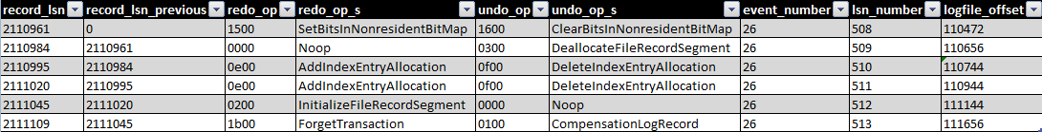
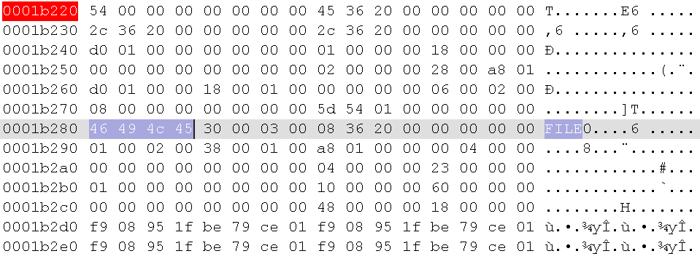
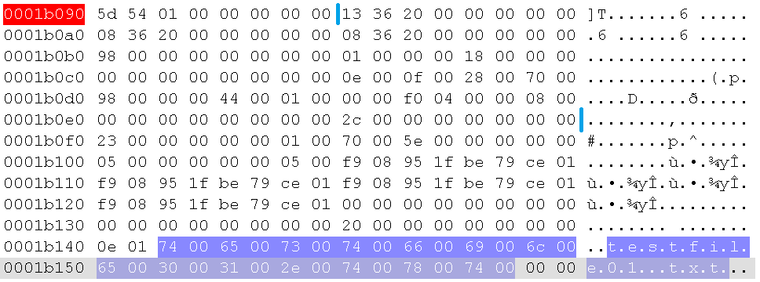
NTFS File Creation of testfile01.txt
0x1B098
0x1B228
InitializeFileRecordSegment Transaction at 0x1B228
AddIndexEntryAllocation Transaction at 0x1B098
*Redo InitializeFileRecordSegment contains
whole MFT Record Entry

Slide 16
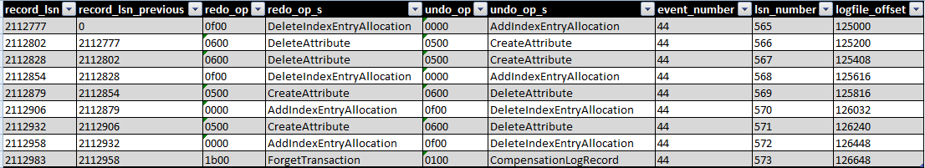
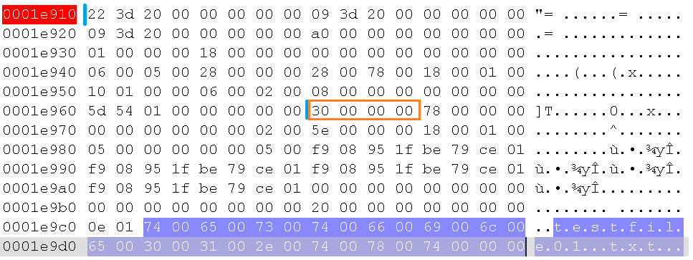
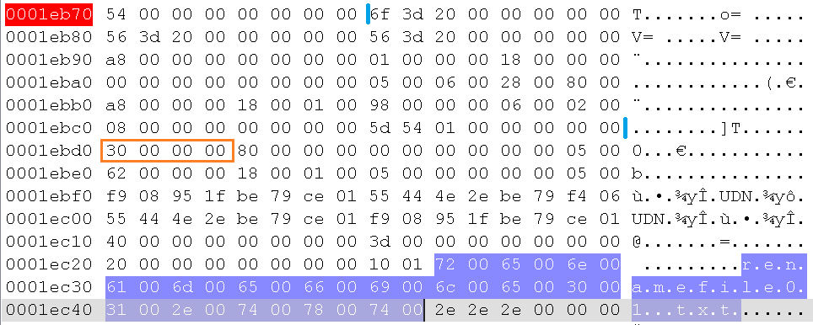
NTFS File Rename of testfile01.txt
0x1E910
0x1EB78
DeleteAttribute Operation at 0x1E910
Create Attribute Operation at 0x1EB78

Slide 17
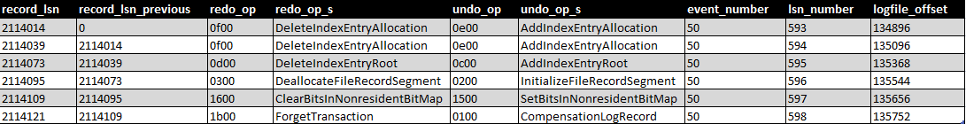
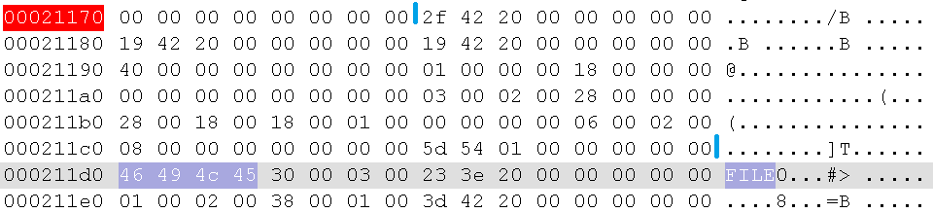
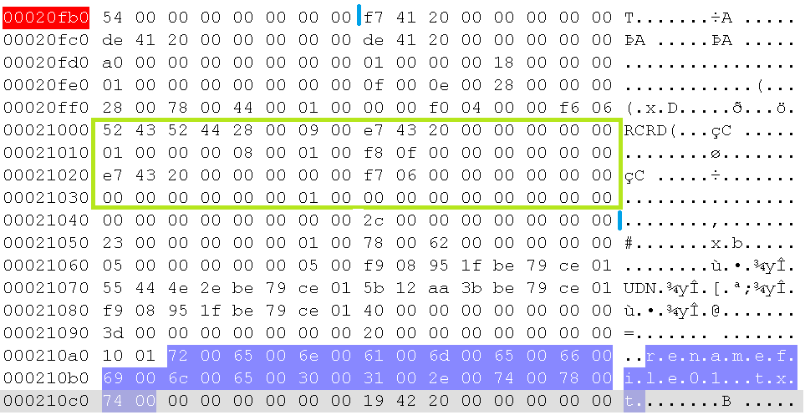
NTFS File Deletion of renamefile01.txt
0x20FB8
0x21178
DeallocateFileRecordSegment Operation at 0x21178
DeleteIndexEntryAllocation Operation at 0x20FB8
*Redo DeallocateFileRecordSegment only contains
24 bytes of MFT Entry

Slide 18
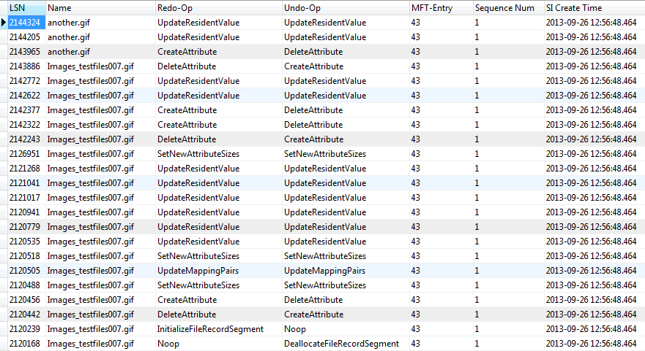
Operations

Slide 19
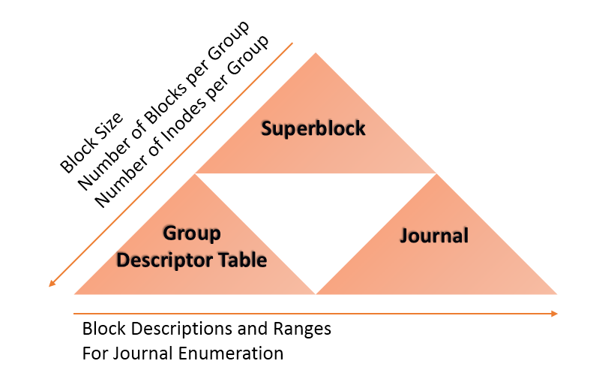
Ext3 Journal Analysis

Slide 20
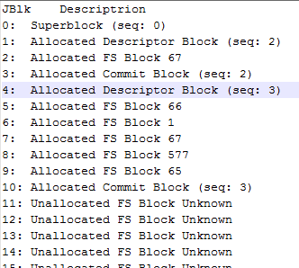
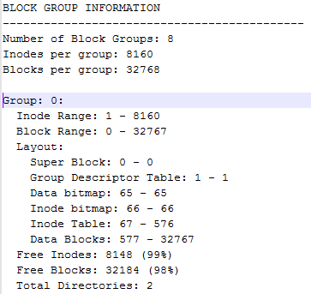
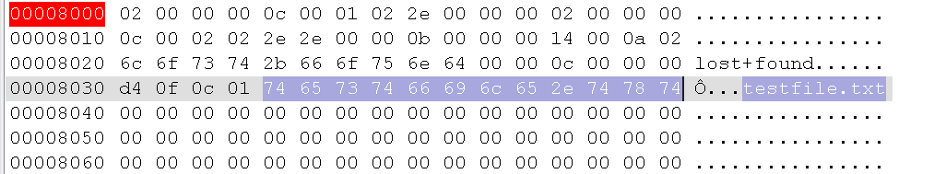
Ext3 File Creation of testfile.txt
Create File - System Changes
5: 66 -> Inode Bitmap
6: 1 -> Group Descriptor Table
7: 67 -> Inode Table
8: 577 -> Data Block
9: 65 -> Data Bitmap
Journal Block 8: FS Data Block 577

Slide 21
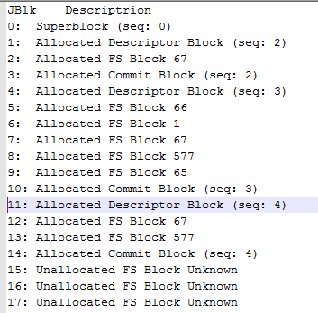
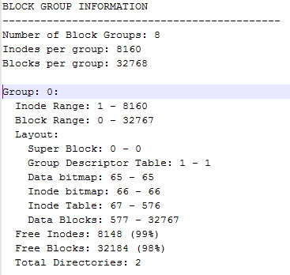
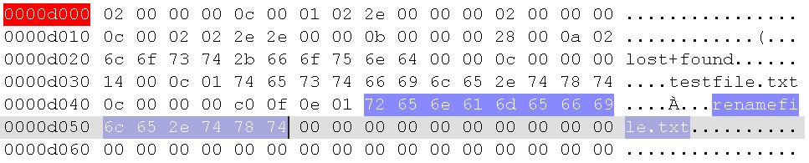
Ext3 File Rename of testfile.txt
Rename File - System Changes
12: 67 -> Inode Table
13: 577 -> Data Block
Journal Block 13: FS Data Block 577

Slide 22
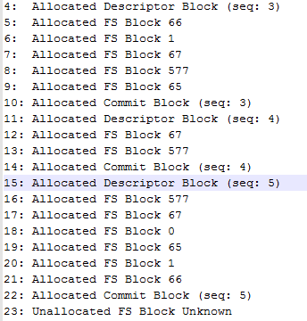
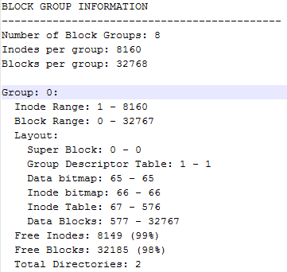
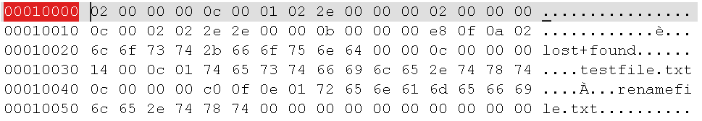
Ext3 File Deletion of renamefile.txt
Delete File - System Changes
16:577 -> Data Block
17:67 -> Inode Table
18:0 -> Super Block
19:65 -> Data Bitmap
20:1 -> Group Descriptor Table
21:66 -> Inode Bitmap
Journal Block 16: FS Data Block 577

Slide 23
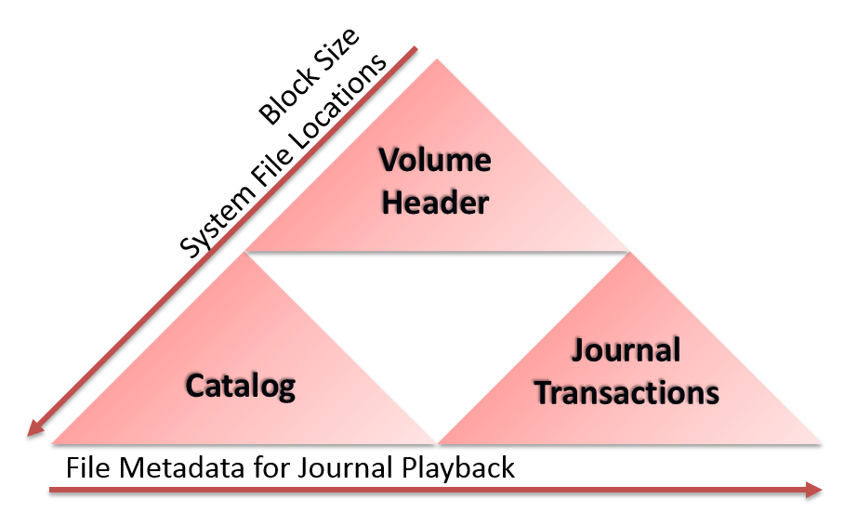
HFS+ Journal Analysis

Slide 24
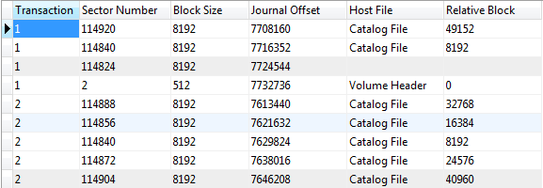
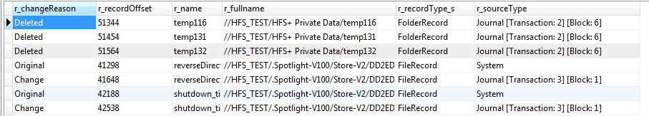
HFS+ Transactions

Slide 25
Advanced NTFS Journal Parser (ANJP) Examples
Tracking Files
Time Changes
Event Profiling

Slide 26
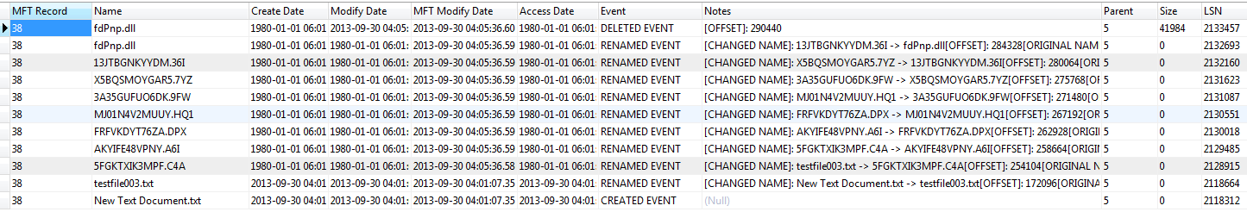
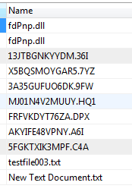
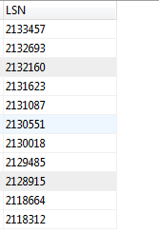
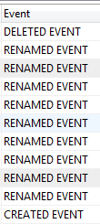
Tracking Events by File
Filtering by MFT Record, Ordering by LSN

Slide 27
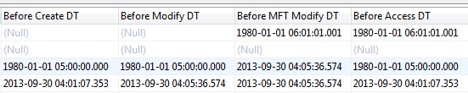
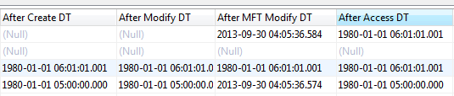
Time Changes

Slide 28
Linking SI Changes
LSN Header Information
Attribute Offset
MFT Entry
Resident Attribute Update
$LogFile
Update Attribute
Operation
Standard Information
Standard Information Attribute Data
(contains USN)
USN Records
Contains Filename
And other Information

Slide 29
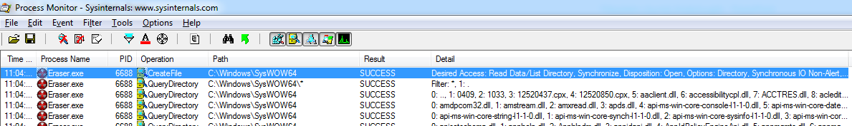
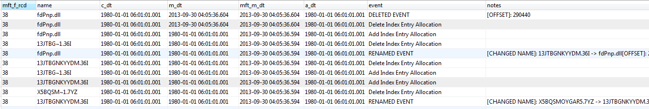
Application Profiling

Slide 30
Building an Indicator
Find Deleted files WHERE name AND filesize == file in SysWOW64 directory but parent directory != SysWOW64
AND Renamed Files preceding are named randomly but same name length as original

Slide 31
Events Being Identified
CD Burning
Windows
Nero Express
InfraRecorder
Erasers
Eraser (and Eraser Portable)
Ccleaner
BCWipe

Slide 32
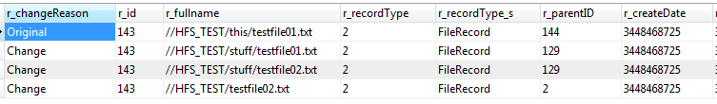
Advanced HFS+ Journal Parser (AHJP) Example
SQLite DB of output from AHJP
Renames
Moves

Slide 33
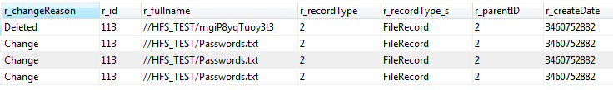
HFS+ Erased File Example

Slide 34
Beta Download Links
ANJP (Advanced NTFS Journal Parser) https://docs.google.com/forms/d/1GzOMe-QHtB12ZnI4ZTjLA06DJP6ZScXngO42ZDGIpR0/viewform
AHJP (Advanced HFS+ Journal Parser) https://docs.google.com/forms/d/1_Zrf7LfmnklJfJ7CteecdAiAWGdRkNp2ltqqHuYFncQ/viewform
*Also great for parsing MFT and Catalog file

Slide 35
Resources
NTFS Resources:
Dig into the $LogFile
http://forensicinsight.org/wp-content/uploads/2012/05/INSIGHT_A-Dig-into-the-LogFile.pdf
HFS+ Resources:
Using the HFS+ journal for deleted file recovery http://www.dfrws.org/2008/proceedings/p76-burghardt.pdf
HFS+ Documentation
https://developer.apple.com/legacy/library/technotes/tn/tn1150.htm

Slide 36
Questions?
Follow Me:
@forensic_matt
Follow Our Research:
Blog http://hackingexposedcomputerforensicsblog.blogspot.com/

