Slide 1
NTFS - The workhorse file system for the Windows Platform
Neal Christiansen
Principal Development Lead
Microsoft

Slide 2
Agenda
High level overview of NTFS
Features added in Windows 2000
Features added in Vista Features added in Windows 7
Features added in Windows 8
Questions?

Slide 3
What is NTFS
NTFS is a Journaled File System
Developed in the early 1990’s
Primary architect was Tom Miller
Part of the original Windows NT 3.1 release
Windows 2000 included an incompatible physical format change
No incompatible physical format change has occurred since
Current on-disk format version is 3.1
http://en.wikipedia.org/wiki/NTFS

Slide 4
What is a Journaled File system?
NTFS uses ARIES style of journaling
http://www.cs.berkeley.edu/~brewer/cs262/Aries.pdf
Uses a transaction model to make atomic updates to file system metadata
A circular log ($Log) is used to track meta data changes
Metadata changes are committed to $LOG before the actual metadata file
Every 5 seconds NTFS checkpoints $LOG
After an unclean dismount the file system metadata can quickly be restored to a consistent state by processing $LOG

Slide 5
NTFS Limits
Cluster size: 512B – 64K (default 4K)
Max volume size: 2³²-1 clusters
16TB at default 4K cluster size
256TB at 64K cluster size
Max file size: 16TB (software limit)
Increased to volume size in Win8
Max filename lengths:
255 unicode characters for individual name component
32760 unicode characters for full path name
Maximum extents per file: ~1.5 million

Slide 6
System Metadata Files
$MFT
$BITMAP
$VOLUME
$LOG
$BOOT
$UpCase
$Secure
$BadClus
(RootDirectory)
$Extend

Slide 7
NTFS on-disk structure - $MFT (Master File Table)
Contains fixed size records (1K or 4K)
Scaled based on the logical sector size of the drive
Each record is subdivided into a list of variable length Attributes:
$STANDARD_INFORMATION
$FILE_NAME
$DATA
$INDEX_ROOT
$BITMAP
$INDEX_ALLOCATION
$ATTRIBUTE_LIST
Most attributes can be RESIDENT or NON-RESIDENT

Slide 8
NTFS on-disk structure - $MFT
All metadata for a file is contained in one or more MFT records
If more than one MFT record is needed an $ATTRIBUTE_LIST attribute is used to track all of the associated MFT records
An $ATTRIBUTE_LIST is limited to 256K in size
Alternate Data Streams (ADS) are implemented by having multiple $Data attributes
Default data stream is unnamed
Directories may have an ADS
Hard links are implemented by having multiple $FILE_NAME attributes
http://msdn.microsoft.com/en-us/library/bb470206(v=vs.85)

Slide 9
NTFS on-disk structure - Directories
A directory is implemented as B-tree of file names with the following attributes:
$INDEX_ROOT – contains the root of the index B-tree
$INDEX_ALLOCATION – describes the clusters allocated to the directory
$BITMAP – Describes which allocated blocks are in use
A directory is managed in 4K blocks
Filenames are case preserving but not case sensitive
Directories duplicate certain metadata information from $MFT (known as DUPINFO)
File and Allocation Size
Time Stamps – Create, Modification, Access, Change
File Attributes
Both long and short names coexist in directories

Slide 10
Unique Features
Named alternate data streams (ADS)
A file can have more than one stream of data
Syntax: <path>\FileName:stream
Compression
Uses a Lempel-Ziv compression algorithm
Chunky algorithm (64k chunks)
Only supported on cluster sizes <=4K
Valid Data Length (VDL)
High water mark for where a file has been written
Allows for efficient creation of large files
Don’t need to pre-zero the entire file
Reading past VDL returns zeroes
Stored persistently

Slide 11
Features added in Windows 2000

Slide 12
Important Windows 2000 features
USN Journal
Reparse Points
Quota
$Secure file
ObjectID’s
File level encryption
Sparse Files

Slide 13
USN Journal
An efficient mechanism for applications to detect which files have changed
Used by the background search indexer
Changes are tracked with a bitmask of reasons (some reasons):
USN_REASON_FILE_CREATE
USN_REASON_FILE_DELETE
USN_REASON_DATA_OVERWRITE
USN_REASON_DATA_EXTEND
USN_REASON_RENAME_OLD_NAME/USN_REASON_RENAME_NEW_NAME
Reasons accumulate until the file is closed
USN_REASON_CLOSE
USN Record also contains:
FileName of the file being changed
FileID of the file being changed
FileID of the parent directory
USN Number
TimeStamp
Disabled by default, can be enabled per volume

Slide 14
Reparse Points
Mechanism for triggering special processing of a file or directory by a file system filter or the IoSystem
Processed at open time
Can be triggered by any pathname component
Consist of:
Unique 32-bit Tag (allocated by Microsoft)
Up to 16K of associated data
Only two supported uses today:
Data redirection – HSM, SIS, DeDup, DFS
Implemented by file system filters
File name redirection – Symbolic links, Mount point
Implemented by the IoSystem
Special index which tracks all reparse points on a volume:
\$Extend\$Reparse:$R

Slide 15
Quota
Supports per-user Quotas
Supports soft and hard limits
Superseded with FSRM (File Server Resource Manager) Quotas
Implemented as a file system filter

Slide 16
Features added in Vista

Slide 17
TxF

Slide 18
What is TxF?
Adds basic database like transaction semantics to file system operations
Provides ACID guarantees for transacted file system operations:
Atomicity – All operations either commit or rollback together
Consistency – Consistent state across multiple files can be maintained
Isolation – Changes are not visible outside the transaction
Durability – On commit changes are durably stored to storage media
Supports file system operations like:
Create
Close
Write
Delete
Rename

Slide 19
TxF Example
Example:
Create transaction
Create file A
Delete file b
Rename file c to d
Commit transaction
Applications outside of the transaction would not see any of the above file system operations until the transaction commits

Slide 20
TxF Limitations
A file can only be in 1 transaction at a time
A file in a transaction can not be modified outside the transaction
File names used in transactions impact what file names can be used outside of a transaction
Functionality being deprecated in Windows 8 and beyond
Not supported by ReFS

Slide 21
Self-healing
NTFS has always had the ability to detect metadata corruptions
Its response was to:
Mark the volume as corrupt
Fail the operation
With self-healing NTFS can not only detect corruptions but it can also repair some corruptions
Only repairs certain MFT related corruptions
Repairs failure without failing operation

Slide 22
Features added in Windows 7

Slide 23
Per-volume Control of Short Filename Generation

Slide 24
Short Filename generation
Before Windows 7 short filename generation could only be disabled globally per system
fsutil behavior set disable8dot3 1|0
Required a reboot to take effect
Windows 7 added the ability to enable/disable short filename generation on a per-volume basis
When disabled prevents short filename generation
Existing short filenames continue to function
Added support for stripping short filenames from a directory hierarchy
fsutil 8dot3name strip
Improved the short filename hashing function

Slide 25
Configuring Short Filename Generation
fsutil 8dot3name set
Change takes effect immediately (no reboot required)
4 global modes of operation:
0 - Enabled on all volumes
1 - Disabled on all volumes
2 - Per-volume configurable (default)
3 - Disabled on all volumes except the system volume

Slide 26
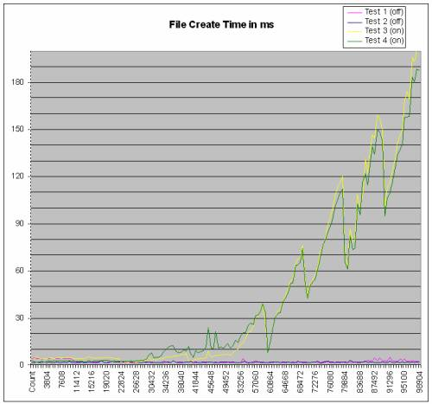
Short Filename Generation Performance Impact
Short filename generation does have a performance impact
Small impact for directories with < 30,000-40,000 files
Beyond this threshold the performance impact continues to increase

Slide 27
ATA Trim

Slide 28
What is ATA Trim?
The ability for a file system to tell the underlying storage system that the contents of sectors are no longer important
Is part of the T13 ATA specification

Slide 29
Why Trim is Important to SSDs
They need to maintain a pool of erased blocks
They need to wear-level blocks
Wear-leveling is more effective the more blocks that are available
Trim allows file systems to identify sectors that are no longer in use
More space is available for internal block management

Slide 30
Trim Implementation in NTFS
When a volume is formatted all clusters on the volume are trimmed
Anytime clusters are freed they are trimmed:
File Deletion
File Defrag
Superseding Create
Superseding Rename
FSCTL_SET_ZERO_DATA
Volume shrink
Not supported on SCSI/SAS devices
Would be useful for thinly provisioned volumes

Slide 31
Example of how Trim works
Application calls DeleteFile
File system metadata is updated and written to device
Metadata is flushed and checkpoint record written to $Log
Device is notified that blocks are no longer in use via TRIM
Blocks are made available for reuse

Slide 32
Disabling Trim
Trim is always sent by NTFS
To disable NTFS from sending Trims:
fsutil behavior set disabledeletenotify 1
Takes effect immediately, no reboot required
Useful in situations where data recovery is more important than SSD efficiency:
Offline undelete tools
Online undelete tools that use a file system filter should function correctly with trim enabled
Unformat tools

Slide 33
Enhanced Oplocks

Slide 34
Oplocks before Windows 7
Four Types of Oplocks
Level 2 – supports caching of reads
Level 1 – supports caching of reads and writes
Batch – supports caching of reads, writes, and handles
Filter – supports caching of reads and writes
Has additional semantics that allow its holder to unobtrusively access a stream

Slide 35
Problems with Oplocks
Cache levels insufficiently granular
Too easy for an app to break its own oplock
Office applications did this regularly
Batch and Filter oplocks may be broken in a create that will ultimately fail anyway with STATUS_SHARING_VIOLATION
No way to atomically request an oplock at create time
Impossible to implement an unobtrusive background scanning application

Slide 36
Oplock Enhancements
One FSCTL to request oplocks and acknowledge breaks
FSCTL_REQUEST_OPLOCK
Can specify caching with a combination of flags
Read (shareable, similar to Level 2)
Read-Handle (shareable)
Read-Write (exclusive, similar to Level 1)
Read-Write-Handle (exclusive, similar to Batch)

Slide 37
Oplock Enhancements
Oplock can be associated with an oplock key
Operations on handles with the same oplock key won’t break the oplock
Perform sharing violation check before breaking oplock
Atomic create-with-oplock semantic
NtCreateFile with FILE_FLAG_OPEN_REQUIRING_OPLOCK
Resulting handle has an “oplock-like state” associated with it when created
Application then requests a real oplock on the created handle
Allows true unobtrusive opens for background scanners, file system filters, etc.
Except for directories (see Windows 8 support)

Slide 38
Support for 512e Disk Drives
Reports a logical sector size of 512B, physical sector size of 4K
The device internally performs read-modify write operations when an IO is not aligned on 4K boundaries
NTFS optimized in Win7 SP1 to align all cached operations to physical sector boundaries (4K).
Maximum supported physical sector size is 4K
Nothing NTFS can do about non-cached operations

Slide 39
Features added in Windows 8

Slide 40
Offload Data Transfers (ODX)

Slide 41
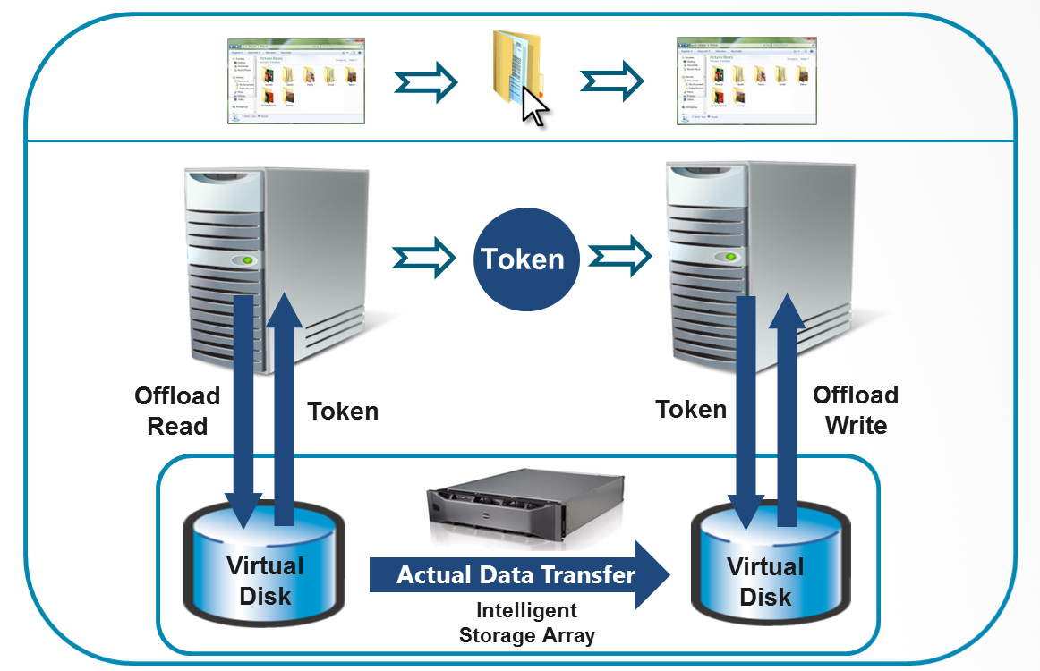
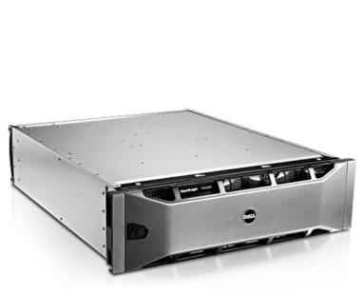
Data Movement Today
Data
Read
Data
Write Data
Results

Slide 42
Data Movement Today
Reads & Writes well understood
Works well with OS Security Model
Security checks occur at open time
Works well with application programming model
Inefficiencies with Today’s Model
Data flowing out and back into the same storage system
Data movement consumes CPU and Memory
Data movement may consume network bandwidth
There must be a better way to do this!

Slide 43
Offload Data Transfer (ODX)
Takes advantage of advanced capabilities present in many of today’s storage arrays (SAN) to enable efficient data movement
Rather than pass the data around, passes around a token which represents a point in time view of the data
Supports cross-machine and cross-subsystem data movement, while not constrained by protocol, transport, or geo-boundaries
Maintains well understood security framework
Offers an easy & familiar programming model for developers
Enable (even untrusted) applications to participate in efficient data movement

Slide 44
Reading the Data: FSCTL_OFFLOAD_READ
Instructs Storage to generate and return a “Token” which represents an immutable point-in-time view of the requested DATA
Token completely managed by Storage (Opaque to OS)
Functionally equivalent to a normal “read” operation:
Operation behaves like a non-cached read (must be sector aligned)
Performs standard oplock and byte range lock processing

Slide 45
Writing the Data: FSCTL_OFFLOAD_WRITE
Given a Token, the Storage attempts to independently execute data movement to the desired destination
Attempts to recognize Token
Determines where the DATA represented by the Token is located
Determines if the data movement is possible
Performs the data movement
All of this happens without OS intervention

Slide 46
Writing the Data: FSCTL_OFFLOAD_WRITE
Functionally equivalent to a normal “write” operation
Operation behaves like a non-cached write (must be sector aligned)
Performs standard oplock and byte range lock processing
Updates the USN Journal with a USN_REASON_DATA_OVERWRITE record
Limitation: does not allocate disk space (space must be pre-allocated)

Slide 47
ODX Data Movement
Offload Read
Token
Offload Write with Token
Results

Slide 48
Support in Windows 8
Enables offloaded transfers between LUNs, arrays, or data centers:
Supported to the same volume on the same machine
Supported across different volumes on the same machine
Supported across different volumes on different machines via SMB
Supported by Hyper-V
Integrated into the Win32 CopyFile API
Any component that uses this API will automatically use ODX when available
If ODX is not supported, normal read/write copy semantics are used
Supported by copy, xcopy, robocopy, as well as Explorer drag and drop
Implemented using new T10 (SCSI) “XCOPY Lite” command
Microsoft co-authored T10 specification
Part of T10 11-059r9 specification

Slide 49
ODX Limitations
Only supported by NTFS
Not supported on compressed files
Not supported on encrypted files
Not supported on sparse files
Not supported by BitLocker
Not supported on Snapshot volumes
Only supported by SANs which implement “XCOPY Lite”

Slide 50
CHKDSK Overhaul

Slide 51
NTFS Volume Scalability
NTFS supports volumes up to 256TB in size
But the practical volume size is smaller based on CHKDSK execution time
CHKDSK scales based on the number of files on the volume (not the size of the volume)
CHKDSK execution time has improved (decreased) with every windows release since Windows 2000
But there is a limit to what additional improvements could be made with the current execution model

Slide 52


New approach for detecting and repairing corruptions in NTFS
Enhanced detection and handling of corruptions in NTFS via on-line repair
Change the CHKDSK execution model
Separate analysis and repair phases
File system health monitored via Action Center and Server Manager
500 GB
Avg size today
64 TB
Design for Win8

Slide 53
Enhanced NTFS Corruption Handling
NTFS now logs information on the nature of a detected corruption
Maintained in new metadata files
$Verify and $Corrupt
Enhanced event logging which includes more detailed information
New “Verification” component which confirms the validity of a detected corruption
Eliminates unnecessary CHKDSK runs
Enhanced on-line repair
Self-healing feature introduced in Vista
Limited to MFT related corruptions
Enhanced to handle a broader range of corruptions across multiple metadata files
Can do on-line repair of most common corruption scenarios

Slide 54
A new model for CHKDSK
The analysis phase is performed online on a volume snapshot which maintains volume availability
If a corruption is detected:
First attempt an on-line repair via the self-healing API
If self-healing can not do the repair the detected corruption is logged to a new NTFS metadata file: $Corrupt
All logged corruptions are verifiable
Offline repair phase (spot fixing) if needed
Volume can be taken offline at administrator’s discretion
Only repairs logged corruptions to minimize volume unavailability
Normally takes seconds to repair

Slide 55
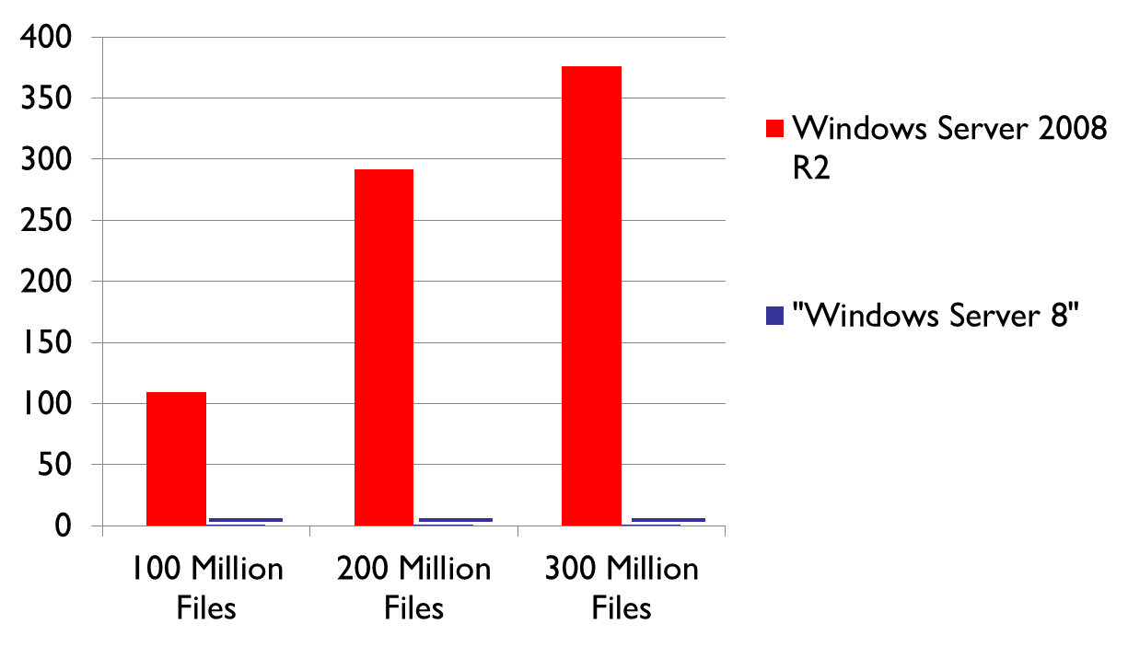
Maximized File System Availability An illustrative example
Volume downtime to handle one corruption
Minutes
In this benchmark, “Windows Server 2012”
execution time 3-5 seconds
Notes:
100 million files – almost 2 hrs
200 million files – almost 5 hrs
300 million files – around 6 hrs

Slide 56
Usage
Explorer:
Check Now UX
Action Center
Server Manager
Systems Center
“chkdsk” command line options:
chkdsk x: /scan - perform an online scan for corruptions
chkdsk x: /spotfix - perform an offline repair
chkdsk x: /f - still works as it always has
“fsutil repair” command line options:
fsutil repair enumerate x: - list known verified corruptions
fsutil repair state - list corruption state of all volumes
Fsutil repair state x: - list corruption state of given volume
powershell:
REPAIR-VOLUME -scan, -spotfix, -offlinescanandfix
Notes:
64TB limit is based on the limit of a volume snapshot
Beyond 64Tb, we go with the default VSS provider (hardware snaphsot). If they have a h/w provider that supports > 64Tb snapshots then this solution will work for > 64Tb volumes too.

Slide 57
Reliability using Flush instead of FUA (Forced Unit Access)

Slide 58
History of FUA
What is FUA (Forced Unit Access)
A flag originally implemented in the SCSI (T10) specification that indicates a given write should go directly to media, writing through a devices write cache
NTFS is a Journaled File System which uses FUA to guarantee write ordering to maintain its metadata integrity
The ATA (T13) specification did not originally define FUA
FUA support was added to T13 in 2002 as part of the ATA7 specification
Since FUA has not been consistently implemented on ATA devices it has never been enabled on Windows platforms
NTFS was designed to rely on proper FUA implementation to maintain robustness

Slide 59
The switch to Flush
To make NTFS robust on SATA devices it has switched in Windows 8 to issuing a flush of a drives write cache instead of relying on FUA
Delivers improved reliability on industry standard SATA storage
Reduces possibility of corruption on power loss
Improves performance on SCSI devices
Allows the disk to cache data for as long as safely possible

Slide 60
Additional Short Filename Improvements
Windows 8 disables short filename generation on all volumes except the boot volume
Only affects volumes formatted under Windows 8
format x: /s:enable - to enable at format time
Volumes migrated from down level versions of windows will maintain their existing short filename generation policy
Still have the ability to enable/disable short filename generation policy on a per-volume basis
Name tunneling is now disabled when short filename generation is disabled

Slide 61
Trim Enhancements
Trim is now supported by SCSI (T10) drivers
Generates a SCSI unmap command
Important for thinly provisioned volumes
NTFS now supports file level trim
Allows an application to tell the underlying storage device that the contents of specified ranges of a file no longer need to be maintained
Semantically operates like a non-cached write operation
Standard oplock and byte-range lock processing
A USN_REASON_DATA_OVERWRITE reason is generated
Trimmed ranges of the file are flush and purged from the cache
Not supported on compressed or encrypted files
Resident files are ignored (no failure is returned)

Slide 62
File Level Trim
Requests are rounded to page size boundaries (4K)
Trimming beyond VDL and EOF up to allocation size is supported
When reading a trimmed region the data returned varies based on the hardware (T10/T13 specifications):
SATA (T13) devices can return: zeroes, original data or ones (most return zeroes)
SCSI/SAS (T10) devices return zeroes or original data if not supported
Trim requests to a mounted VHD or inside Hyper-V are now propagated to the underlying storage device

Slide 63
Storage Optimizer (Defrag) Enhancements
Slab Consolidation (for thin provisioned volumes)
Efficiently defrags files to minimize the number of allocated slabs
A slab is the unit of allocation on a thin provisioned volume
ReTRIM
Generates Trim commands for all free space on a given volume
Supported on live volumes
Fast Analysis of Optimizations
Significantly faster analysis phase by using new NTFS interface: FSCTL_QUERY_FILE_LAYOUT
Can query for a range of clusters, a range of file IDs, or the whole volume at once
Caller can specify kinds of information to return: names, streams, extents, timestamps, security IDs, etc.

Slide 64
Defrag Enhancements
Media-aware optimization
Performs the proper optimization based on the media type of the given volume:
HDD – Defrag + ReTRIM
SSD – ReTRIM only
VirtualDisks (Spaces) – Slab Consolidation + ReTRIM
Thin Provisioned Arrays – Slab Consolidation + ReTRIM
Dynamic VHDs – Slab Consolidation + ReTrim

Slide 65
Directory Oplocks
Allows applications and network clients to cache directory handles and enumeration results
No more stale directory information cached on clients
Background scanner and file system filters can now unobtrusively open directory handles using a Read-Handle (RH) oplock, just like with files
Resolves conflict between scanning empty directories and directory deletion

Slide 66
Native 4K Sector Booting
NTFS has always supported native 4K sectors
Not well tested in previous OS versions
MFT records are 4K in size
Requires UEFI firmware (instead of BIOS)

Slide 67
Questions?

