Slide 1



Dark Matter

Slide 2



Dark Matter
Dark Matter is an invisible substance that makes up about 27% of the universe's mass, influencing the formation of galaxies and cosmic structures.

Slide 3



Evidence for Dark Matter
Galaxy Velocity Dispersion
Galaxy Rotation Curves
Large Scale Structure Formation
Cluster Collisions (Bullet Cluster)
Gravitational Lensing
Cosmic Microwave Background

Slide 4


Dark Matter Vs. Ordinary Matter
Dark Matter
Vs.
Ordinary Matter
Composition
Unknown particles; does not interact with light directly.
Composition
Made of atoms; interacts with light and radiation.
Detection
Detected indirectly through gravitational effects on galaxies.
Detection
Directly observed via light emission and physical interactions.
Abundance in Universe
Comprises about 27% of the universe's mass-energy content.
Abundance in Universe
Makes up only about 5% of the universe's total mass.

Slide 5


The Role of Dark Matter in Galaxy Formation
Dark matter's gravitational pull helps clump ordinary matter together, forming the scaffolding for galaxies to form and evolve, shaping the universe's large-scale structure.

Slide 6


Dark Matter Detection Methods
Direct Detection
Searching for dark matter particles interacting with detectors on Earth.
Gravitational Lensing
Measuring light bending around unseen mass to infer dark matter.
Dark Matter Halo Mapping
Using galaxy rotation curves to map dark matter distribution in halos.
Cosmic Microwave Background Analysis
Studying early universe radiation patterns to detect dark matter's influence.
Particle Accelerators
Attempting to create and detect dark matter particles in high-energy collisions.
Indirect Detection
Observing byproducts like gamma rays from dark matter particle annihilation.

Slide 7
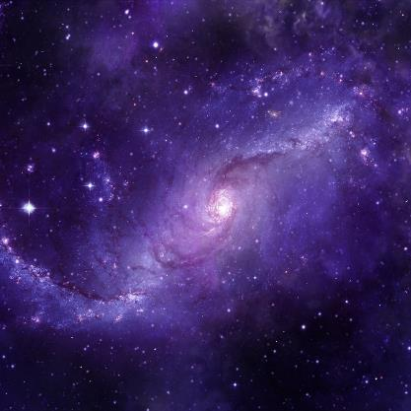
Conclusion
Dark matter remains one of the universe's greatest mysteries, crucial for understanding cosmic structure, yet eluding direct detection, driving ongoing scientific research and exploration.

Slide 8
Icons

Slide 9

Icons

Slide 10
How To Edit Shapes
You can add and edit some shapes to your presentation to present your data in a visual way.
Choose your favourite infographic and insert it in your presentation using Ctrl C + Ctrl V or Cmd C + Cmd V in Mac.
Select one of the parts and ungroup it by right-clicking and choosing “Ungroup”.
Change the color by clicking on the paint bucket.
Then resize the element by clicking and dragging one of the square-shaped points of its bounding box (the cursor should look like a double-headed arrow). Remember to hold Shift while dragging to keep the proportions.
Group the elements again by selecting them, right-clicking and choosing “Group”.
Repeat the steps above with the other parts and when you’re done editing, copy the end result and paste it into your presentation.
Remember to choose the “Keep source formatting” option so that it keeps the design. For more info, please visit Slideegg (Tips & Tricks).

Slide 11
Terms Of Use (Free Users)
If you are a free subscriber, you should credit SlideEgg by keeping the “Thank You” slide.
Kindly refer to the following slide for the Terms of Use for premium users.
You can:
Customize or edit this template
Use this template for both business and personal endeavors.
You can not:
Sell, rent, or second-license SlideEgg content or its altered version. Promulgate, unless explicitly permitted, SlideEgg content, by SlideEgg.
Incorporate SlideEgg content in any database or file online or offline.
Obtain SlideEgg content’s copyright.
Kindly refer to our Tutorial page or FAQ for advanced slide modification guidelines.

Slide 12
Terms Of Use (Premium Users)
Being a premium subscriber, you have the privilege of using this PPT template
without giving attribution to SlideEgg or keeping the “Thank You” slide.
You can:
Customize or edit this template.
Use this template for both business and personal endeavors.
Circulate or share the editable format of this template with anyone you want.
You can not:
Sell, rent or second-license SlideEgg content or the altered version of it. Promulgate or include the templates in any other services database
that performs as distribution or resale platform, unless explicitly permitted, by SlideEgg.
Incorporate the elements used in SlideEgg templates separately.
Obtain SlideEgg copyright for the elements used in this template as a logo or trademark.
Kindly refer to our Tutorial page or FAQ for advanced slide modification guidelines.

Slide 13





Thank You!
We respect your valuable time with SlideEgg!
If you have any questions, please reach us
Do you have a design request, please visit our Deckez site.
CREDIT: SlideEgg created this PowerPoint template.
Let this slide be kept for attribution.
www.slideegg.com

