Slide 1
Finding a Failing Bearing Before It Breaks
Part I · Fault diagnosis on the NASA/IMS bearing dataset
A two-stage, training-free method
Notes:
We built a method that tells which bearing on a machine is failing, since when, and what part of it is broken, using only vibration sensors and no labelled fault examples. Tested on the NASA/IMS run-to-failure data.

Slide 2






A diagnosis system has to answer three questions
When?
Where?
What?
Detection
Localization
Identification
When did the bearing stop being healthy?
Which of the bearings on the shaft is failing?
Outer race, inner race or rolling element?
Why it is hard
No labelled faults
Speed is not exact
Sensors hear neighbours
Machines are not broken on purpose, so there is almost nothing to train on.
Textbook fault frequencies assume the nameplate speed.
A failing bearing shakes the whole shaft and housing.
Notes:
When, where, what: detection, localization, identification. Three practical obstacles: no fault labels to learn from, the real machine speed differs from the nameplate, and on a shared shaft every sensor picks up every bearing.

Slide 3
A cracked bearing clicks; its rhythm names the broken part
Outer race (still)
Rolling elements
Damage on | Rhythm | At 2,000 rpm | Why
Outer race | BPFO | 236.4 Hz | Rollers pass the still crack one after another
Inner race | BPFI | 296.9 Hz | Crack turns with the shaft and meets rollers more often
Rolling element | 2BSF | 279.8 Hz | Damaged roller hits both rings once per spin
Cage | FTF | 14.8 Hz | Cage carries the rollers slowly around
Like a pebble in a bike tyre: count the ticks per second and you know which wheel it is in.
BPFO / BPFI = Ball Pass Frequency, Outer / Inner race · BSF = Ball Spin Frequency · FTF = Fundamental Train (cage) Frequency · Hz = times per second · rpm = revolutions per minute
Inner race (turns with shaft)
Cage holds the rollers
Notes:
Every time a rolling element rolls over a crack there is a tiny impact. The number of impacts per second depends on which part is cracked, because each part moves at a different speed. That is the physical key to identification.

Slide 4
NASA/IMS data: three tests run until a bearing failed
9,464
20 kHz
4
8
one-second snapshots, about every 10 minutes
sampling rate: 20,480 values per snapshot
bearings that failed, to be found
bearings that stayed healthy, not to be flagged
Test | Snapshots | Duration | Sensors | Failed bearing | What broke
Set 1 | 2,156 | 828 h | 8 (x and y per bearing) | B3 and B4 | Inner race (B3), rolling element (B4)
Set 2 | 984 | 164 h | 4 (one per bearing) | B1 | Outer race
Set 3 | 6,324 | 1,073 h | 4 (one per bearing) | B3 | Outer race
Four Rexnord ZA-2115 bearings on one shaft, nominal 2,000 rpm, constant radial load. IMS = Center for Intelligent Maintenance Systems, University of Cincinnati. B1-B4 = bearing 1-4.
Notes:
Three tests, about 9,500 snapshots. Four failures are the positives, the eight surviving bearings are the negatives. Set 1 has two sensors per bearing.

Slide 5
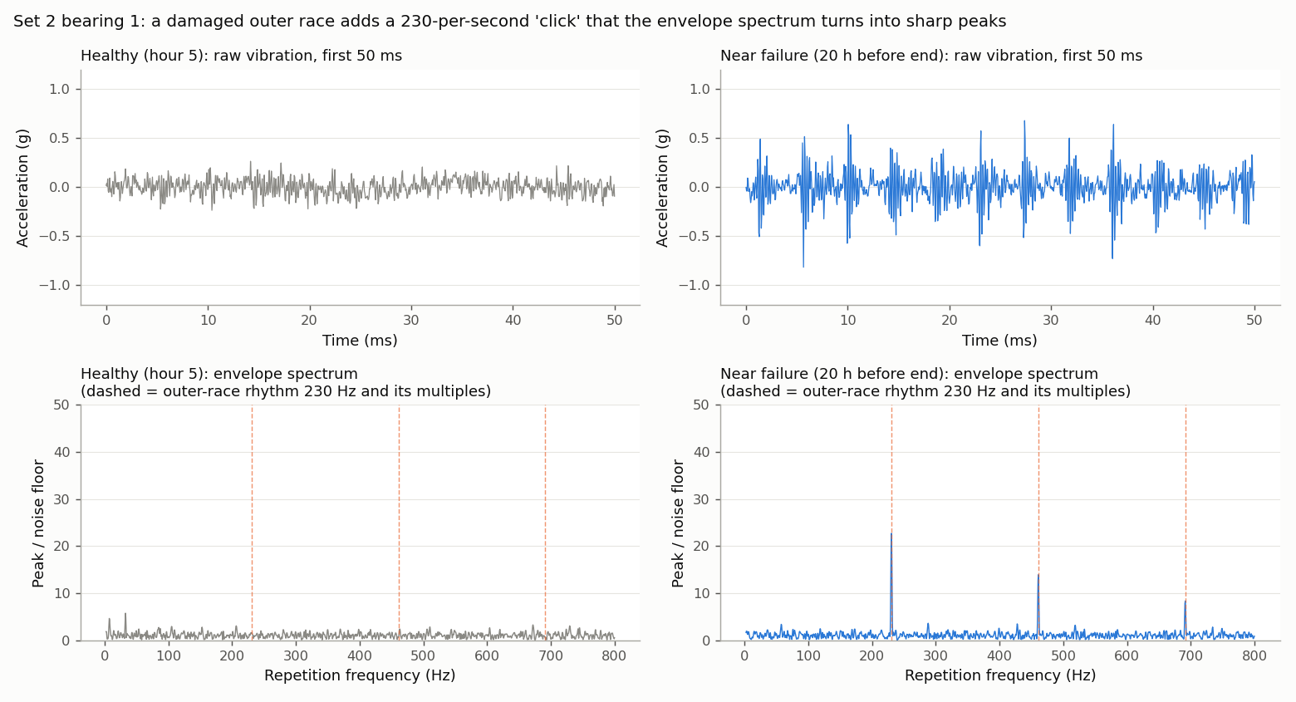
In the data, the click becomes sharp peaks at 230, 461 and 692 Hz
Envelope spectrum
1. Trace the outline of the spikes (the envelope).
2. Ask which rhythms the outline contains, with the FFT (Fast Fourier Transform).
3. A repeating click becomes a sharp peak, plus its multiples.
Notes:
Top: healthy bearing is just noise; the failing one has a spike every 4.3 ms, 230 times per second. Bottom: the envelope spectrum turns that into peaks at 230 Hz and its multiples - the outer-race rhythm. Note: 230 Hz, not the textbook 236.4 Hz.

Slide 6



The usual method trips in four places
Usual method: filter 1-9 kHz → envelope spectrum → read peaks at textbook frequencies → compare with the bearing's own early data
Fixed filter band
Textbook frequencies
Like listening to one radio station while the song moves.
The ringing frequency differs per sensor and shifts as damage grows.
Like looking for a friend at seat 236 when they sit at 230.
The real machine runs about 2.5% slow, so the peaks sit beside where we look.
Raw peak heights
Own early data as normal
When the whole bearing gets louder, every peak grows.
All three fault scores rise together; the tallest is nearly random.
Like checking for illness against yesterday, when you were already ill.
A fault present from the start is absorbed into normal.
Notes:
This is the standard fixed-band envelope approach. Each weakness has a plain analogy. The two that matter most turned out to be the speed error and the raw peak heights.

Slide 7

Three findings from the data shaped the method
2.5%
Every
594 h
slower than the nameplate
sensor hears the failing bearing
before failure, a fault already visible
The outer-race peak sits at 230 Hz, not 236.4 Hz. Real speed is about 1,950 rpm.
In set 3, healthy B4 showed the outer-race rhythm as strongly as failing B3. Rhythm says what, not where.
Set 1 B4's cage rhythm is there early; set 2 B1's from its first hours. Own early data hides them.
What does tell bearings apart: loudness. The failing bearing's RMS (Root Mean Square, vibration energy) grows faster than its neighbours'.
Notes:
We looked at the data before designing. Speed is off by 2.5%. The fault rhythm reaches every sensor. Some faults exist from the start. Loudness relative to the neighbours is what localizes.

Slide 8
Loudness says where and when; rhythm says what
Raw snapshots
1 s at 20 kHz from every sensor
Stage A · where and when
Stage B · what
RMS health index
how much louder than its own healthy start
Adaptive band
tune to where the clicks ring
Peer contrast
minus the median growth of the other bearings
Whitened envelope spectrum
each peak measured against local noise
Persistent alarm
above the limit for about 1 hour
Rhythm combs + speed search
slide the ruler to the real speed
alarm time
Fault Evidence Index (FEI)
compared with all healthy bearings
Diagnosis
which bearing · since when · which fault
Notes:
The method splits the job. Stage A uses loudness, which differs between bearings, so it can say which bearing and when. Stage B uses the rhythm, which is the same on every sensor, so it reliably says what. Stage B averages its evidence from Stage A's alarm onward. No step learns from labelled faults.

Slide 9

Stage A: compare each bearing's loudness with its neighbours
1
Health Index (HI)
HI = log( RMS now ÷ RMS in its healthy start )
Classroom analogy
First 20% of the test = healthy. log(2) means twice as loud.
Find the student whose voice is growing. If the whole class gets louder because the teacher left, that does not count.
2
Peer contrast
C = HI − median HI of the other bearings
Cancels anything that hits the whole machine: load, temperature, a neighbour's vibration.
2 / 8
7 / 8
3
Persistent alarm
C > max( 8 × normal spread, 0.15 ) for 6 snapshots
healthy bearings falsely alarmed, with peer contrast
without peer contrast (own loudness only)
0.15 ≈ 16% more energy than the peers; 6 snapshots ≈ 1 hour, so a single bump is ignored.
Notes:
Stage A in three steps. The key is step 2: subtracting the neighbours' growth. Without it, seven of eight healthy bearings raise alarms, because the whole machine gets louder near the end of a test.

Slide 10
Stage B: read the click rhythm, robust to speed and noise
1
Tune the radio
Comb | Lines | Why
Outer race | 1-3 × BPFO | Still ring: evenly spaced clicks
Inner race | 1-3 × BPFI, ± shaft speed side peaks | Crack turns with the shaft, clicks swell once per turn
Rolling element | 1-3 × 2BSF, 1-4 × FTF | Broken roller travels with the cage
Try 28 frequency bands; keep the one with the sharpest repeating rhythm.
2
Whiten
Measure each peak against the noise around it, so loudness doesn't fake evidence.
3
Slide the ruler
Fit each fault's comb of peaks at 95-101% of the nameplate speed.
4
Fault Evidence Index
FEI = (score − median of all healthy data) ÷ (1.4826 × MAD)
Robust z-score against the healthy data of all bearings in the test.
MAD = Median Absolute Deviation, a spread measure not fooled by outliers. FEI = 5 means 5 normal wobbles above normal.
5
Verdict
Highest average FEI after Stage A's alarm; below 1 = "unspecified".
Notes:
Five steps. Step 3, the speed search, fixes the 2.5% speed error. Step 4 compares with all healthy bearings, not the bearing's own start, so a fault present from day one is still seen. The method refuses to guess when evidence is weak.

Slide 11
All 4 failures caught, a median 61 hours before the end
Bearing | Truth | Alarm (h before end) | Verdict
Set 1 B4 | Rolling element | 96.7 | Rolling element ✔
Set 2 B1 | Outer race | 69.5 | Outer race ✔
Set 3 B3 | Outer race | 52.7 | Outer race ✔
Set 1 B3 | Inner race | 11.7 | Inner race ✔
Set 3 B4 | Healthy | 728.1 (short bump) | Unspecified (refused)
Set 2 B4 | Healthy | 3.7 | Outer race ✘
Other 6 bearings | Healthy | No alarm | Healthy ✔
4 / 4
failures detected and named correctly
61 h
median warning before the end of the test
2 / 8
healthy bearings falsely alarmed
Notes:
Every failure found and named. The two false alarms differ: set 3 B4 had a short energy bump and the method refused to name a fault. Set 2 B4 alarmed in the last 4 hours during its neighbour's breakdown and copied the neighbour's outer-race signature.

Slide 12
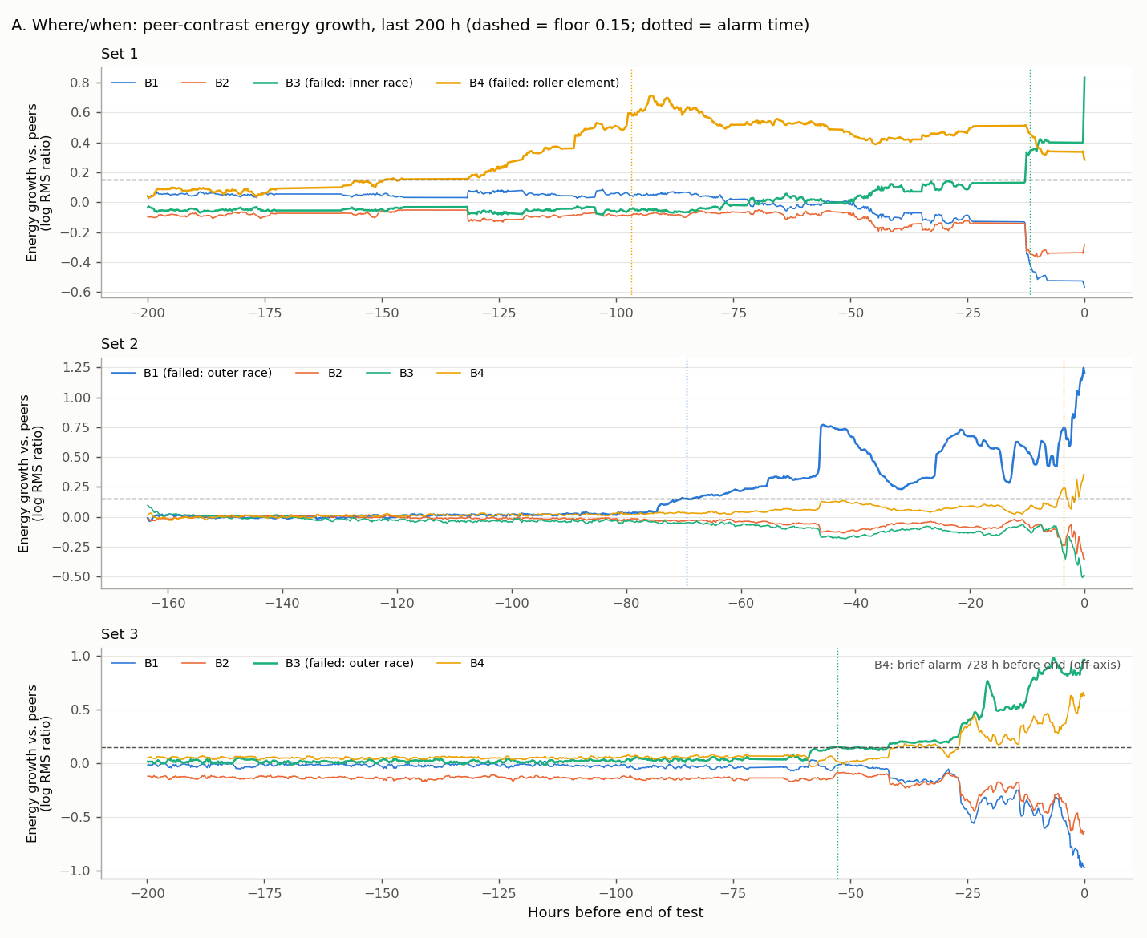
The failing bearing's energy pulls away from its peers
How to read it
Each line = one bearing's energy growth minus its neighbours'.
Thick line = the bearing that failed.
Dashed line = 0.15 limit; dotted lines = alarms.
Set 1 B4 rises 120 h before the end; set 1 B3 jumps only in the last 12 h.
Notes:
Show how each failing bearing separates from its peers. Point out that the healthy bearings drift downward relative to the failing one, which is why the contrast is so clean.

Slide 13
Our margin is 2.7× to 50×; the usual method drops to a coin flip
Separation
= true fault's evidence ÷ strongest wrong fault's evidence
1.0 = coin flip. Both methods name all 4 faults, but the usual one is right twice by a 3% margin.
Proposed: weakest case still 2.7×.
Notes:
Both methods get 4 of 4 verdicts, so accuracy alone hides the difference. Separation shows confidence. The usual method's verdict on set 3 B3 and set 1 B4 is a coin flip; ours is clear in every case.

Slide 14
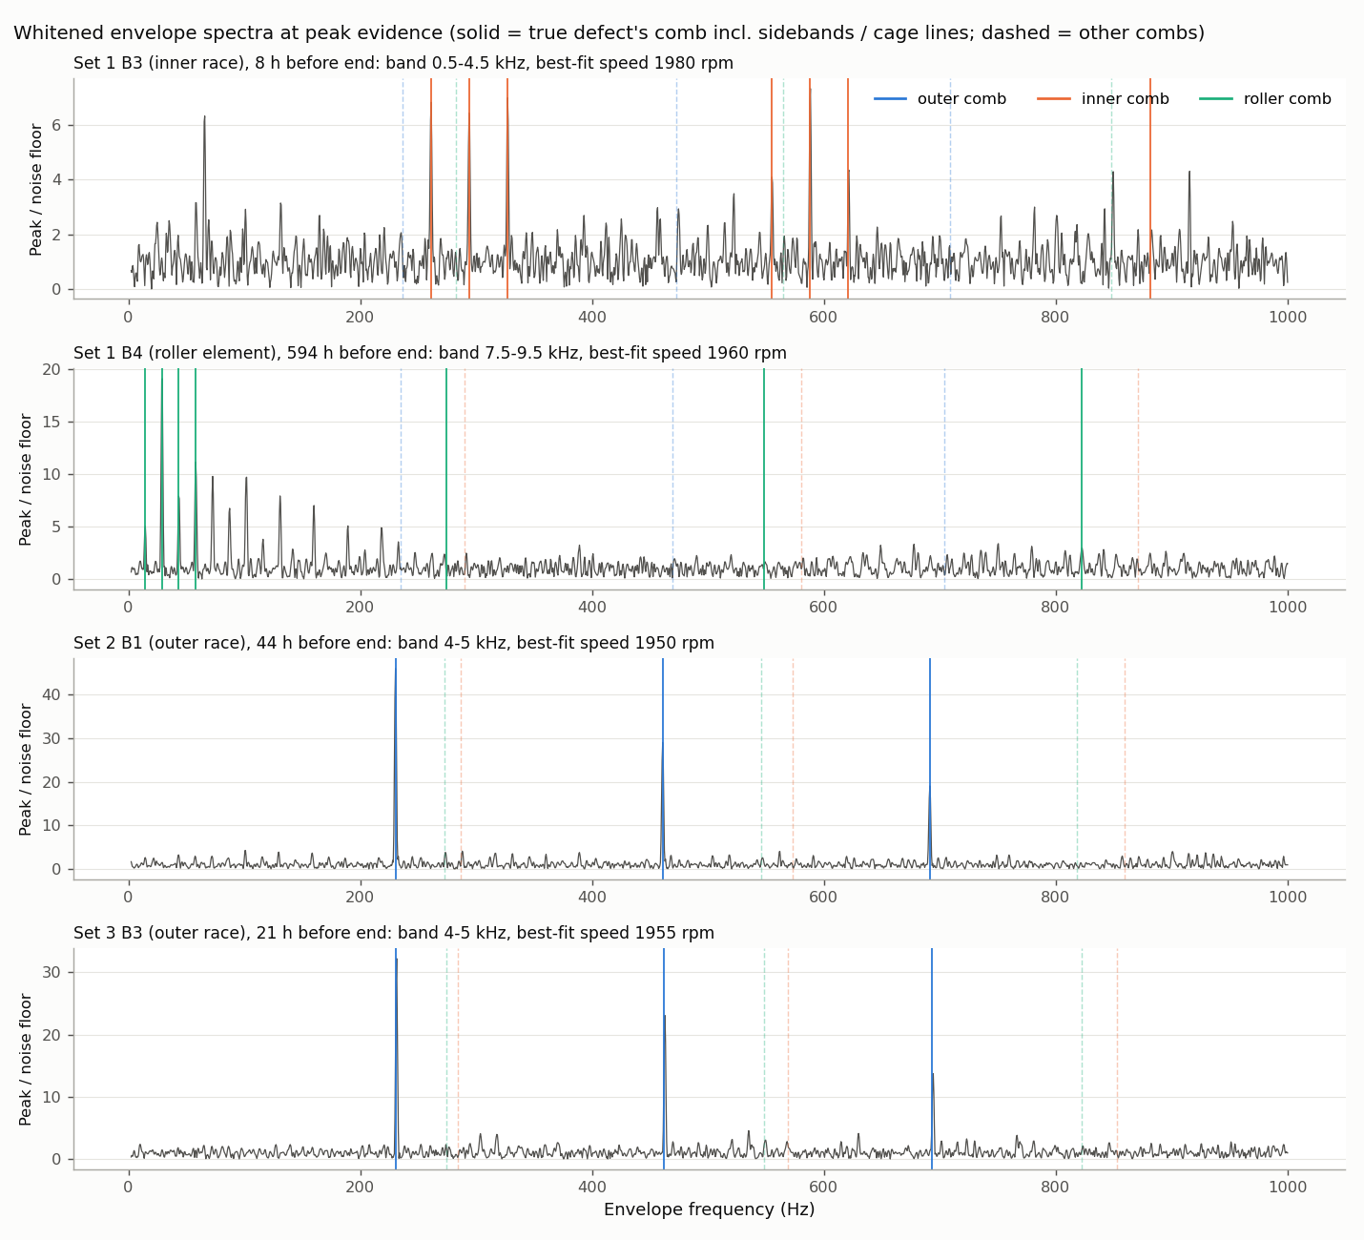
At peak evidence, the true fault's comb lands on the peaks
Solid lines = true fault's comb; dashed = other faults.
Set 2 B1 and set 3 B3: clean outer-race peaks at 230, 461, 692 Hz.
Set 1 B3: inner-race peaks with shaft-speed side peaks.
Set 1 B4: cage-rhythm comb (14.4 Hz and multiples) already 594 h before the end.
Notes:
This is the physical evidence behind each verdict. The speed search finds the real speed, about 1,950 rpm, and the combs line up with real peaks.

Slide 15
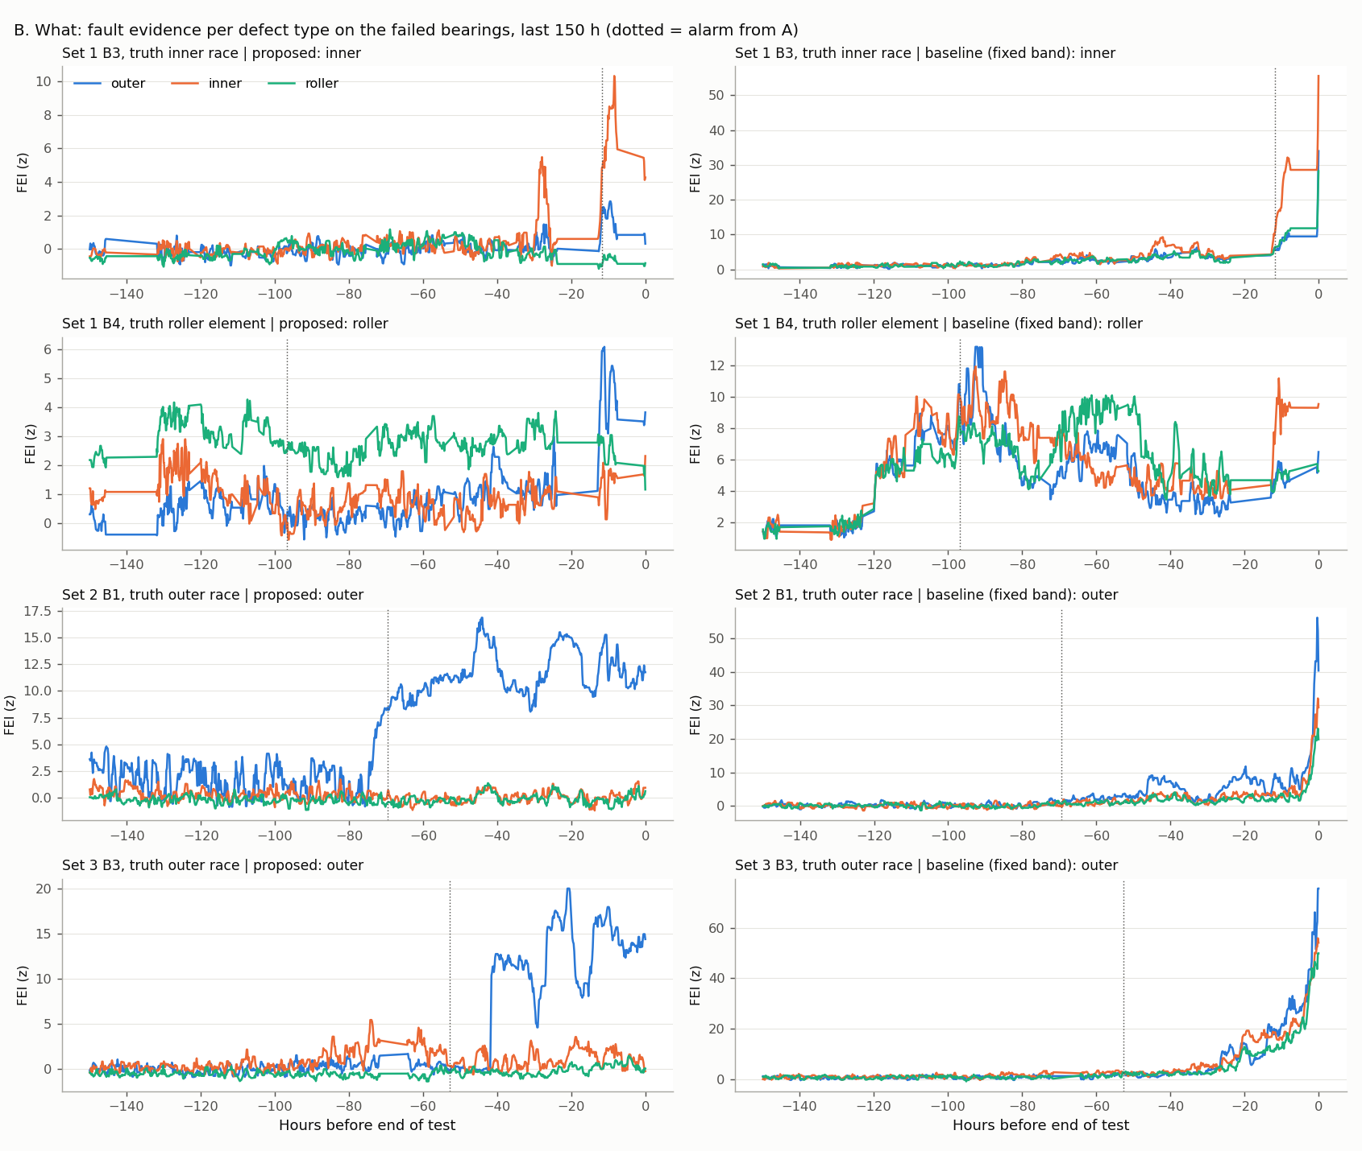
The usual method's three scores rise together; ours separate
Left column: proposed method. One colour (one fault type) clearly rises above the others.
Right column: usual method. All three colours climb together, because the whole bearing just got louder.
Notes:
This is why separation matters. Whitening removes loudness, so only the true rhythm grows.

Slide 16
Remove one ingredient and the diagnosis breaks
Without the speed search
Textbook frequencies miss the real peaks by 6-18 Hz; 3 of 4 verdicts become "unspecified". Only the slow cage rhythm survives.
Own early data as normal
Set 1 B4's cage rhythm was there from the start, so it counted as normal and the fault was lost.
Notes:
Removing the speed search makes the method almost blind. Using a bearing's own early data as normal loses the rolling-element fault. Both ingredients are necessary.

Slide 17




Honest limitations
Only 4 failures
2 of 8 false alarms
Limits were chosen on the same data: a case study, not a proven accuracy.
One came during the neighbour's breakdown and copied its fault label.
Inner race shows late
Speed must be steady
Set 1 B3's rhythm appears only in the last ~12 hours.
Varying speed would need a tachometer (speed sensor) for order tracking.
Needs peers
Deep learning needs faults
Peer contrast assumes similar bearings on one machine, and weakens if several fail at once.
With 1 inner and 1 roller example, a CNN on real labels named only 2/4.
Notes:
Be upfront: four failures is a tiny sample and thresholds were set on this data. The method is physics plus statistics; no model is trained.

Slide 18


Deep-learning option: features in, three networks tested
D1 · Autoencoder (AE)
D2 · Sim-to-real CNN
D3 · Supervised CNN
Where and when
What
What
Input: 16 condition features per snapshot
Learns to copy healthy snapshots; a failing bearing is copied badly.
Input: Envelope spectrum, 1,024 numbers
1D Convolutional Neural Network trained only on simulated faults.
Input: Envelope spectrum, 1,024 numbers
Same CNN trained on real fault snapshots, Leave-One-Run-Out.
No fault labels
No real labels
Real labels
The catch: the dataset has only 1 inner-race and 1 rolling-element failure, like learning "zebra" from a single photo.
Notes:
Deep learning variant: compute features, then hand them to networks. Three designs. D1 and D2 use no real fault labels; D3 does. The core issue is that rare fault types have one example each.

Slide 19
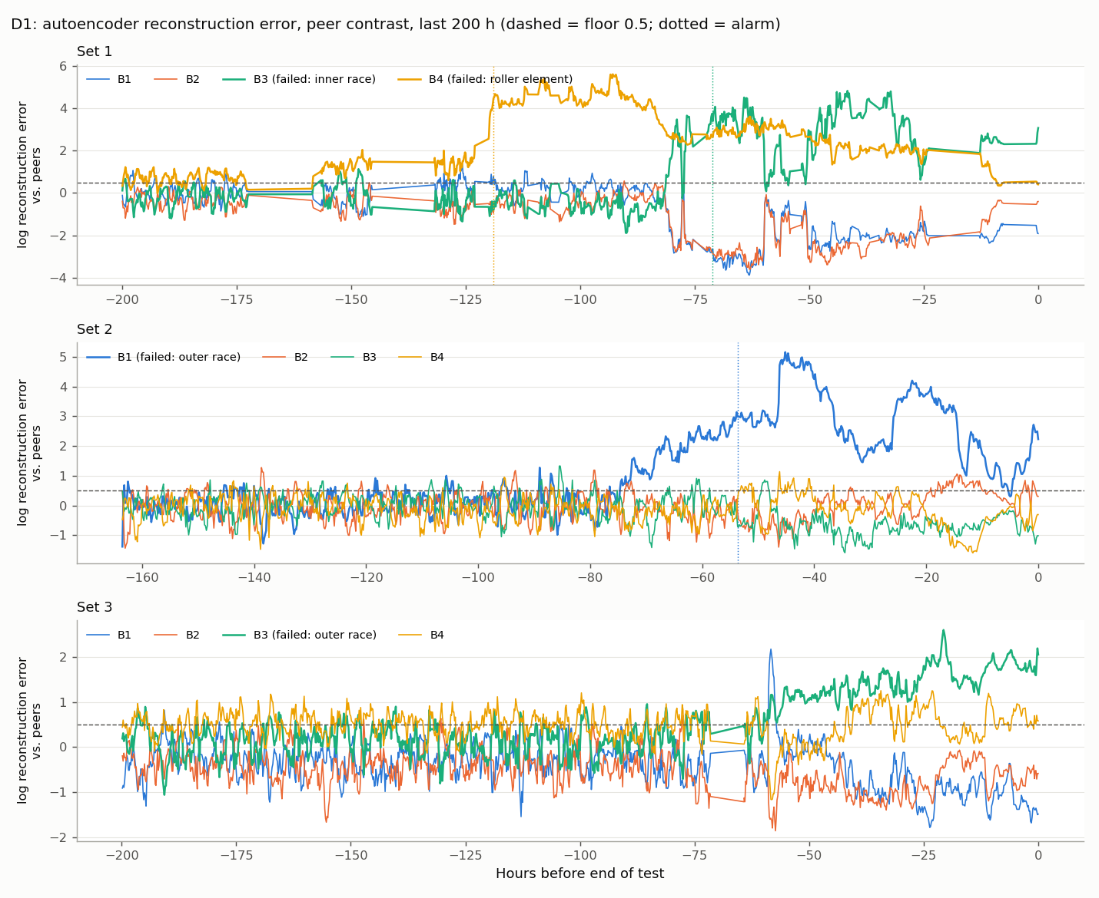
D1 autoencoder: earlier, cleaner alarms, but one miss
0 / 8
71 h
false alarms (Stage A: 2/8)
median warning (Stage A: 61 h)
3 / 4
failures detected (Stage A: 4/4)
Like a student who only practised copying healthy heartbeats: an irregular one comes out clumsy.
Set 1 inner race flagged 71 h early (Stage A: 12 h). Set 3 B3 missed: its noisy healthy period set the limit too high.
Notes:
The autoencoder squeezes 16 features into 4 and back, trained on healthy data only. Its copy error goes through the same peer-contrast alarm rule as Stage A. Trade-off: no false alarms and earlier warnings, but one missed failure.

Slide 20
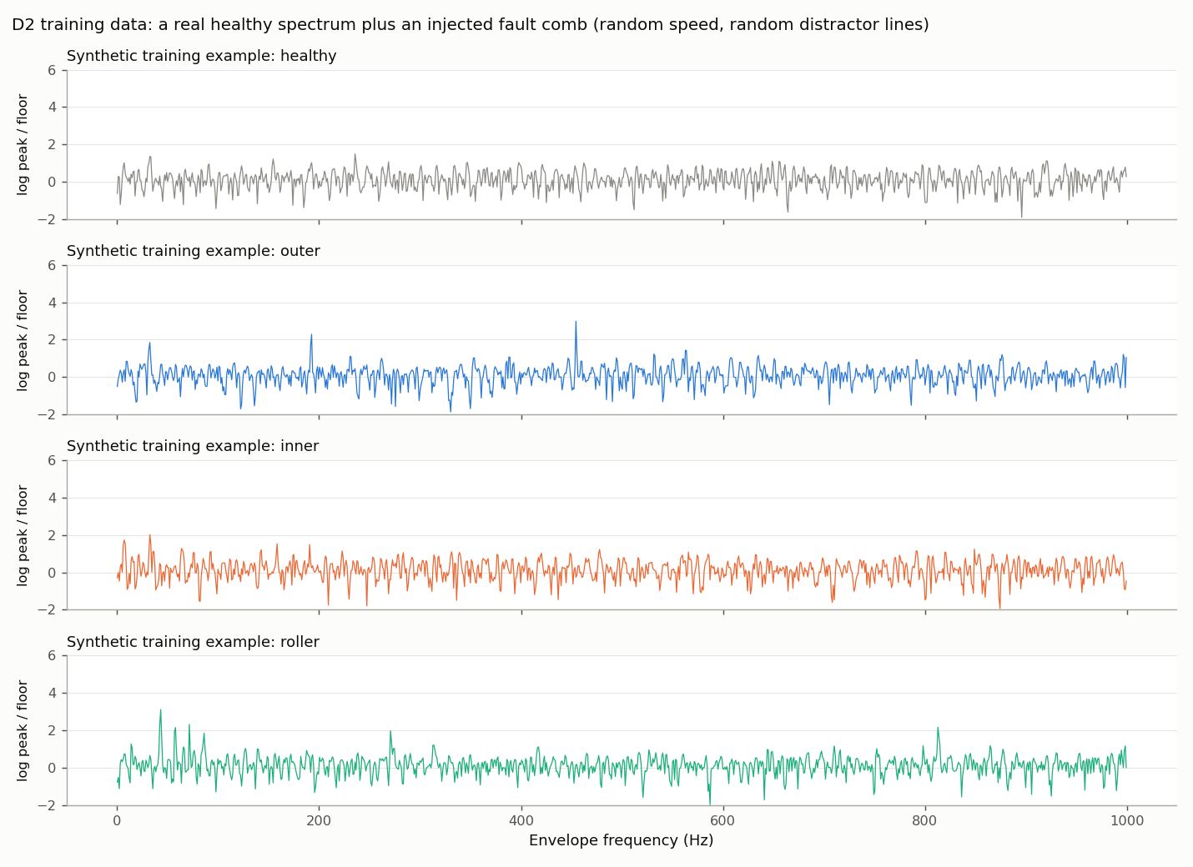
D2: train on simulated faults, like a pilot in a simulator
Recipe
Real healthy spectrum + a painted fault rhythm at a random speed (95-101%) + random distractor peaks.
Fair-test rules
Never sees a real fault.
Backgrounds only from the other two tests.
89-93%
accuracy on fresh synthetic examples
Notes:
Real faults are rare, so we create them from physics, the way pilots train for emergencies in a simulator. The network never sees a real fault or any data from the test it is scored on.

Slide 21
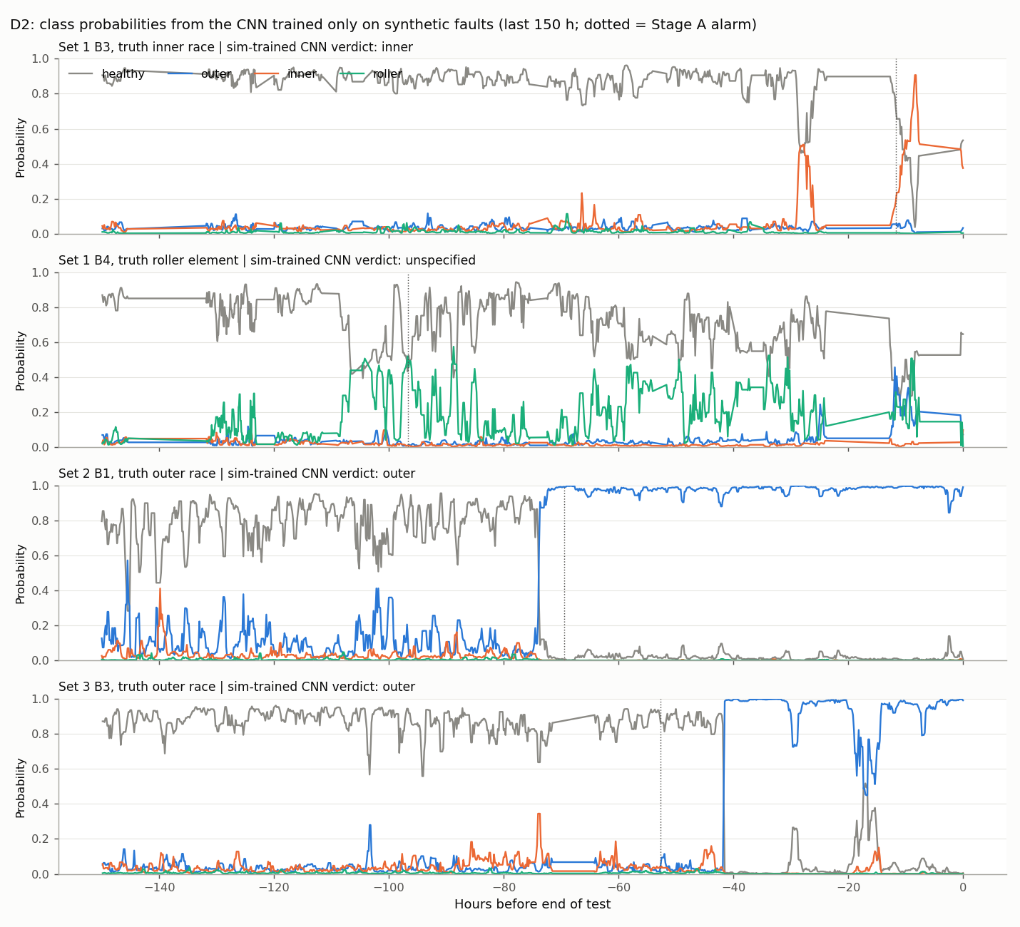
Simulated training beats real labels; physics still wins
Identification | Correct | Last 48 h | Why
Stage B: physics combs | 4 / 4 | 0.61 | Knows every rhythm in advance
D2: CNN, simulated faults | 3 / 4 | 0.51 | Roller left "unspecified"; no fault on any healthy bearing
D3: CNN, real labels (LORO) | 2 / 4 | 0.45 | Held-out inner / roller has no training example
Deep learning needs examples; physics can create them. A combined system: autoencoder for detection, then physics combs and the simulated-fault CNN agreeing on the fault type.
Notes:
LORO = Leave-One-Run-Out. The supervised CNN cannot name a fault type it has never seen. The simulated-fault CNN gets outer and inner right and never calls a fault on a healthy bearing. The physics method remains the most complete.

Slide 22
Loudness finds it; rhythm names it
All 4 failures found, median 61 h early, margin ≥ 2.7×
Keys: speed search, all-bearing reference, loudness/rhythm split
Deep learning: AE 0/8 false alarms; simulated-fault CNN 3/4
Part II: predict RUL (Remaining Useful Life) from the alarm
Notes:
Close with the one-line summary and the link to Part II: the Stage A health index is the signal the RUL model extrapolates, and Stage B's fault type can select a degradation model per fault.

