Slide 1
End-to-End Quadrotor Position Control via Proximal Policy Optimization with Direct Motor Actuation
Adrian Ferdinand Jotham, Muhammad Wicaksono, Soo Young Shin
Dept. IT Convergence Engineering
Kumoh National Institute of Technology

Slide 2
Introduction & Contributions
1. Reward Design
2. Training Progression
Potential-based approach term gives a dense transit gradient toward the goal.
Velocity-gated hover bonus rewards arrival without overshoot.
Training from 3M → 40M environment steps.
Two spawn regimes: clean-start and full curriculum randomisation.
Classical control: 4 tuned layers (planner → position → attitude → motor mixer), each brittle to unmodelled dynamics.
RL collapses all layers into one neural network — sensors map directly to motor commands.
Direct-RPM is the hardest variant: every layer must be learned from one reward signal.
3. Robustness Gap
4. Open Environment
Distance-stratified success rates show graceful degradation with target distance.
Robustness gap narrows monotonically: 47.1 → 28.3 pp.
Open Crazyflie 2.x training environment.
Newton GPU physics + Stable-Baselines3 PPO.

Slide 3
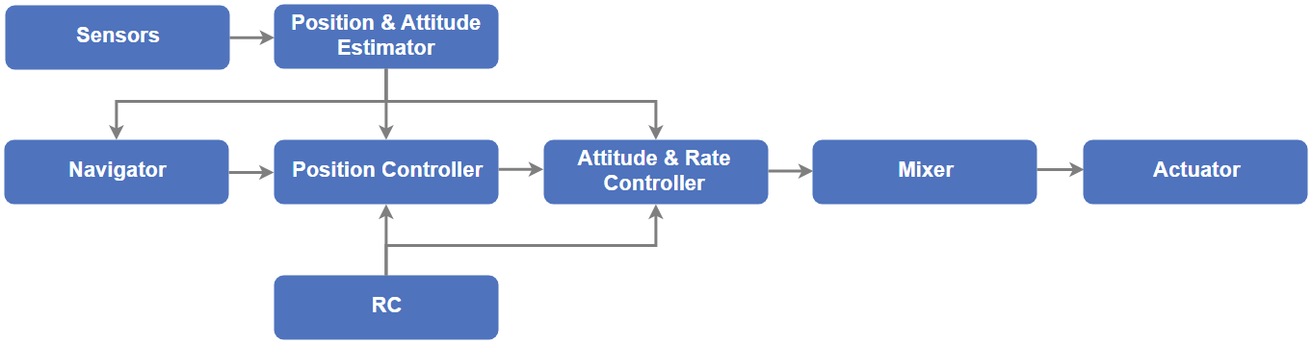
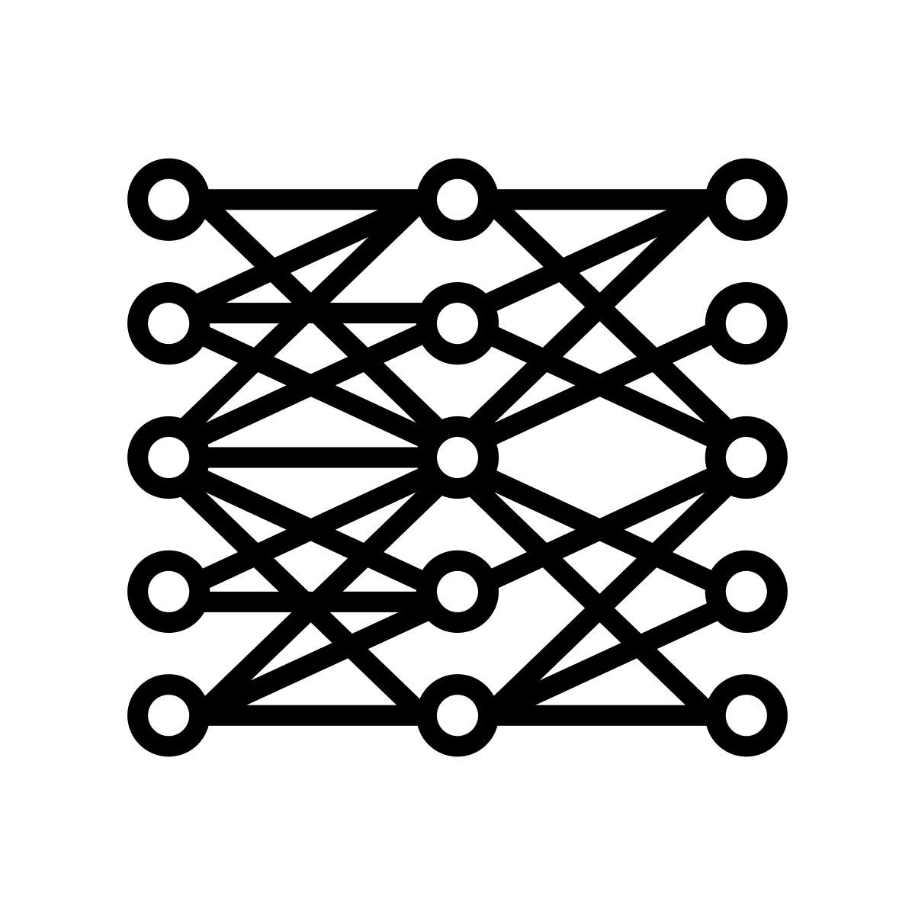
System Comparison
Classical Control Architecture
Src : PX4 Flight Stack
End to End Control Architecture
Sensors
Position & Attitude Estimator
NEURAL NETWORK
Multi Layer Perceptron (22 x 128 x 128 x 4)
Actuator
Navigator
Position Controller
Attitude & Rate Controller
Mixer

Slide 4
Method
Table 1. Crazyflie 2.x Parameters
Parameter | Value
Mass | 27 g
Arm length | 32.5 mm
I_{xx} = I_{yy} | 1.657 × 10⁻⁵ kg·m²
I_{zz} | 2.900 × 10⁻⁵ kg·m²
K_{T} (thrust) | 3.16 × 10⁻¹⁰ N / RPM²
K_{D} (drag) | 7.94 × 10⁻¹² N·m / RPM²
Hover RPM | ≈ 14,476 RPM
End-to-end: obs → PPO → motor RPM.
Shared 2 × 256 MLP, actor + critic heads.
Proximal Policy Optimization
Goal: π* = arg max _{π} 𝔼_{π} [ Σ_{t} γ^{t} r_{t} ]
Loss: L^{CLIP}(θ) = 𝔼_{t} [ min ( r_{t}(θ) Â_{t} , clip( r_{t}(θ), 1 − ε, 1 + ε) Â_{t} ) ]
Clipping bounds the policy step — the same rollout can be reused safely.
Simulation Environment
Network Architecture
PPO Configuration
100 Hz Newton GPU integration.
Motor lag τ = 0.15 s (1st-order LPF).
16 parallel envs.
Episodes ≤ 800 steps (8 s).
Observation (22D)
SB3 PPO, MLP 2 × 256 (tanh).
Rollout 2,048; batch 64.
γ = 0.99, λ = 0.95.
clip = 0.2, ent = 0.005.
Linear 256 + tanh
Linear 256 + tanh
Actor (4D) | Critic V(s)

Slide 5
Reward Function & Spawn Curriculum
Term | Formula | Role
pos_c | −C_{rp} · ‖p_{err}‖² | Position precision
orient_c | −C_{rq} · (1 − q_{w}²) | Upright attitude
vel_c | −C_{rv} · ‖v‖² | Velocity damping
ang_c | −C_{rω} · ‖ω‖² | Angular stability
act_c | −C_{ra} · ‖Δa‖² | Action jerk penalty
survival | +0.50 (fixed) | Stay airborne
approach | +λ · (d_{t−1} − d_{t}), d > 0.10 m | Dense transit signal
hover_bonus | +0.15, d < 0.15 m & ‖v‖ < 0.5 | Settlement reward
arrival | +15.0 (one-time) | Waypoint reached
crash | −2.0 (one-time) | Ground impact
Why these terms
Penalties (pos / orient / vel / ang / act) shape the long-tail target hovering behaviour.
Approach term gives a dense gradient — pure goal-reach is too sparse for PPO.
Velocity-gated hover bonus prevents the policy from sprinting at the target.
Arrival (+15) and crash (−2) provide the terminal signal.
Curriculum logic
c ∈ [0, 1] ramps spawn difficulty over the first 1.5 M steps.
Reward weights anneal in parallel — learn to hover first, then to recover.

Slide 6
Results
How we measure it
A leg = one waypoint segment. Success = ‖p_{err}‖ < 0.15 m.
Multi-waypoint chaining, no reset, 8 000-step budget, 20 episodes.
Key findings
Clean-start: 73 → 82.9% (3 → 30 M). Converges at ~30 M.
Randomised keeps improving: 25.9 → 53.5%.
Robustness gap narrows monotonically: 47.1 → 28.3 pp.
Distance-stratified: 100% at < 0.5 m drops to 68.2% at 1.5–3.0 m.

Slide 7
Conclusion & Future Work
End-to-end PPO learned direct-RPM position control — no hand-tuned cascade.
Robustness keeps improving past clean-start convergence.
Sim-to-Real
Motor-Lag Robustness
Reward Refinement
Validate the simulator: zero-shot transfer to a physical Crazyflie 2.x.
Real motor lag and battery sag will stress the policy.
Randomise τ around 0.15 s during training.
Closes the gap between sim motor dynamics and any unseen real airframe.
Remove flat +0.5 survival bonus — currently creates a hover attractor away from the goal.
Replace with a small altitude/recovery term.

