Slide 1
Web Based System for Mid sized Software/IT Companies
Adrian McDevitt and Steve Svetlichniy (Team 3)

Slide 2
Customer Requirements
Available for all modern platforms
Must be able to view and purchase products
Must be able to interact with chatbots
Must be able to view and apply for jobs
Must be able to contact the company
Be able to post and edit forums
Be able to view and subscribe to services
Be able to view case studies
Be able to subscribe for membership
Be able to view and comment on Demos

Slide 3
System Feasibility
This software system for a website for IT/Software development companies is an improvement over current software because it is more client orientated with functions such as:
Chat bots, Projects, Demos, News, Forums, Contacts,...etc.

Slide 4
System Requirements
System Scope: Provides a website where customers and potential clients are able to view projects, awards, forums, news, tools and other important objects and be able to communicate with chatbots and view demos of the products
Functionality: Communicate with chatbots, view news articles, post on the forums page, edit your profile for forums page, view available products,purchase products, view services, apple to services, view available careers and apply for jobs

Slide 5
Platform and Environment
Operating Systems: Windows Vista, 7, 8, 10, Mac OS X V. 10.5 to MacOS 10.14, Linux 2.6 to Linux 5.0, IOS, Android OS, Windows Phone OS, Chrome OS
Access to internet: Required
Types of Computers: Anything that runs listed operating systems
Devices Used: Mobile Devices that run the listed Mobile Operating Systems
Web Browsers: Chrome, MS Edge, Mozilla Firefox, Safari, Opera

Slide 6
Constraints
Types of constraints that can be face are:
Build time, Run time, cost of development, manpower, specification of equipment and technical tools, cost of maintenance

Slide 7
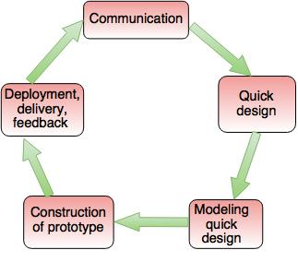
Process Model
We will be using the evolutionary prototype model because we want to make sure that all of the functionalities and the layout is up to the customers standards by delivering a robust prototype that can be constantly refined over time.

Slide 8
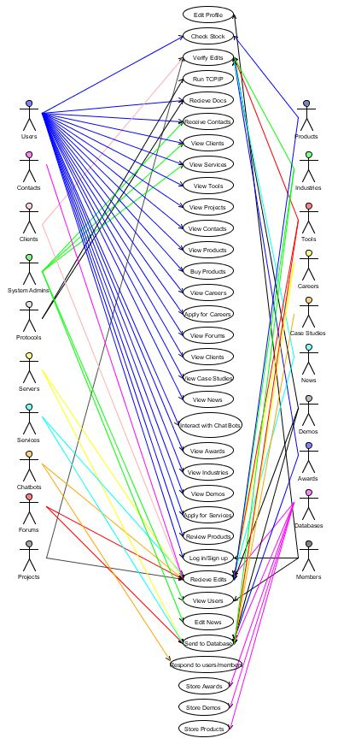
Use Case Diagram
Actors: Users, Contacts, Clients, System Administrators, Protocols, Servers, Services. Chatbots, Forums, Projects, Products, Industries, Tools, Careers, Case studies, News, Demos, Awards, Databases and Members.
Functions: Edit profile, Checkstock, Verify Edits, Run protocols, Receive Documents, Receive Contacts, view clients, view tools, view projects, view contacts, view products, buy products, view careers, apply to careers, view forums, view clients, view case studies, view news, interact with chatbots, view awards, view industries, view demos, apply for services, Review Products, Log in, receive edits, view users, edit news, send to database, respond to members, store actors and demos.
Tool Used:
UMlet

Slide 9
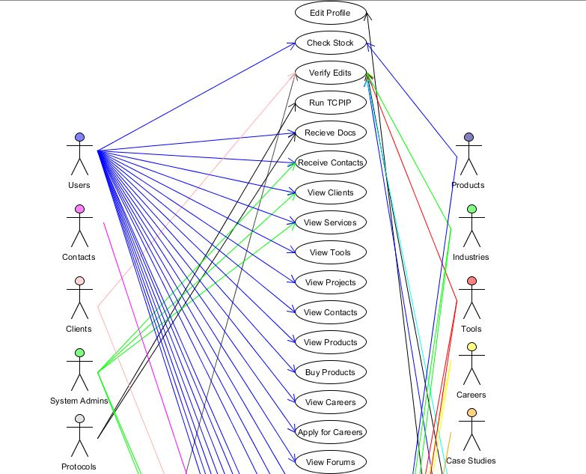
Use Case Diagram

Slide 10
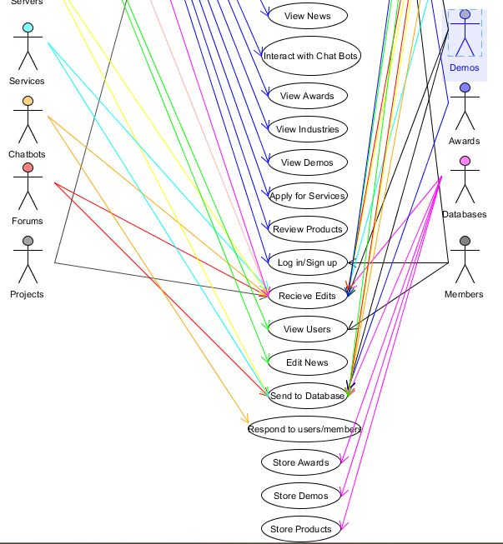
Use Case Diagram

Slide 11
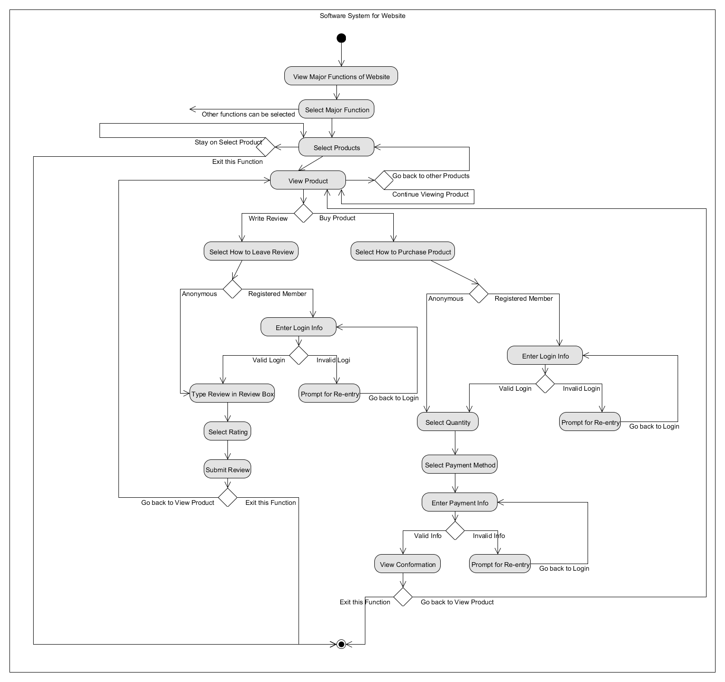
Activity Diagram
(for Products)
(Optional)
Tool Used: Umlet

Slide 12
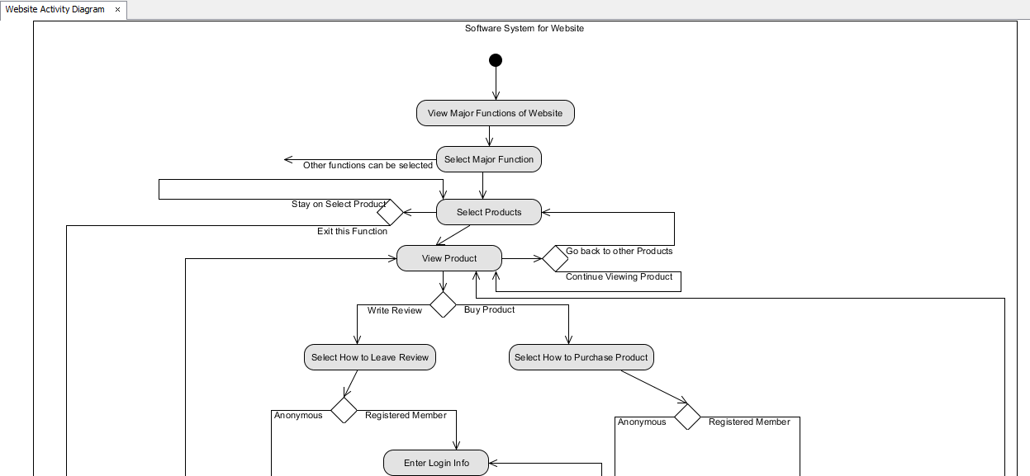
Activity Diagram (part 1)

Slide 13
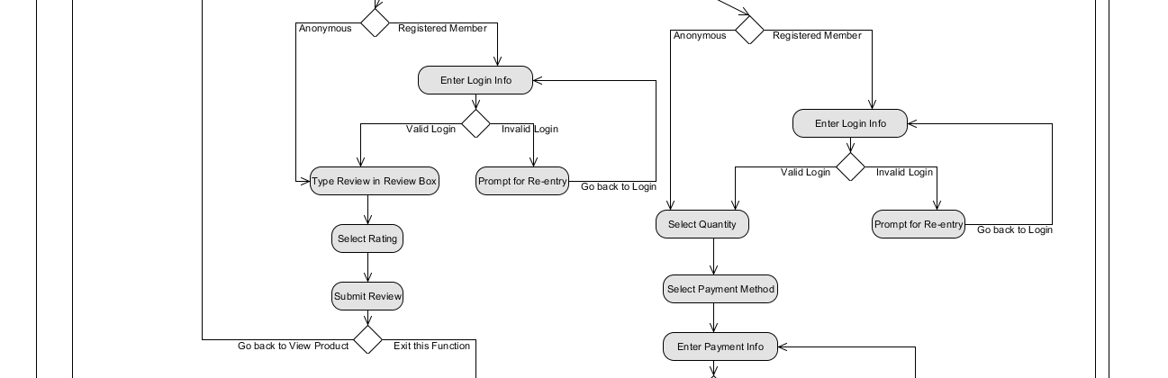
Activity Diagram (part 2)

Slide 14
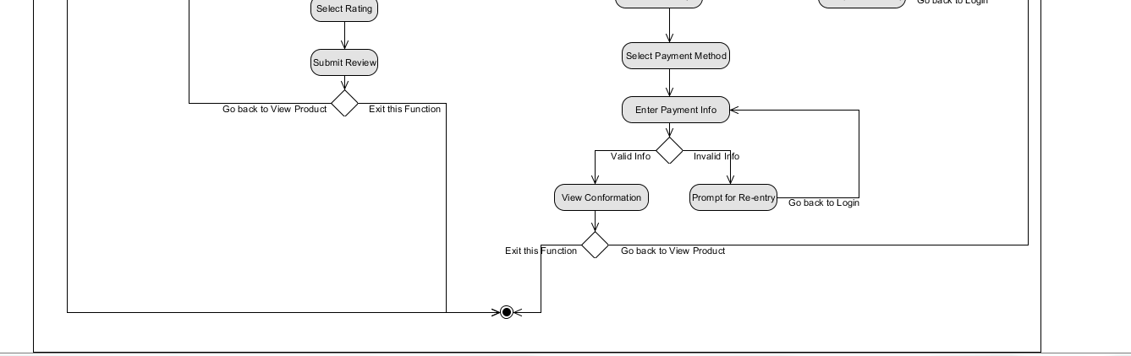
Activity Diagram (part 3)

Slide 15
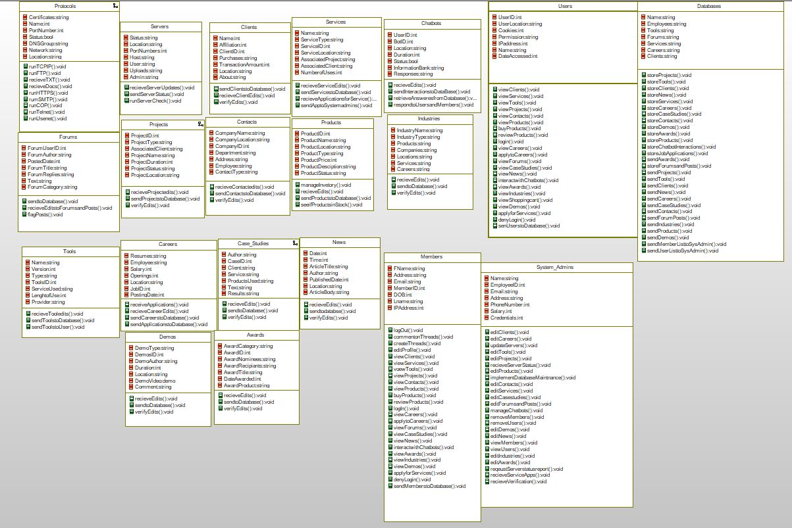
Class Object Diagram
Tool Used: IBM Rational

Slide 16
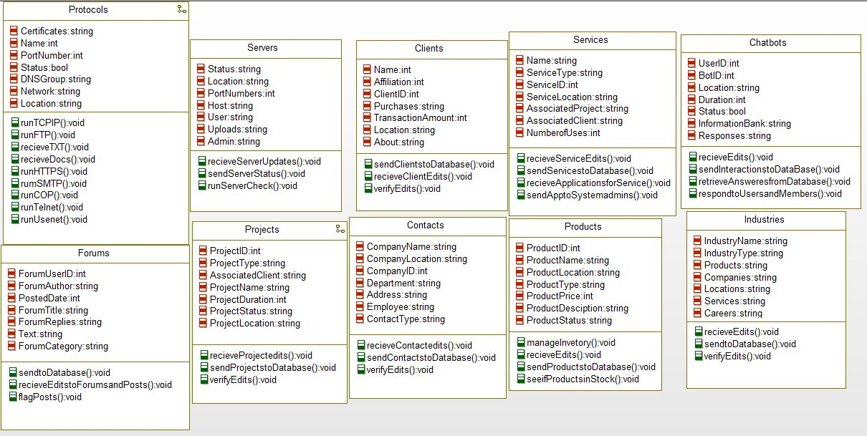
Class Object Diagram

Slide 17
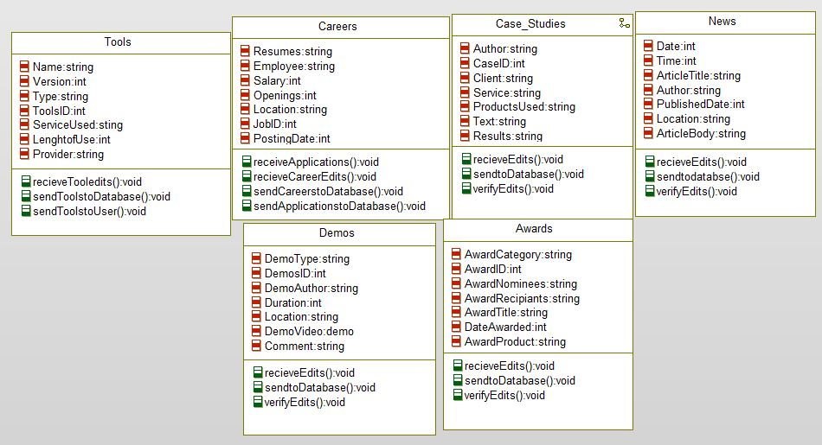
Class Object Diagram

Slide 18
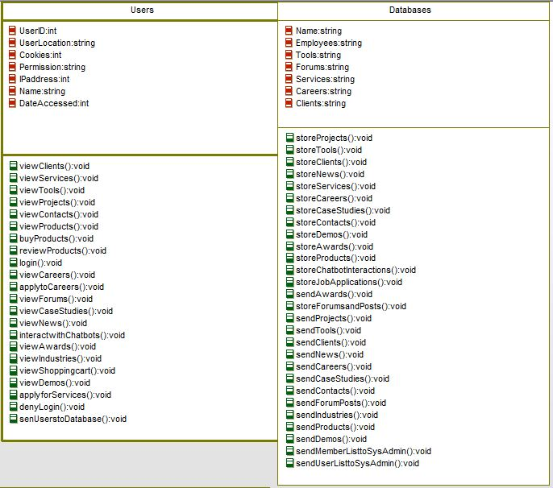
Class Object Diagram

Slide 19
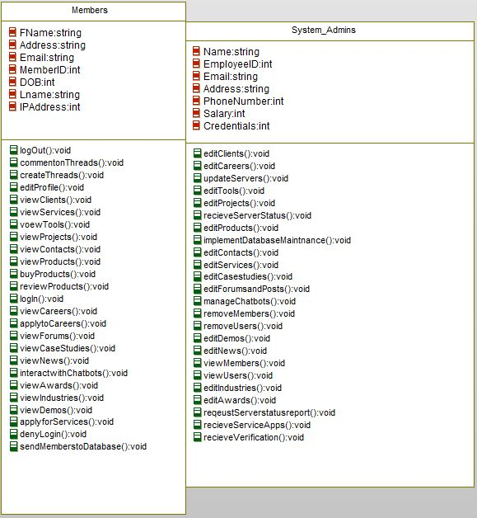
Class Object Diagram

Slide 20
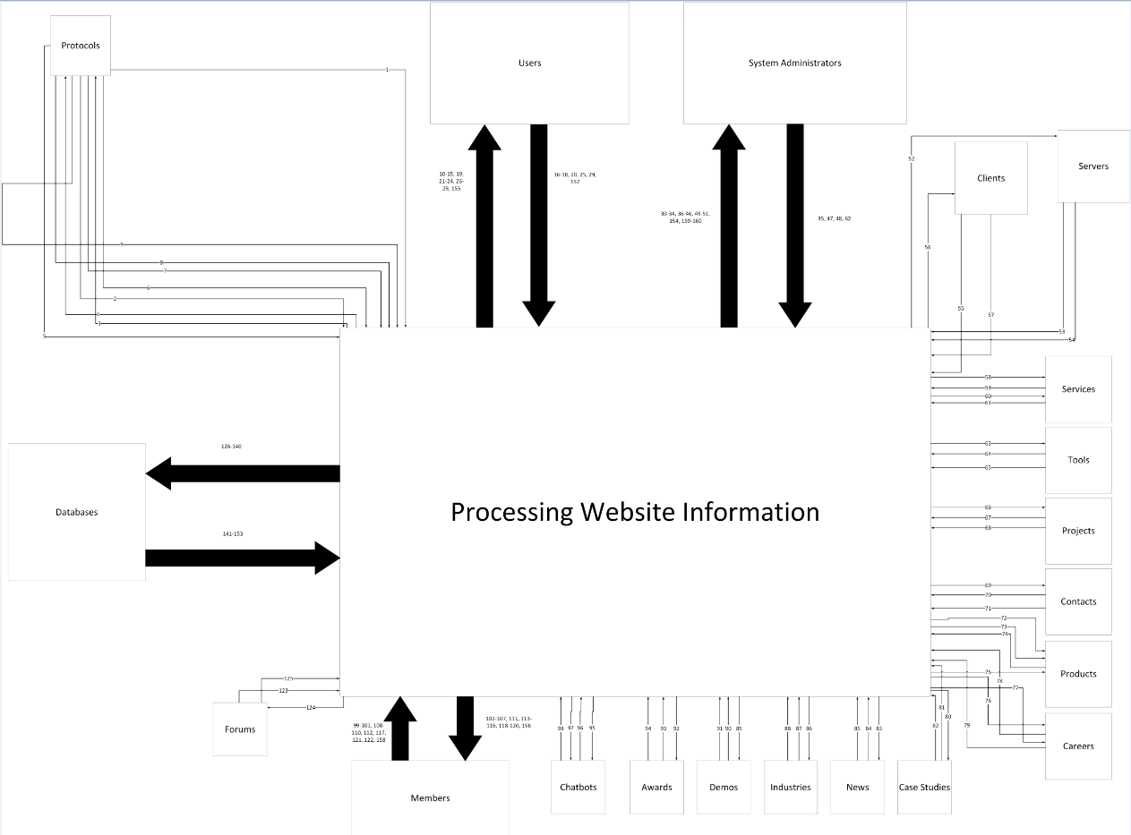
Context Data Flow Diagram
Tool used: MS Visio 2013

Slide 21
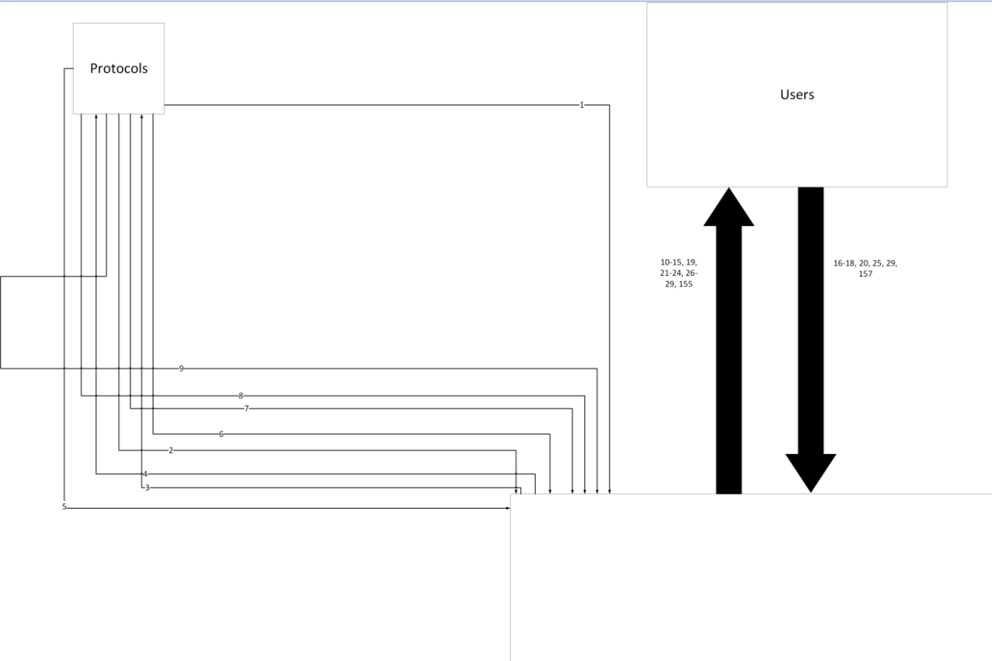
Context Data Flow Diagram (Part 1)

Slide 22
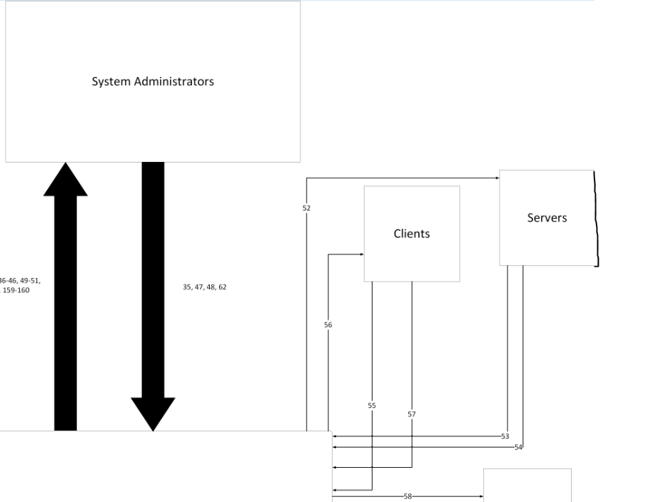
Context Data Flow Diagram (Part 2)
The picture snipped Servers a bit, so we had to "fix it" a bit

Slide 23
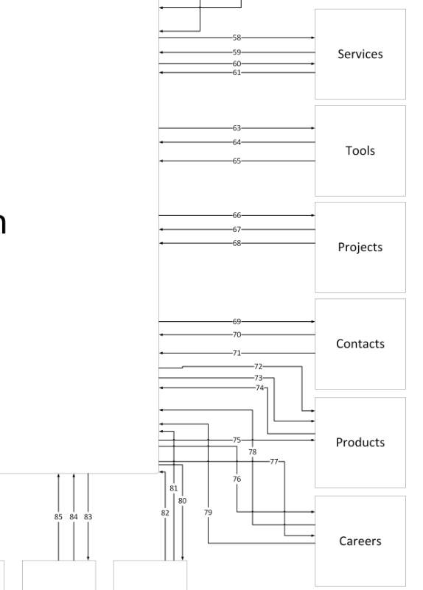
Context Data Flow Diagram (Part 3)

Slide 24
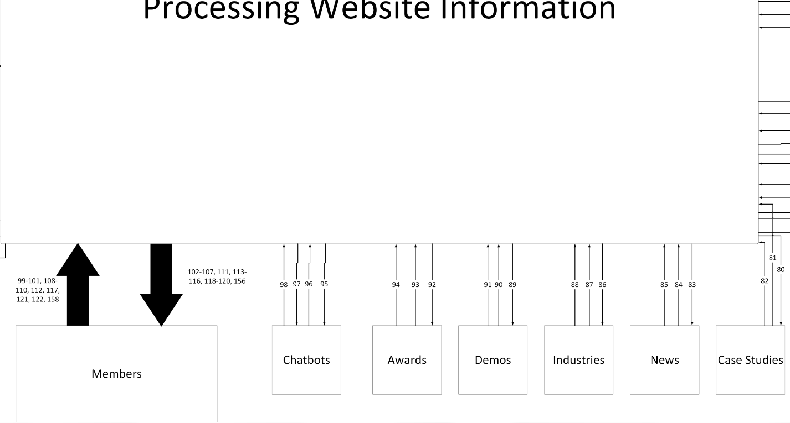
Context Data Flow Diagram (Part 4)

Slide 25
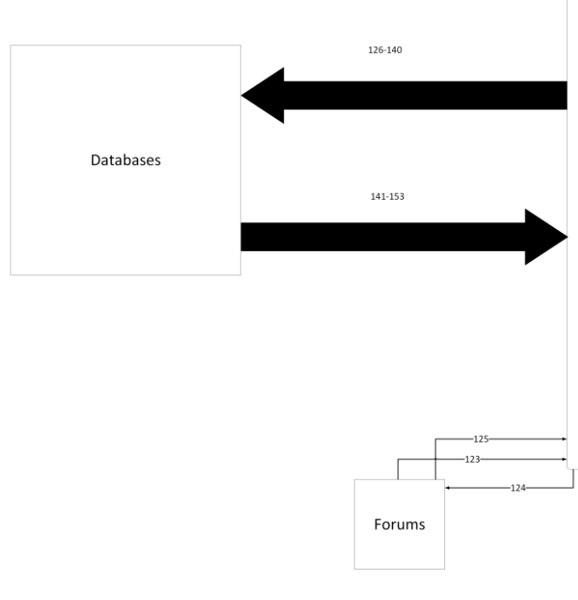
Context Data Flow Diagram (Part 5)

Slide 26
Legend
51. Request Server Status Report
62. Receive Service Applications
154. Receive Verification
Servers
52. Receive Server Updates
53. Send Server Status
54. Run Server Status Check Up
Clients
55. Send Clients to Database
56. Receive Client Edits
57. Verify edits
Services
58. Receive Services Edits
59. Send Services to Databases
60. Receive Applications for Services
61. Send Applications to System Admins
Protocols
1. Run TCP/IP
2. Run FTP
3. Receive TXT
4. Receive DOC
5. Run HTTPS
6. Run SMTP
7. Run COP
8. Run Telenet
9. Run Usenet
Users
10. View Clients
11. View Services
12. View Tools
13. View Projects
14. View Contacts
15. View Products
16. Buy Products
17. Review Products
18. Login/Signup
19. View Careers
20. Apply for Careers
21. View Forums
22. View shopping cart
23. View Case Studies
24. View News
25. Interact with Chatbots
26. View Awards
27. View Industries
28. View Demos
29. Apply for Services
155. Deny Login
157. Send Users to Database
System Administrators
30. Edit Clients
31. Edit Careers
32. Update Servers
33. Edit Tools
34. Edit Projects
35. Receive Server Status
36. Edit Products
37. Implement Database Maintenance
38. Edit Contacts
39. Edit Services
40. Edit Case Studies
41. Edit Forums and Posts
42. Manage Chatbots
43. Remove Member
44. Remove Users
45. Edit Demos
46. Edit News
47. View Members
48. View Users
49. Edit Industries
50. Edit Awards

Slide 27
Legend (cont)
Tools
63. Receive Tool Edits
64. Send Tools to Databases
65. Verify Edits
Projects
66. Receive Project Edits
67. Send Projects to Databases
68. Verify edits
Contacts
69. Receive Contact Edits
70. Send Contacts to Databases
71. Verify Edits
Products
72. Sell
73. Receive Edits
74. Send Products to Databases
75. See If In Stock
Careers
76. Receive Job Applications
77. Receive Career edits
78. Send Careers to Databases
79. Send Job Applications to Databases
Case Studies
80. Receive Case Studies Edits
81. Send To Database
82. Verify Edits
News
83. Receive News Edits
84. Send News to Databases
85. Verify Edits
Industries
86. Receive Industries Edits
87.Send to Databases
88. Verify Edits
Demos
89. Receive Demos Edits
90. Send Demos to Databases
91. Verify edits
Awards
92. Receive Awards Edits
93. Send Awards to Databases
94. Verify Edits
Chatbots
95. Receive Edits
96. Send Interactions to Databases
97. Retrieve Answers from Answer Bank
98. Respond to User/Member

Slide 28
Legend (cont)
148. Send Contacts
149. Send Forums/Posts
150. Send Industries
151. Send Products
152. Send Demos
153. Send Awards
159. Send Members to System Administrators
160. Send Users to System Administrators
Users
99. Logout
100. Comment on Threads
101. Create Threads
102. View Clients
103. View Services
104. View Tools
105. View Projects
106. View Contacts
107. View Products
108. Buy Products
109. Review Products
110. Login/Signup
111. View Careers
112. Apply for Careers
113. View Forums
114. View shopping cart
115. View Case Studies
129. Store Clients
130. Store News
131. Store Services
132. Store Careers
133. Store Case Studies
134. Store Contacts
135. Store Demos
136. Store Awards
137. Store Products
138. Store Chatbot Interactions
139. Store Job Applications
140. Store Forums and Posts
141. Send Projects
142. Send Tools
143. Send Clients
144. Send News
145. Send Careers
146. Send Case Studies
147. Send Services
116. View News
117. Interact with Chatbots
118. View Awards
119. View Industries
120. View Demos
121. Apply for Services
122. Edit Profile
156. Deny Login
158. Send Users to Database
Forums
123. Send to Databases
124. Receive edits to Forums and Posts
125. Flag posts
Databases
126. Receive Maintenance Procedures
127. Store Projects
128. Store Tools

Slide 29
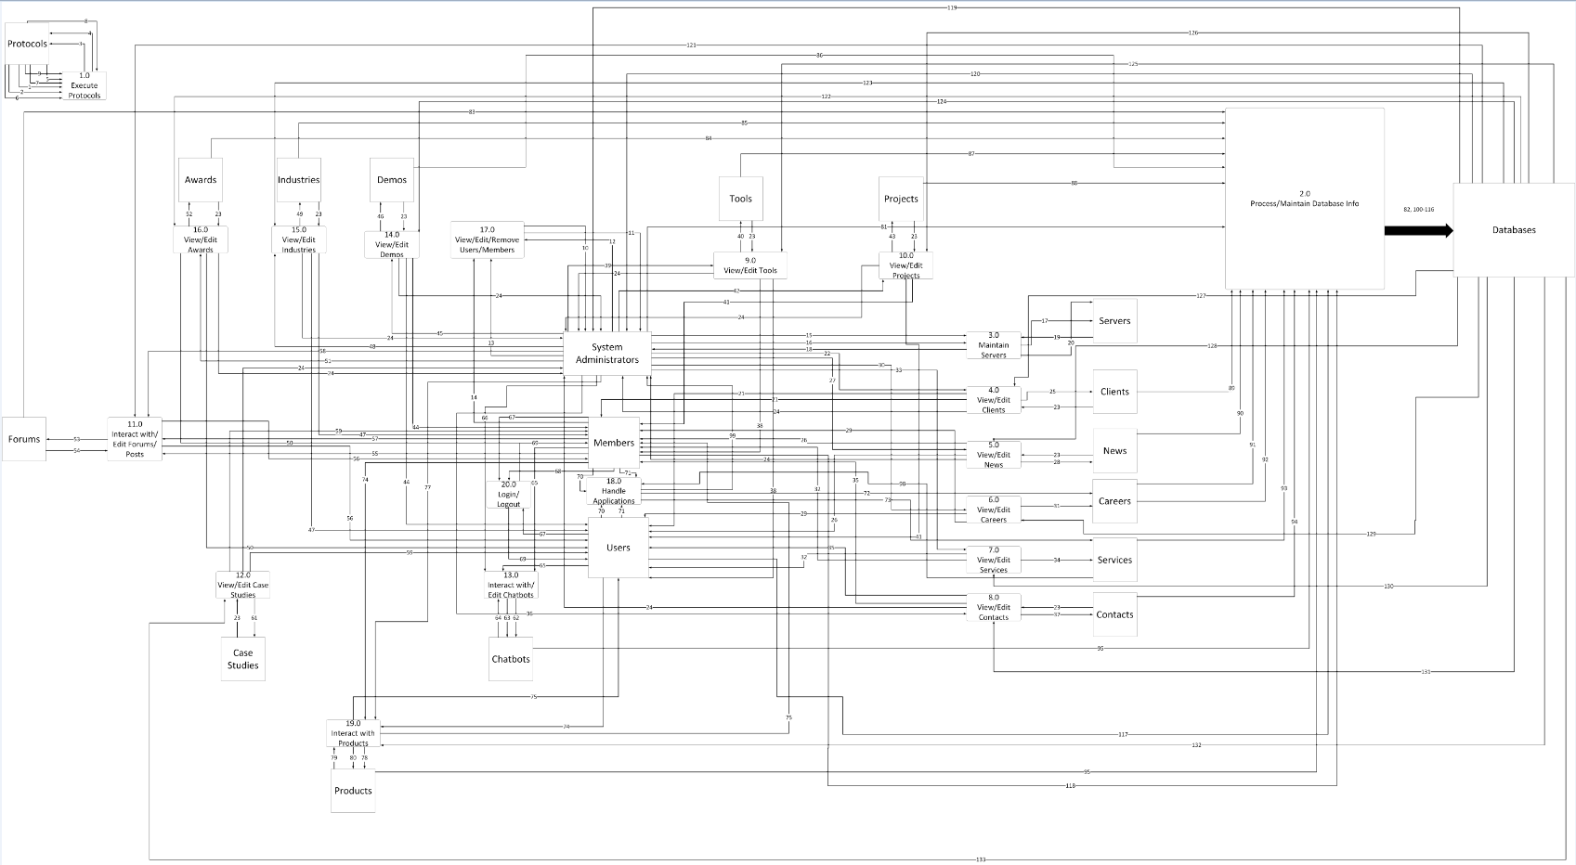
Level-0 Data Flow Diagram
Tool used: MS Visio 2013

Slide 30
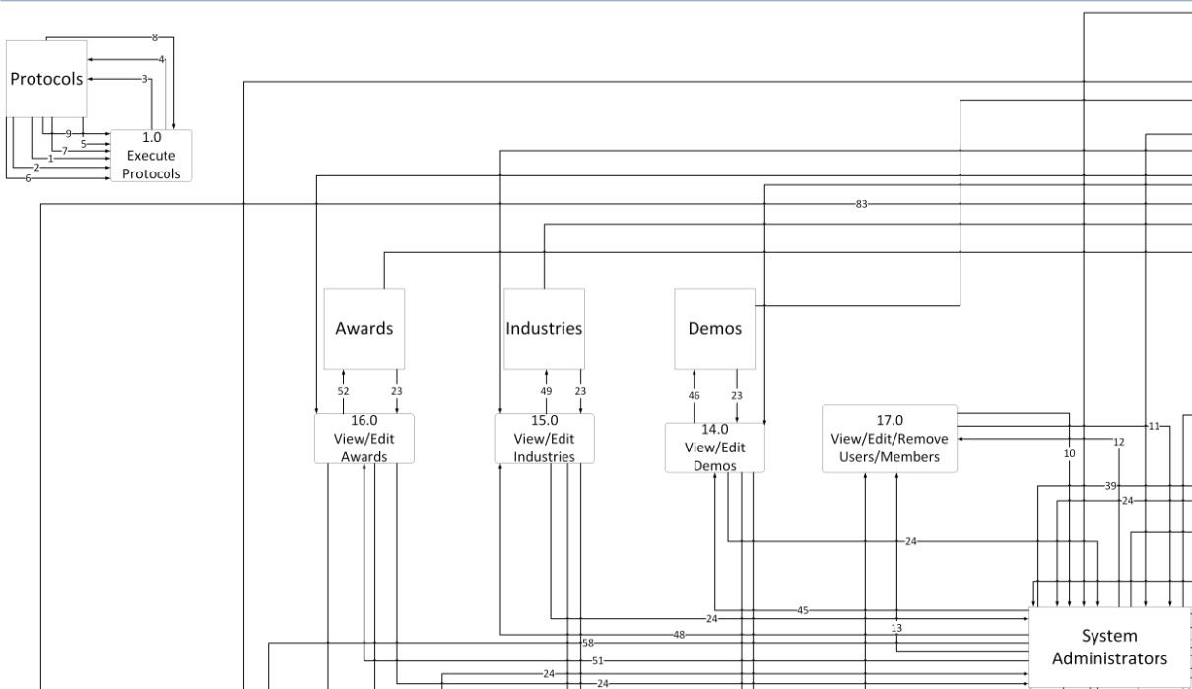
Level-0 Data FLow Diagram (Part 1)

Slide 31
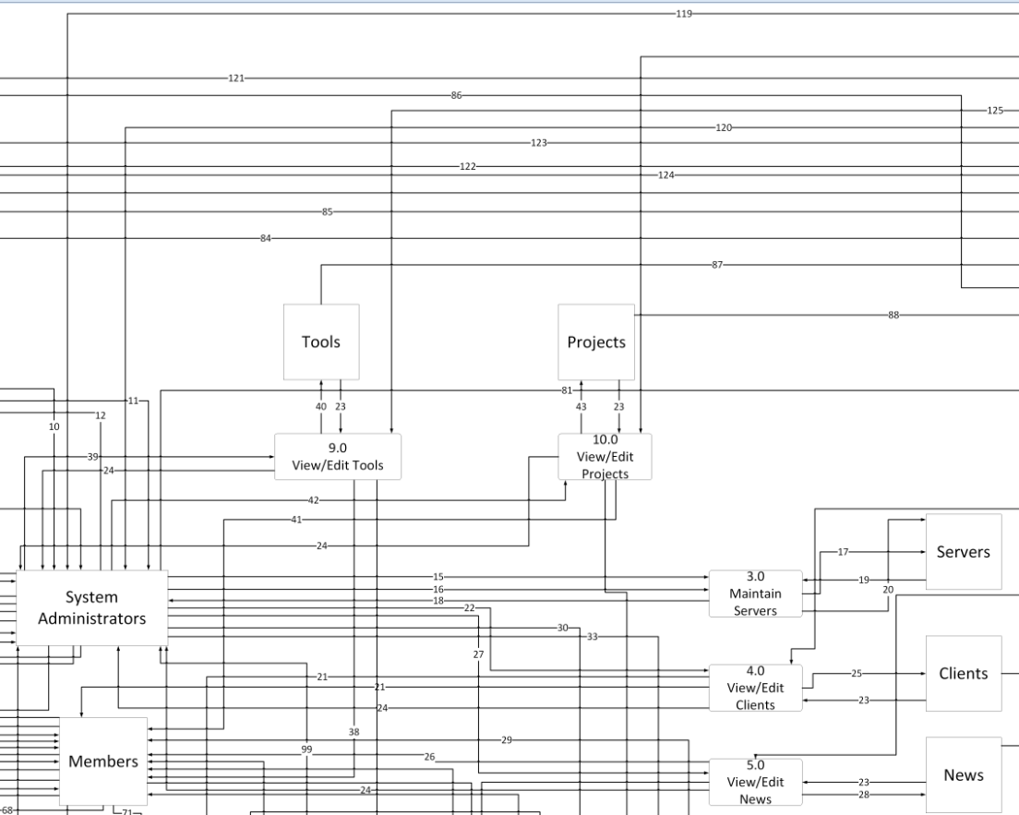
Level-0 Data FLow Diagram (Part 2)

Slide 32
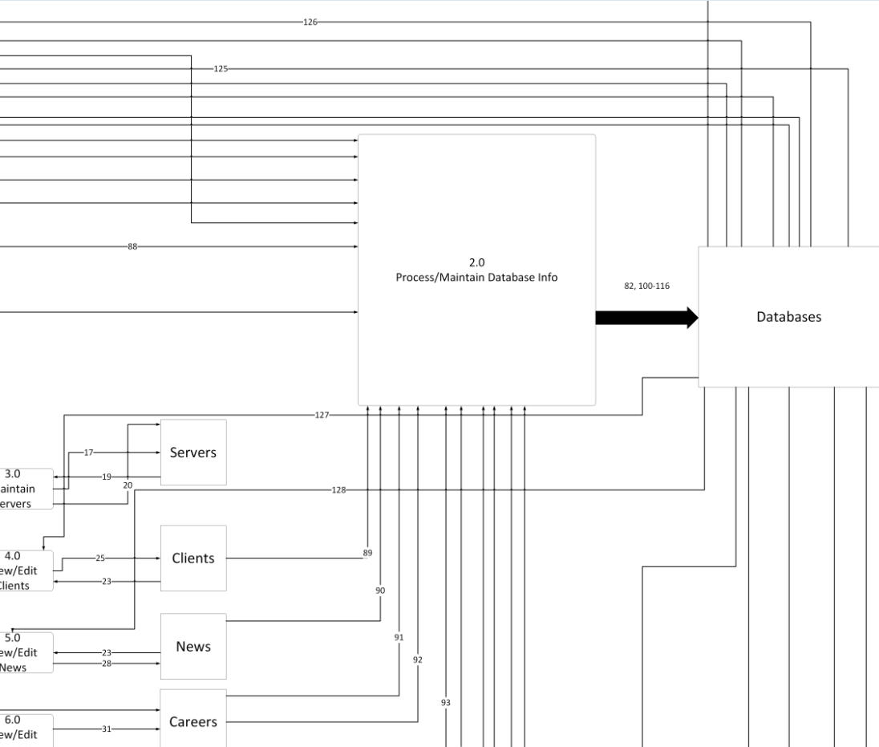
Level-0 Data FLow Diagram (Part 3)

Slide 33
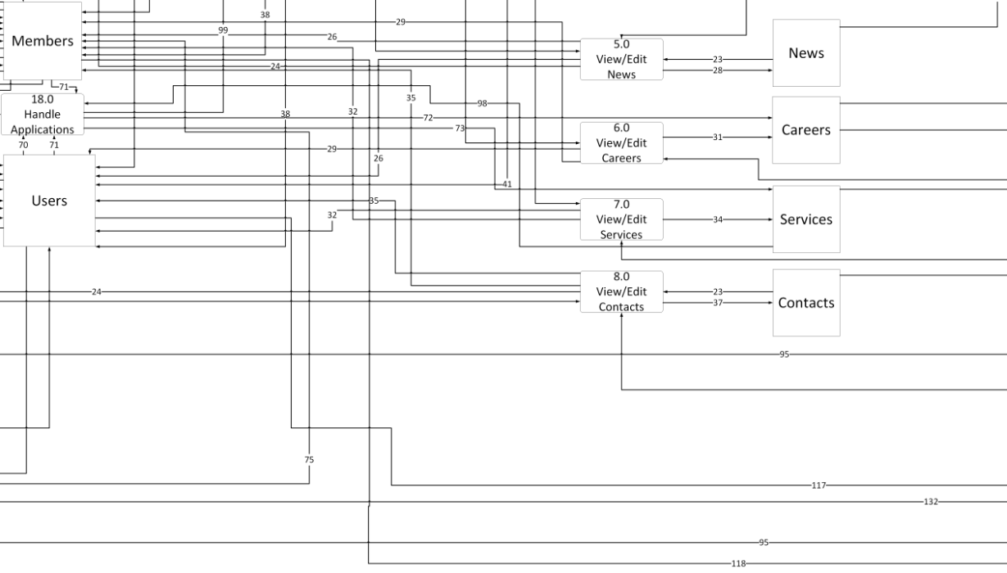
Level-0 Data FLow Diagram (Part 4)

Slide 34
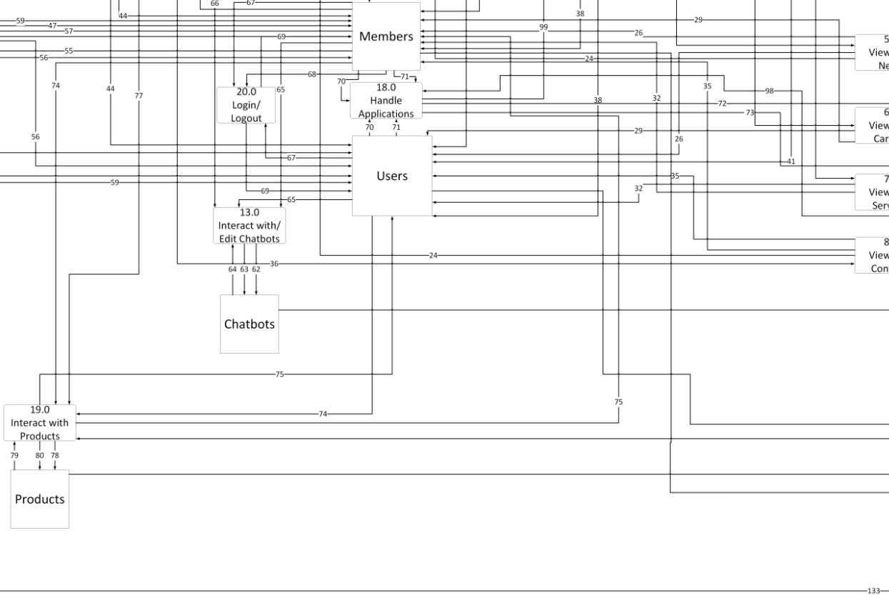
Level-0 Data FLow Diagram (Part 5)

Slide 35
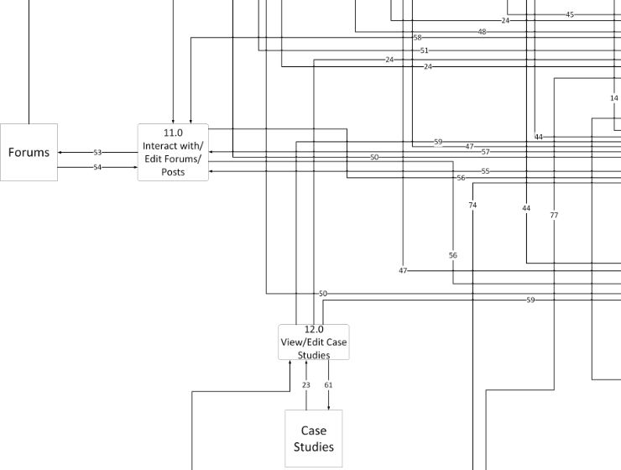
Level-0 Data FLow Diagram (Part 6)

Slide 36
Legend
View/Edit Tools
38. View Tools
39. Edit Tools
40. Receive Tools Edits
23. Verify Edits
24. Receive Verification
View/Edit Projects
41. View Projects
42. Edit Projects
43. Receive Projects Edits
23. Verify Edits
24. Receive Verification
View/Edit Demos
44. View Demos
45. Edit Demos
46. Receive Demos Edits
23. Verify Edits
24. Receive Verification
Maintain Servers
15. Update Servers
16. Request Server Status Report
17. Receive Server Updates
18. Receive Server Status
19. Send Server Status
20. Run Server Status Checkup
View/Edit Clients
21. View Clients
22. Edit Clients
23. Verify Edits
24. Receive Verification
25. Receive Clients Edits
View/Edit News
26. View News
27. Edit News
23. Verify Edits
24. Receive Verification
28. Receive News Edits
View/Edits Careers
29. View Careers
30. Edit Careers
31. Receive Career Edits
View/Edit Services
32. View Services
33. Edit Services
34. Verify Edits
View/Edit Contacts
35. View Contacts
36. Edit Contacts
37. Receive Contact Edits
23. Verify Edits
24. Receive Verification
Execute Protocols
1. Run TCP/IP
2. Run FTP
3. Receive TXT
4. Receive DOC
5. Run HTTPS
6. Run SMTP
7. Run COP
8. Run Telenet
9. Run Usenet
View/Edit/Remove Users/Members
10. View Members
11. View Users
12. Remove Users
13. Remove Members
14. Edit Profile

Slide 37
Legend (cont)
68. Logout
69. Deny Login
40. Receive Tools Edits
Handle Applications
70. Apply for Careers
71. Apply for Services
72. Receive Job Apps
73. Receive Service Apps
98. Send Service Apps to System Administrators
99. Receive Service Apps
Interact with Products
74. Buy Products
75. View Products
76. Review Products
77. Edit Products
78. Receive Products Edits
79. Sell
80. See If In Stock
View/Edit Industries
47. View Industries
48. Edit Industries
49. Receive Industries Edits
23. Verify Edits
24. Receive Verification
View/Edit Awards
50. View Awards
51. Edit Awards
52. Receive Awards Edits
23. Verify Edits
24. Receive Verification
Interact with/Edit Forums and Posts
53. Receive Edits
54. Flag posts
55. Comment on Thread
56. View Forums
57. Create New Thread
58. Edit Forums/Posts
View/Edit Case Studies
59. View Case Studies
60. Edit Case Studies
61. Receive Case Studies Edits
23. Verify Edits
24. Receive Verification
Interact/Edit Chatbots
62. Receive Chatbots Edits
63. Retrieve Answers from Answer Bank
64. Respond to User/Members
65. Interact with Bots
66. Edit Bots
Login/Logout
67. Signup/Login

Slide 38
Legend (cont)
Process/Maintain Database Info
81. Implement Maintenance Procedures
82. Receive Maintenance Procedures
83. Send Forums/Posts to Database
84. Send Awards to Database
85. Send Industries to Database
86. Send Demos to Database
87. Send Tools to Database
88. Send Projects to Database
89. Send Clients to Database
90. Send News to Database
91. Send Careers to Database
92. Send Job Applications to Database
93. Send Services to Database
94. Send Contacts to Database
95. Send Chatbot Interactions to Database
96. Send Products to Database
97. Send Case Studies to Database
100. Store Forums/Posts
101. Store Awards
102. Store Industries
103. Store Demos
104. Store Tools
105. Store Projects
106. Store Clients
107. Store News
108. Store Careers
109. Store Job Applications
110. Store Contacts
111. Store Chatbot Interactions
112. Store Services
113. Store Products
114. Store Case Studies
115. Store Members
116. Store Users
117. Send Users to Database
118. Send Members to Database
119. Send Users List to System Administrators
120. Send Members List to System Administrators
121. Send Forum/Posts Reference
122. Send Awards Reference
123. Send Industries Reference
124. Send Demos Reference
125. Send Tools Reference
126. Send Projects Reference
127. Send Clients Reference
128. Send News Reference
129. Send Careers Reference
130. Send Services Reference
131. Send Contacts Reference
132. Send Products Reference
133. Send Case Studies Reference

Slide 39
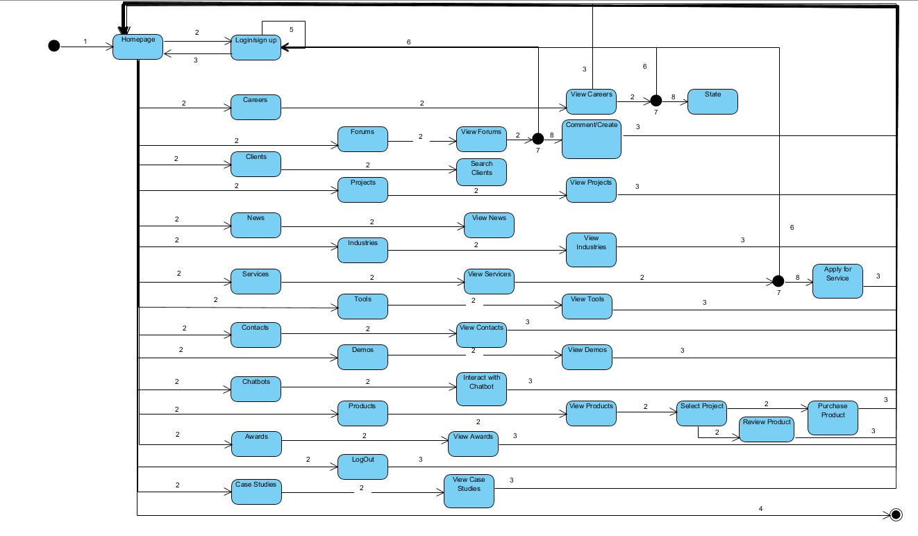
State Transition Diagram
Legend:
Enter
Left single Click
Go to Homepage
Exit
Invalid Login
Go to Login
if(!login)
Proceed
Tool Used:
Visual Paradigm

Slide 40
Software Architectural Model Used
The Software Architecture model that we will be using is a Data Centered one because all of the Products, Tools, Demos and Forum posts will be stored on a centralized database in which Clients, Users and Members will be able to retrieve it from.

Slide 41
SW Architectural Model
Members/User
Software
Members/User
Software
Members/User
Software
Website
Database
Members/User
Software
Members/User
Software
Members/User
Software

Slide 42
Software System Hierarchical Design Model
Website for mid sized software/IT company :
Databases
GUI
Servers
Protocols
Security
Products:
- Product ID
Name
Price
Type
Description
Tools:
- Version
Name
Provider
Type
ID
Databases:
- Products
Tools
Users
Members
Services

Slide 43
Software System Hierarchical Design Model 3
Labels:
Color
Font
Position
Typeface
Size
Check Boxes:
- Size
Position
Status
Background Color
Border color
Drop Downs:
- Position
Font Type
Background Color
Frame
Text Boxes:
- Size
Shape
Background Color
Font
Text Color

Slide 44
Software System Hierarchical Design Model 4
Servers:
Status
Port Number
Host
Uploads
Admin
Status:
Availability
Enabled
Disabled
On
Off
Port:
Number
Location
Availability
State
Name
Host:
Name
Number
Location
Availability
Permissions

Slide 45
Software System Hierarchical Design Model 5
Uploads:
- Size
File type
Location
Description
Address
Admins:
- Permissions
Name
Location
ID
Email
Protocols:
- Certification
Domain
Port Number
Network
Location
Certifications:
Version
Serial Number
Issuers
Keys
Subject

Slide 46
Software System Hierarchical Design Model 6
Domain:
Name
Type
Description
Range
Policies
Port Numbers:
Status
Length
Size
Range
Availability
Network:
Status
Speed
Size
Range
Availability
Location:
Assignments
Address
Name
Origin
Availability

Slide 47
Software System Hierarchical Design Model 7
Protocols:
Certification
Domain
Port Number
Network
Location
Certifications:
Version
Serial Number
Issuers
Keys
Subject
Security:
Protocols
Certificates
Cookies
Status
Firewall
Cookies:
Domain
Path
Interval
Location
Interval

Slide 48
Software System Hierarchical Design Model 8
Firewall:
- Stability
Status
Packets
Protocols
Plugins
Status:
Availability
Enabled
Disabled
On
Off

Slide 49
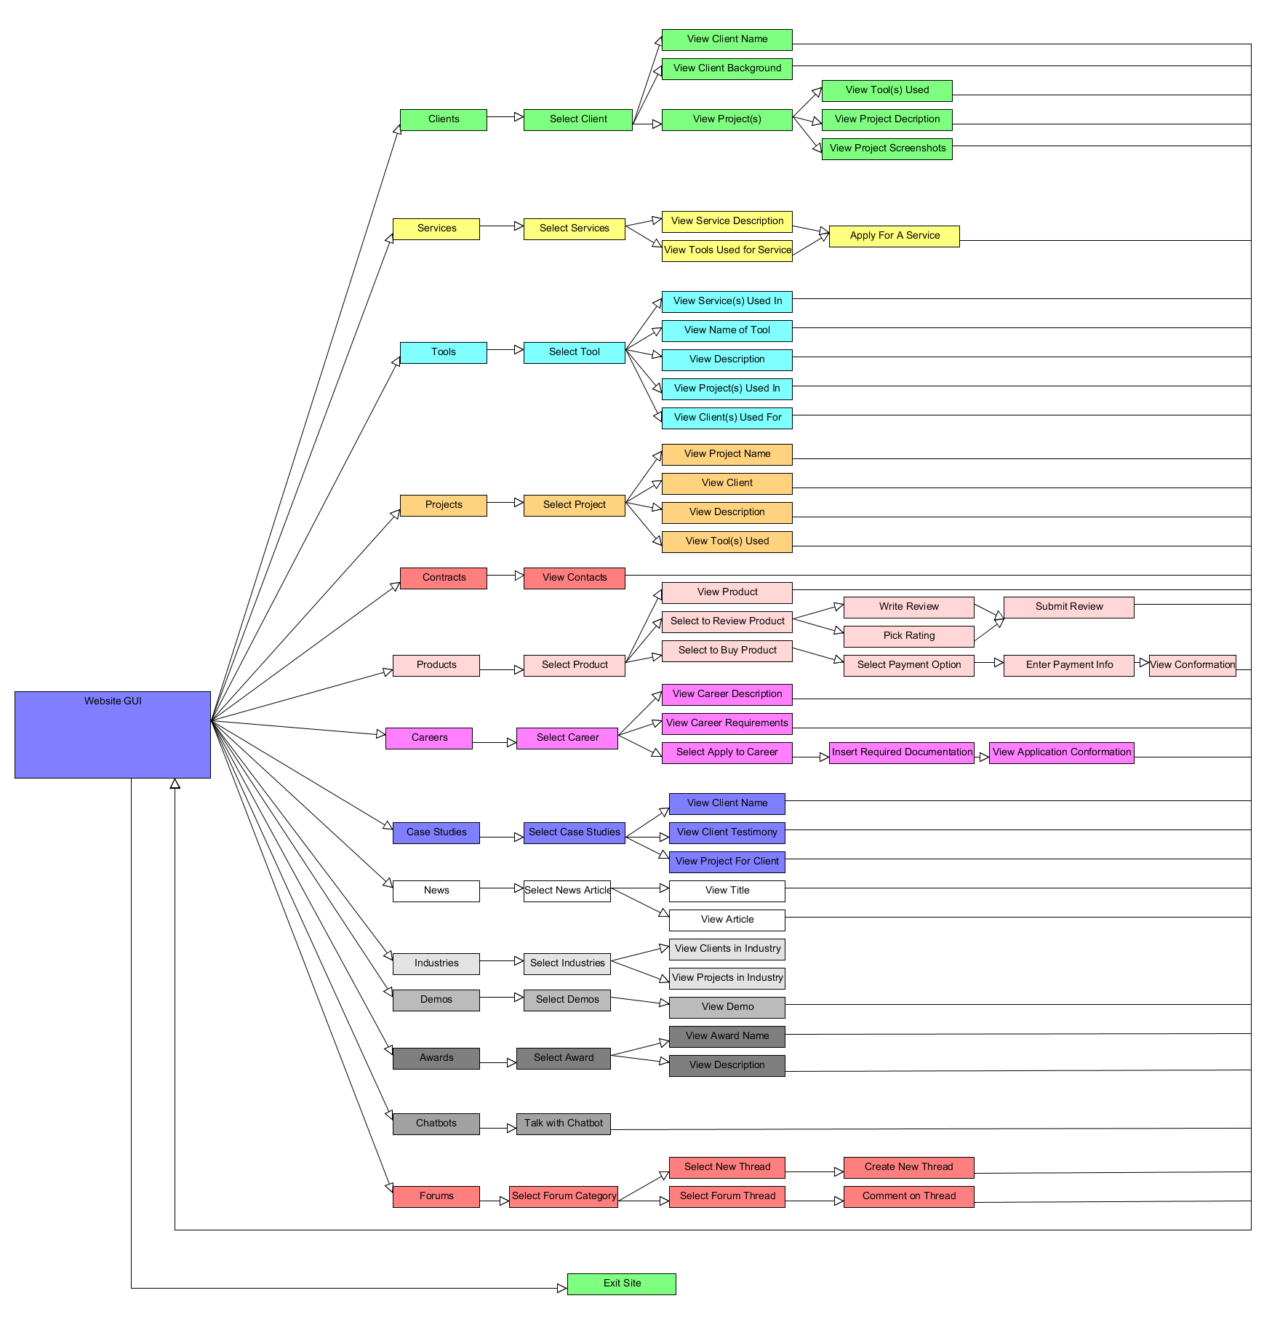
Hierarchical GUI Design Model (Function View)
1 2 3 4 5 6 7
Tool Used:
UMlet

Slide 50
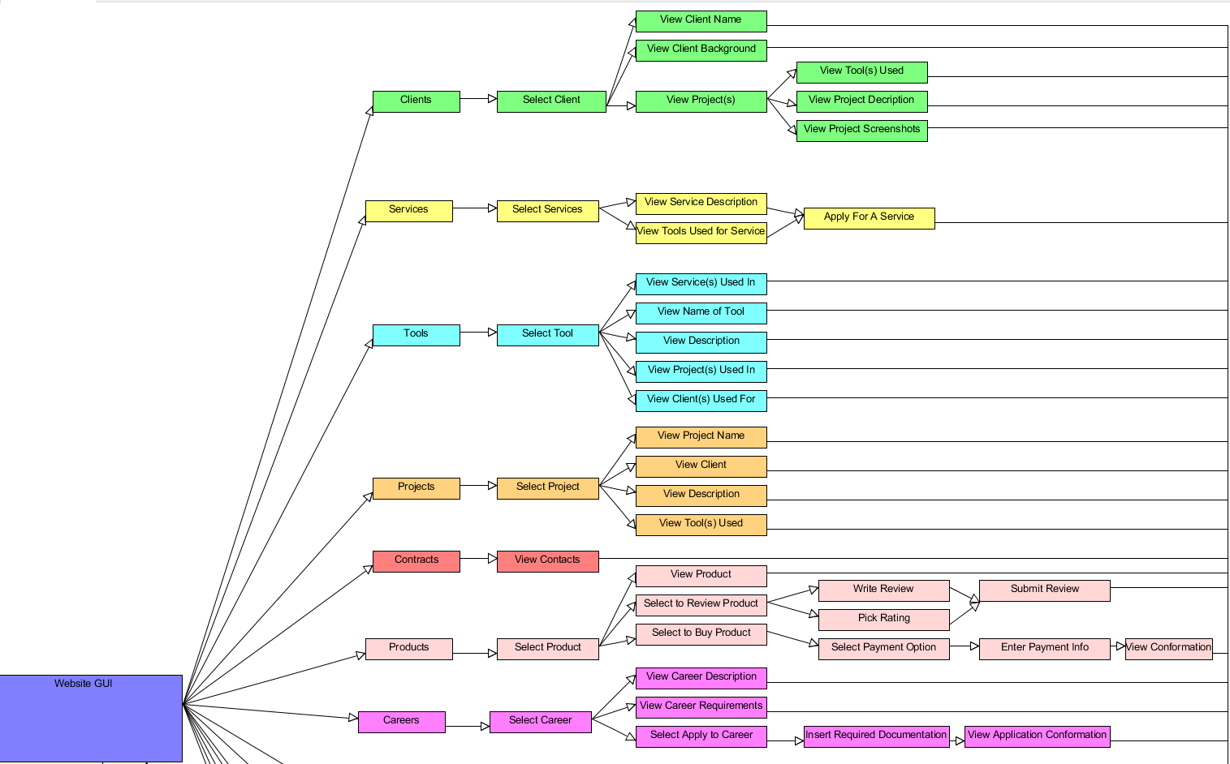
Hierarchical GUI Design Model (part 1)
1 2 3 4 5 6 7

Slide 51
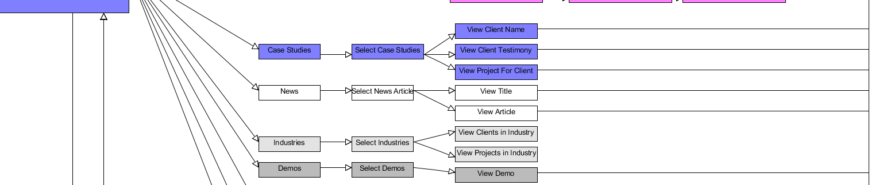
Hierarchical GUI Design Model (part 2)

Slide 52
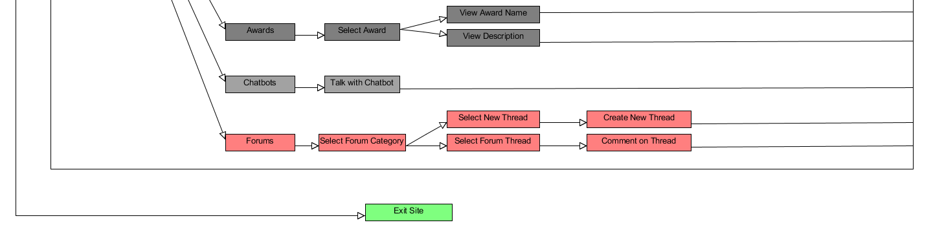
Hierarchical GUI Design Model (part 3)

Slide 53
LOC-Based Estimations
Functions in Web based System | Estimated LOC
User Interface | 2,300
Two-dimensional geometric analysis | 5,300
Database management system | 3,300
Computer Graphics Display Functions | 4,300
Control Peripherals | 2,100
Total Lines of Code | 17,300

Slide 54
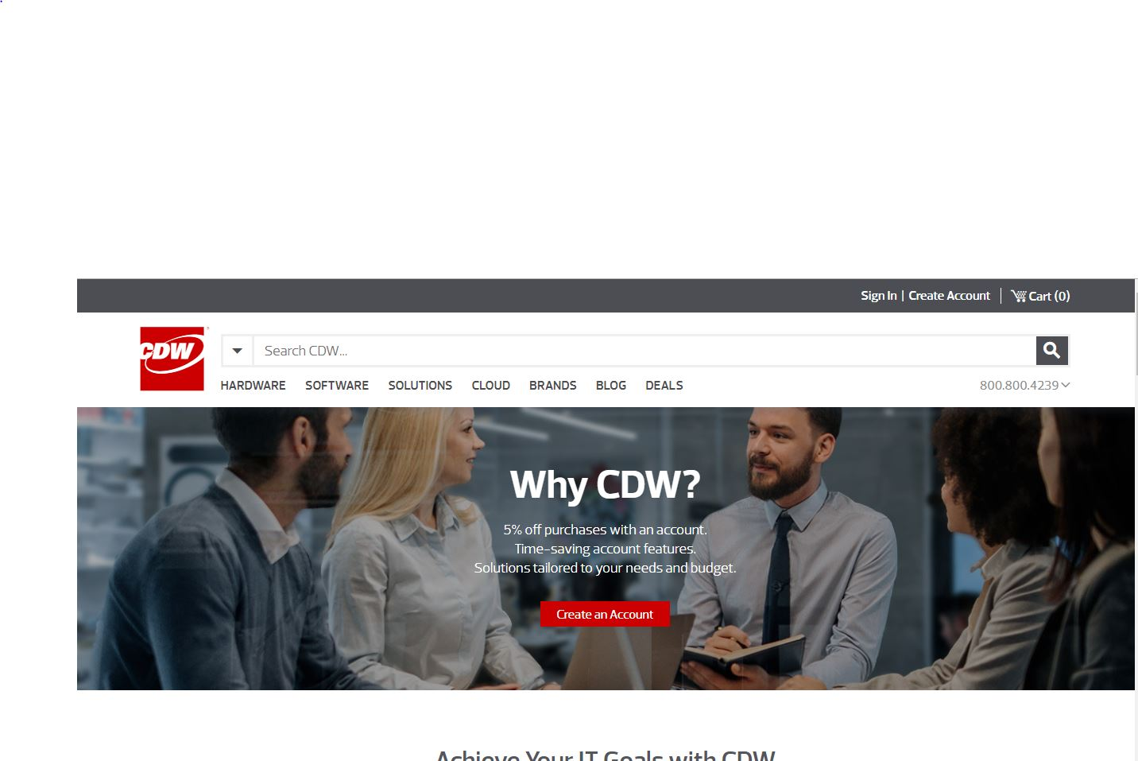
CDW
Class Objects
Hardware
Software
Solutions
Cloud
Brands
Blogs
Deals
Accounts
Clients
Orders
Careers
Events
Locations
Investors
Products
Leasing
Profiles
Privacy policy
Benefits
Searches
Functions:
View Clients
Buy products
View Products
View Careers
View Accounts
Sign Up
View Events
View Orders
Place Orders
View Locations
View Profiles
View Policies
View Benefits
Search Careers
Place Leasing
View Terms and Conditions
Client sign up
Apply for jobs
View Brands
View Investors

Slide 55

SWC Technology Partners
Class Objects
Services
Clients
Support
News
Awards
Careers
Contacts
Subscriptions
Videos
Blogs
Reports
Analytics
Collections
Financials
Privacy
Searches
Contact Info
Customers
Infrastructures
Insights
Functions:
View Services
View Clients
Contact Support
View news
View Awards
View Careers
Apply to Careers
View Subscription
Subscription signups
View Blogs
View reports
Contact Staff
View Collections
View FInancials
View Privacy Policy
Service Sign up
Client feedback
View Infrastructure
View Insights
View Analytics
4

Slide 56
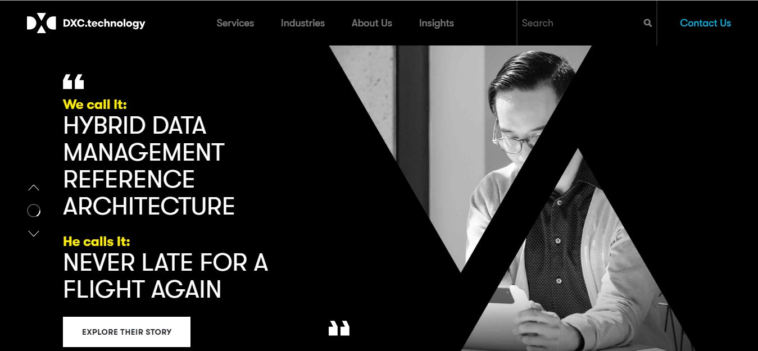
DXC Technology
Class Objects
Services
Insights
History
Events
Careers
Case Studies
Blogs
Podcasts
Locations
Surveys
Distributors
Markets
Relations
News
Events
Industries
Clients
Contacts
Apps
Values
Functions:
View Services
View Insights
View History
View Events
View Careers
View Blogs
Listen to Podcasts
View Locations
View Surveys
View Markets
View Relations
View News
Apply to Careers
View Industries
Contact Staff
Contact Clients
View Apps
View Values
View Distributors
View Case studies
5

Slide 57
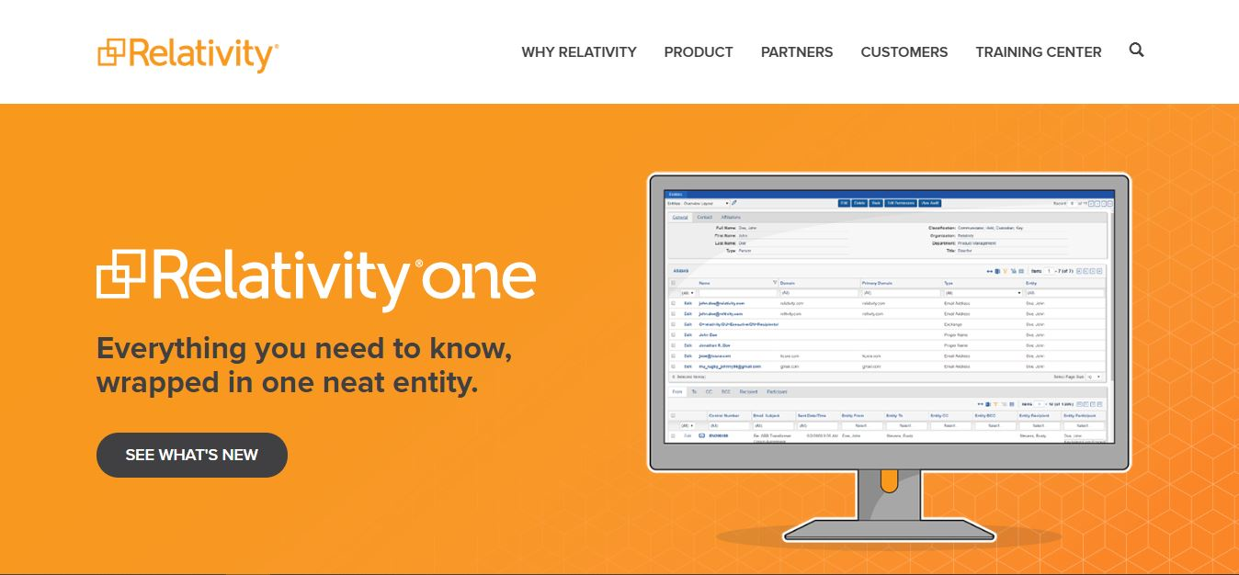
Relativity Software
Class Objects
Products
Partners
Customers
Training Centers
Careers
News
Events
Support
Educations
Clients
Communities
Models
Demos
Privacy
Apps
Hubs
Searches
Cases
Admins
Certification
Functions:
View Services
View Partners
View Classes
View Events
View Careers
View Blogs
View Products
View Locations
View Communities
View Demos
Contact Support
View News
Apply to Careers
View Privacy
Contact Staff
Contact Clients
View Apps
View Values
View Admins
View Case studies
6

Slide 58

Analytics 8
Class Objects
Services
Technologies
Experiences
Blogs
Resources
Events
Offices
Webinars
Blogs
Insights
Subscriptions
Careers
Privacy Policy
Schedule
Contacts
Case studies
Articles
Customers
Customer Stories
Products
Functions:
View Services
View Technologies
View Experiences
View Events
View Offices
View Webinars
Subscribe
View News
View Careers
Apply to jobs
View Schedule
View Case Studies
Read Articles
Contant Company
View Products
View Software
Read Stories
View Insights
View Blogs
Register Account
7

Slide 59
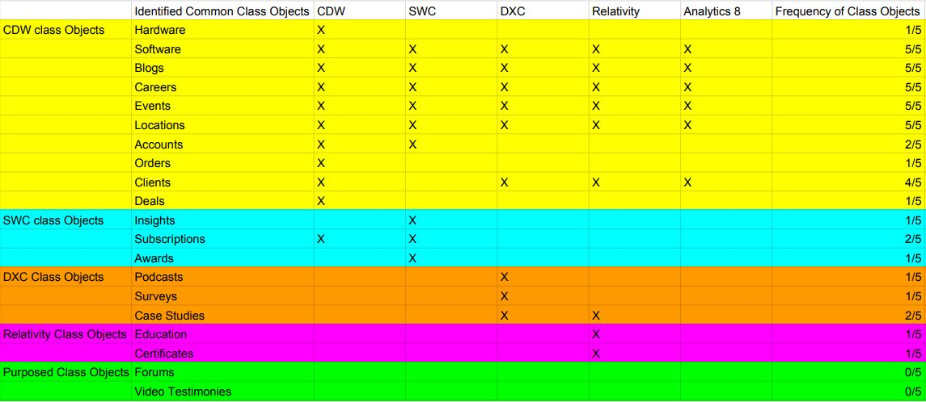
Appendix A.1

Slide 60
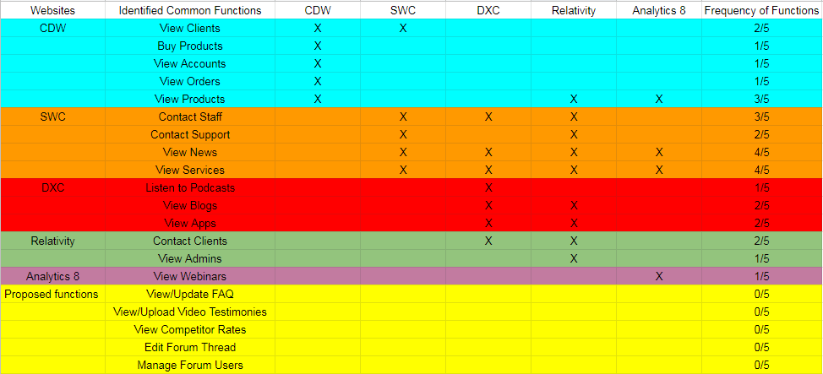
Appendix A.2

Slide 61
Thank You!

