Slide 1


Data Mining and Machine Learning Project 2022
David Hornung & Adrian Muino

Slide 2

Data Mining and Machine Learning Project 2022
01
04
Introduction
Embeding text models
02
05
Basic models
BERT & Tensor model
03
Improved models
06
Conclusion

Slide 3

Introduction

Slide 4
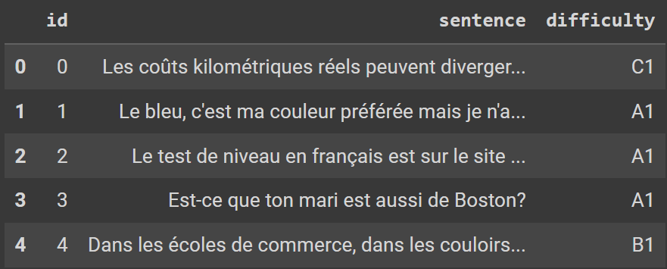
What was the problematic ?
In the context of the course of Data Mining and Machine Learning (Master in Information Systems and Digital Innovation,UNIL) we were asked to make a model to predict the difficulty of French text (A1,A2,B1,B2,C1,C2)
Training data (4’800 unique entries)

Slide 5
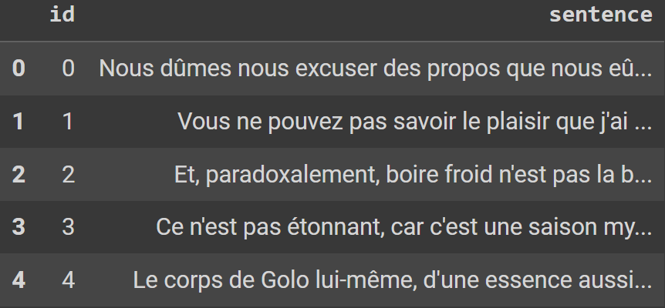
What was the problematic ?
We were asked to submit our result on Kaggle with a CSV files. In return, we got the accuracy of our response.
Test data (1’200 unique entries)

Slide 6
Basic models

Slide 7
Basic models
 | Logistic Regression | Random Forest | K-nearest neighbors | Decision Tree
Accuracy | 0.4666 | 0.4156 | 0.3604 | 0.3000
Recall | 0.4676 | 0.4178 | 0.3616 | 0.2999
Precision | 0.4644 | 0.4267 | 0.3858 | 0.2989
F1_score | 0.4640 | 0.4059 | 0.3360 | 0.2964

Slide 8
Improved models

Slide 9
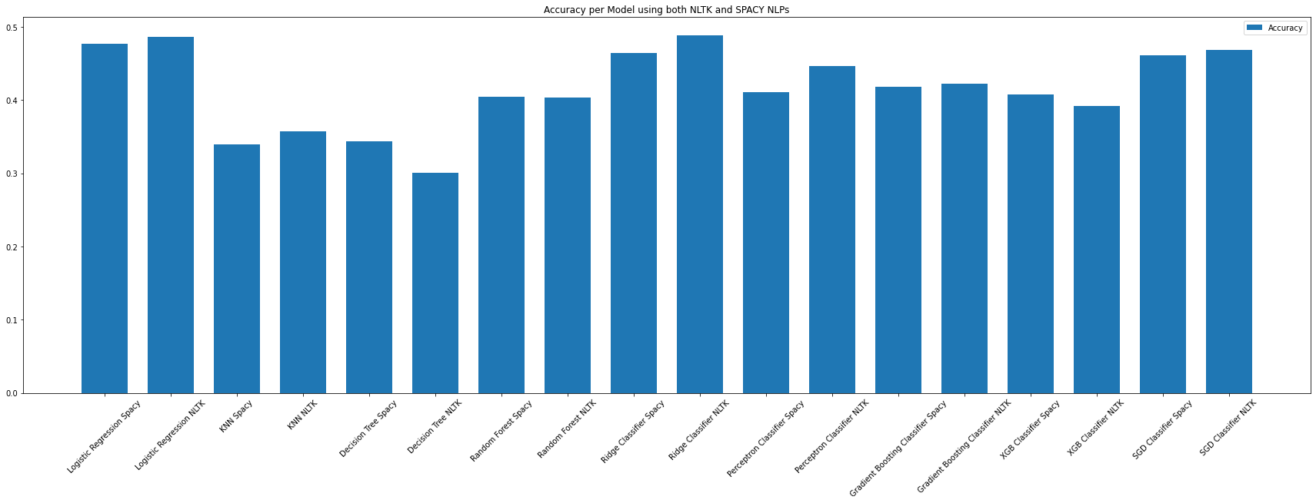
Improved models accuracy

Slide 10
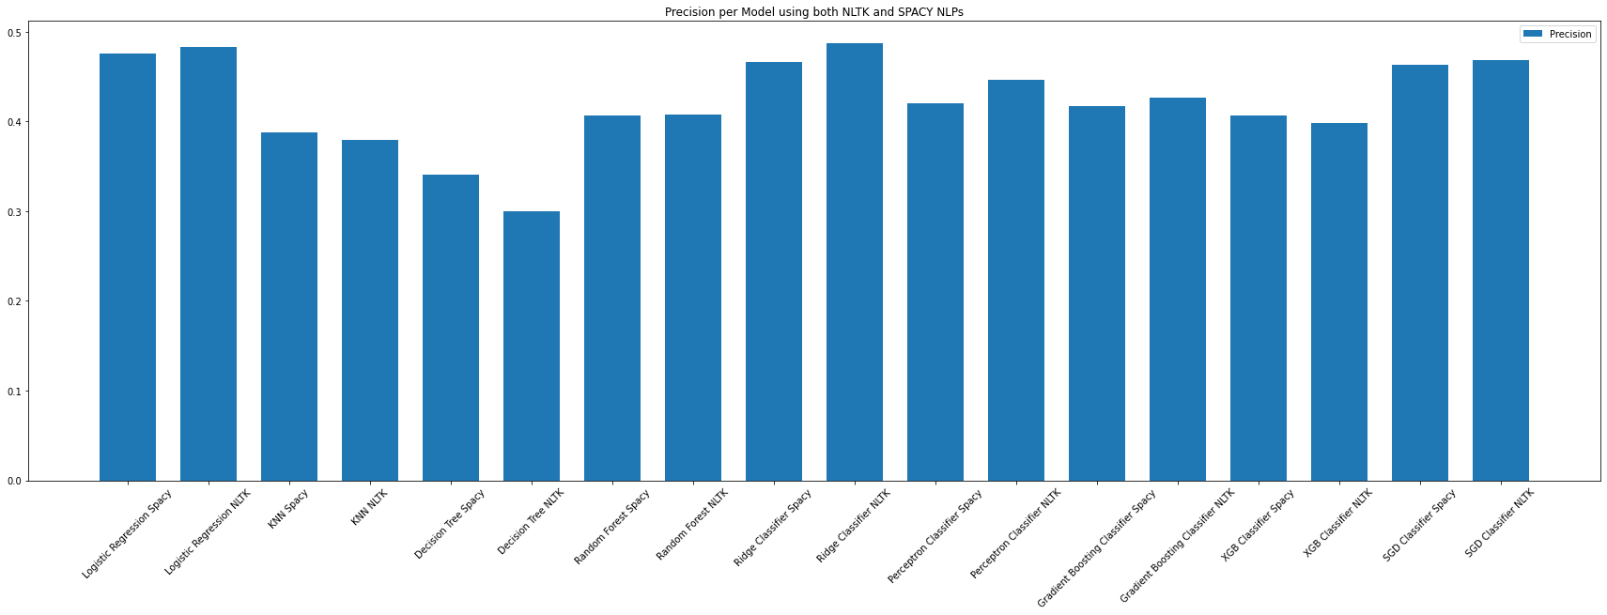
Improved models precision

Slide 11
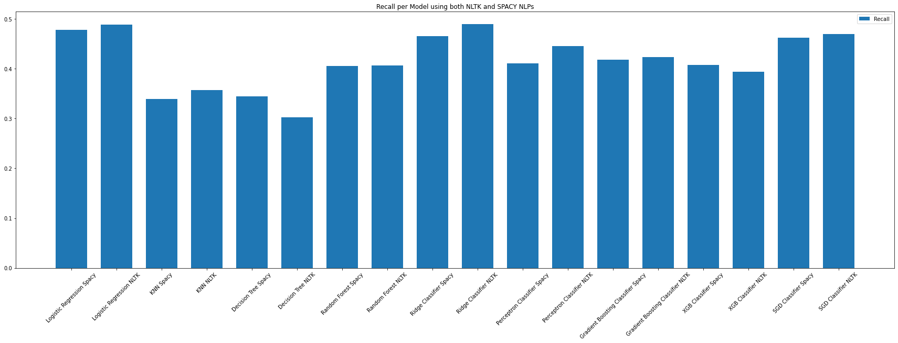
Improved models recall

Slide 12
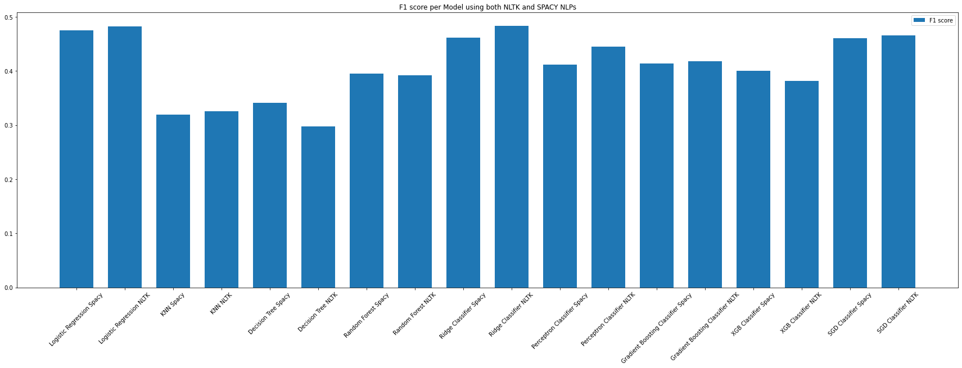
Improved models F1 score

Slide 13
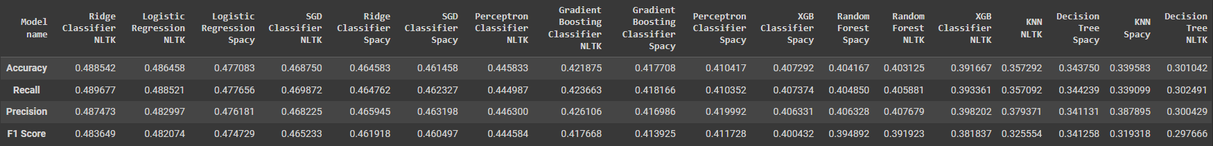
Improved models

Slide 14
Embeding text models

Slide 15
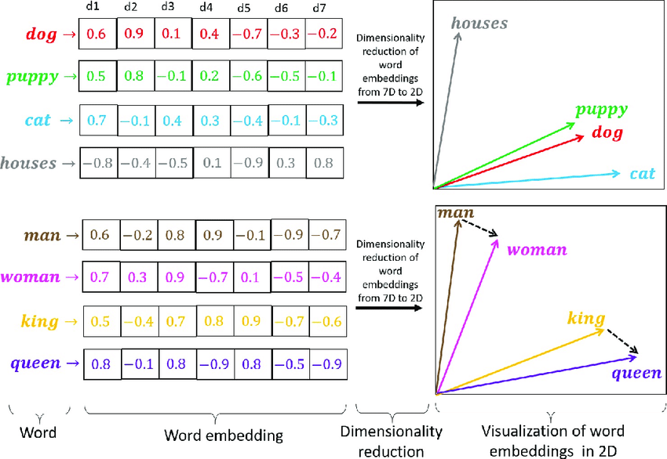
Embeding text models
 | Accuracy | Recall | Precision | F1_score
Logistic Regression | 0.5302 | 0.5313 | 0.5285 | 0.5273

Slide 16
BERT & Tensor model

Slide 17
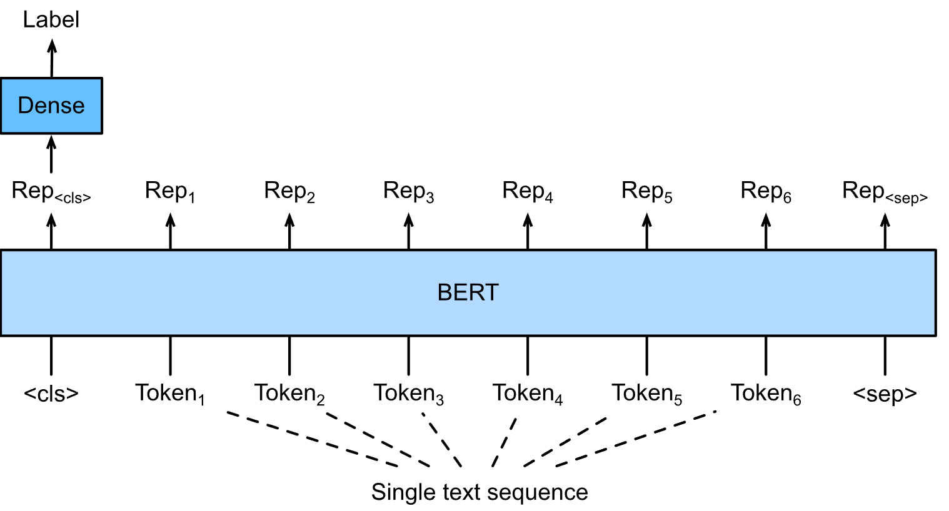
BERT & Tensor models
 | Accuracy | Recall | Precision | F1_score
Bert & Tensor | 0.5704 | 0.3441 | 0.5924 | 0.4306

Slide 18
Conclusion

Slide 19
Conclusion
Our Journey
Nine different classification models were tested in total
We tested two different NLPs (SpaCy and NLTK)
Word Embeddings allowed an improvement of the accuracy
The best model to predict the difficulty levels was the BERT & Tensor model
Overall, this study demonstrates the effectiveness of using BERT models, but also that there are some limitations.

