Slide 1
Document Control Training
Document Number: CHD-CHE-0003
Security Classification: For internal use
Version: 1.0
Status: Final
Source: Atos
Document Date: 10-Jun-2014
Author(s): Hans Müller
Owner: Hans Müller

Slide 2

Agenda
Contents
  Module 1: Background Concepts
  Module 2: Organization & Attributes
  Module 3: Process & Roles
  Module 4: Knowledge Mgmt., Templates & Registries
Questions and Answers session

Slide 3
Training objectives
What you will learn
After this training, you will:
Understand the Atos Document Control Policy (ASM-BMS-1002)
Have the skills & knowledge to execute any role within the Document Control Process
Be able to deploy document control rules and tooling within your unit
Understand how to decide on document control related activities and issues for your unit

Slide 4
Getting started
Two versions to choose from
Choose your version:
Version for:
Document Controllers
Version for:
Users of Document Control

Slide 5
Document Control
Module 1
Background concepts

Slide 6
You will learn
Why use a Document Control System?
Definitions – Document, Regulated Document, Work Document, Record
Differences
  Regulated Document vs. Work Document
  Document vs. Record

Slide 7
Document Control
What is it about and why should you do it?
To deliver consistent services with reproducible quality to (international) customers we need to share information (world-wide) while guaranteeing it’s always controlled and up-to-date.
To save a lot of (hidden) costs of non-quality (and frustration) we have to ensure that documentation used to run our business is not only up-to-date but also reliable, available where it’s needed and protected against misusage.
A lot of norms (ISO-9001, -14001, -20000 and -27001), standards (cGxP), clients (e.g. pharmacy) actually require it from us and want proof that we are in control of our documentation.
Document Control is critical in managing our delivery and helps us to prove to our customers that we are in control so they can meet their regulatory requirements (e.g. cGxP and SOx).
And ultimately …. because of the above, Senior Management has decided to endorse and deploy a Document Control Policy (ASM-BMS-1002) and the associated processes, procedures, templates and tooling.

Slide 8
Definitions (1)
Document
Document
In the context of the Document Control Policy, the term “document” includes policies, strategies, process and procedure descriptions, work instructions, job / role descriptions, forms and templates, etc. used to manage our business.
A document can be in various formats, e.g. Word, PowerPoint, Excel, Visio, PDF, HTML (web-pages) …
A distinction is made between Regulated Documents and Work Documents.
Regulated document
  A regulated document is a strictly managed document required by the Atos Integrated Management System (AIMS).
  It has a controlled lifecycle and is compliant with relevant regulatory requirements. It has the following meta data: a title, document number, security classification, version, status, document (release) date(s), named author(s), named owner and is approved for adequacy prior to release.
Work document
  A work document requires less ‘strict’ document control.
  It has a simplified lifecycle @ the owner’s discretion. A work document has the following meta data: unique identifier, security classification, version, document (release) date(s), named owner.

Slide 9
Definitions (2)
Regulated Documents vs. Work Documents
Regulated Document | Work Document
Strict Document Control | Less strict document control
Mandatory listing in the Master Index | Optional listing in the Master Index
Must follow the CCT-FFF-XXXX format | Unique identification, can be CCT-FFF-XXXX format
Strict version control | Unique identification
Named owner | Ownership indicated (either person, function or unit)
Approved for adequacy prior to use | Approval is optional
Security classification | Security classification
Document (release) date | Document (release) date
Reviewed ≤ 2 years | Reviewed when necessary
‘Review before’ date (optional) | -
‘Retain until’ date (withdrawn doc, optional) | -
Compulsory storage in Electronic Document Management System | Optional storage in Electronic Document Management System

Slide 10







Definitions (3)
Record
Record
A record is a document stating results achieved or providing evidence of activities performed. Records can be used, for example, to document traceability and to provide evidence of verification, preventive action and corrective action. Generally, records need not be under revision control.
Indicators
Controls
Inputs
PROCESS
Outputs
Procedures
Resources
¹ ISO 9001:2008

Slide 11
Definitions (4)
Documents vs. Records
Document | Record
Describes what must be done | Describes what has happened
Has a (managed) lifecycle | One-off piece of evidence (e.g. of process execution and/or for assurance purposes)
Subject to change | Cannot and may not be changed
Used regularly (e.g. daily) | (Historical) Snapshot
Document control applied | Uniquely identified
Design of processes, work, services, etc. | Traceable evidence of (process) execution

Slide 12
Definitions (5)
Documents vs. Records: Graphical
Records
(output from DC-process)
Signed documents, scanned documents, old versions
Work documents
Contracts, presentations, project documentation, portfolio docs
2
records
Work documents
documents
3
4
Regulated documents
1
Records
(output from a general process)
Screen prints, SLA reports, outcome of CSAT surveys, information in systems (USD/CMIS)
Regulated documents
e.g. MSOs, policies, process, procedures, work instructions, forms, templates, organization charts, design documents

Slide 13
QUIZ 1
Lessons learned
Q1: This document is traceable evidence from (process) execution.
A1: RECORD
Q2: This document has a simplified lifecycle.
A2: WORK DOCUMENT
Q3: This document requires a mandatory listing in the Master Index.
A3: REGULATED DOCUMENT
Q4: This document does not require approval prior to use.
A4: WORK DOCUMENT
Q5: This document is a historical snapshot.
A5: RECORD
Q6: This document requires a named owner.
A6: REGULATED DOCUMENT

Slide 14
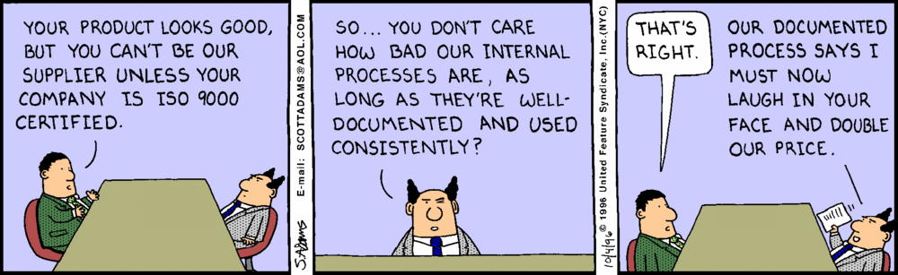
Quality Joke 1
“Reset the mind”

Slide 15
Document Control
Module 2
Organization & Attributes

Slide 16
You will learn
Document Types
Attributes – document number, security classification, version & status, review date, responsibilities of document owner

Slide 17
Document framework & types
A Pyramid
Why & What
(e.g.: business plan, mission, vision,
policy, strategy, MSM/MSO….)
M
Management
High business impact
& low volume →
tight control, approval
Records
How & Who
& When
P
Process
Procedure
J/R
Job- & Role
Descriptions
Very high volume
& key for providing
assurance and
proving compliance
(creation & storage only)
Detail &
support
W
Work
Instructions
F
Forms,
Templates
D
Other
Documents
Lower business impact
& high volume → less control

Slide 18
Document types
Naming the Pyramid
Type | Sort of document | Regulated document? | Approval | Approver table | Comment
CCM | Policy, directives guidelines | YES | YES | YES | Management System documentation
CCP | Process, Procedure | YES | YES | YES | (delegated) Owner
CCW | Work instruction | YES | YES | OPTIONAL | Subject Matter Expert
CCJ | Job description | YES | YES | YES | Hierarchical / HRM manager
CCR | Role description | YES | YES | YES | Process Owner
CCF | Forms & Templates | OPTIONAL | OPTIONAL | NO | Includes “checklists”
CCD | ‘Other document’ | OPTIONAL | OPTIONAL | OPTIONAL | By default a Work document. Regulated document when listed in Master Index

Slide 19
Minimum set of attributes (1)
General
For M/P layer documents required for Management and Delivery, incl. but not limited to all Policy-, Process- and Procedure-related documents, are controlled in accordance with the document control procedure referenced in the respective MSOs. As a minimum, they require a(n):
  Title
  Document Number
  Security Classification
  Version
  Status
  Document Date
  Author(s)
  Owner
  Review date set to a minimum of once every two years
All regulated documents, in addition to the above, must have a Document Control section with:
  Terms and abbreviations
  Target readers
  List of changes
  Approvals (M- and P-layer documents only)
Notes:
Mandatory
Key-message:
If all of us follow these simple rules, we will save a lot of money, frustration and have an easy job in convincing customers and external auditors that we are serious about document control
How to use the slide:
Hand out the Document Control Reference Card (MOF-GEN-0002)
Interaction with trainees:
Discuss the question on the bottom
Examples:
N.A.
Background information:
N.A.

Slide 20
Minimum set of attributes (2)
Document number
Each regulated document must have a unique document number
Regulated documents must be registered in a Master Index by a Document Controller with:
  Document number
  Title
  Status
  Document Owner
  Remarks
Refer to Guidance sheet in ASF-BMS-1000 “Document Control Master Index – Template” for a description of numbering and the usage of the Master Index.
Notes:
Mandatory
Key-message:
If all of us follow these simple rules, we will save a lot of money, frustration and have an easy job in convincing customers and external auditors that we are serious about document control
How to use the slide:
Hand out the Document Control Reference Card (MOF-GEN-0002)
Interaction with trainees:
Discuss the question on the bottom
Examples:
N.A.
Background information:
N.A.

Slide 21
Minimum set of attributes (3)
Document number cont’d
CC | T | -FFF- | XXXX
 |  |  | XXXX is a unique alpha-numeric code per document, issued by the Document Controller and registered in the master index.
 |  | FFF describes the functional area owning the document. The GBU Quality organization maintains the registration of FFF-codes and issues them to respective Document Controllers.
 | The T identifies different types (layers) of documents: M = Management (e.g. policies, strategies, MSO’s); P = Process or Procedure; W = Work instruction; F = Form and Template; J = Job description; R = Role description; D = Other Document.
The CC codes identify the highest ranges within the registration and are issued by the Group Quality Steering Committee. Specific codes related to the global organization are defined: AS for Atos corporate MS for Managed Services SI for Systems Integration HT for HTTS Codes related to the countries follow the ISO3166-1(alpha-2) standard. Special non-conflicting GBU codes have been allocated.

Slide 22
Minimum set of attributes (4)
Security Classification
Each regulated document must have a Security Classification on every page
An Owner is accountable for classifying information.
  The creator of information is responsible for assigning a classification to it as soon as the information is created.
  This immediate classification assists any recipient of the information to use appropriate measures to safeguard its value to the company against unauthorized disclosure, loss of availability, or loss of integrity.
  Owners of information are managers or management representatives, under whose responsibility the information has been created.
  Owners determine where, how an by whom information may be used.
  Owners may delegate authority to grant access to the information to other Atos employees
Refer to ASM-SEC-0003 Information Classification Policy for a description of the Security Classifications:
  Public
  For internal use (default one)
  Confidential
  Secret
Notes:
Mandatory
Key-message:
Secret documents must have the recipient list that details target readers’ names and surnames.
Confidential documents must have the recipient list that refers to at least a defined functional group of target readers.
Should you receive a classified information you may not forward it without formal consent of the original sender.

Slide 23
Minimum set of attributes (5)
Version & status
Each regulated document must have a version identifier on every page
  Before final review, the document version is set to:
  either an X.Y version number (in case of minor changes such as clarifications, format changes, (typographic) corrections, customizing organization names etc.) or
  an X.0 version number (in case of large or essential changes)
Each regulated document must have a status (Draft or Final) on the title / description page
  After final review:
  the document status is set to “Final” and
  the document is approved by the people listed in the approval table.

Slide 24
Minimum set of attributes (6)
Responsibilities of the Document Owner
Each regulated document must have a Named Owner
The owner is not just a person mentioned on the document; (s)he is also accountable for:
  Why and when to create / review / approve a document and by whom
  The content of the document
  Application of agreed document control rules, incl. version history.
  Which target readers should read this document
  How, where and by what medium to distribute or publish; who should have what access to this documentation
  The data classification of the document (public, for internal use, confidential, secret)
  When to withdraw a document and how long to archive and where
Responsible to ensure that the target readers can execute what is defined in the document (e.g. a procedure or work instruction); this includes (when needed):
  Allocating budget and taking other measures to ensure sufficient resources are made available
  Granting target readers required authorizations
  Training target readers
  Keeping them informed of changes
Notes:
Key-message:
Ownership can not be delegated, it is key for document control and requires some good management skills and experience to work
How to use the slide:
Before showing the slide, brainstorm with the group a list of responsibilities from a document owner. Then compare with the list on the slide
Alternatively simply discuss centrally the points on the slide
Examples:
The owner of document control has to ensure that the rules set in the procedure document can also be implemented in practice; this means amongst others:
Training for document controllers
Maintaining a documentation package explaining what document control means and how to use procedures, tooling and (virtual) organization
Ensuring right tooling is made available
Background information:
N.A.

Slide 25
Minimum set of attributes (7)
Review date
Each regulated document must have a review date set to a minimum of once every two years
Refer to MSP-GEN-0002 Procedure Document Control for a description of the review cycle of managed documents

Slide 26
QUIZ 2
Lessons learned
Q1: How often should a regulated document be reviewed?
A1: @ Minimum once every two years
Q2: How does the version number of a document change when you make significant changes to it.
A2: It changes into X.0 number.
Q3: What does the FFF code describe?
A3: It describes the functional area owning the document.
Q4: Who is accountable for classifying information?
A4: The Owner
Q5: What is the default security classification?
A5: For internal use

Slide 27
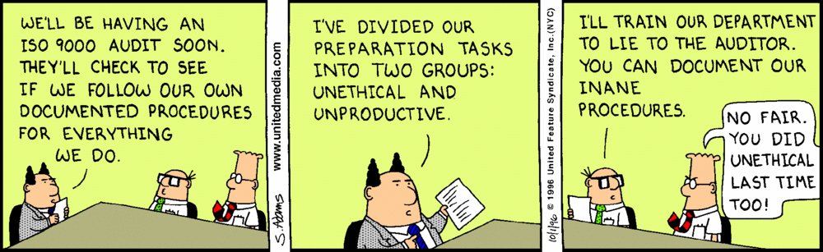
Quality Joke 2
“Reset the mind”

Slide 28
Document Control
Module 3
Process & Roles

Slide 29
You will learn
Document lifecycle
Roles – document controller, document owner, author, reviewer, QA reviewer, target reader.

Slide 30


Document lifecycle
Review
Document
Modify
Document
Approve
Document
Archive
Withdraw
Document
Create
Document
Publish
Document
Distribute
Document
Acquire
Information
Identify
Need
Use
Document
Plan
Document

Slide 31
Regulated document creation process flow
Document Controller
Document Manager
Document Owner
Author
Reviewer
Reviewer (Quality)
Create entry in Master Index
Reserve number
Update Master Index
Regulated document ?
Request to Document Controller
Formulate task
Decide on Target Readers
Decide on publication media / method
Approve
(content & publication)
Publish in EDMS
Write document
(status: Draft)
Process comments
Process comments
Give document status “Final”
Comment on content
Comment on Quality aspects

Slide 32
Roles (1)
Document Controller
Overall
Document Controller
Regulated documents
Document Manager
Document Owner
Author
(QA)Reviewer
Target Reader
Work documents
Document Owner
The Document Controller is responsible for:
creating entries in Master Index for new documents
maintaining the Master Index for documents in his/her responsible area (i.e. Master Range)
monitoring of document relevant attributes (e.g. status, reviews etc.)
supporting the Document Managers and other responsible persons in the business units when dealing with regulated documents

Slide 33
Roles (2)
Document Manager (new for Atos CH)
Overall
Document Controller
Regulated documents
Document Manager
Document Owner
Author
(QA)Reviewer
Target Reader
Work documents
Document Owner
The Document Manager is responsible for:
identifying documents to be regulated within his/her department;
requesting an entry in the Master Index at his/her department level;
providing Document Controller with necessary document information.
supporting the responsible persons within the department when dealing with regulated documents

Slide 34
Roles (3)
Document Owner
Overall
Document Controller
Regulated documents
Document Manager
Document Owner
Author
(QA)Reviewer
Target Reader
Work documents
Document Owner
The Document Owner is accountable for:
the full document lifecycle with proper document control;
the content of the document;
appointing Author(s) and (QA) Reviewer(s);
the preparation of training material (when necessary),
the distribution and communication (methods) to the Target Readers;
approving and authorizing documents for publication and deployment.
withdrawing the document from publication or deleting them according to defined retention periods
The Document Owner may delegate tasks but remains overall accountable.

Slide 35
Roles (4)
Author
The Author is appointed by the Document Owner and is responsible for:
creating draft - and final version(s) of the document;
Supporting the Document Owner in assessing review information.
Overall
Document Controller
Regulated documents
Document Manager
Document Owner
Author
(QA)Reviewer
Target Reader
Work documents
Document Owner

Slide 36
Roles (5)
(QA) Reviewer
The Reviewer is appointed by the Document Owner and is responsible for:
reviewing draft versions of the document from a content perspective.
Overall
Document Controller
Regulated documents
Document Manager
Document Owner
Author
(QA)Reviewer
Target Reader
Work documents
Document Owner
The QA Reviewer is appointed by the Document Owner and is responsible for:
reviewing (final) draft versions of the document for application of correct document control.

Slide 37
Roles (6)
Target Reader
The Target Reader has to:
understand the impact of the (changed) content on him/her;
receive training (where needed) to ensure that he/she is capable of handling the consequences of the (changed) content (e.g. adjusted procedures or work instructions) in time.
Overall
Document Controller
Regulated documents
Document Manager
Document Owner
Author
(QA)Reviewer
Target Reader
Work documents
Document Owner

Slide 38
Roles (7)
Document Owner (of Work Documents)
The Document Owner is accountable for:
the full document lifecycle;
the content of the document;
giving a unique identification and document date to the work document.
Overall
Document Controller
Regulated documents
Document Manager
Document Owner
Author
(QA)Reviewer
Target Reader
Work documents
Document Owner

Slide 39
QUIZ 3
Lessons learned
Q1: Who is accountable for the full document lifecycle?
A1: DOCUMENT OWNER
Q2: Who deletes documents and records according to defined retention periods?
A2: DOCUMENT CONTROLLER
Q3: Who reviews the (final) draft versions of the document for application of correct document control?
A3: QA REVIEWER
Q4: Who reviews content of regulated documents?
A4: REVIEWER
Q5: Who creates draft - and final version(s) of the document?
A5: AUTHOR
Q6: Which role is better – document controller or author?
A6: DOCUMENT CONTROLLER ☺

Slide 40
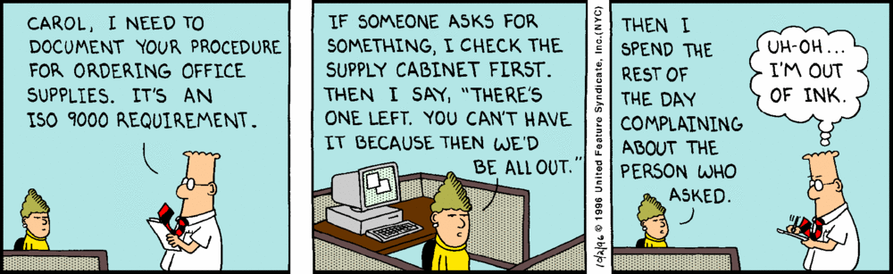
Quality is fun
“Reset the mind”

Slide 41
Document Control
Module 4
Knowledge Mgmt., Templates & Registries

Slide 42
You will learn
Where to find and how to use Templates
How and where to Register regulated documents.

Slide 43




Knowledge Management Model
Content:
Document Lifecycle Management
Collaboration:
people to people
Quality
Security
Classification
Members
Collaboration Management
(shared environments, repositories)
VALIDATION
Document Control (Electronic Document Management System)
Users
Deployment
Guests
users using knowledge for improvement
Owners
Notes:
Knowledge-sharing environment: Goal: share knowledge & find good practices
Supporting EDMS functionality:
Communities when there is no end-date
Virtual teams, network of professionals, knowledge teams….
Project spaces when there is an end date
Projects, bids,…
Members are expected to actively contribute if access is granted
Guests are expected to use the knowledge provided in the knowledge sharing environment and apply for membership when active contribution is applicable
Validation:
Knowledge coordinators/material experts/document controllers:
Validates candidate documents (and other information carriers) against agreed rules
Stores validated knowledge at agreed locations & publishes to target parties
Looks continuously for improvements and best practices in usage of knowledge sharing process, organization and tooling (both: knowledge sharing environment as well as managed environment)
Managed environments – principles:
Goal: Guarantee users validated information to work with (up-to-date, relevant, verifiable)
Choices made and documented on:
Policy/strategy/objectives/rules
Document control process including validation
Roles involved, their tasks and authorizations, sufficient skills (trained) and human capacity (budgeted)
Ownership of information
Budgeted support for users (e.g. helpdesks, administrators)
Supporting tooling functionality in EDMS
Permissions
Folder structure
Metadata
Classification
Reports
Preferred usage of EDMS functionality per process step
Choices are owned and maintained based on business needs
Usage:
Further knowledge development in collaboration areas is based on managed knowledge stored in the managed environment

Slide 44
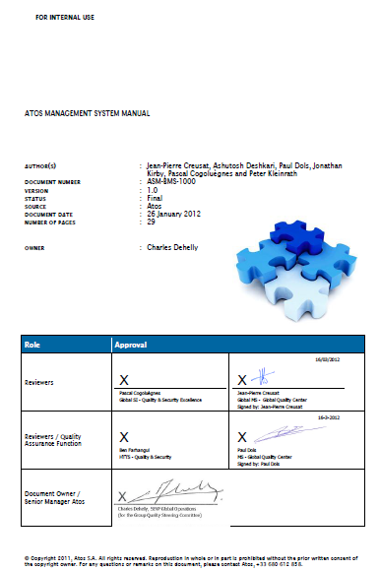
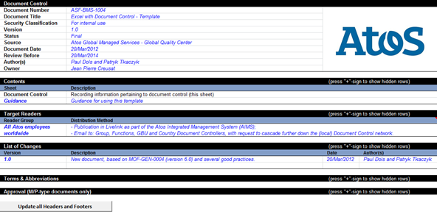
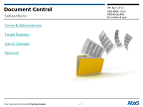
Templates (1)
MS Word, MS Excel and MS PowerPoint
For REGULATED documents in: use:
  MS Word format TEMPO templates
  MS Excel format ASF-BMS-1004
  MS PowerPoint format ASF-BMS-1005

Slide 45
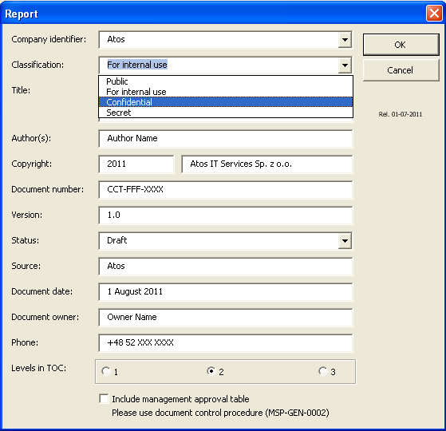
Templates (2)
MS Word
To install TEMPO templates, please follow the instructions on the
  Global Communications page on Source (“Word templates” section).
<(short) demo>
When using standard Atos TEMPO templates you must choose the appropriate (security) classification.
  It will be visible on the title page and
  in header on the other pages of the document.
Assistance?
  Help file (no training material (yet))
  Experienced GBU/Country DCs
  Antoine Venrooij (SME)

Slide 46

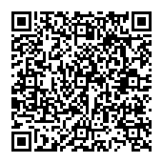
Templates (3)
MS Excel
For each and every Regulated document in MS Excel format, the proper template should be used (ASF-BMS-1004).
Follow the “Guidance” sheet embedded in the above file for additional DC rules in your controlled workbooks.
<(short) demo>
Atos Integrated Management System
(AIMS)

Slide 47
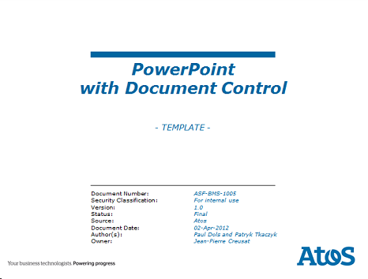
Templates (4)
MS PowerPoint
For each and every Regulated document in MS PowerPoint format, the proper template should be used (ASF-BMS-1005).
Follow “Guidance” notes embedded in the above file for additional DC rules.
<(short) demo>
Atos Integrated Management System
(AIMS)

Slide 48
Registering Documents (1)
Coding Scheme
CC | T | -FFF- | XXXX
 |  |  | XXXX is a unique alpha-numeric code per document, issued by the Document Controller and registered in the master index.
 |  | FFF describes the functional area owning the document. The GBU Quality organization maintains the registration of FFF-codes and issues them to respective Document Controllers.
 | The T identifies different types (layers) of documents: M = Management (e.g. policies, strategies, MSO’s); P = Process or Procedure; W = Work instruction; F = Form and Template; J = Job description; R = Role description; D = Other Document.
The CC codes identify the highest ranges within the registration and are issued by the Group Quality Steering Committee. Specific codes related to the global organization are defined: AS for Atos corporate MS for Managed Services SI for Systems Integration HT for HTTS Codes related to the countries follow the ISO3166-1(alpha-2) standard. Special non-conflicting GBU codes have been allocated.
Notes:
Last Line: no longer true, special CC-codes allocated to whole GBUs. Refer to the Master Range Document!

Slide 49

Registering Documents (2)
Hierarchy
Document Controller
Registry
Corporate
Master Ranges
ASD-BMS-1000
    Document Control - Master Ranges
GBU/Country
Sub-Ranges
ASF-BMS-1008
    Document Control - Sub-Ranges (– Template)
Unit
Individual Documents
ASF-BMS-1000
Document Control – Master Index (– Template)

Slide 50
Registering Documents (3)
Master Ranges (a.k.a. “CC-codes”)
Overview:
  ASD-BMS-1000 Document Control - Master Ranges
As a general rule, CC-codes for countries follow the ISO 3166-1 alpha-2 coding scheme
Includes relevant Global Service Lines and Atos Group
For Global Service Lines and whole GBUs logical codes are selected that do not conflict with the ISO 3166-1 alpha-2 coding scheme
<(short) demo>
Master Ranges
Sub-Ranges
Individual Documents
Atos Integrated Management System
(AIMS)

Slide 51
Registering Documents (4)
Sub-Ranges (a.k.a. “FFF-codes”)
Template: ASF-BMS-1008 Document Control - Sub-Ranges – Template
  Includes list of allocated Sub-Ranges (FFF-codes)
  For whole Countries, irrespective of the Service Line, ISO 3166 alpha-3 coding scheme is used
Examples:
  ASD-BMS-1014 Document Control - Sub-Ranges Atos Group
  MSD-BMS-1000 Document Control - Sub Ranges Global MS
<(short) demo>
Master Ranges
Sub-Ranges
Individual Documents
Atos Integrated Management System
(AIMS)

Slide 52
Registering Documents (5)
Individual Documents – Master Indexes
Register your regulated documents in a “Master Index”
  (You are free to register work documents as decided by Owner)
Template:
  ASF-BMS-1000 Document Control – Master Index – Template
  (Follow “Guidance”-sheet embedded in the above files for additional support)
<(short) demo>
Master Ranges
Sub-Ranges
Individual Documents
Atos Integrated Management System
(AIMS)

Slide 53
QUIZ 4
Lessons learned
Q1: What is the main activity in transferring information from a “Collaboration Environment” to a “Document Management System”?
A1: Validation
Q2: What template-set do you use for Regulated documents in MS Word Format and where can you find it?
A2: TEMPO / Source (Corporate Communications)
Q3: For what other formats are Templates with Document Control available and where can you find them?
A3: MS Word & MS PowerPoint / AIMS-page on Livelink
Q4: What is the proper order to register documents?
A4: Master Range > Sub-Range > Individual Documents
Q5: Where can you find the templates for registering documents (e.g. the Sub-Range template and the Master Index Template?
A5: AIMS-page on Livelink

Slide 54
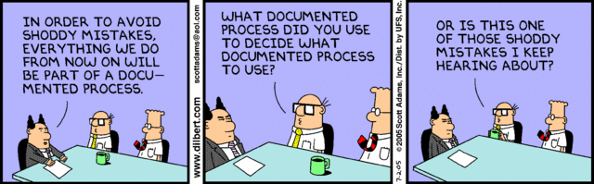
Quality Joke 4
“Reset the mind”

Slide 55
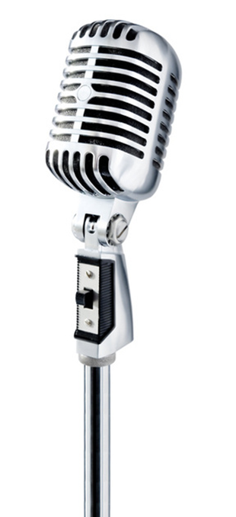
Questions and Answers session
Over to you

Slide 56

ASD-BMS-1012
Training Record
I hereby declare to have read and understood, followed and been trained in the contents of :
ASD-BMS-1012: Document Control Training
version 1.0 , 19 April 2012
and will use it in my work.
Date:
Name:
Signature:
(The following should only be filled-in in case of a formal training session by a trainer)
I hereby declare that the above mentioned employee is to be considered formally trained on the above training Module.
Date:
Name:
Signature:
* When completed, this form should be registered as a Training Record and submitted to
the department secretariat of the employee for archiving in his/her personal file.
Notes:
Key-message:
The purpose of this form is to be able to present document evidence to (external) auditors that an employee is trained in the contents of this QA-Academy Module.
How to use the slide:
The employee should print and sign this form.
When the employee was trained as part of a formal training-session by a trainer, then the trainer should sign the lower half.
Interaction with trainees:
Trainer should request employee to sign.
Examples:
Not applicable.
Background information:
Not applicable.

Slide 57

Document Control
Subsections
Terms & Abbreviations
Target Readers
List of Changes
Approvals

Slide 58

Document Control
Terms & Abbreviations
Term / Abbreviation | Description
e.g. | for example
Term / Abbreviation | Description
e.g. | for example
Notes:
Entries in blue italics are for template purposes only; replace them with appropriate text/values and change the style to “non-italic” and black.
The font type should remain “Verdana”.

Slide 59
Document Control
Target Readers
Reader group | Distribution method
All Atos employees in Switzerland | Publication in Sharepoint as part of the Atos Integrated Management System (AIMS); Email to: Country Document Managers, with request to cascade further down the (local) Document Control network.
Notes:
Entries in blue italics are for template purposes only; replace them with appropriate text/values and change the style to “non-italic” and black.
The font type should remain “Verdana”.

Slide 60
Document Control
List of Changes
Version | Description | Date | Author(s)
0.1 | Country specific adaptations based on ASD-BMS-1012 Document Control Training | 09-May-2014 | Hans Müller
1.0 | Final version | 10-Jun-2014 | Hans Müller
Notes:
Entries in blue italics are for template purposes only; replace them with appropriate text/values and change the style to “non-italic” and black.
The font type should remain “Verdana”.

Slide 61
Document Control
Approvals (M/P-layer documents only)
Role | Name / Function / Unit | Approvals | Date
Reviewer (Content) | n.a. | n.a. | n.a.
Reviewer (Quality Assurance) | n.a. | n.a. | n.a.
Document Owner | Hans Müller | n.a. | n.a.
Senior Manager | n.a. | n.a. | n.a.
Notes:
Entries in blue italics are for template purposes only; replace them with appropriate text/values and change the style to “non-italic” and black.
The font type should remain “Verdana”.

Slide 62
Thanks
For more information please contact:
T +41 58 702 1633
hans.mh.mueller@atos.net
T +41 58 702 1770
djemila.usein@atos.net

