Slide 1
Fraud Detection in Financial Transactions
Richard Moreno & Adrian Stahl

Slide 2
Fraud Detection and its Significance
It affects individuals, businesses, and entire economies.
According to the Federal Trade Commission (FTC), in the United States alone, there were over 4.5 million reports of fraud in 2020, resulting in approximately $3.3 billion in losses.
“Identity theft is not a joke!” It affects millions of individuals worldwide. In 2020, identity theft accounted for 1.4 million reports to the FTC.
Fraud can take many forms
Insurance Fraud, Identity Theft, Bank Fraud, Healthcare Fraud, Credit Card Fraud, among others
Outdated methods to detect Credit Card Fraud.
Signature Verification, Manual Review, Blacklist Filtering, Address Verification Services(AVS)
Notes:
Adrian

Slide 3
Overview and Purpose
The project aims to solve the problem of fraud detection in financial transactions using machine learning. we can build a predictive model to identify fraudulent transactions
We developed two machine learning models using Scikit-learn and Tensorflow to train our fraud detection, including linear regression and keras sequential
Notes:
Ritchie

Slide 4
Data Cleanup and Challenges
Synthetic data set containing transaction type, amount, sender, recipient, and account balance before and after a transaction
Used Pyspark to load and read in data
Removed columns with string values
Separated data into labels and features
Split the dataset into training and testing sets before evaluating the performance of each model
Size of dataset
Reading in data
Wait times
Notes:
Ritchie

Slide 5
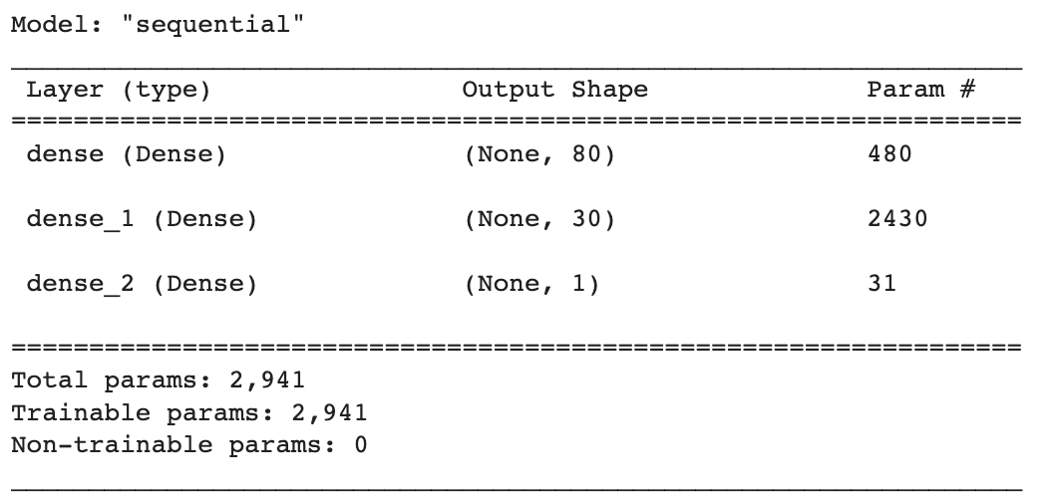
Sequential Model
Ability to create a flexible and customizable neural network architecture
Easily add layers, choose activation functions, and configure other parameters to create a model that suits the specific characteristics of the dataset
A sequential model analyzes patterns model and can relationships between transaction amount, initial balance, and balance after a transaction
Scaled train and test data
Defined model and added layers and units
Trained model (10 epochs)
Loss: 0.0027400129474699497
Accuracy: 0.9994659423828125
Notes:
Ritchie

Slide 6
99%
A great accuracy score… right?

Slide 7
Imbalanced Data
Extreme degree of imbalance
Fraudulent transactions made up less than 1% of data
How to solve the problem of imbalanced data?

Slide 8
Random Resampling

Slide 9
Linear Regression Model
It provides interpretability by quantifying the impact of input variables on the target variable.
It is a simple and easy-to-understand algorithm, suitable for initial analysis and establishing baseline models.
They can be trained efficiently, making them scalable and well-suited for scenarios where speed is important.
Notes:
Adrian

Slide 10
Confusion matrices and Classification Reports
Confusion Matrix: Summarizes the performance of a classification model
It provides detailed breakdown of the predicted and actual class labels, allowing us to evaluate the model’s accuracy and identify potential errors.
Classification Reports: Helps assess how well the linear regression model performs in classifying the data into different classes based on a threshold value. It provides a comprehensive summary of the model’s precision (ability to correctly identify positive cases), recall(ability to capture all positive cases), and F1-score (a balance between precision and recall) for each class.
Notes:
Adrian

Slide 11
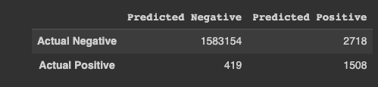
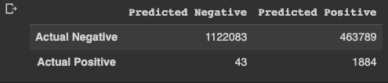
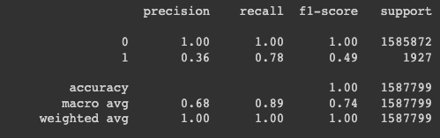
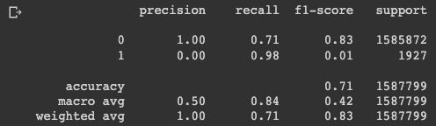
Confusion matrices and Classification Reports
Notes:
Adrian

Slide 12
Conclusion
Sequential method performed higher than the linear regression model
Sequential model accuracy score: 99%
Linear regression model accuracy score: 89%
Resampled linear regression model accuracy score: 84%
Data is imbalance due to a significantly higher set of non-fraudulent transactions
Linear regression provides further insights into the model’s performance by stating the precision, recall, and F1-score
In addition, we were able to resample the data, which deals with the challenge of the imbalance dataset
Resampled data performed better in identifying fraudulent transactions
Notes:
Ritchie

Slide 13
Source
Fraudulent Transactions Dataset
https://www.kaggle.com/datasets/bannourchaker/frauddetection
Imbalanced Data
https://developers.google.com/machine-learning/data-prep/construct/sampling-splitting/imbalanced-data
Random Oversampling
https://machinelearningmastery.com/random-oversampling-and-undersampling-for-imbalanced-classification/#:~:text=Random%20resampling%20provides%20a%20naive,distribution%20for%20an%20imbalanced%20dataset.
Notes:
Ritchie

Slide 14
Questions

