Slide 3
SK Telecom 가입자 현황에 대한 시계열 데이터 분석

Slide 4
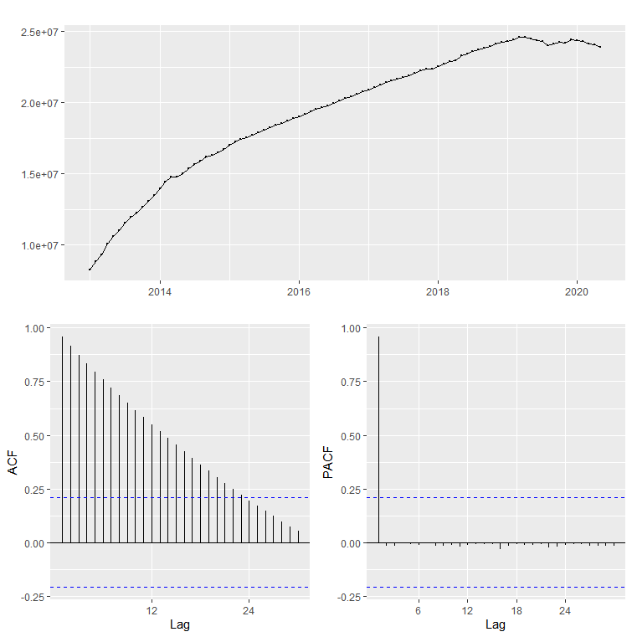
원본 데이터의 Time Series Plot 및 ACF, PACF

Slide 5
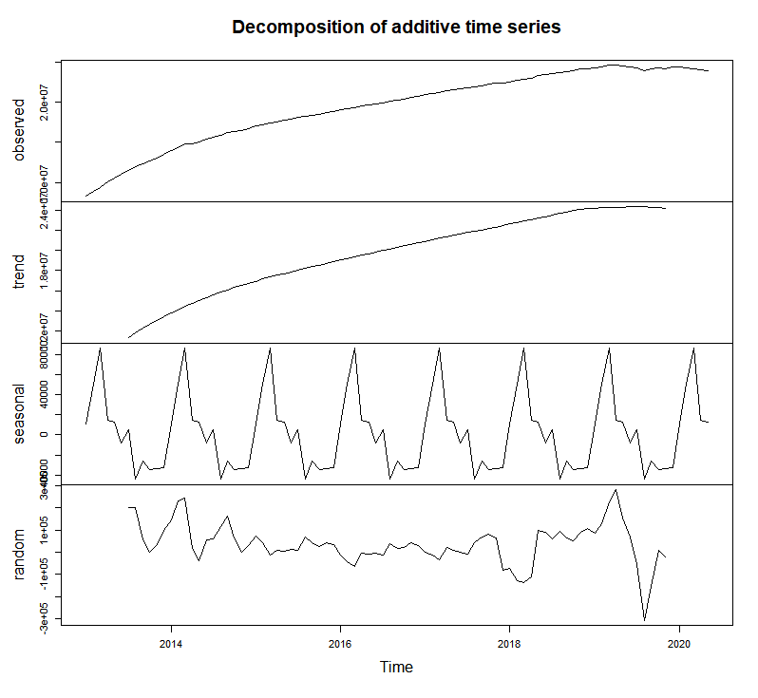
## skt4g data 분기별 시계열 분석
>freq > ts_skt4 <- ts(df_sk$skt,start=c(2013,1),frequency = 12)
>end(ts_skt4)
[1] 2020 5
>dev.new()
>plot(decompose(ts_skt4))
※ end(ts_skt4) : 시계열 분석이 끝나는 지점 확인

Slide 6
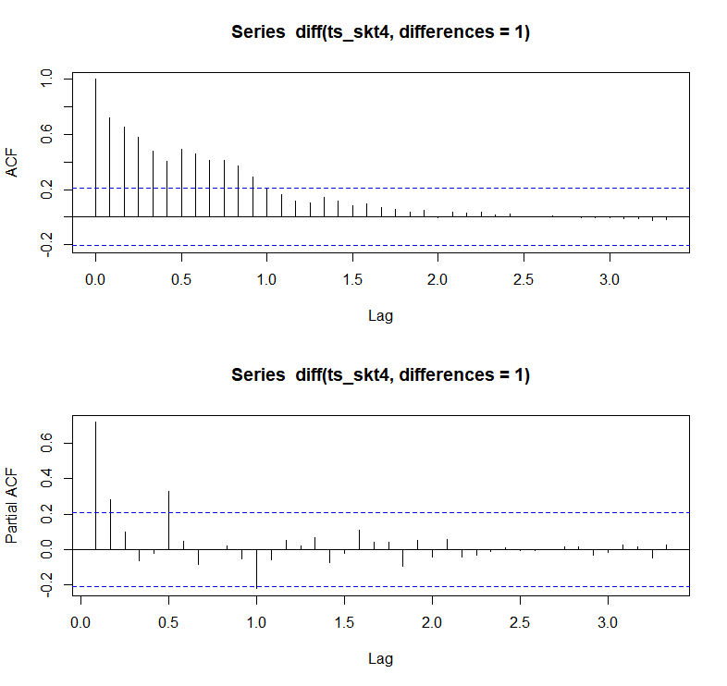
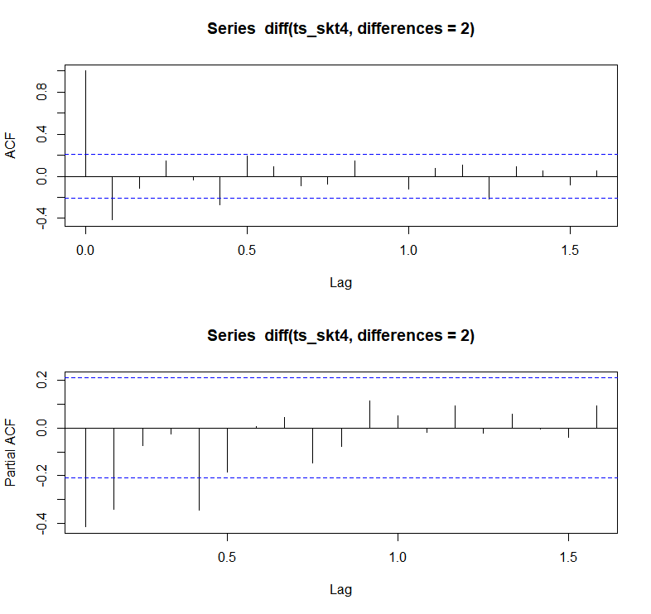
auto.arima(ts_skt4,seasonal = F, stepwise=F, approximation = F)
Series: ts_skt4 ARIMA(5,2,0)
Coefficients:
ar1 ar2 ar3 ar4 ar5
-0.5695 -0.3621 -0.1858 -0.2284 -0.4046
s.e.
0.0989 0.1133 0.1212 0.1183 0.1080
sigma^2 estimated as 8.764e+09:
log likelihood=-1117.4 AIC=2246.81 AICc=2247.86 BIC=2261.6
※ Auto ARIMA를 통해 ACF, PACF와 차분 값을 확인 후 fitted model을 직접 생성

Slide 7
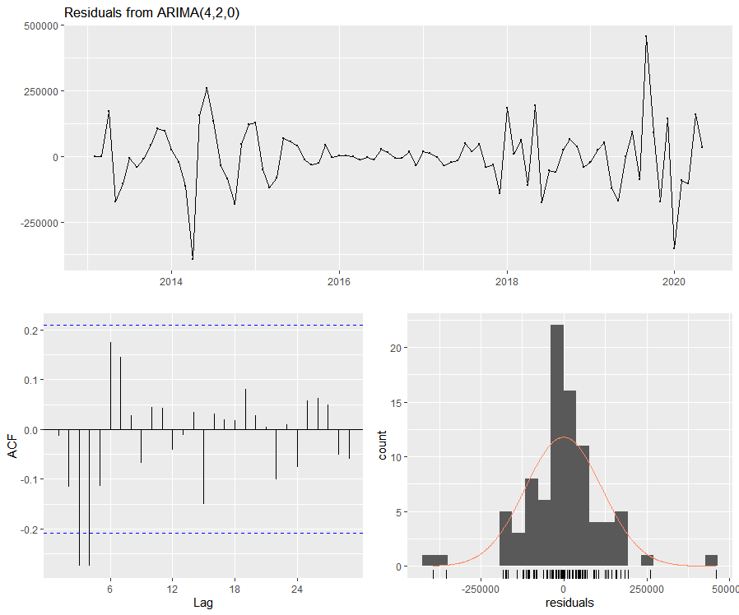
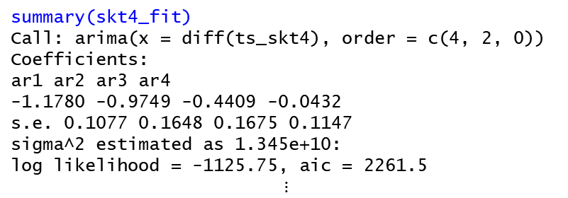
summary(skt4_fit)
Call: arima(x = diff(ts_skt4), order = c(4, 2, 0))
Coefficients:
ar1 ar2 ar3 ar4
-1.1780 -0.9749 -0.4409 -0.0432
s.e. 0.1077 0.1648 0.1675 0.1147
sigma^2 estimated as 1.345e+10:
log likelihood = -1125.75, aic = 2261.5
$$⋮$$
checkresiduals(skt4_fit)
Ljung-Box test data: Residuals from ARIMA(4,2,0)
Q* = 25.525, df = 14, p-value = 0.02973
Model df: 4. Total lags used: 18

Slide 8
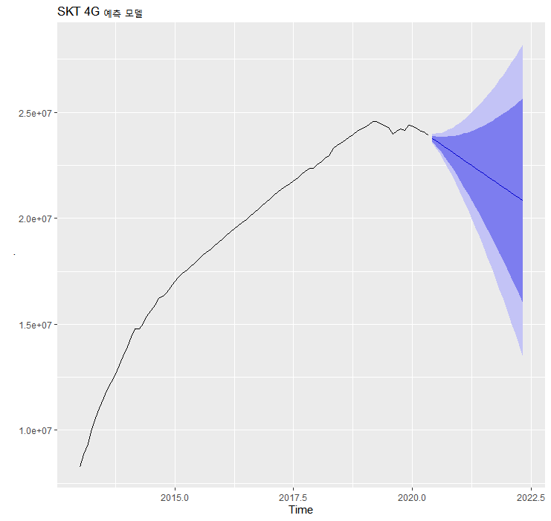
ts_skt4
%>% Arima(order=c(4,2,0))
%>% forecast()
%>% autoplot() + ggtitle('SKT 4G 예측 모델')

Slide 9
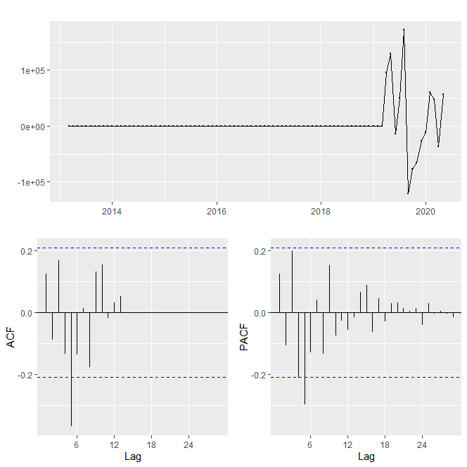
auto.arima(ts_skt5,seasonal = F, stepwise=F, approximation = F)
Series: ts_skt5 ARIMA(5,2,0)
Coefficients:
ar1 ar2 ar3 ar4 ar5
0.1623 -0.1187 0.2173 -0.1559 -0.2988
s.e.
0.1037 0.1045 0.1036 0.1058 0.1045
sigma^2 estimated as 915386754:
log likelihood=-1018.94 AIC=2049.88 AICc=2050.93 BIC=2064.67

Slide 10
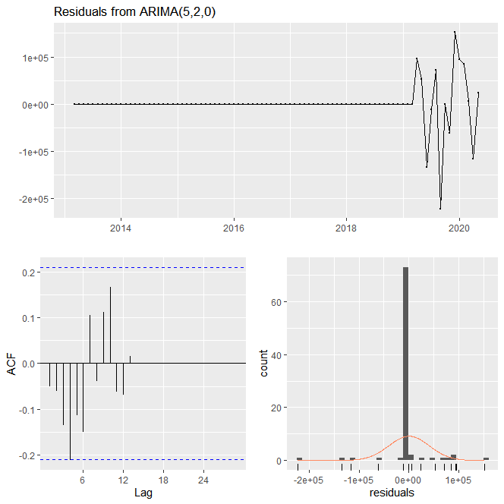
checkresiduals(skt5_test)
Ljung-Box test
data: Residuals from ARIMA(5,2,0)
Q* = 16.012, df = 12, p-value = 0.1907
Model df: 5. Total lags used: 17
※ p-value = 0.1907 :
시계열 분석을 위한 표본데이터의 부족으로 예측 정확성이 조금 낮은 편

Slide 11
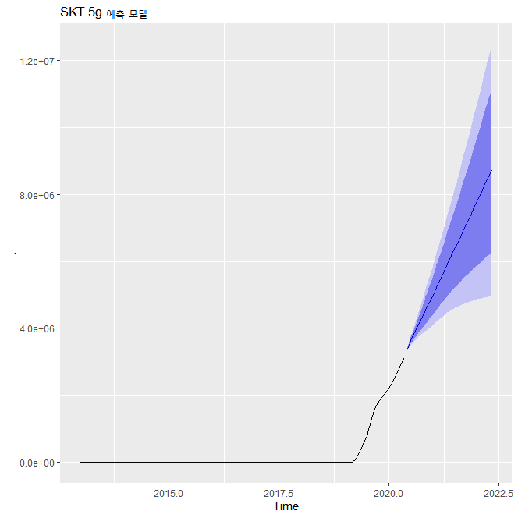
ts_skt5
%>% Arima(order=c(5,2,0))
%>% forecast()
%>% autoplot() + ggtitle('SKT 5g 예측 모델')

Slide 12
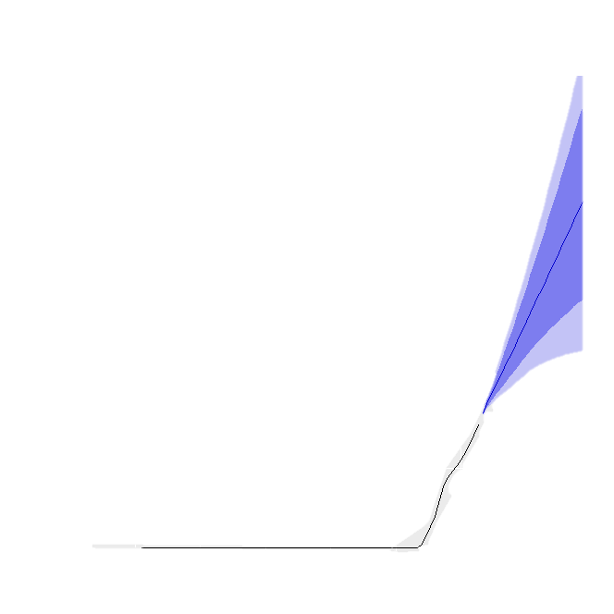

Slide 13
KT 가입자 현황에 대한 시계열 데이터 분석

Slide 14
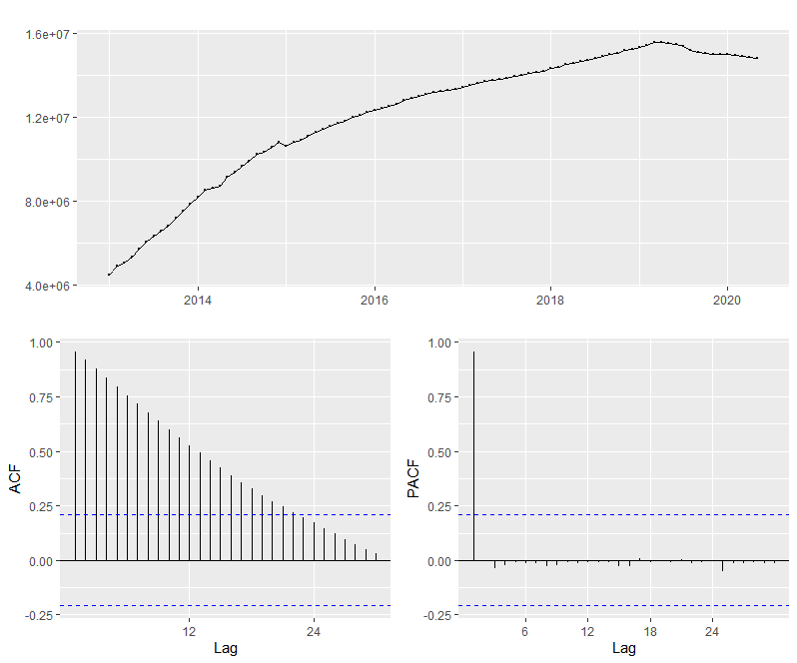
원본 데이터 시계열 데이터 분석

Slide 15
auto.arima(ts_kt5,seasonal = F, stepwise=F, approximation = F)
Series: ts_kt5 ARIMA(5,2,0)
Coefficients:
ar1 ar2 ar3 ar4 ar5
0.1476 0.0781 0.0011 0.1035 -0.4646
s.e.
0.0937 0.0943 0.0965 0.0966 0.0950
sigma^2 estimated as 3.11e+08:
log likelihood=-972.16 AIC=1956.31 AICc=1957.36 BIC=1971.11
auto.arima(ts_kt4,seasonal = F, stepwise=F, approximation = F)
Series: ts_kt4 ARIMA(0,2,1)
Coefficients:
ma1 -0.7087
s.e. 0.0758 sigma^2 estimated as 5.714e+09: log likelihood=-1100.57 AIC=2205.13 AICc=2205.28 BIC=2210.06

Slide 16
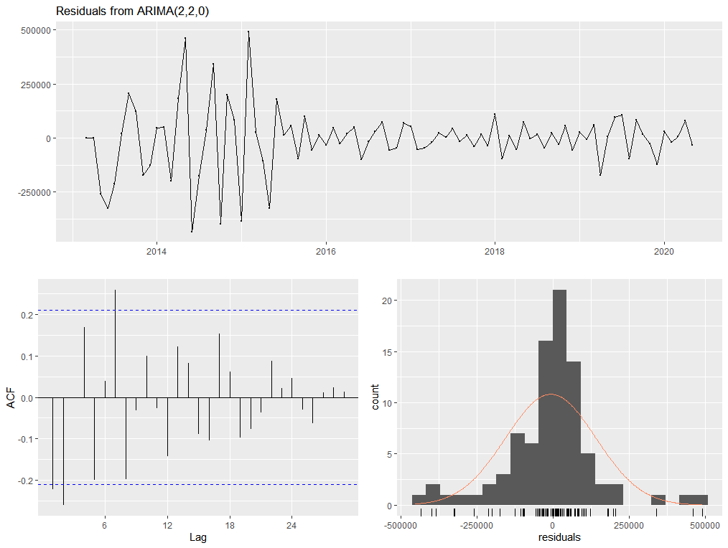
KT 4G checkresiduals : 적합한 difference 및 모델 생성(MA(2,2,0))
checkresiduals(kt4_fit)
Ljung-Box test data: Residuals from ARIMA(2,2,0)
Q* = 37.781, df = 15, p-value = 0.0009719 Model df: 2. Total lags used: 17

Slide 17
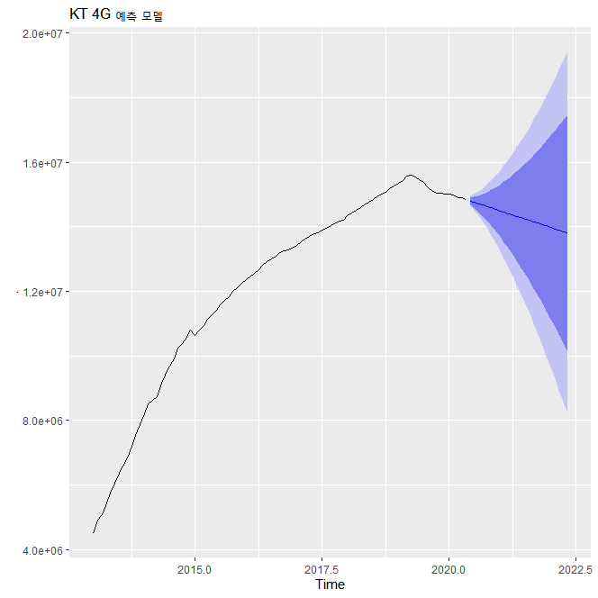

Slide 18
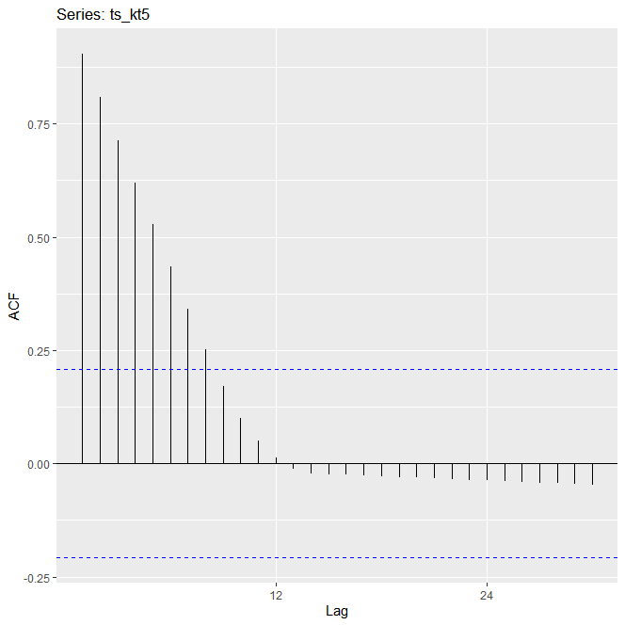
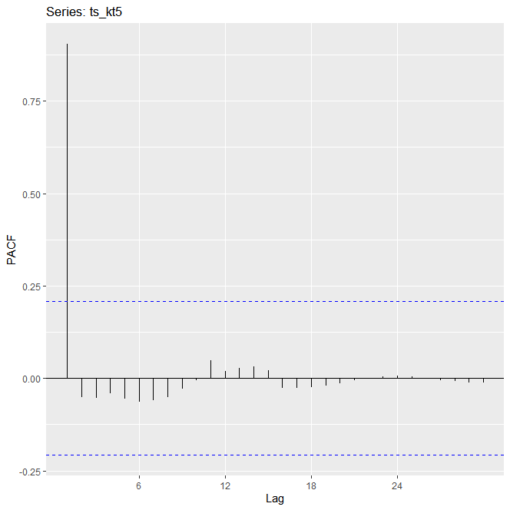
※ 원본 데이터의 ACF, PACF 확인

Slide 19
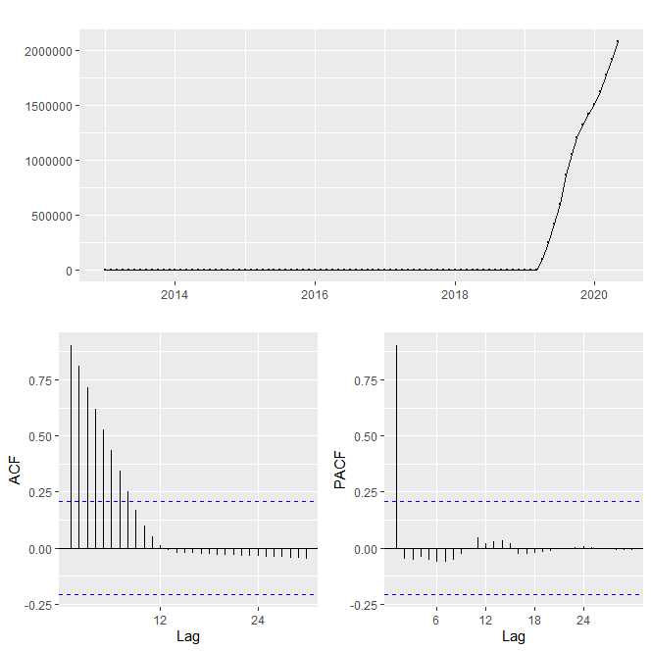
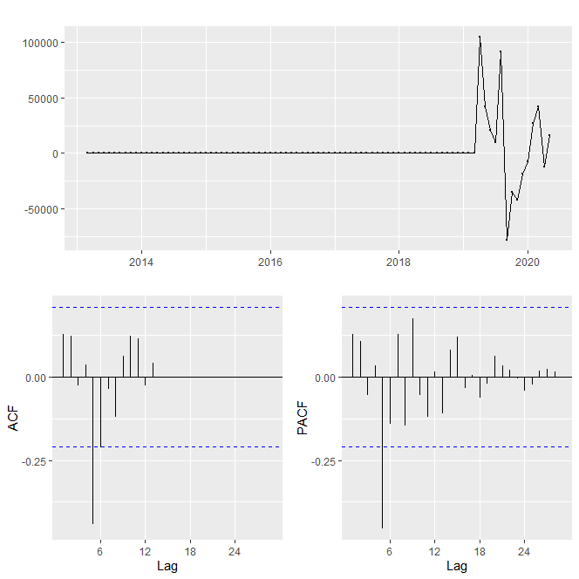
※ 원본 데이터의 시계열 데이터과 차분 diff=2로 시행했을 때 시계열 데이터 비교

