Slide 2
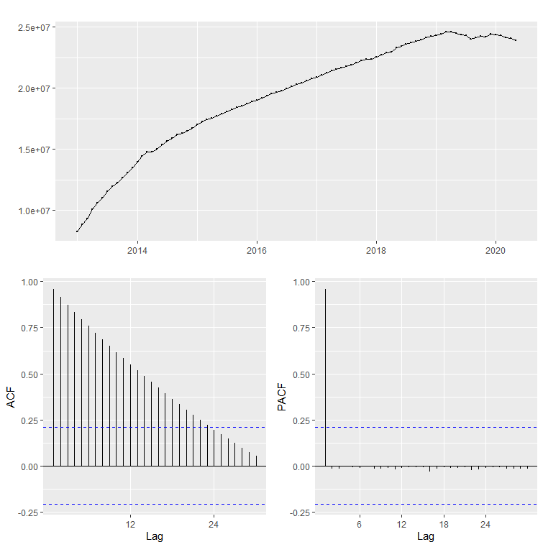
원본 데이터의 Time Series Plot 및 ACF, PACF

Slide 3
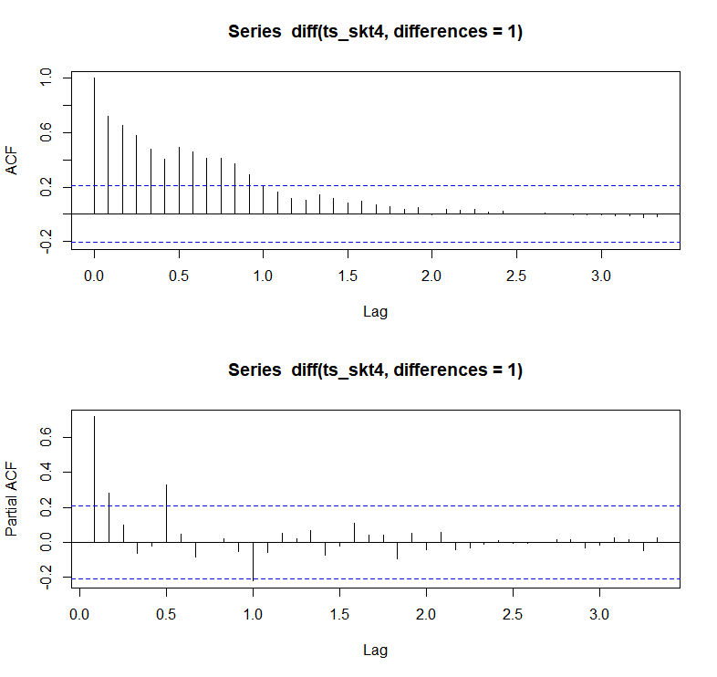
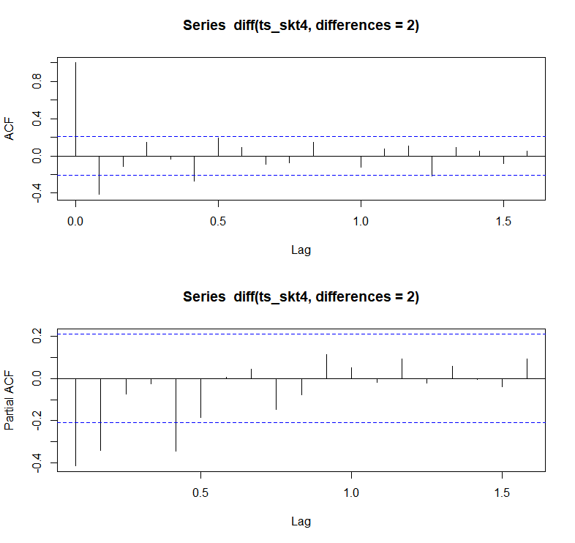
auto.arima(ts_skt4,seasonal = F, stepwise=F, approximation = F)
Series: ts_skt4 ARIMA(5,2,0)
Coefficients:
ar1 ar2 ar3 ar4 ar5
-0.5695 -0.3621 -0.1858 -0.2284 -0.4046
s.e.
0.0989 0.1133 0.1212 0.1183 0.1080
sigma^2 estimated as 8.764e+09:
log likelihood=-1117.4 AIC=2246.81 AICc=2247.86 BIC=2261.6
※ Auto ARIMA를 통해 ACF, PACF와 차분 값을 확인 후 fitted model을 직접 생성

Slide 4
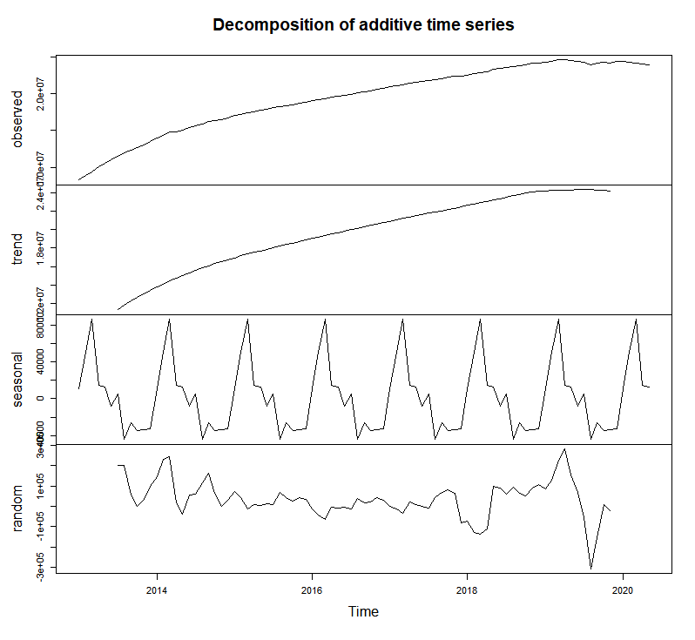
## skt4g data 분기별 시계열 분석
>freq > ts_skt4 <- ts(df_sk$skt,start=c(2013,1),frequency = 12)
>end(ts_skt4)
[1] 2020 5
>dev.new()
>plot(decompose(ts_skt4))
※ end(ts_skt4) : 시계열 분석이 끝나는 지점 확인

Slide 5
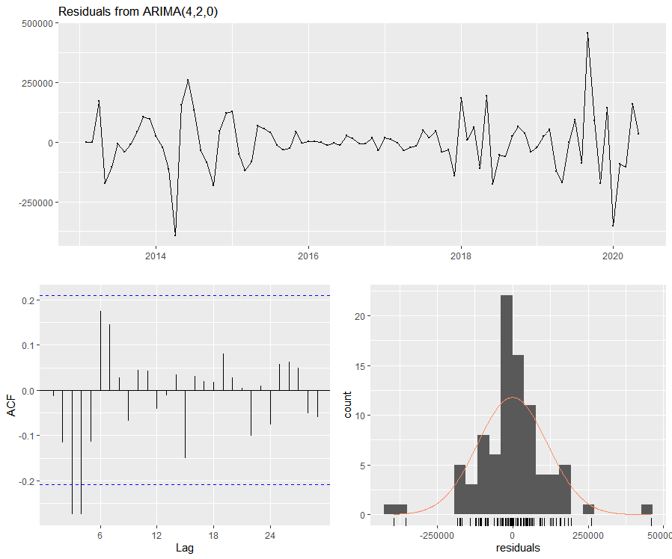
checkresiduals(skt4_fit)
Ljung-Box test data: Residuals from ARIMA(4,2,0)
Q* = 25.525, df = 14, p-value = 0.02973
Model df: 4. Total lags used: 18

Slide 6
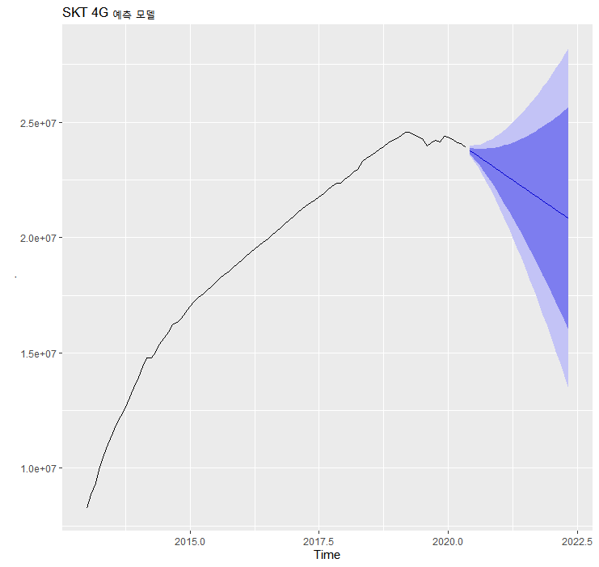
ts_skt4
%>% Arima(order=c(4,2,0))
%>% forecast()
%>% autoplot() + ggtitle('SKT 4G 예측 모델')

Slide 7
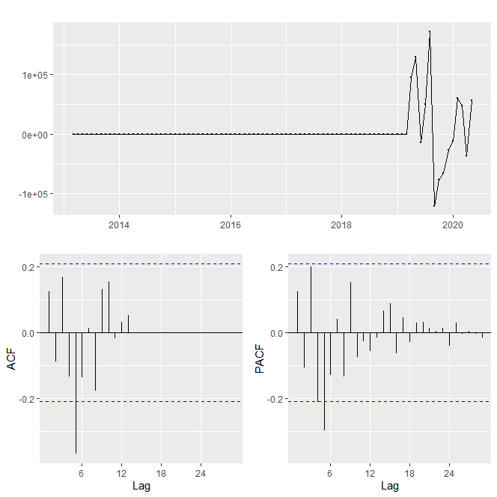
auto.arima(ts_skt5,seasonal = F, stepwise=F, approximation = F)
Series: ts_skt5 ARIMA(5,2,0)
Coefficients:
ar1 ar2 ar3 ar4 ar5
0.1623 -0.1187 0.2173 -0.1559 -0.2988
s.e.
0.1037 0.1045 0.1036 0.1058 0.1045
sigma^2 estimated as 915386754:
log likelihood=-1018.94 AIC=2049.88 AICc=2050.93 BIC=2064.67

Slide 8
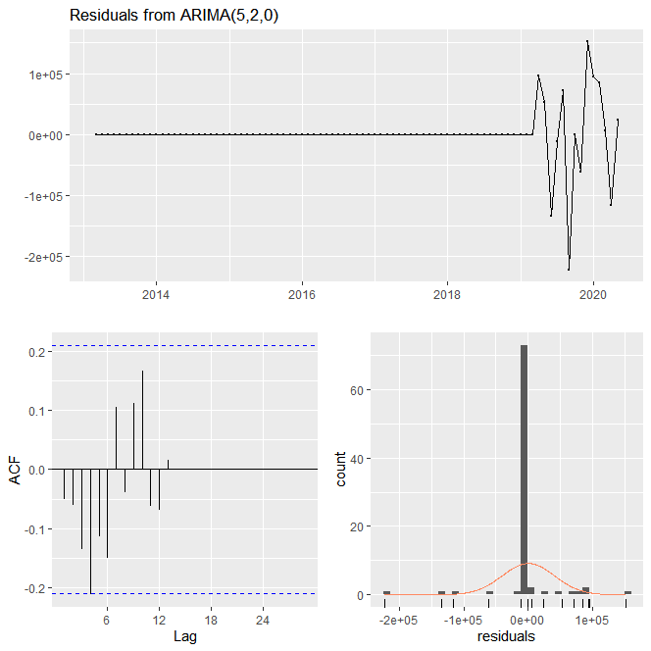
checkresiduals(skt5_test)
Ljung-Box test
data: Residuals from ARIMA(5,2,0)
Q* = 16.012, df = 12, p-value = 0.1907
Model df: 5. Total lags used: 17
※ p-value = 0.1907 :
시계열 분석을 위한 표본데이터의 부족으로 예측 정확성이 조금 낮은 편

Slide 9
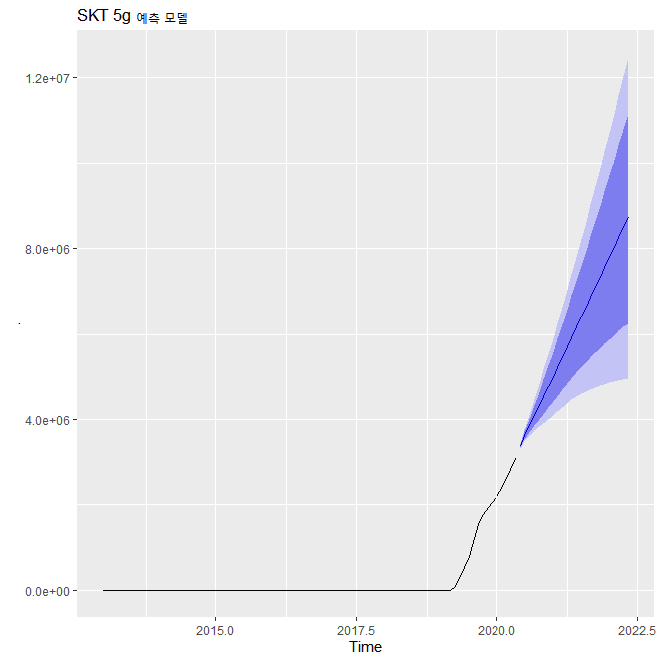
ts_skt5
%>% Arima(order=c(5,2,0))
%>% forecast()
%>% autoplot() + ggtitle('SKT 5g 예측 모델')

Slide 10
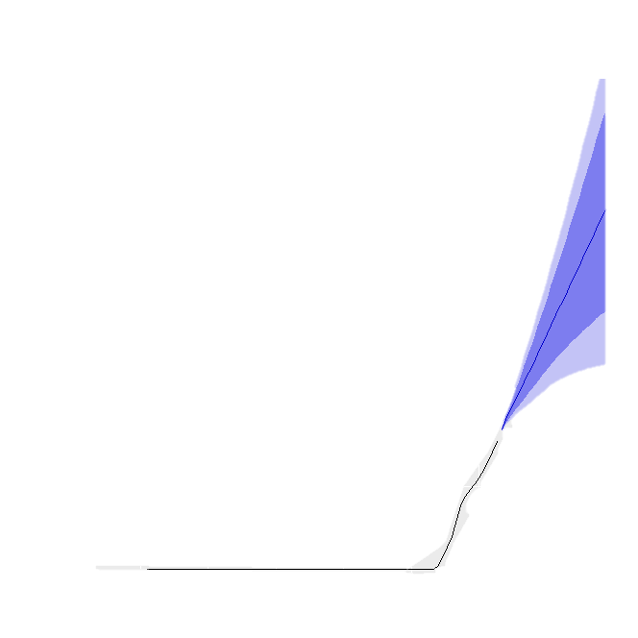

Slide 13
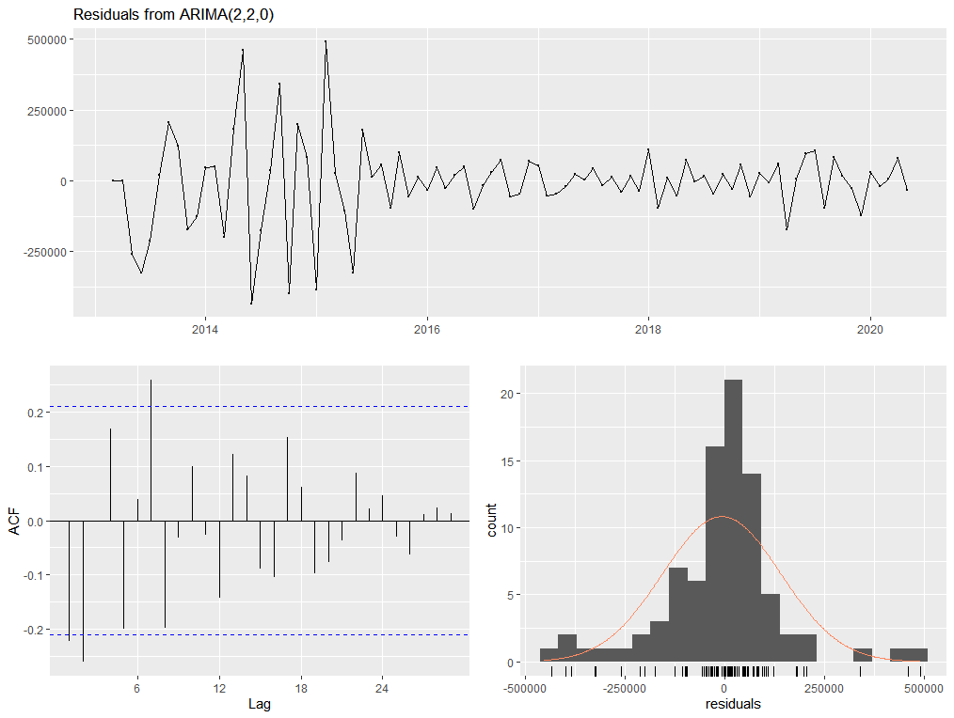
KT 4G checkresiduals : 적합한 difference 및 모델 생성(MA(2,2,0))
checkresiduals(kt4_fit)
Ljung-Box test data: Residuals from ARIMA(2,2,0)
Q* = 37.781, df = 15, p-value = 0.0009719 Model df: 2. Total lags used: 17

