Slide 1
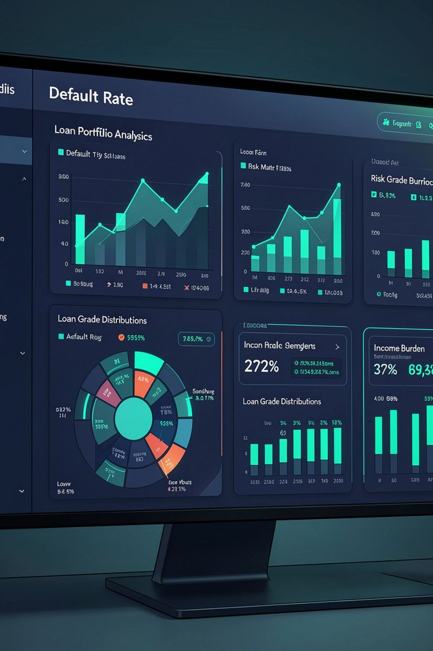
Credit Risk & Loan Default Analysis
Portfolio Risk Analysis & Multivariable Segmentation
SQL · Google BigQuery · Power BI · DAX

Slide 2


BUSINESS PROBLEM
Which Borrower Characteristics Are Most Associated With Default?
Financial institutions must balance portfolio growth with borrower default risk. This analysis identifies historical risk patterns to support credit-risk monitoring and lending-policy discussions.
Understand Portfolio Default Behavior
Identify Meaningful Risk Patterns
The objective is not to automatically approve or reject borrowers — but to identify historical risk patterns that inform credit-risk discussions.
Evaluate Borrower & Loan Characteristics
Segment Higher-Risk Borrower Profiles
Translate Findings Into Decision Support

Slide 3

ANALYTICAL WORKFLOW
From Raw Data to Decision Support
Ingest Data
Clean & Validate
Analyze Risk
Deliver Insights
Final analytical dataset: 32,409 loan records. Data quality work included type validation, duplicate analysis, missing-value assessment, unrealistic-value detection, and outlier validation.

Slide 4

PORTFOLIO OVERVIEW
Portfolio Risk at a Glance
32,409
$310.9M
7,088
Total Loans
Total Exposure
Defaulted Loans
21.87%
$76.9M
Default Rate
Default Exposure
The portfolio shows substantial variation in historical default behavior across borrower and loan characteristics, creating clear opportunities for risk segmentation.

Slide 5
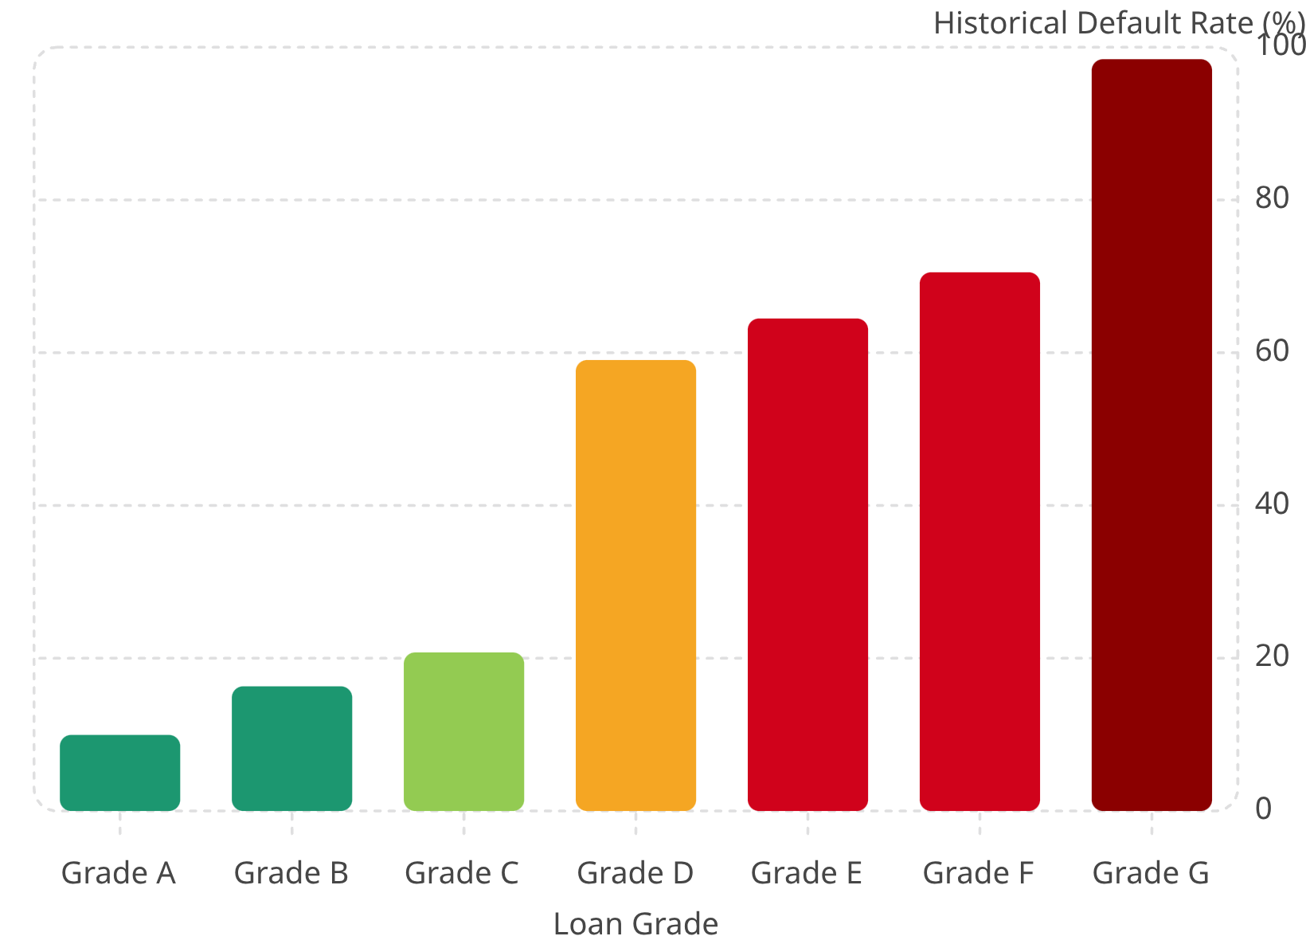
RISK SEGMENTATION
Loan Grade Reveals a Clear Risk Gradient
Key Finding
Observed default behavior deteriorates substantially as Loan Grade moves from A toward G. The most pronounced shift occurs between Grade C (20.76%) and Grade D (59.05%) — nearly a 3× increase in observed default rate.
Loan Grade provides strong segmentation of historical default behavior, but it should not be evaluated independently.

Slide 6
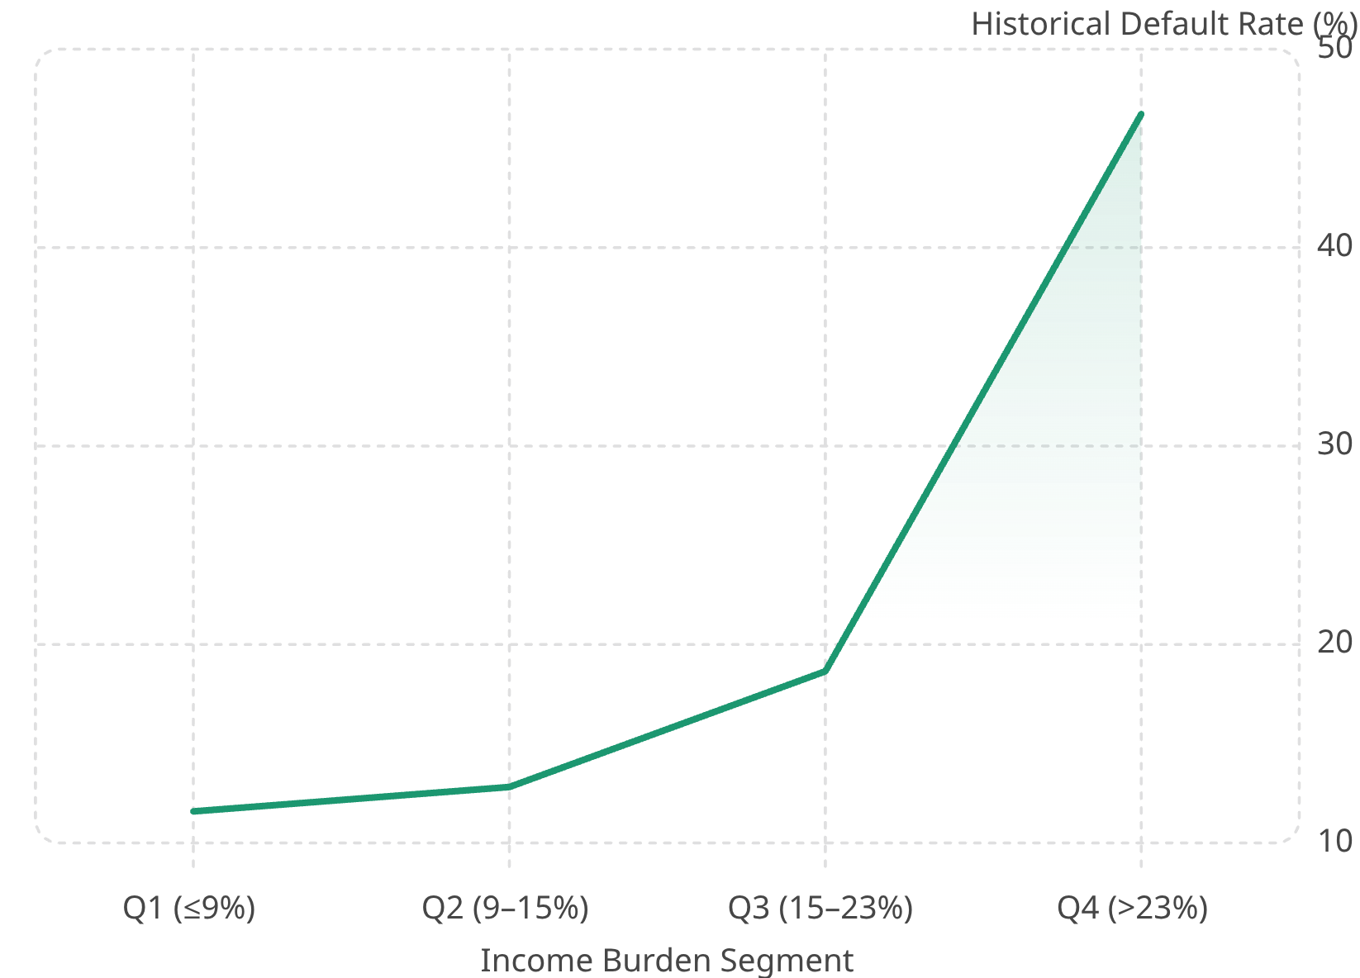

RISK SEGMENTATION
Income Burden Identifies Another Major Risk Pattern
Key Finding
Observed default increases substantially when the loan represents more than 23% of borrower income. Q4 borrowers show a default rate of 46.73% — nearly 4× higher than Q1 at 11.59%.
Income Burden provides meaningful additional information about borrower repayment risk and should be considered together with credit quality.

Slide 7
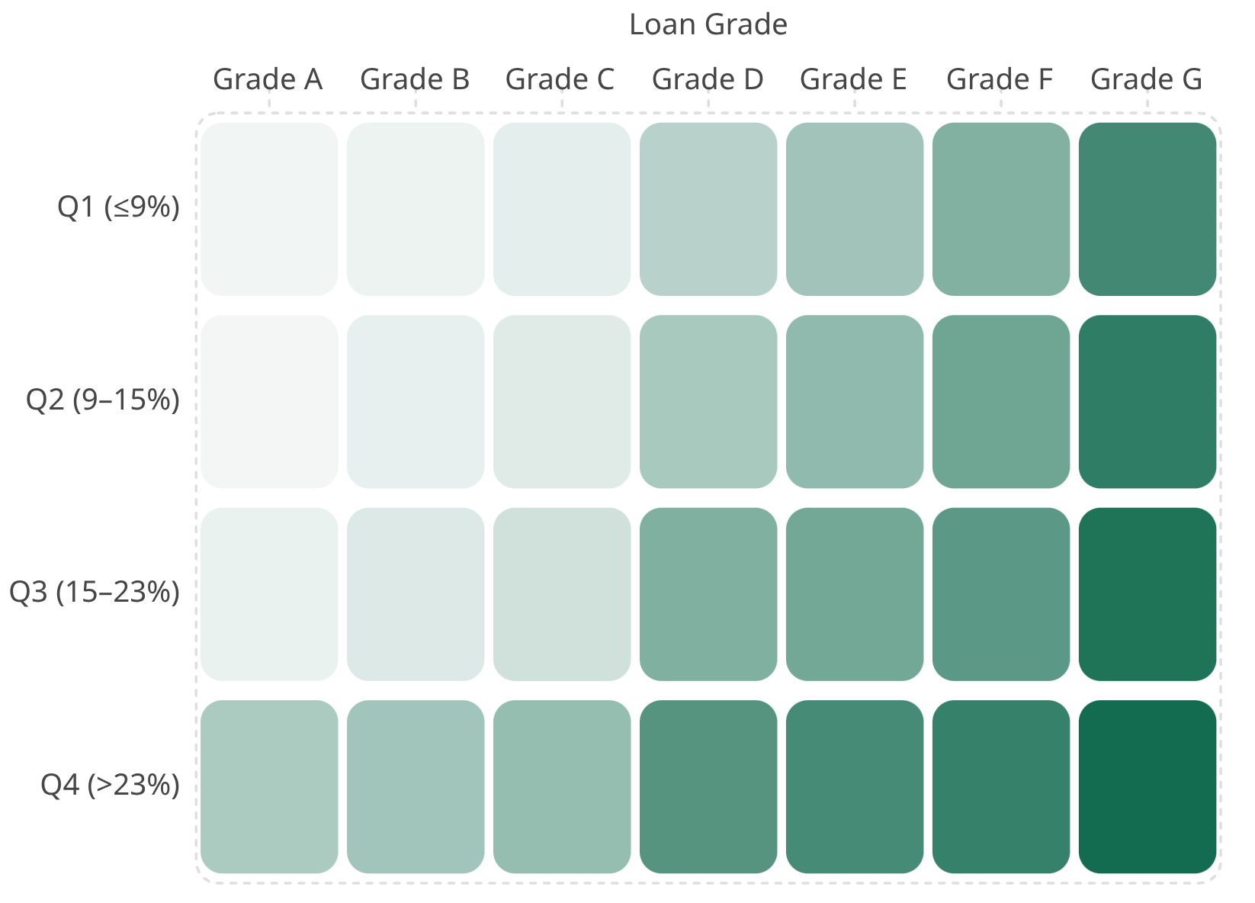
MULTIVARIABLE ANALYSIS
The Strongest Insight: Risk Factors Should Not Be Analyzed in Isolation
Key Insight
Even Grade A borrowers show substantial deterioration when Income Burden reaches Q4 — rising from 3.81% to 34.50%. Grade G ranges from 80% to 100% depending on Income Burden.
Loan Grade and Income Burden provide a more informative risk profile when evaluated together — revealing risk concentrations invisible in isolated analysis.

Slide 8
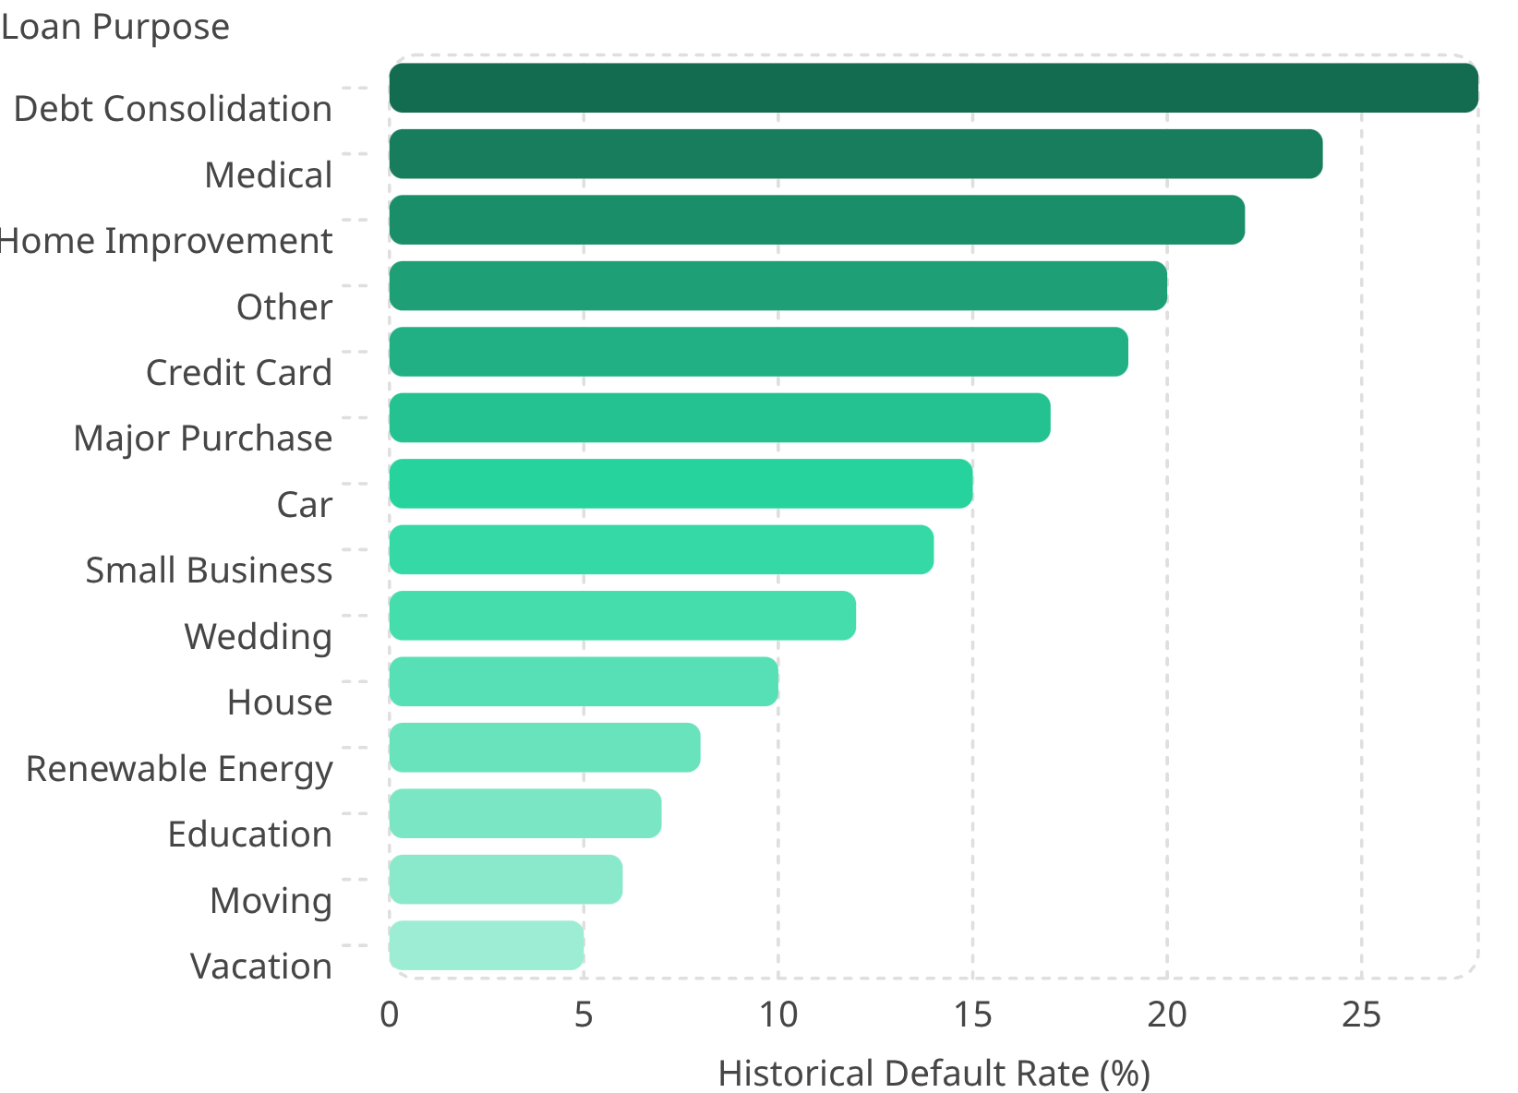
BUSINESS CONTEXT
Loan Purpose Adds Business Context
Key Finding
Debt Consolidation shows the highest observed default rate at approximately 28%. However, a higher historical default rate does not automatically mean a lending product should be eliminated.
Loan Purpose should be considered together with Loan Grade, Income Burden, borrower characteristics, and credit history.
Higher observed default should trigger deeper analysis — not an automatic product restriction. Profitability, expected losses, recoveries, and collateral must also be evaluated.

Slide 9
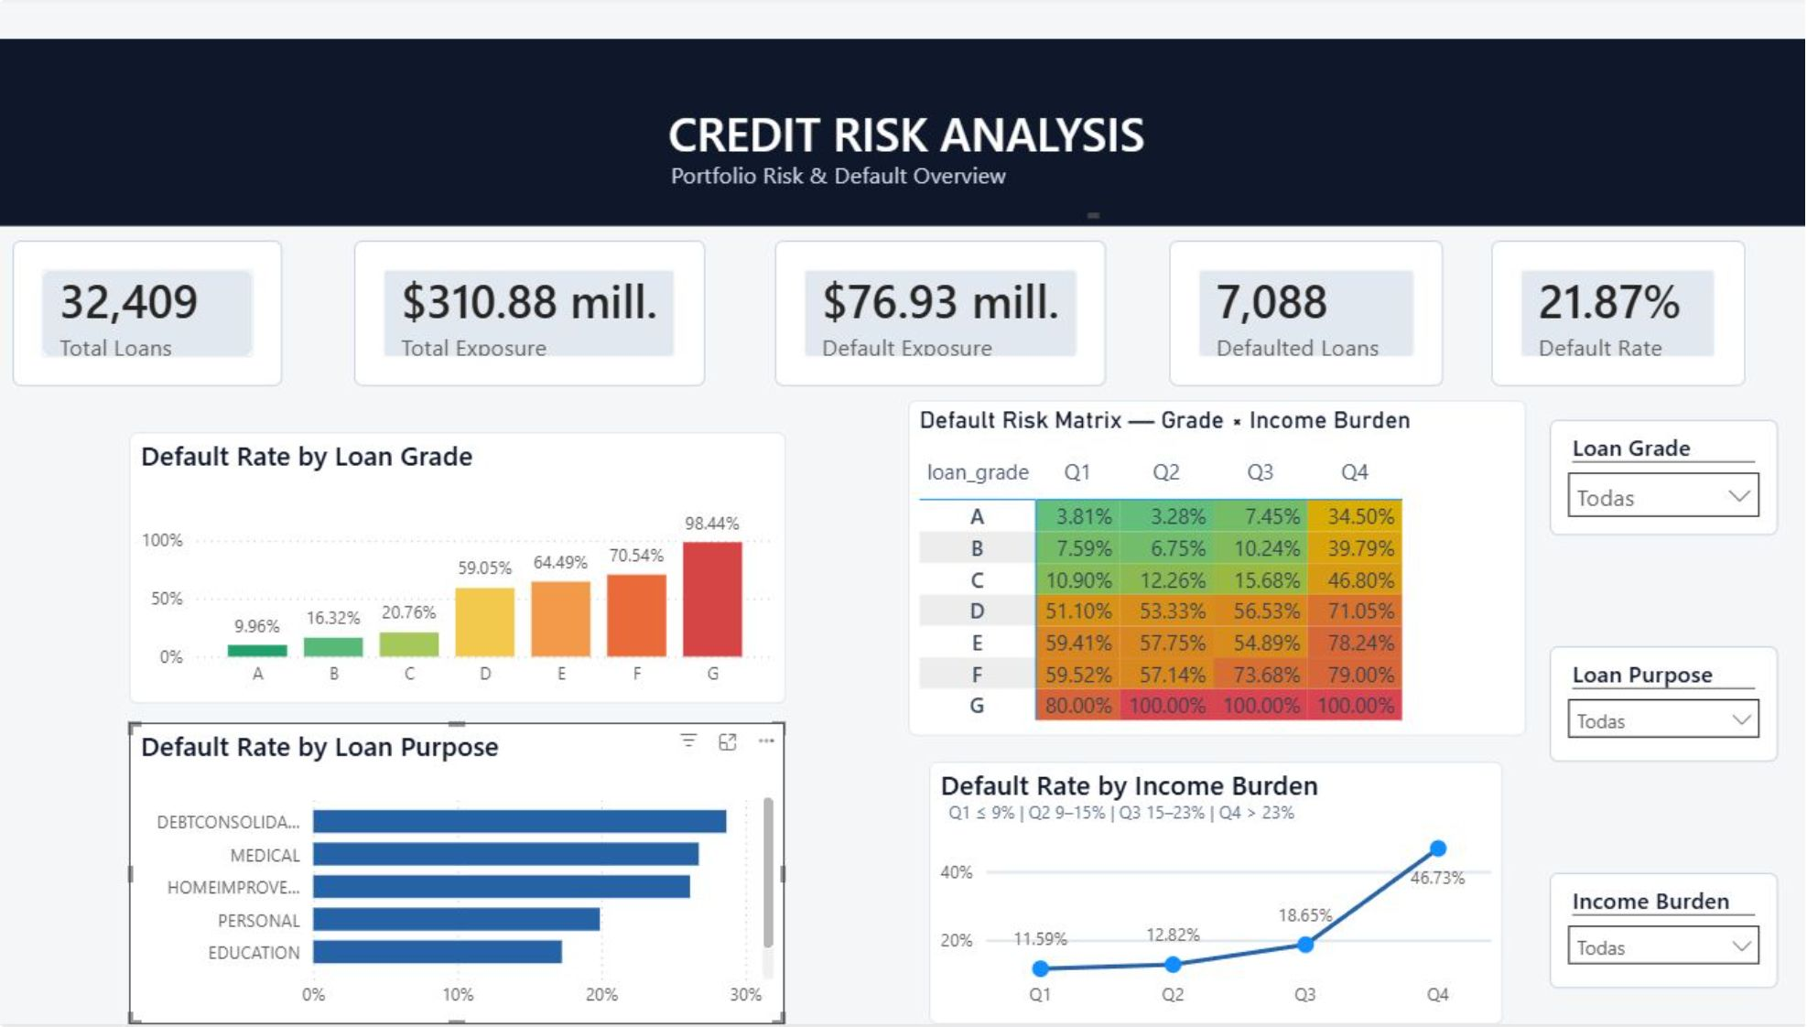

DASHBOARD
Interactive Credit Risk Dashboard
Executive KPIs
Analytical Views
Dynamic Filters
Total Loans · Total Exposure · Default Exposure · Defaulted Loans · Default Rate
Default Rate by Loan Grade · Loan Purpose · Income Burden · Grade × Income Burden Risk Matrix
Interactive filtering by Loan Grade, Loan Purpose, and Income Burden for ad-hoc segmentation

Slide 10
SUMMARY
Key Findings & Strategic Implications
Loan Grade
Multivariable Segmentation
Strongest single segmentation factor — but must be evaluated alongside Income Burden.
Grade × Income Burden reveals risk concentrations invisible in isolated analysis.
Income Burden
Loan Purpose
Q4 (>23%) shows substantially higher observed default, including a sharp increase among Grade A borrowers.
Debt Consolidation shows highest observed default (~28%), but requires broader financial context.
Strategic Implication: Multivariable risk segmentation supports more informed credit-risk monitoring and lending-policy discussions.

