Slide 1
WMS核心分析
Notes:
https://baike.baidu.com/item/Material%20Design/16011141?fr=aladdin

Slide 2
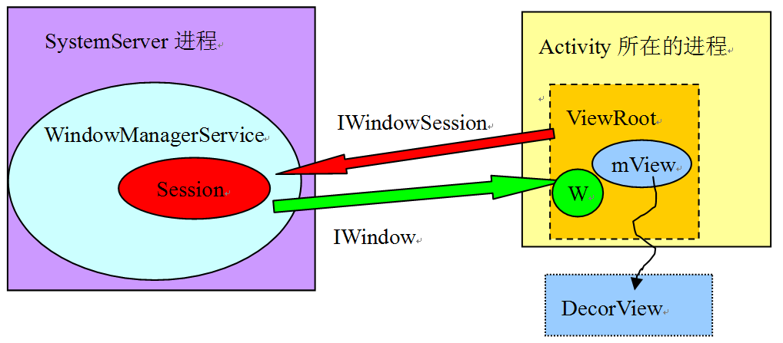

Slide 3
WMS整体架构

Slide 4
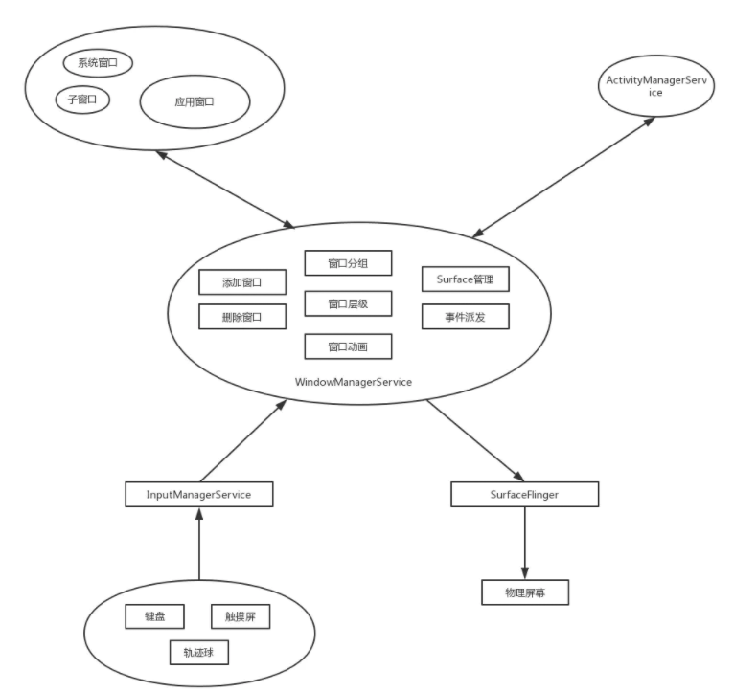

Slide 5
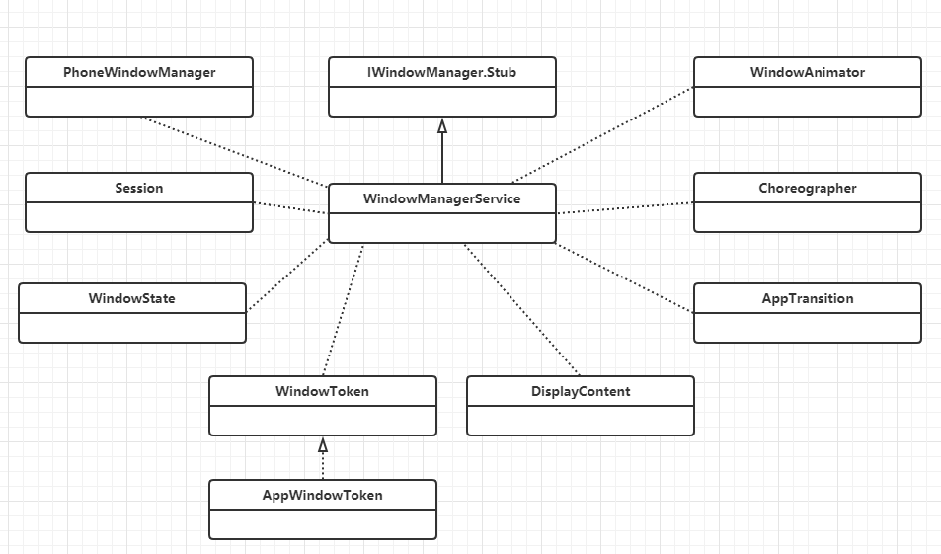

Slide 6
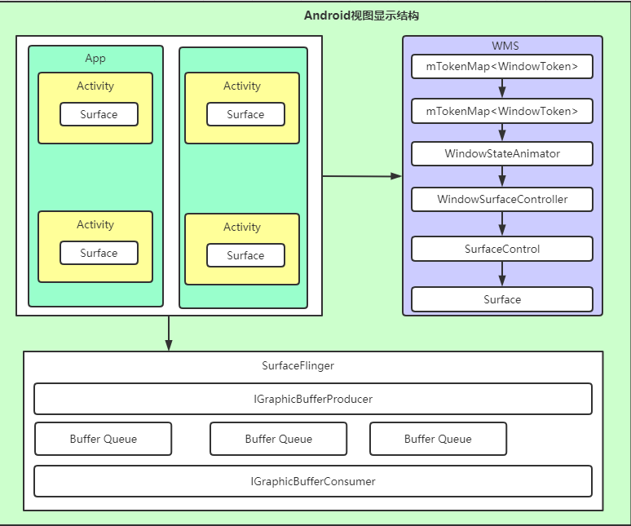

Slide 7
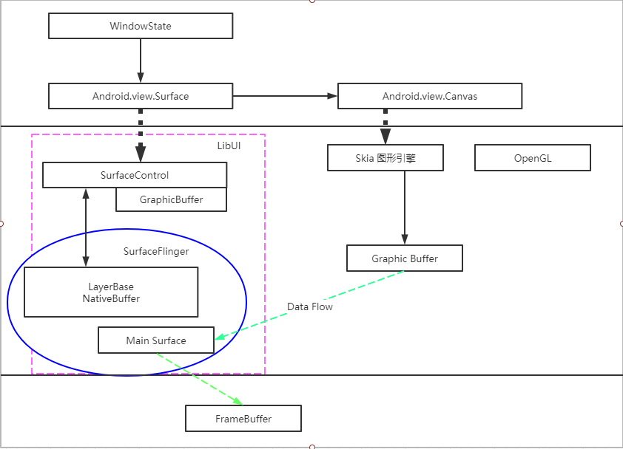

Slide 8
WMS窗口显示

Slide 9
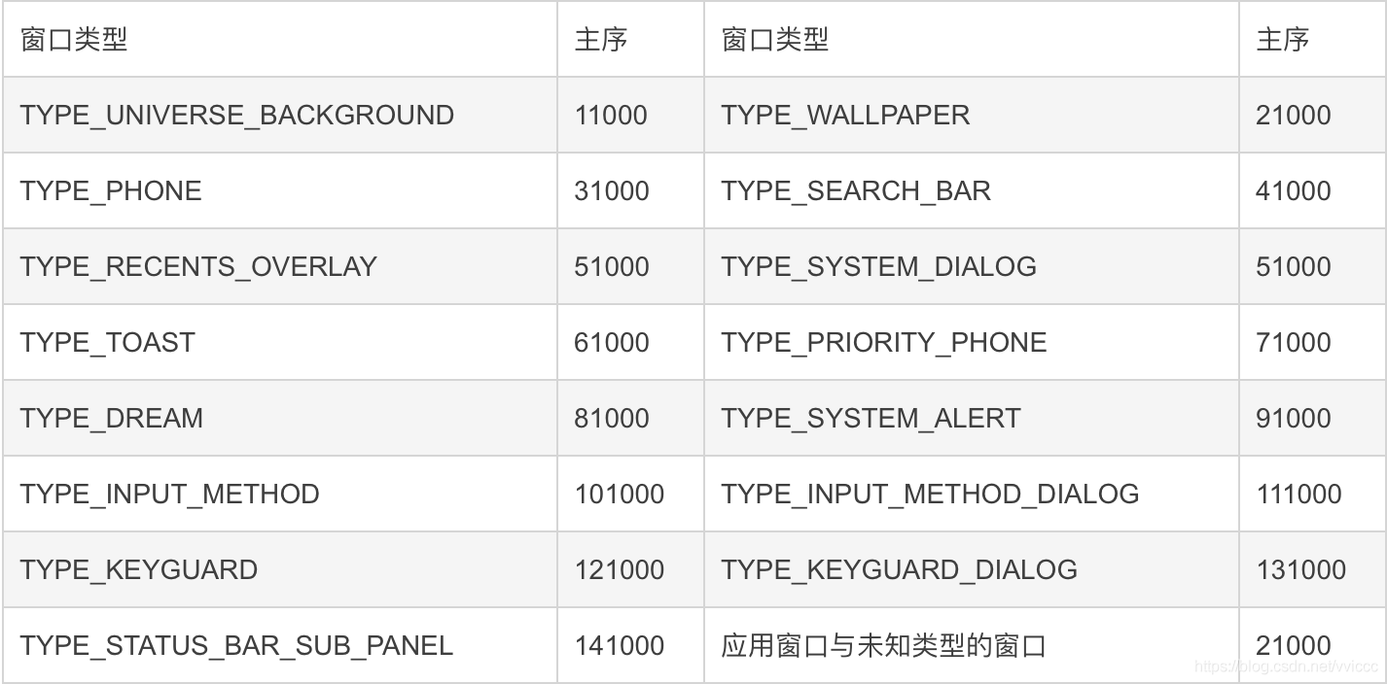
窗口类型

Slide 10
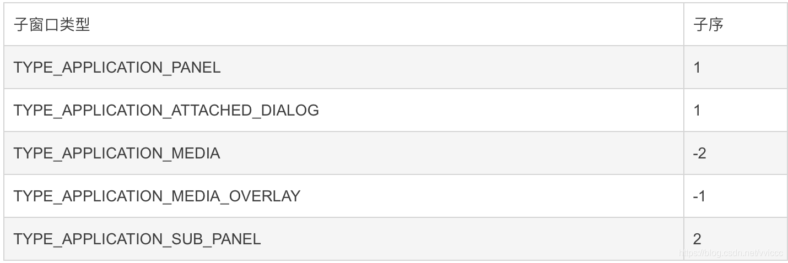
子窗口类型

Slide 11
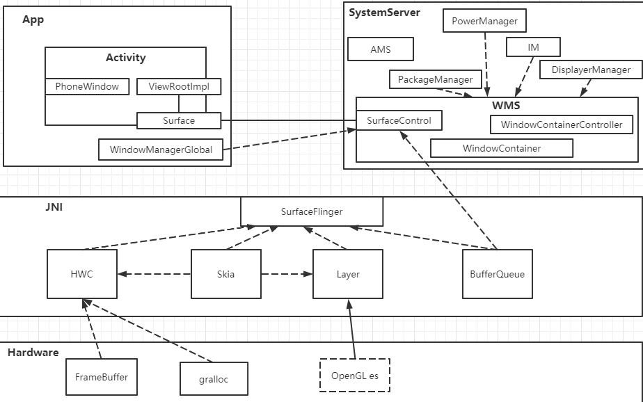

Slide 12
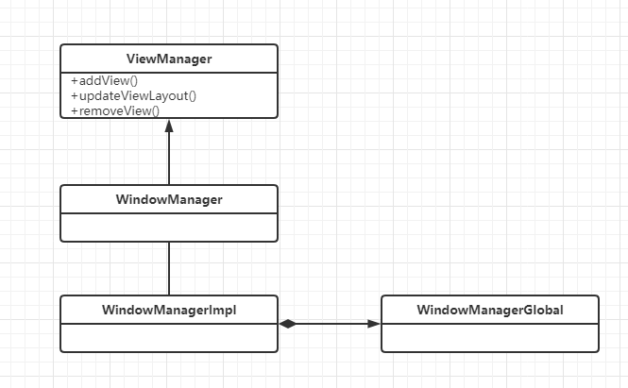
WindowManager

Slide 13
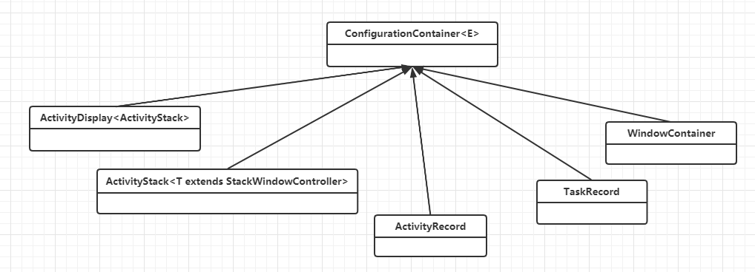
ConfigurationContainer

Slide 14
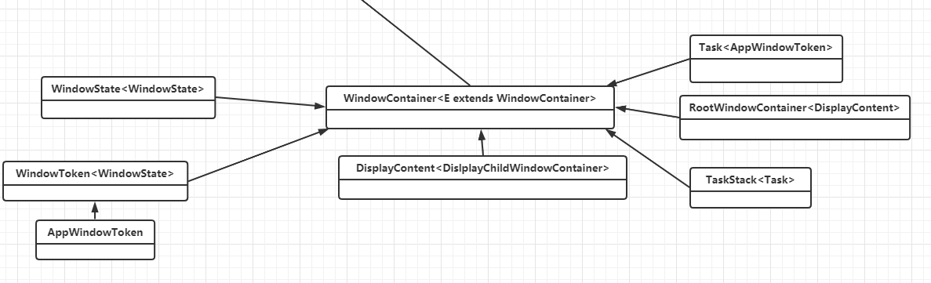
WindowContainer

Slide 15
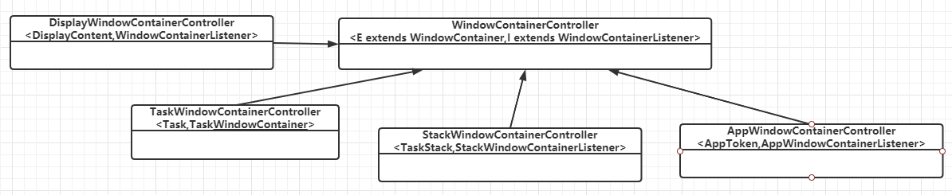
WindowContainerController

Slide 16
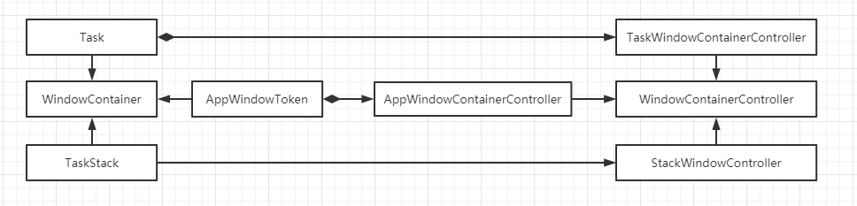
WindowContainerController和WindowContainer

