Slide 1
MHC PMS Task3
Gruppe Rot

Slide 2
Übersicht
Vorgehen
Ergebnisse
Fazit

Slide 3
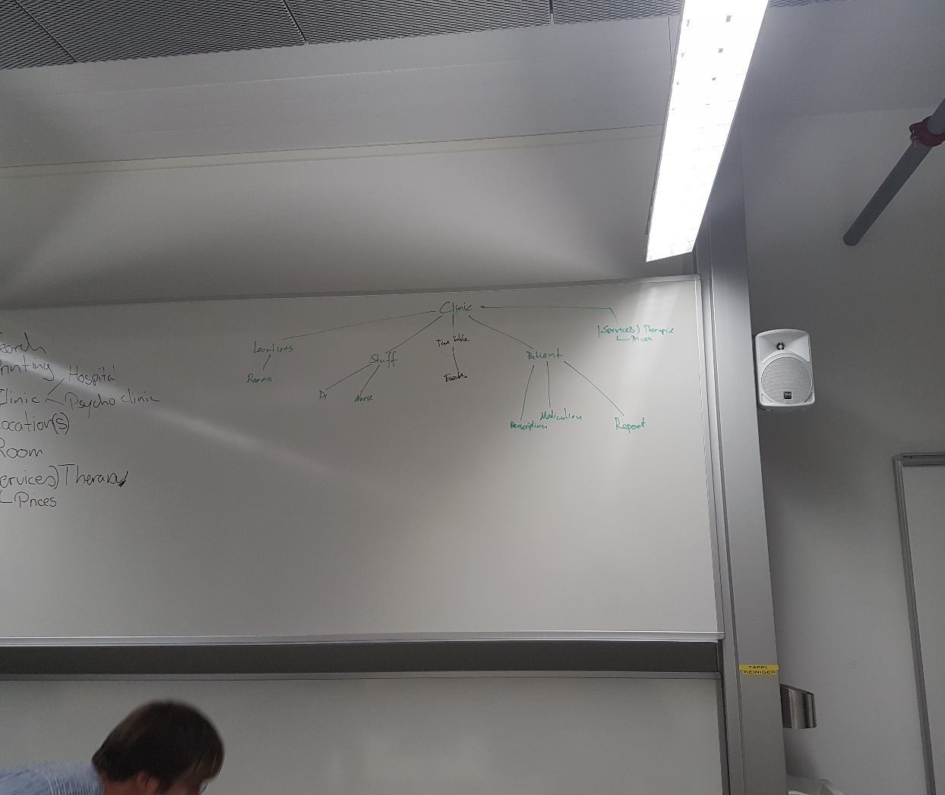
Vorgehen
Was gibt es alle für Entitäten?
Brainstorming an Whiteboard
Erste Gedanken zu Beziehungen

Slide 4
CRC Card
Class Name: Doctor
Purpose: Holds sessions with patients, writes reports and can prescribe medication.
Responsibilities: Can manage and view sessions. Knows upcoming sessions. Can save reports and notes. Can prescribe medication. Knows his patients and can manage their records. Can have holydays / days off. Has a surrogate doctor. | Collaborators: Holds sessions with patients. Is employed by a clinic and works at different locations. Is assigned to a room. Can have a session.

Slide 5
