Slide 1
MHC PMS Task 7
Group Red

Slide 2
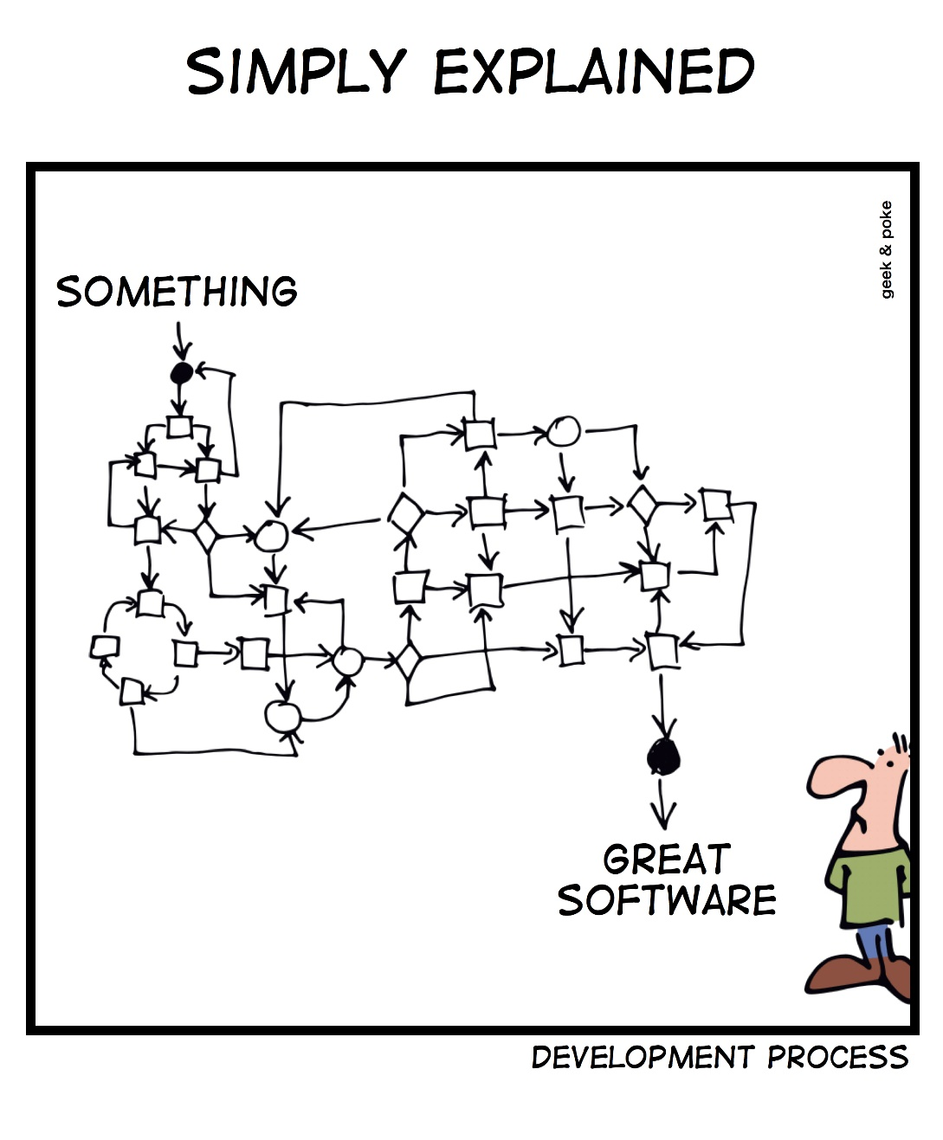
Overview
Approach
Results
Some CRC cards
Domain model
Sequence diagram
Verdict

Slide 3
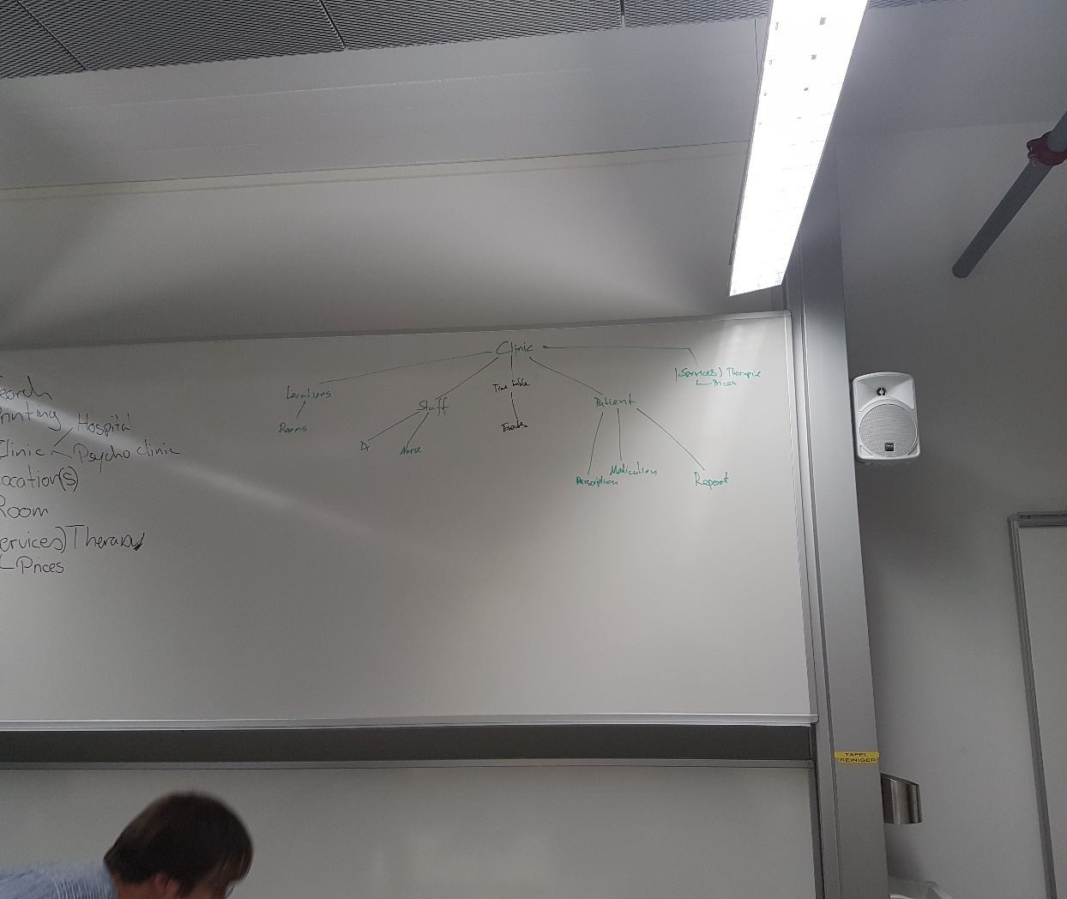
Approach
What entities do we need?
Brainstorming
Thoughts on associations

Slide 4
CRC Card: Doctor
Purpose: Holds sessions with patients, writes reports and can prescribe medication.
Responsibilities: Can manage and view sessions. Knows upcoming sessions. Can save reports and notes. Can prescribe medication. Knows his patients and can manage their records. Can have holydays / days off. Has a surrogate doctor. | Collaborators: Holds sessions with patients. Is employed by a clinic and works at different locations. Is assigned to a room. Can have a session.

Slide 5
CRC Card: Report
Purpose: Encapsulates attributes and functions of a report.
Responsiblities: Knows patient Knows MedicalRecord Knows the treating doctor Knows the author Knows Session -> Event in Timetable it corresponds to. Knows notes made during session. | Collaborators: Is linked to a session.

Slide 6
CRC Card: Medication
Purpose: To store all medication per patient.
Responsibilities: Knows patient Knows Prescription Knows prescription interval Medication can validate its self (dosage / interaction) Knows Price | Collaborators: Belongs to a patient

Slide 7
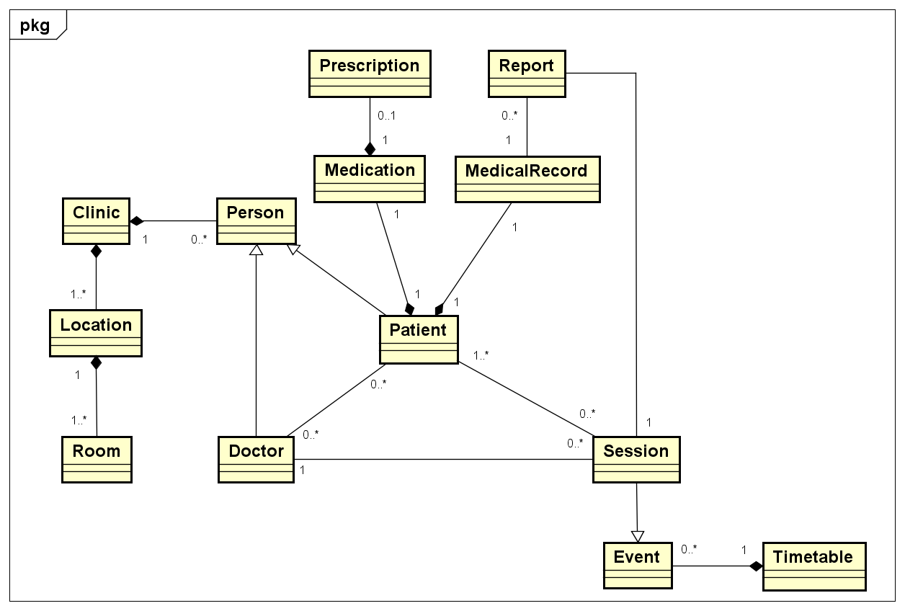
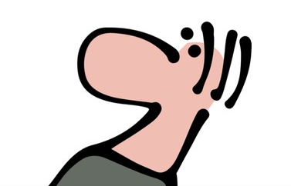
Domain Model

Slide 8
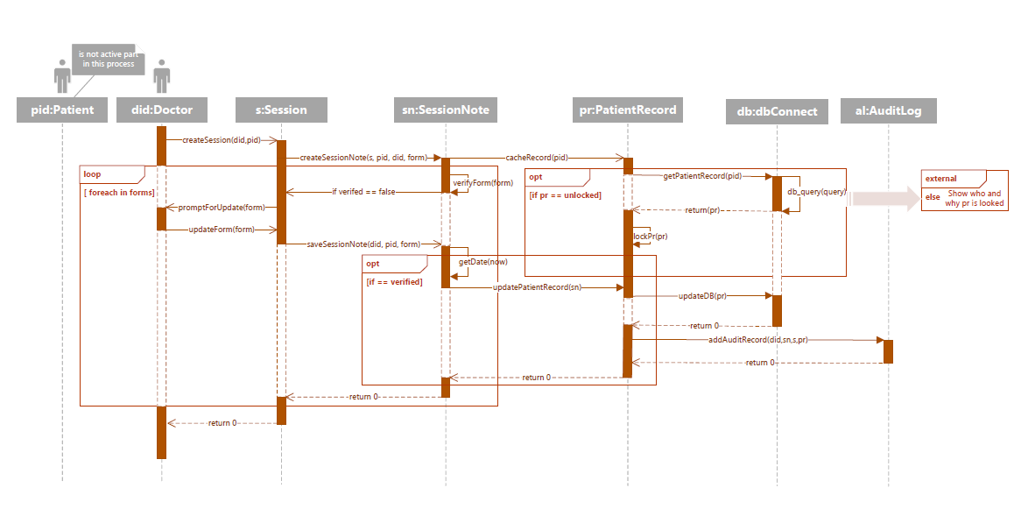
Sequence diagram

Slide 9
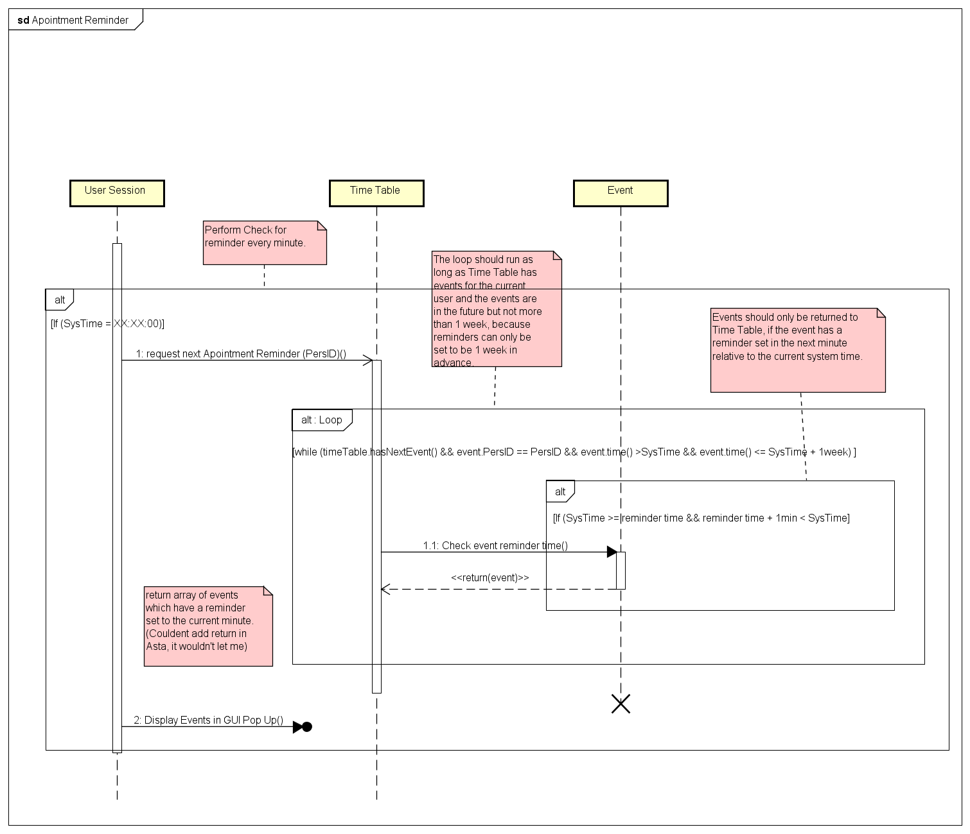
Sequence diagram

Slide 10
Verdict
CRC cards may be a good idea
Somewhat out of touch with reality
Feels like waterfall model

