Slide 1
Team RED
CS1:Task09

Slide 2
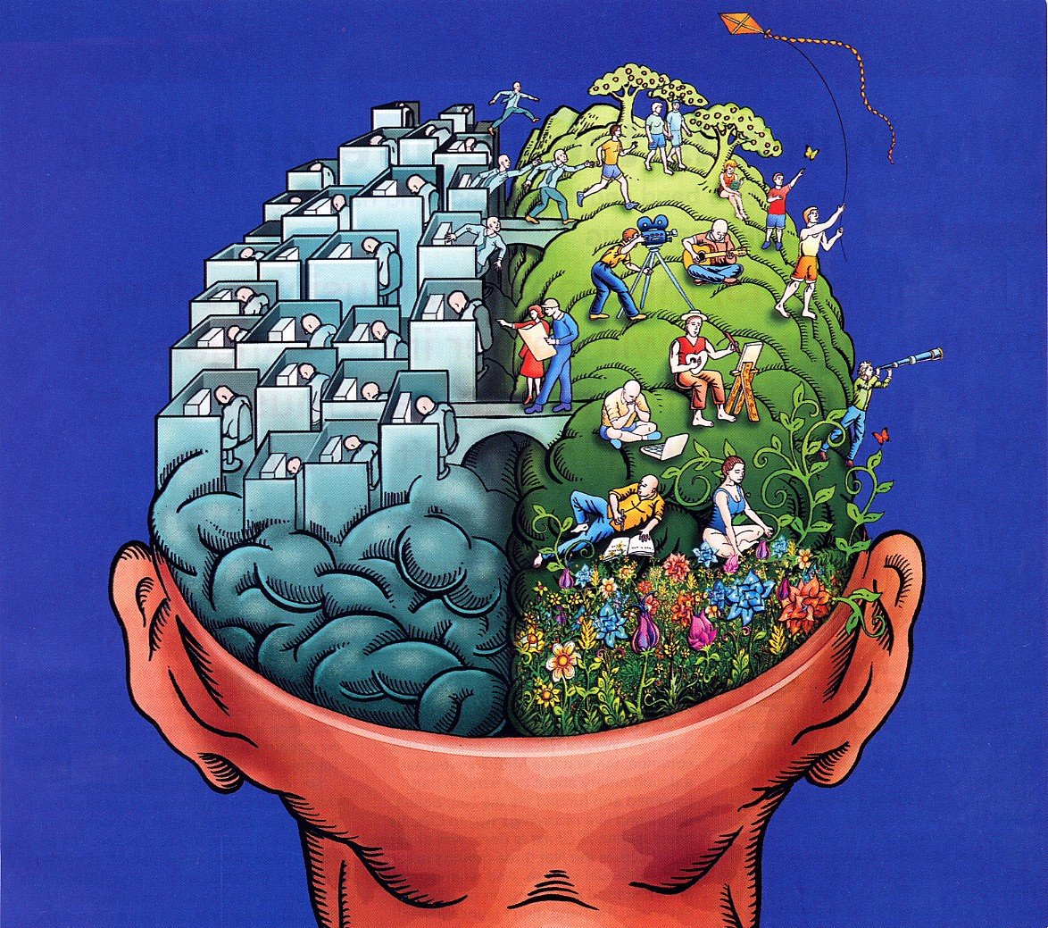
Split-brain

Slide 3
Specialisation vs. Generalisation

Slide 4
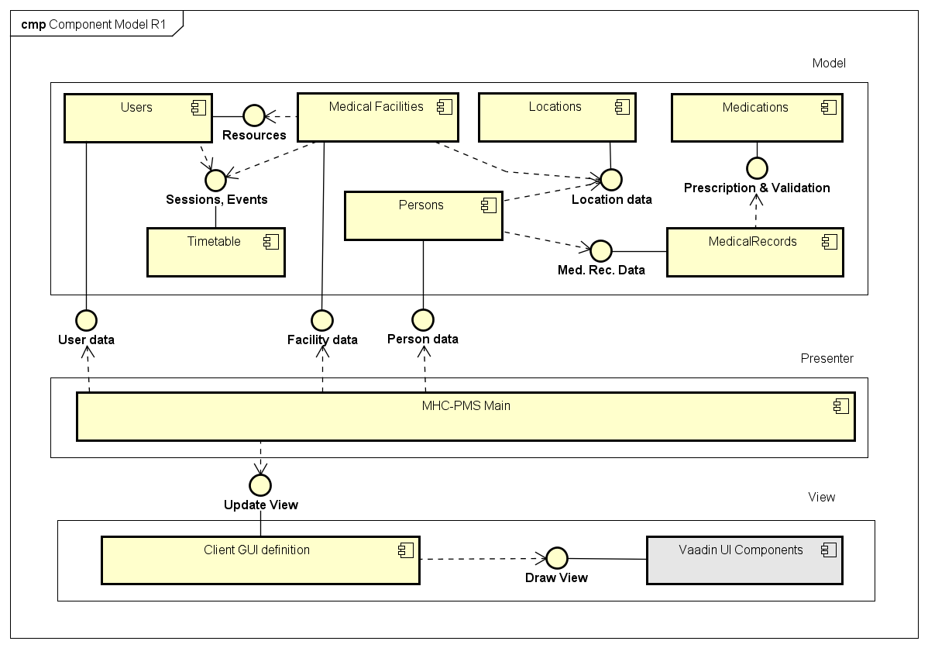

Slide 5
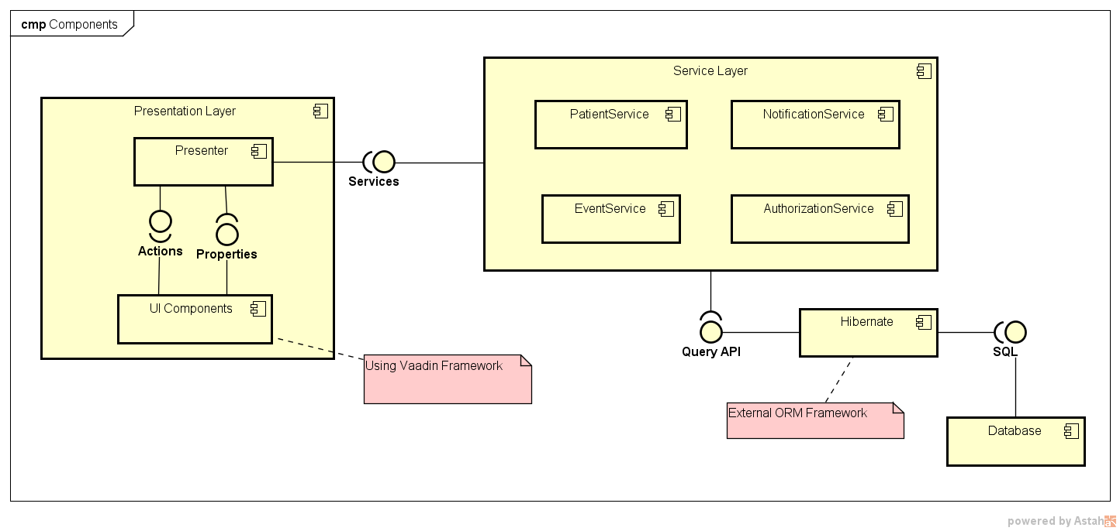

Slide 6
UML Class Diagram
https://github.com/AdrianAulbach/ch.bfh.bti7081.s2017.red/tree/master/doc/CS1/task09

Slide 7

?

