Slide 1

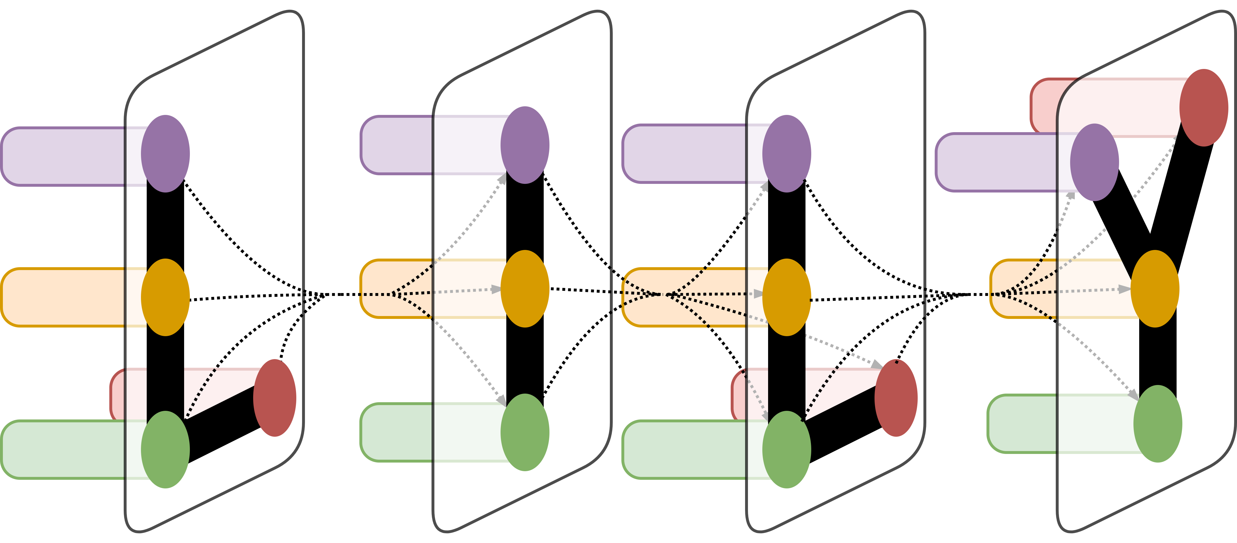
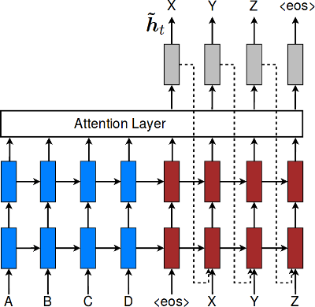
Domain Mixing for Chinese-English Neural Machine Translation
Christopher Leege
Department of Computer Science, Yale University
LILY Lab
Introduction
While there is a plethora of parallel corpora for languages that are similar, such as Indo-European languages, it is much harder to find corpora for language pairs that are more distance. My goal for this project was to translate Chinese fiction into English. While there are parallel corpora for Chinese-English, the majority focus on domains such as news and legal documents. I was unable to find any parallel corpora that dealt with modern Chinese fiction. As a result, I created my own corpus out of a popular Chinese web novel that has an official English translation. I then trained four neural network translation models and tested how they performed on both data sets.
Smaller | Casia2015 | Fiction
Casia2015 | 8.79 | 2.01
Fiction | 1.12 | 11.79
Mix | 9.44 | 13.67
Mix+Token | 9.37 | 13.01
Results
For the first four models, both the naïve mixture and the mixture with target token mixing performed better than the pure Casia and pure Ficiton datasets. The naïve mixture performed better than the mixture with target tokens on both Casia and Fiction test data.
The target token was correctly predicted 2317/2400 times on the Ficiton data set, and 1044/1050 times on the Casia dataset.
For the second four models, the pure Fiction dataset performed better than either of the mixed datasets on Fiction. The naïve mixture performed best on the Casia test data, and the pure Casia and the mixture with target tokens performed equally well on Casia test data.
Figure 2. BLEU Scores for the four models. Models on the y-axis, test data on the x-axis
Conclusion
Materials and Methods
It is unexpected that the naïve mixing of the Casia and Fiction data sets resulted in better BLEU scores than the mixing with target tokens. Two possible explanations are as follows. One, the Casia data set may be too mixed already. The Casia data set was pulled from various places around the web, and while there are no domain tags, it does seem that the number of domains covered are fairly broad. It is possible that the heterogeneity of the corpus had already led to a degradation of translation quality. If possible, I would redo the experiment with a more homogenous corpus as the base, then try naïve mixing and mixing with target tokens. A second possibility is simply that more data is required. It is possible that the naïve mixing improved scores in both categories because the model was still being refined, and having a larger amount of data was more important than having domain specific data.
I scraped the Chinese original and the official English translation of a Chinese web novel and manually aligned forty-five thousand sentences. For my other set of training data, I used the casia2015 corpus, a corpus of sentence pairs collected around the web. I used the nltk tokenizer and jieba, a Chinese tokenizer, to tokenize the Chinese and English corpora. I used OpenNMT to train four neural network translation models on the default encoder-decoder architecture. The first model was trained exclusively on the casia2015 corpus. The second model was trained exclusively on the fiction corpus I compiled. The third model was trained on a mix of the two corpora. The last model was trained on the same mix, but employed target token mixing from the paper Effective Domain Mixing for Neural Machine Translation (Denny Britz, Quoc Le, and Reid Pryzant. 2017). I performed the steps twice, training a total of eight models. For the first four models, I used a smaller portion of the casia2015 corpus. For the second four models, I used the full casia2015 corpus.
Larger | Casia2015 | Fiction
Casia2015 | 14.38 | 3.42
Fiction | 0.74 | 10.60
Mix | 14.43 | 10.50
Mix+Token | 14.38 | 10.03
Figure 1. OpenNMT encoder-decoder architecture
Figure 3. BLEU Scores for the second four models. Models on the y-axis, test data on the x-axis
Acknowledgement
Thank you Drago for your guidance this semester.
Effective Domain Mixing for Neural Machine Translation (Denny Britz, Quoc Le, and Reid Pryzant. 2017).

